Slide 1
Predicting weight gain based on body composition and metabolic rate

Slide 2
Objective
To identify predictors that can estimate the amount of weight gain after a fasting period of 16 hours

Slide 3
Hypothesis
Weight loss during fasting may be a predictor of weight gain after HFD.
Previous cohorts 5-6: there appeared to be a negative relationship
Current cohorts 7-8: there is a positive relationship

Slide 4
Experimental design
C57BL/6J mice
HFD #5 – Born 2013-04-03 (n=24)
HFD #6 – Born 2013-07-02 (n=24
HFD #7 – cohort id is 8 (n=24)
HFD #8 – cohort id is 15 (n=30)
10/17
10/21
10/22
08/11/2014
1/16/2015
NCD
FAST
HFD
11/26
12/01
12/02
09/22/2014
2/24/2015
NCD
FAST
HFD

Slide 5
Available Data
Cohort | Body Weight | Lean & Fat Mass | CLAMS | Hormones | Glucose
5 (n=24) | Yes | no | no | yes | yes
6 (n=24) | yes | no | no | Yes | yes
7 (n=24) | yes | yes | yes | Not yet | ?
8 (n=30) | yes | yes | yes | Not yet | ?

Slide 6
Changes
Removed the initial weight analysis.
Fixed the initial weights in cohort 5 & 6 to be the pre-fasting weights.
Updated the WL as the difference of after fasting from pre-fasting instead of from the initial weights.
Checked and removed mice with negative WL.

Slide 7
Body weight
Tukey’s post-hoc of pre-fasted weights
Tukey’s post-hoc of fasted weights

Slide 8
HFD weights
Tukey’s post-hoc of after HFD weights

Slide 9
Density plots for weights

Slide 10
Checking normality for WL and WG
Shapiro’s p-values for WL and WG are 0.6206632 and 0.0097316, respectively.

Slide 11
Relationship between WL and WG

Slide 13
The 95% CI for Kendall’s tau is (0.149, 0.375)

Slide 16
Body composition and Clams
Cohort 7 and 8

Slide 18
Changes
Removed after_fasting data for cohort 7
Removed mice that were for short-term dex
Removed RER outliers (>1 and < 0.7)
Added outlier.size=NA to not show the outlier dots in the box plots.
Fixed the average bugging

Slide 19
*
*

Slide 20
Notes
Cohort 8 doesn’t have CLAMS after fasting.
Pre-fasting
After-fasting
NCD
FAST
HFD
During fasting

Slide 26
Notes:
Check food intake
Take the difference VO2 between Pre-fasting and During fasting.

Slide 27
Short-term Dex mice
The 8 mice that don’t belong to this cohort are 1740, 1741, 1742, 1743 and 1770, 1771, 1772, 1773

Slide 28
FOOD INTAKE
Cohort 7 and 8

Slide 29
Mouse 2110 – no food data
Mouse 2101 – only record the first interval
Mouse 2102 – only record the first 3 intervals

Slide 30
Juvenile HFD
JuvHFD # 1 – Born 2014-04-21 (Mice #410-433)
JuvHFD # 2 – Born 2014-07-07
RNAseq – Born 2015-01-21

Slide 31
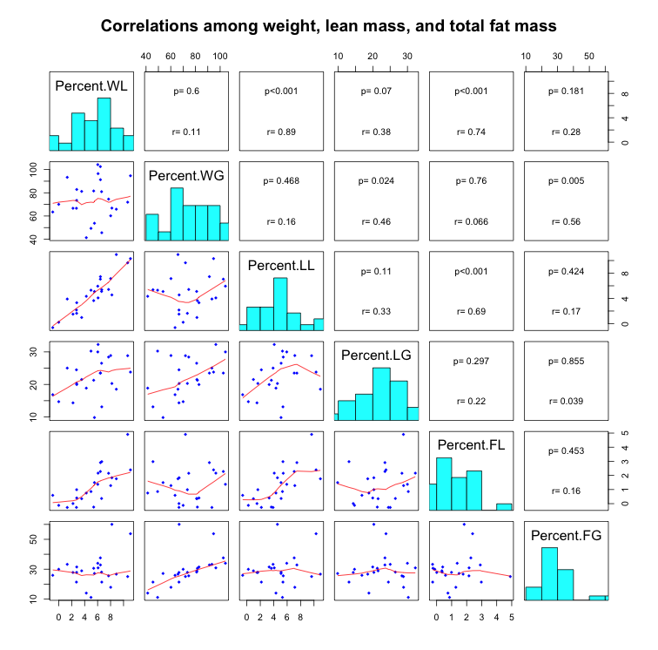

Slide 32
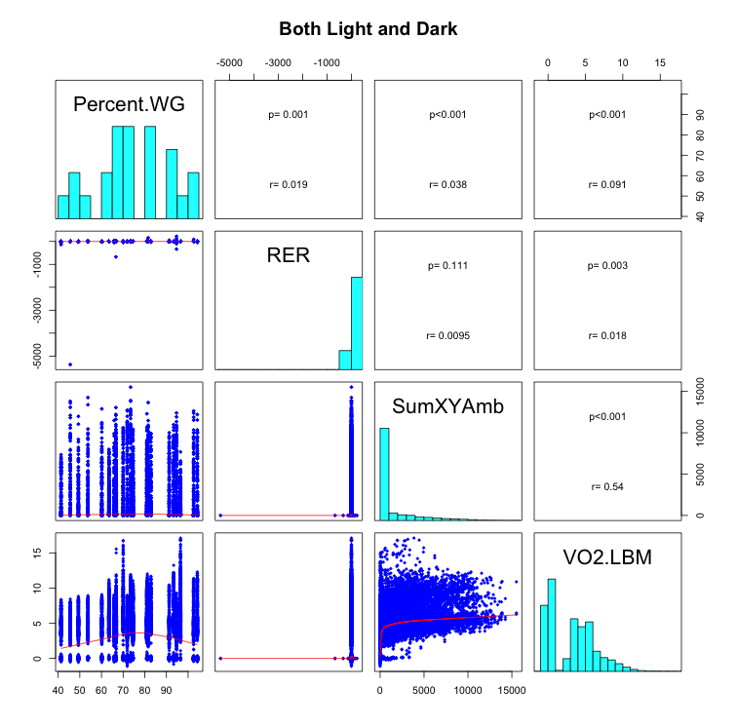

Slide 33
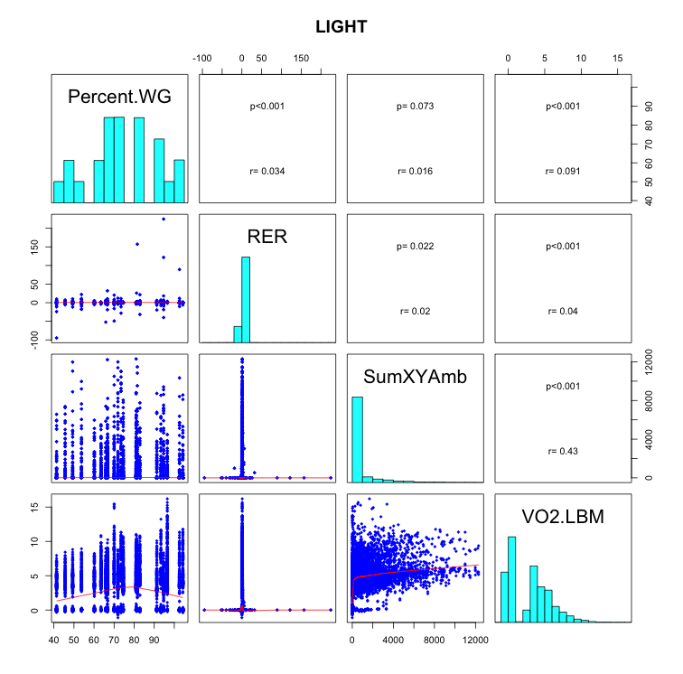

Slide 34
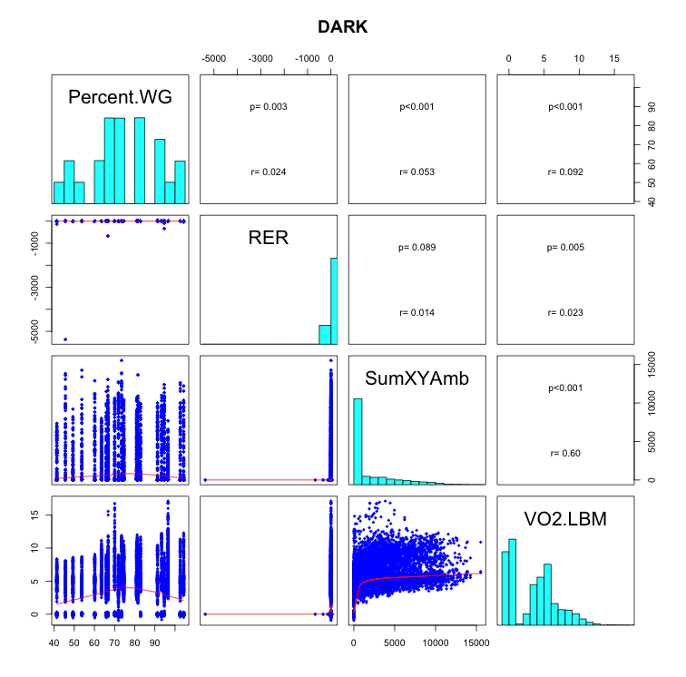

Slide 35
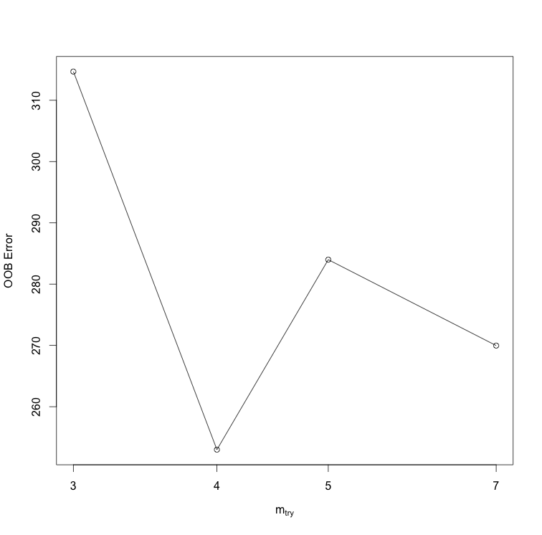
Optimal # of vars to split at each node

Slide 36
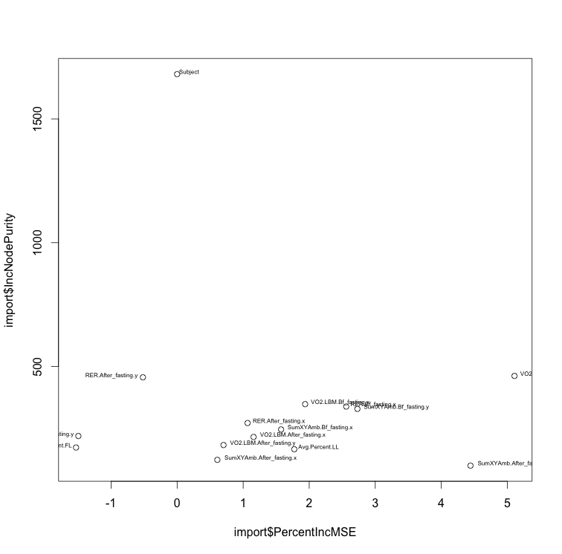
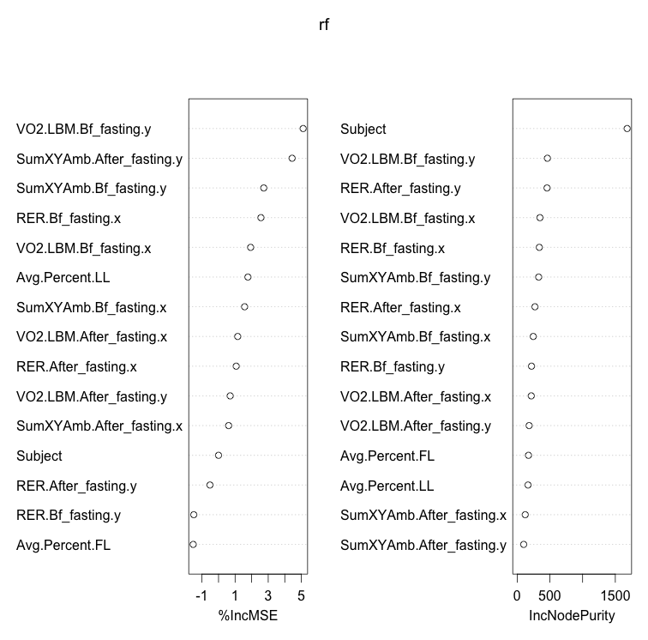

Slide 37
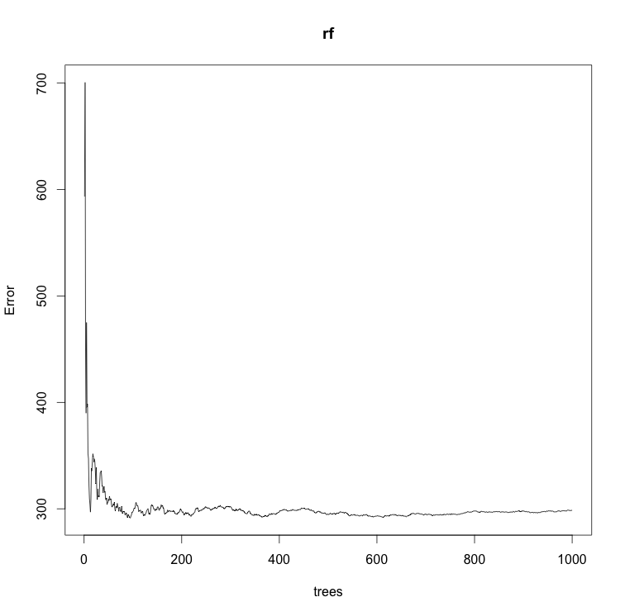

Slide 38
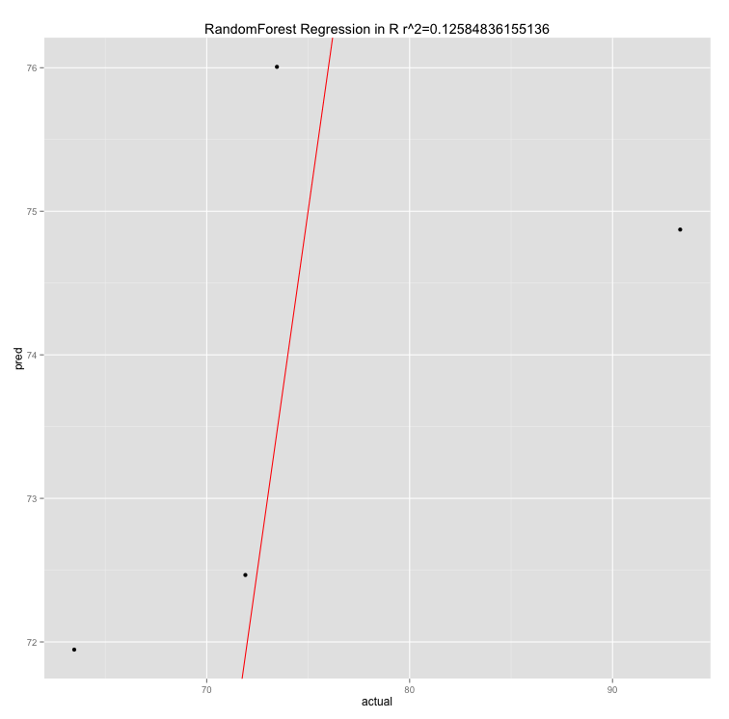

Slide 39
RE-EM tree

Slide 40
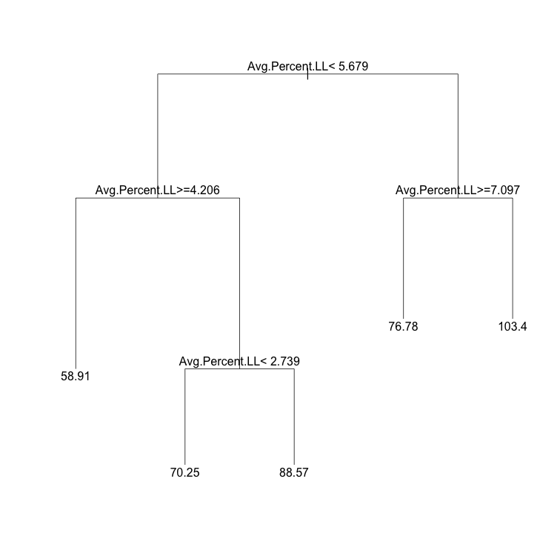

Slide 41
sub <- c(rep(TRUE, 96), rep(FALSE, 62))
weight.rf2 <- REEMtree(Percent.WG~ VO2.LBM + RER + SumXYAmb+
Avg.Percent.FL + Avg.Percent.LL + Light.Dark + Fast
, data=combine.data, random=~1|Subject, subset=sub)
R2 = 0.288
MSE = 190.12

Slide 42
