Slide 1
Predicting weight gain based on body composition and metabolic rate using random forest algorithm

Slide 2
Objective
To identify predictors that can estimate the amount of weight gain after a fasting period of 16 hours

Slide 3
Experimental design
C57BL/6J mice
HFD#8 – cohort id is 8 (training data set, n=24)
HFD#9 – cohort id is 15 (evaluation data set, n=30)
10/17/2014
1/16/2015
10/21/2014
10/22/2014
11/26/2014
2/24/2015
12/01/2014
12/02/2014

Slide 4
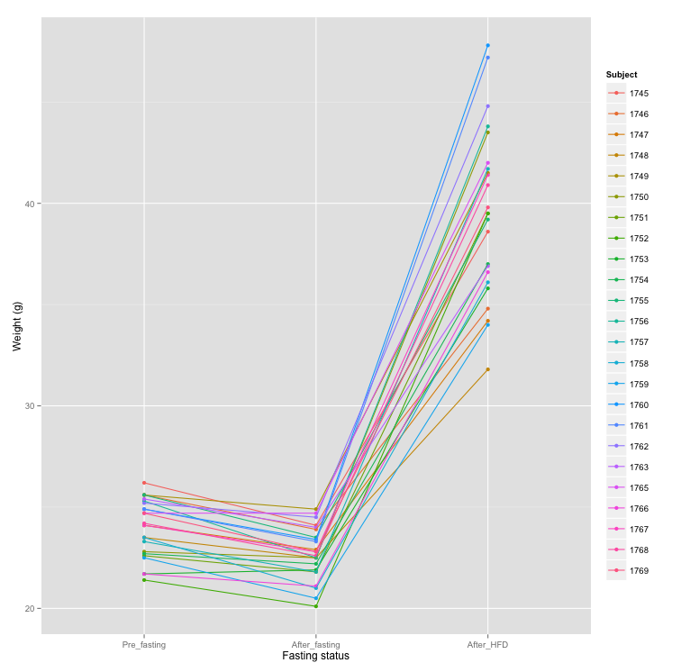

Slide 5
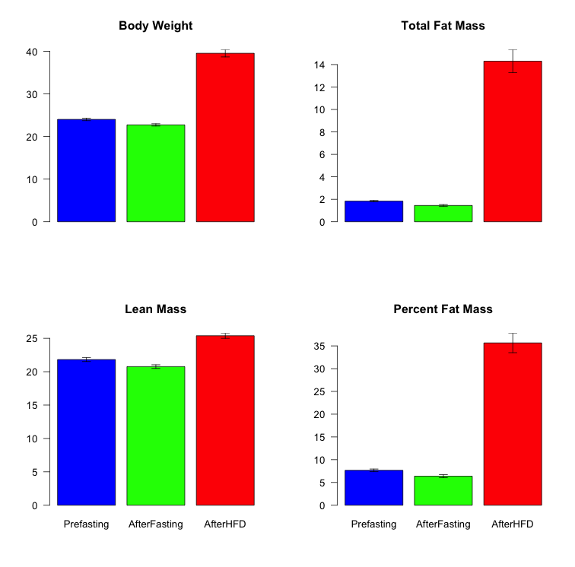
*

Slide 6
 | Pval | padj
Weight | 3.49E-19 | 1.40E-18
Fat | 5.80E-11 | 7.73E-11
Lean | 3.34E-10 | 3.34E-10
Percent.Fat | 3.78E-11 | 7.56E-11

Slide 7
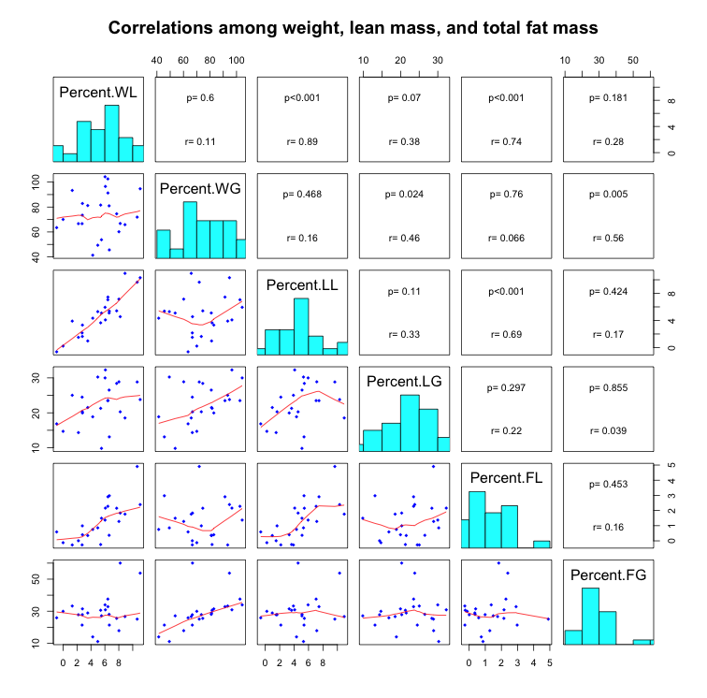

Slide 8
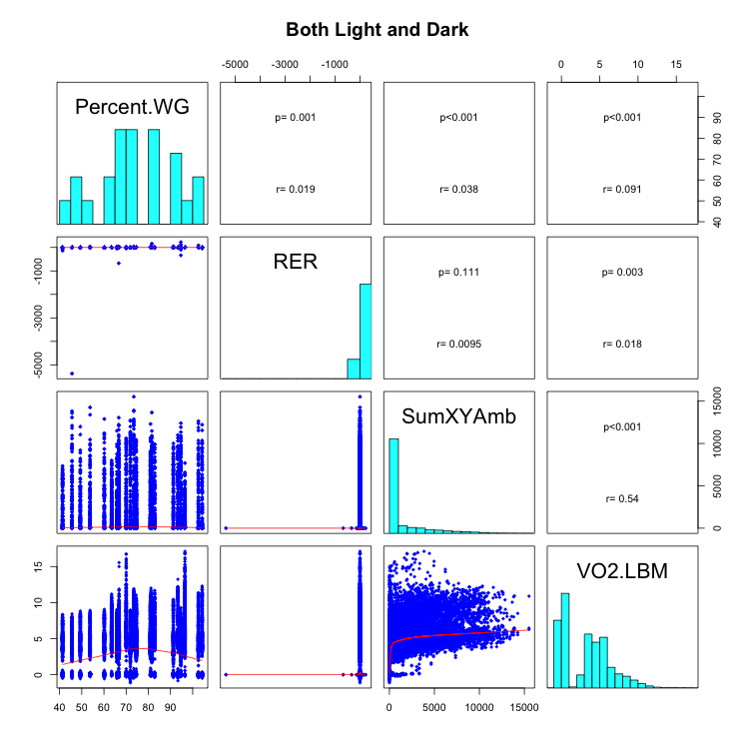

Slide 9
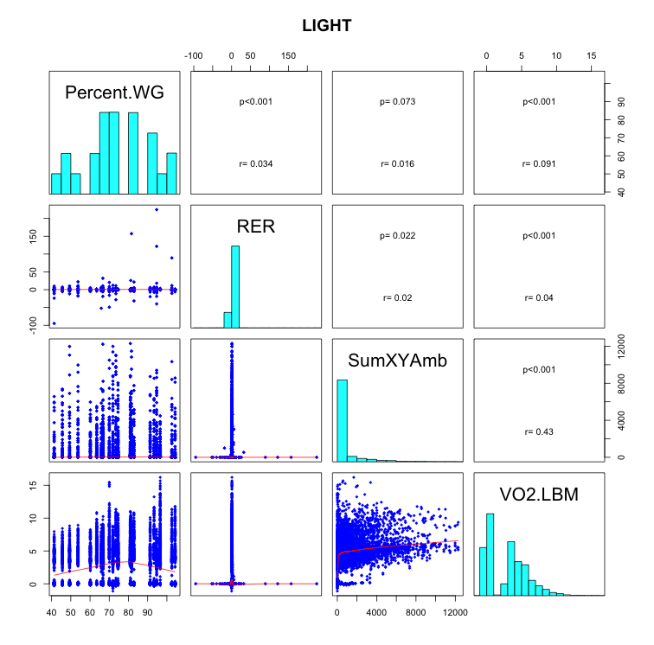

Slide 10
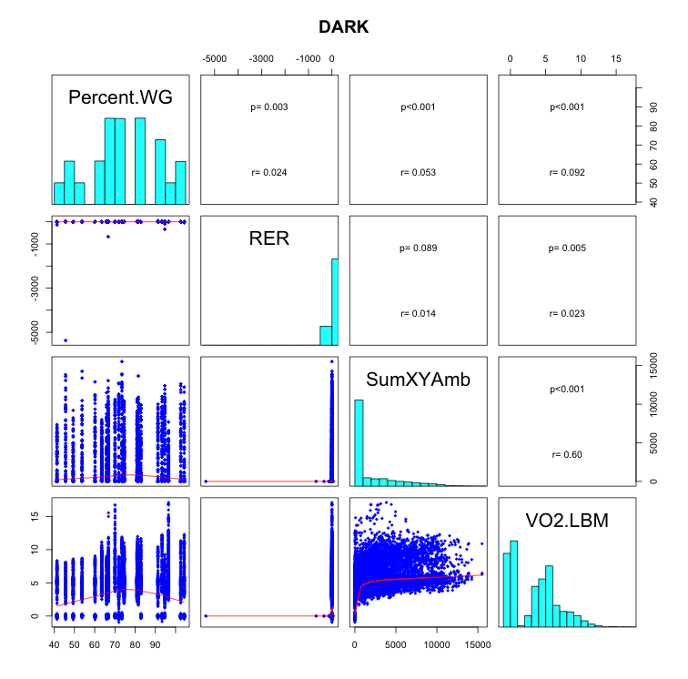

Slide 11
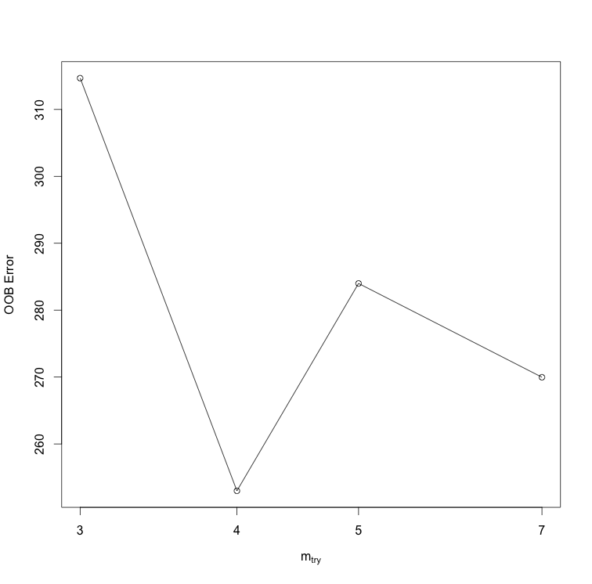
Optimal # of vars to split at each node

Slide 12
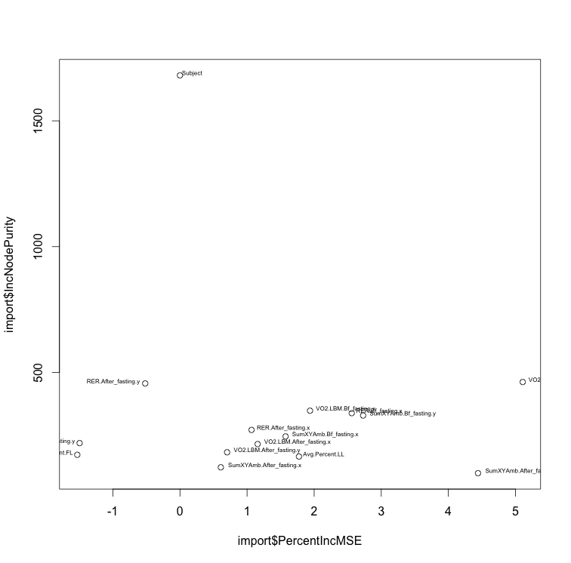
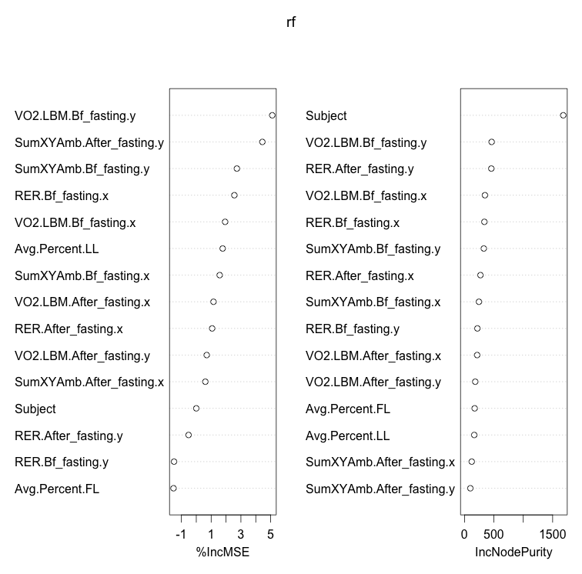

Slide 13
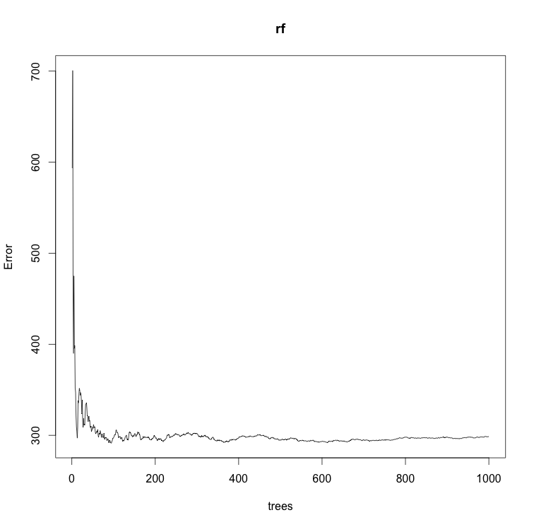

Slide 14
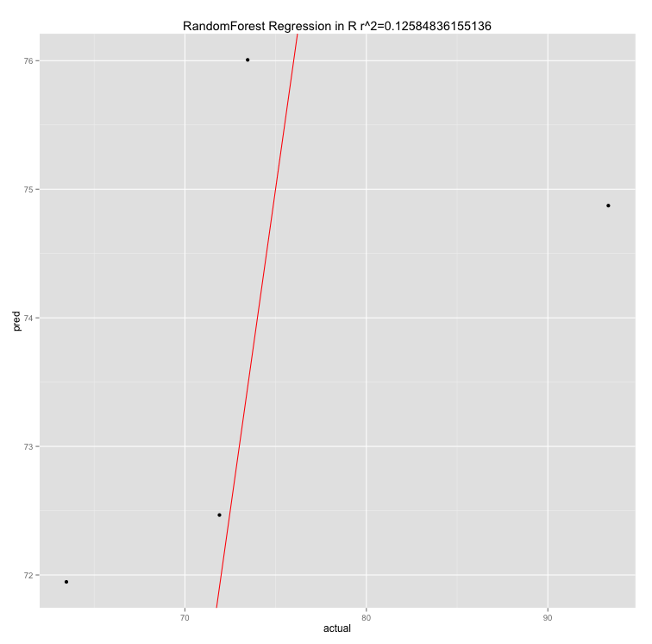

Slide 16
Linear Mixed-Effect Model

Slide 17
RE-EM tree

