Slide 1

Capstone 1
Presented by: Ivan Martinez
03/11/2022

Slide 2
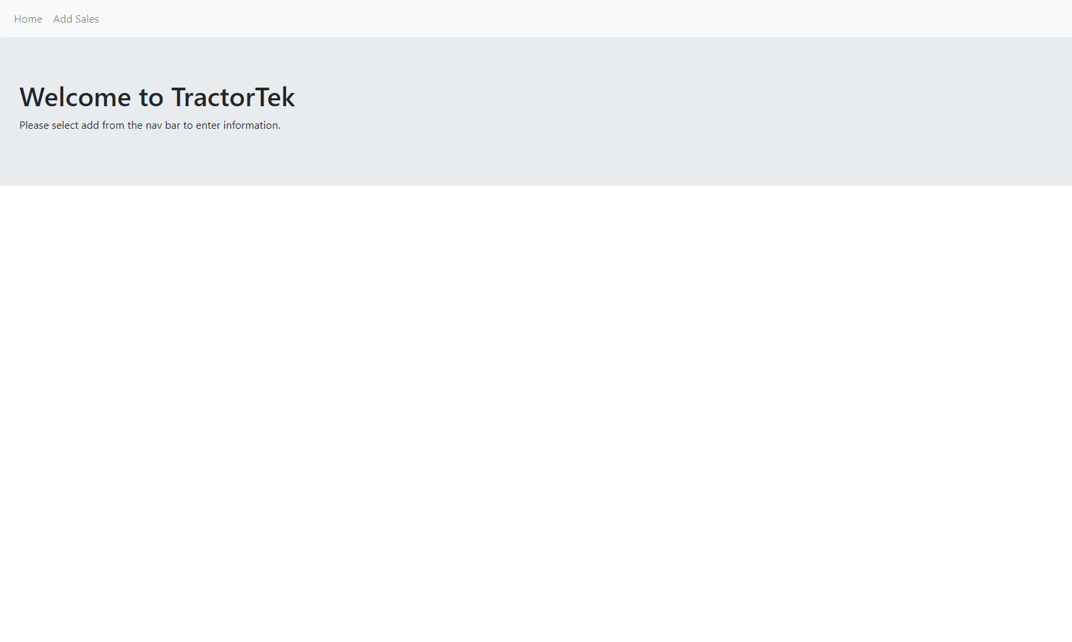
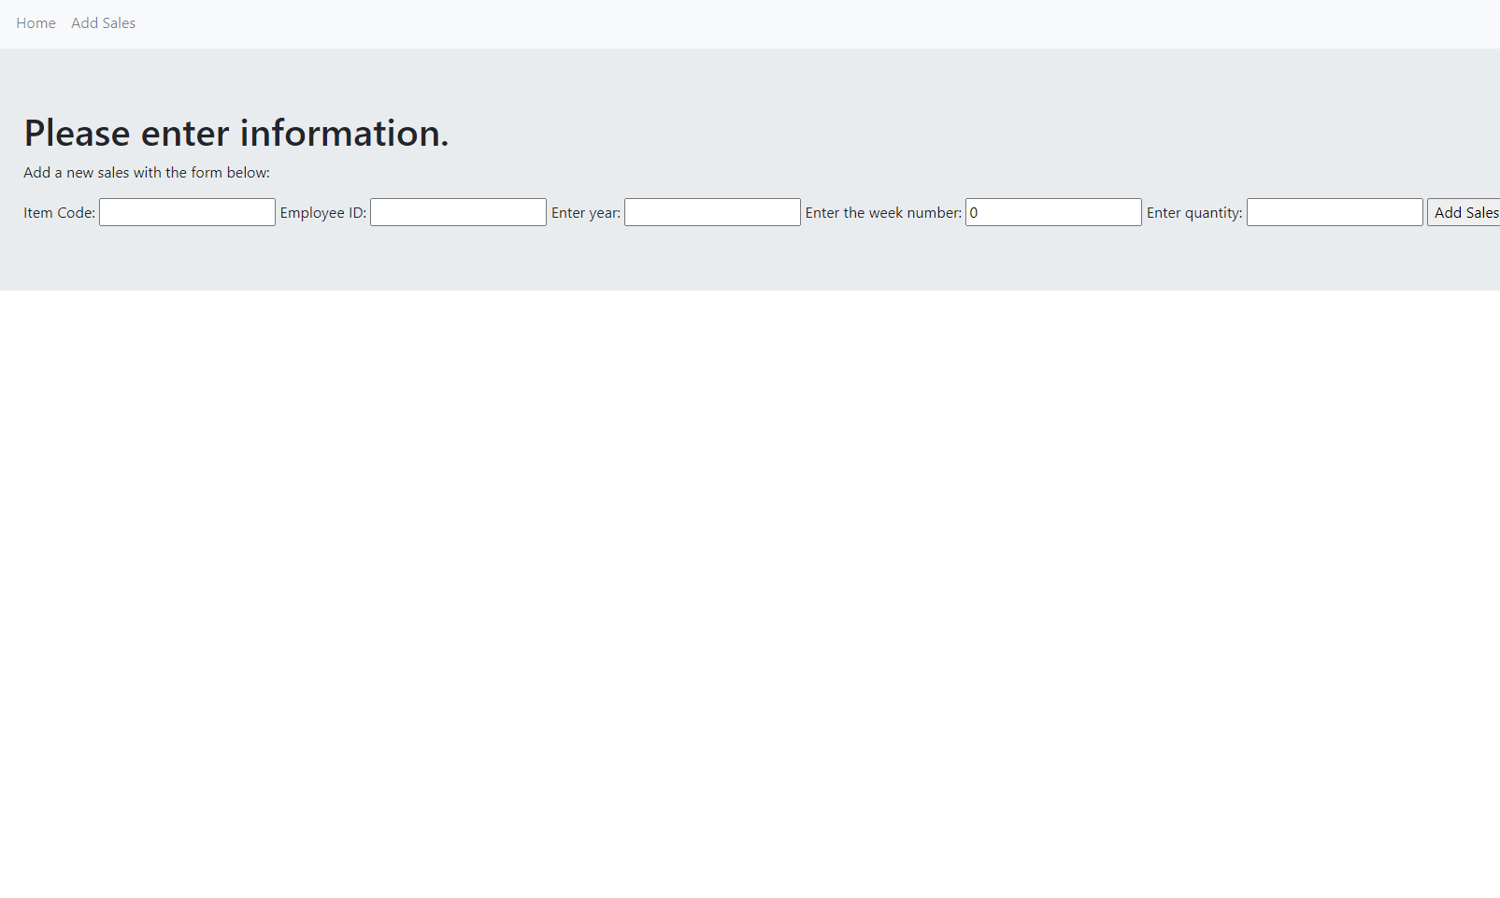
TractorTEK data entry app
Simple to use. Enter data in respective field to add into the database
New WebApp
Add page
Notes:
The idea behind this choice was to keep it simple. Be able to add into the database.
Describe how your ideal app given a longer time frame.

Slide 3
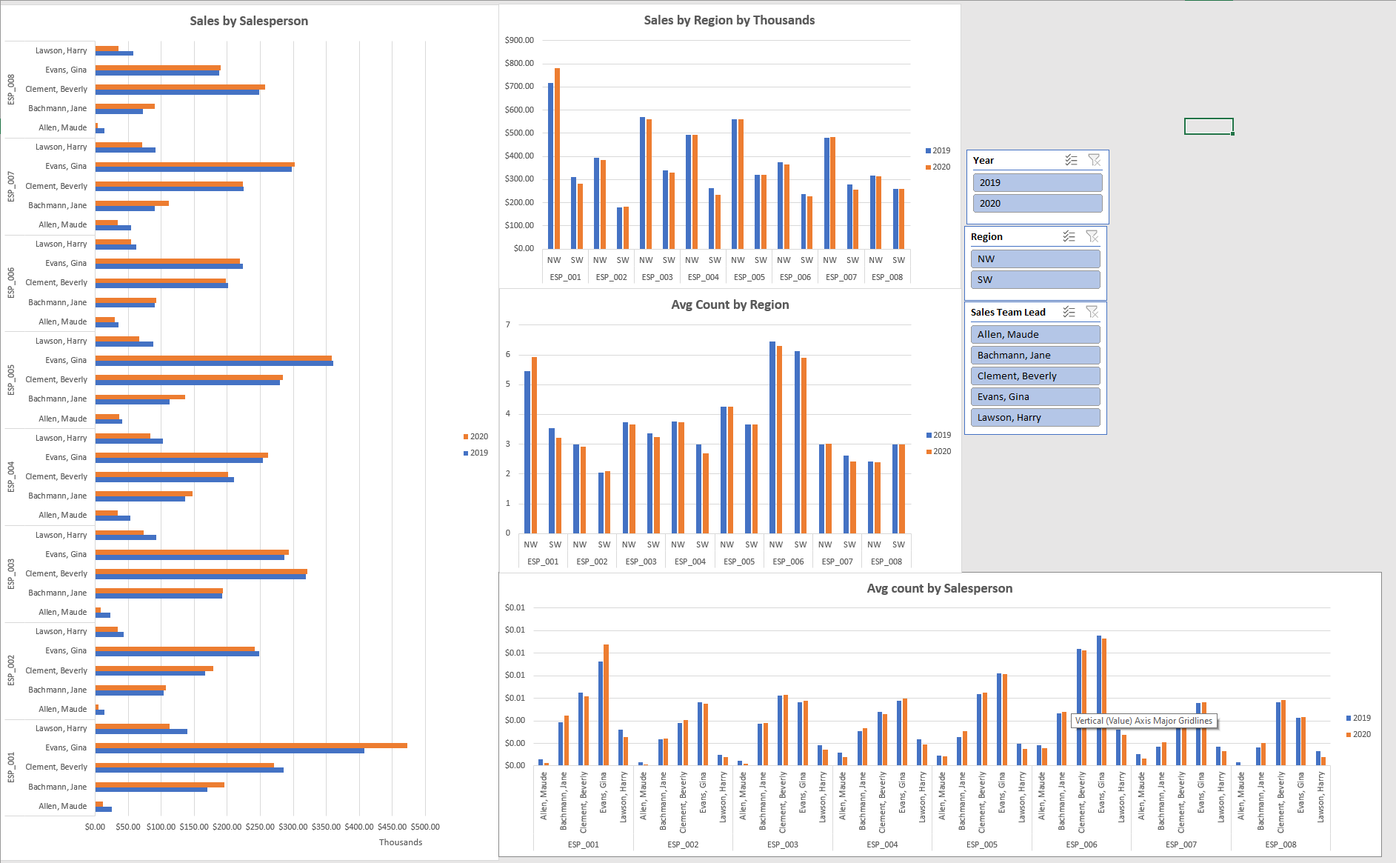
Excel Dashboard
Analytical findings
Dashboard shows Sum of Sales and the avg count of service plans sold.
This is group by Salesperson and by Region
Notes:
Specifically choose to just show only ESP data as it is the main point of sales.
Talk about the lowest performing person and highest.
Mention how SW is selling just as much as NW.
How its not connected to db via PQ due to time constraint and to have it be simple.

Slide 4
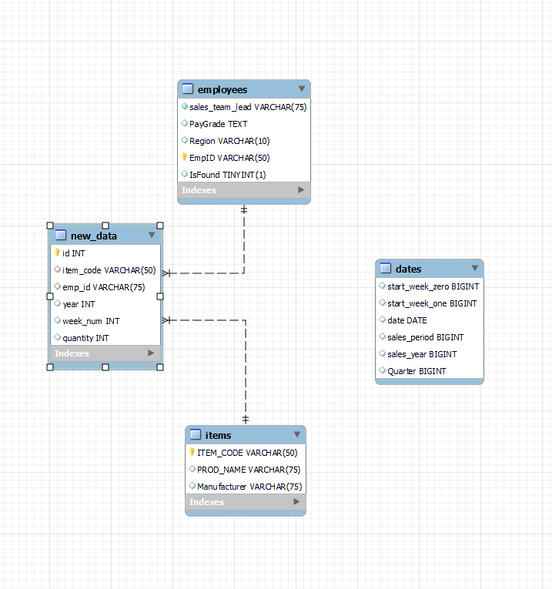
TractorTEK database
Attempted Star Schema
The fact table is ‘new_data’ with the rest of the tables being its dimensions.
The design process was to keep things simple as possible and have foreign keys do the work in the fact table.
Ideally all the tables should be connected.

Slide 5
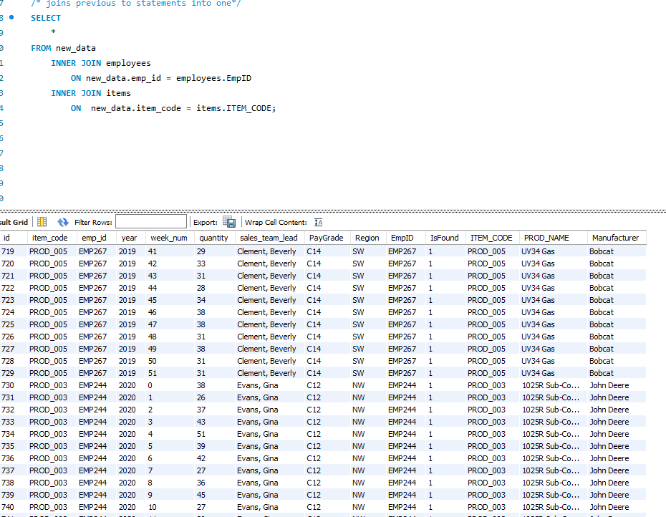
TractorTEK database
Aggregation
The query shows the joining of the employees table and items table with the new_data table.
This allows us to see the name of the emp_id associated with the sale and the product name and manufacuter

