Slide 1
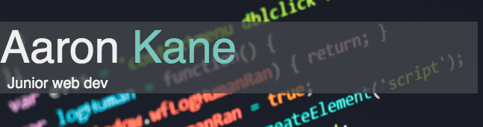
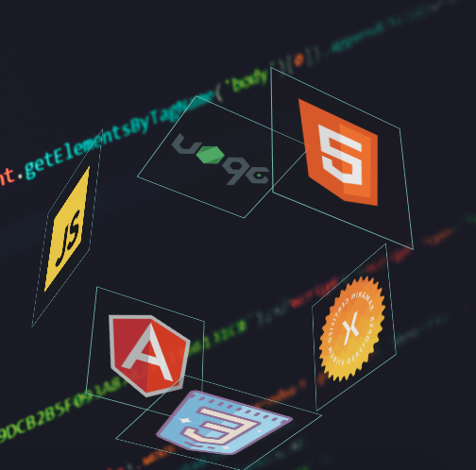

Slide 2
Purpose and scope
Online space for me to advertise myself as a developer
Portfolio site/ online resume
Test my skills on the frontend

Slide 3
Components
Makes use of
Grid layout most pages
Contact page uses flex
Color scheme dark theme with turquoise accents
Transform animations
Tab navbar navigation
Responsiveness for different screen resolutions

Slide 4
Design
Minimalist approach no clutter
Easy to navigate (one click/tap) – user can navigate to any page with one click excluding external links
Interactive design – user can interact with elements on the page

Slide 5
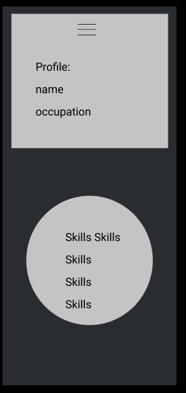
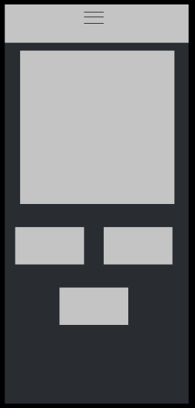
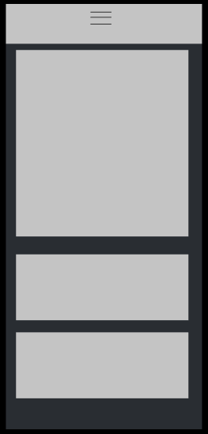
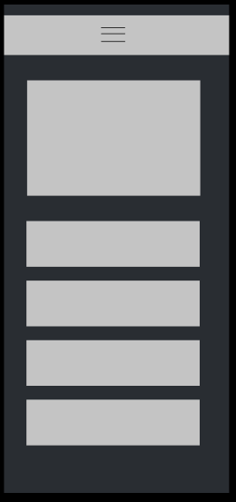
Contact
Portfolio
Homepage
About

Slide 6
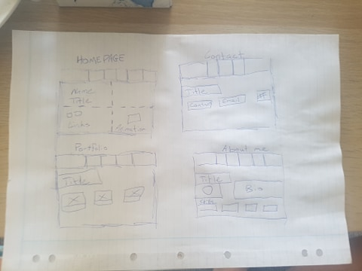

Slide 7
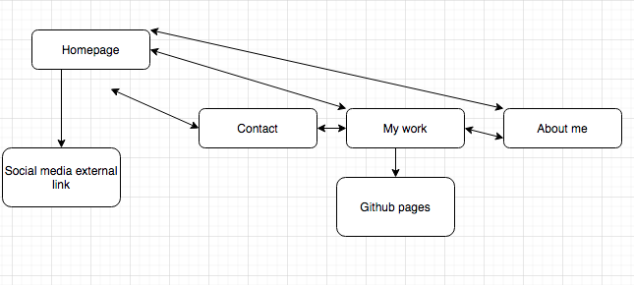
Sitemap

Slide 8
Challenges
Responsiveness
Navbar
Designer’s eye
Mobile first approach

