Slide 1

React Gaming
Purpose - To match gamers with games
To keep gamers informed on upcoming and new releases
Find games based on user activity to serve them information on games they may be interested in

Slide 2

Features and Functionality
The site is powered by Rawg’s api
React gaming requests Rawg’s data and return the data for the user to view
User’s can select games they own and the site will recommend games based on this information
User data such as username, email, password and interests
Calendar that will show the user upcoming games that may interest them

Slide 3





Target Audience
Tech Stack
Gamers of all ages and platforms
Customers looking for potential title recommendations

Slide 4
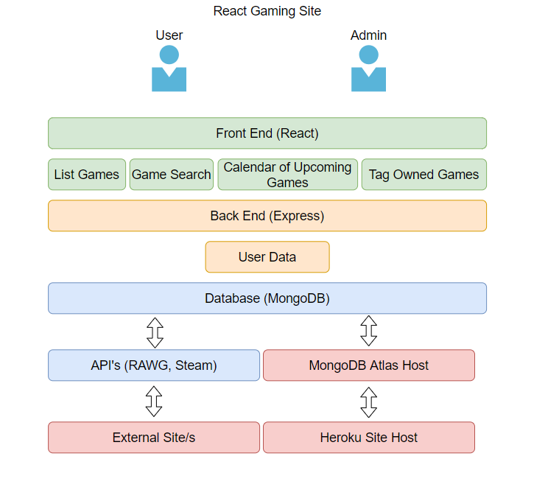
Application Architecture Diagram

Slide 5
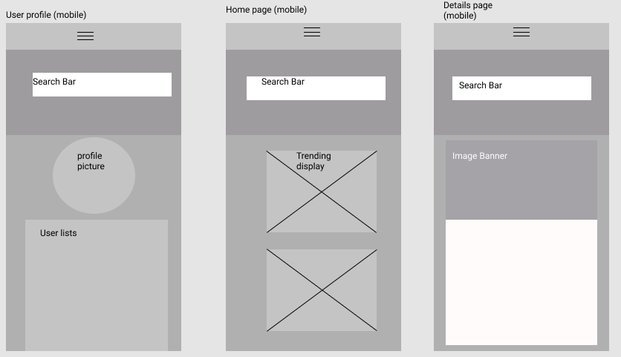

Slide 6
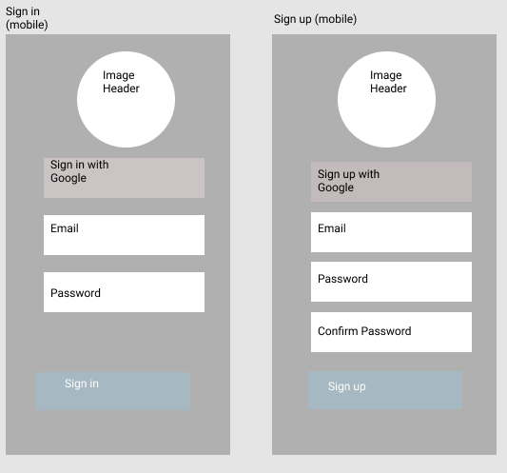

Slide 7
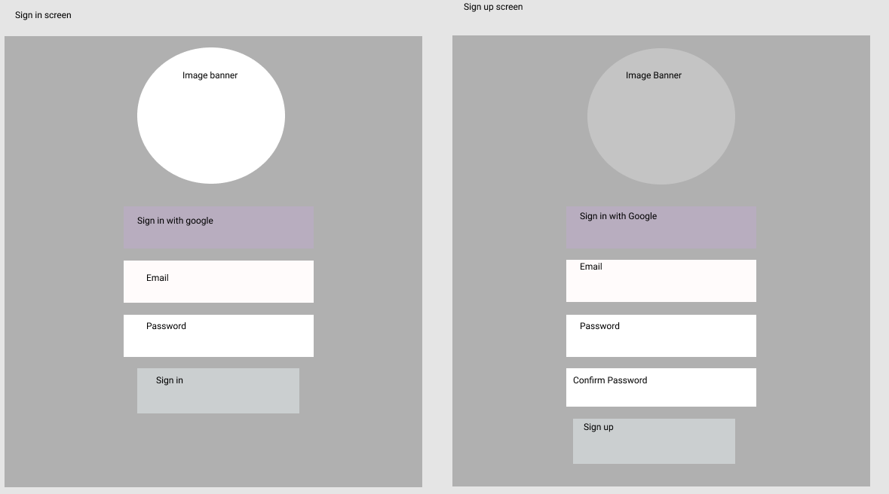

Slide 8
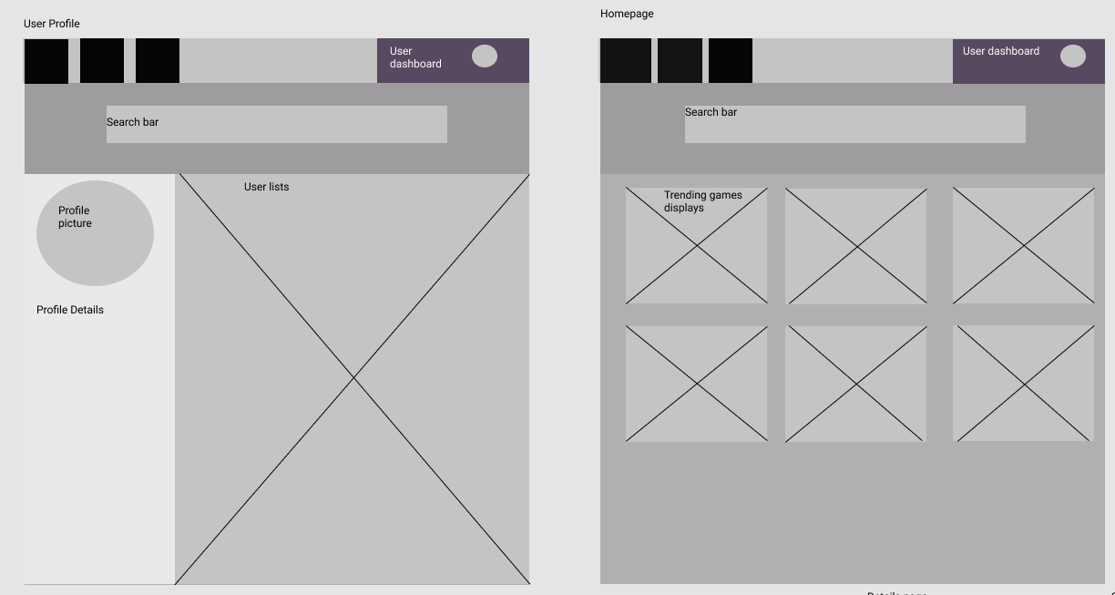

Slide 9
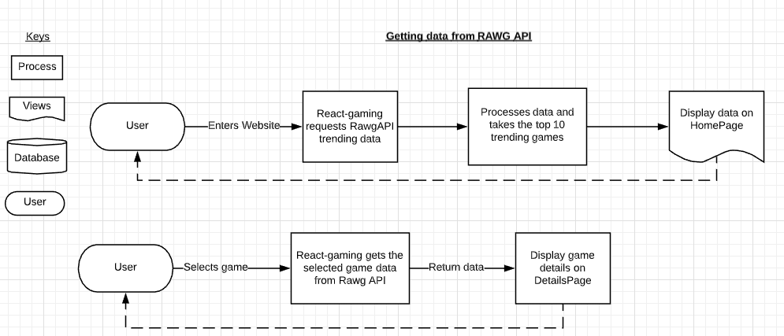
Data flow diagrams
Data Flow Diagram

Slide 10
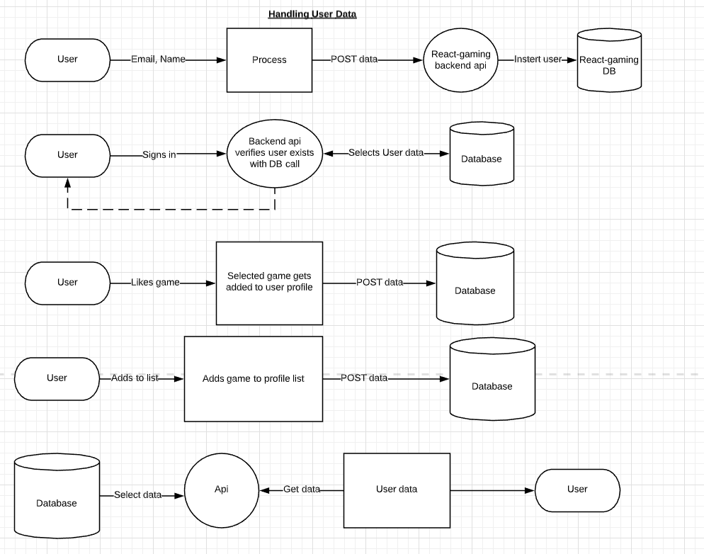

Slide 11
