Slide 1

Headcount Reconciliation
Product discovery case study
The problem: leaders can’t trust or explain planned vs filled headcount.
The bet: make that story clear, for Finance, and HR.
BambooHR interview case study
Notes:
Open on the problem. Prototype is the proof; this deck is why it matters.

Slide 2
BACKGROUND
What is Headcount Reconciliation?
Headcount reconciliation is comparing the hiring plan leadership approved to the people actually in roles, and explaining any difference.
Approved plan
Filled (actual)
The reconciliation
How many people the company said it would hire or keep, usually locked with the budget.
How many people are really in those roles as of a specific date (often month-end close).
The work of matching those views, naming gaps, and agreeing on one number Finance and HR can trust.
Why it matters: people are usually the largest operating cost, so this number drives hiring, budget, and board conversations.
BambooHR interview case study
2/16

Slide 3
THE PROBLEM
Headcount reconciliation is critical, but nobody can follow the story.
01
02
03
The number isn’t trusted
The gap isn’t explained
The date isn’t clear
Approved plan, working plan, and filled headcount live in different tabs, often only one Finance owner can rebuild the story. HR and Finance often have different numbers.
Marketing can be −2 headcount vs planned headcount with no named reason (not backfilling, role closed, or a pivot to another team).
Is this as of today or as of month-end close? Without a trusted as-of, every reconciliation rebuilds trust from scratch.
BambooHR interview case study
3/16
Notes:
Say this out loud: we are solving “make headcount recon understandable,” not “collect more HR data.” Rooted in a real Utah Head of Finance workflow and follow-up review.

Slide 4
WHO BENEFITS
With one system, everyone benefits
Finance
Benefit: A headcount number they can trust at close, and that isn’t locked in one person’s head.
HR
Benefit: Real alignment with Finance on every hire and departure, without spreadsheet ping-pong.
Managers
Benefit: Clear visibility into whether their hiring request is moving, without chasing people.
Leadership
Benefit: Confidence the people story holds up for the board, even if a key FP&A owner is out.
BambooHR interview case study
4/16
Notes:
Client why = time, trust, shared language. Tie every prototype feature back to one of these rows.

Slide 5
BUSINESS BENEFIT
A product Finance will fight for, not only HR.
Sell Finance easier
Expand beyond HRIS admin
Head of Finance: “If this product existed, you would sell the finance department much easier.” Direct GTM signal.
Headcount recon sits on BambooHR’s source-of-truth. Makes the HRIS the system Finance opens at close, not a spreadsheet export.
Differentiate
Retention & expansion
Companies like ADP who have large clients do not have this type of product even though it is a major time commitment and headache for current finance and HR leaders.
Once FP&A depends on BambooHR for the monthly story, switching costs rise and seats expand into finance buyers.
BambooHR interview case study
5/16
Notes:
BambooHR why = GTM into Finance + stickiness of the close ritual. Quote is primary research — treat as directional, not a win-rate claim.

Slide 6
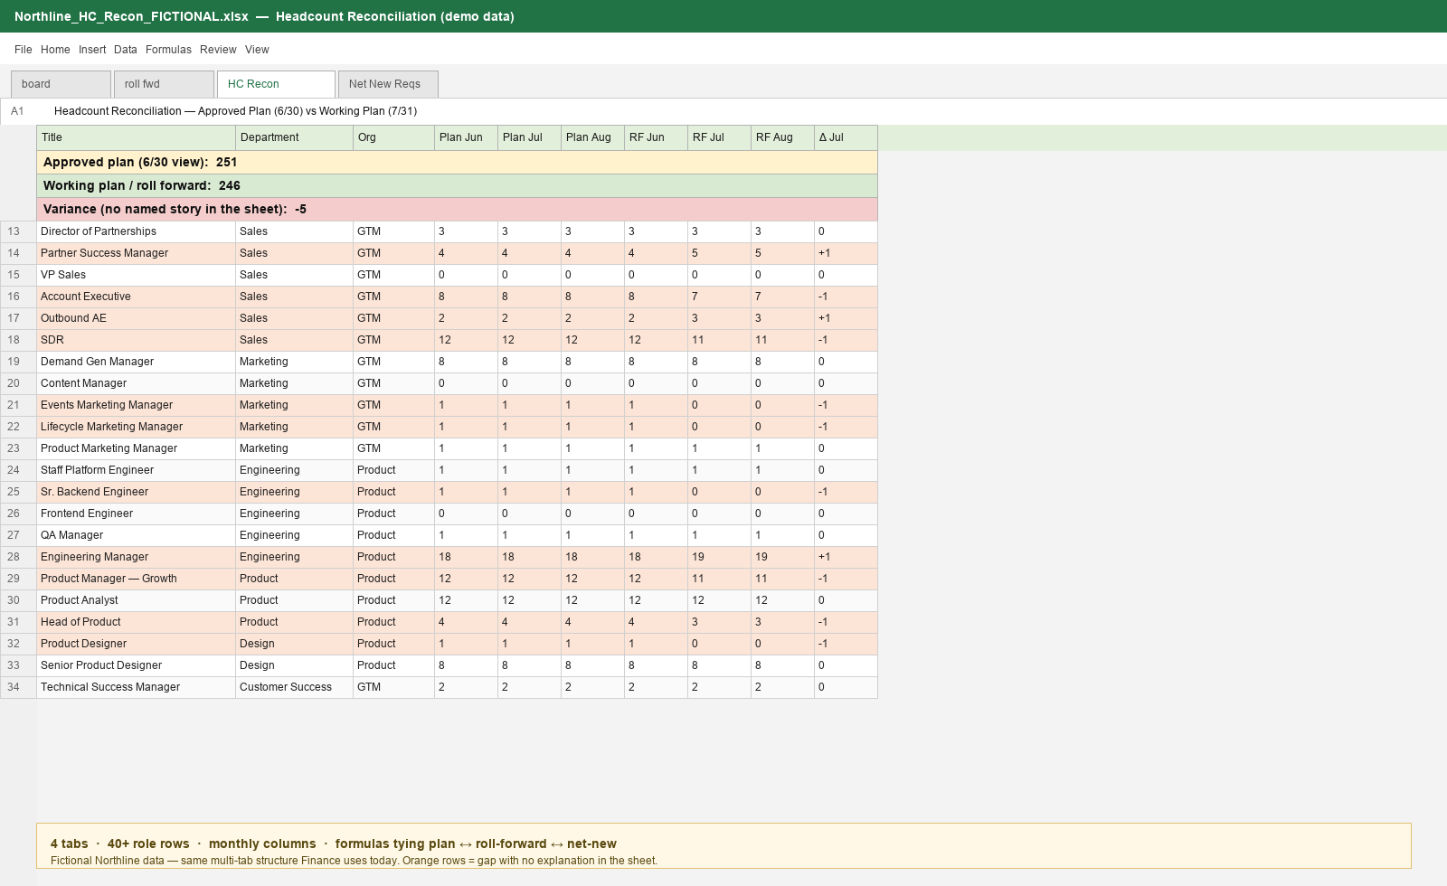
WHAT IT LOOKS LIKE TODAY
Spreadsheet that only the FP&A leader can follow
Fictional Northline data: This is a real spreadsheet from a Head of Finance but with numbers and roles changed to protect confidentiality
BambooHR interview case study
6/16
Notes:
Emphasize: proprietary contact data was scrubbed. Structure is the point — 4 tabs, dense role rows, monthly columns, formulas. This is why “presentation tools are complicated and nobody understands them.”

Slide 7
HYPOTHESES
Five initial hypotheses
H1
Cognitive load
Leaders can’t follow the reconciliation without a specialist walking them through the tabs.
H2
Definition debt
Finance and HR are on the same terms when they say backfill, not backfilling, or pivot.
H3
No decision object
Mid-cycle changes disappear into one person’s spreadsheet or disappear completely.
H4
Time blindness
Nobody knows whether the number is as of close, or as of today.
H5
Wrong default visualization
The gap is not readable in one pass; it’s buried in a grid for authors.
BambooHR interview case study
9/16
Notes:
AI helped generate; human kept five and mapped each to a UI test.

Slide 8
EVIDENCE – REASONS TO BELIEVE
Interview with Head of Finance at 300 employee company
“Reconciliation is critical, but the presentation tools are complicated, and nobody understands them”
— Head of Finance
“The problem is I’m the only one that reconciliation relies on. If I got hit by a bus, we’d be doomed”
— Head of Finance · Key-person / business-factor risk
“If this product existed, you would sell the finance department much easier”
— Head of Finance · Direct GTM signal for BambooHR
BambooHR interview case study
7/16
Notes:
Lead with the bus-factor quote after the comprehension quote. Problem is not only time — institutional knowledge concentrated in one FP&A owner. Product value = shared story so the company is not doomed if that person is out.

Slide 9
EVIDENCE – REASONS TO BELIEVE
Market Research: HR and Finance still don’t share one headcount system
72%
14 → 8 days
25%
of HR & Finance teams lack shared systems for workforce planning
Without a connected system between HR and Finance headcount reconciliation takes 14 days. With a connected system it takes 8. This is without a product that actively monitors reconciliation
average discrepancy between HR and Finance headcount reports
Gartner, cited via Kinnect
IJIRMPS healthcare case study, 2025
PwC (2022), cited in IJIRMPS 2025
BambooHR interview case study
8/16
Notes:
Prefer cohesion + recon-time stats. Cite carefully: Gartner via Kinnect; IJIRMPS for 14→8 days and 45% recon-time cut; PwC 25% discrepancy. Also available: Workday customer claim 60% less manual recon / 50% faster close — use only if you want vendor-sourced color.

Slide 10
Product Process
Cross-Functional Collaboration is a must
Some of the teams we need to collaborate with
Product
Finance (customer + internal FP&A)
HR / People ops
I own the problem statement and the cuts. I keep a visible decision log so Engineering and Design never guess what “done” means.
I sit in their close ritual. I learn their words, approved plan, working plan, filled, and pressure-test every screen against a real recon week.
I co-design dispositions inside HR’s flow, not as a Finance bolt-on. If they won’t tag a Tuesday attrition, the product failed.
Design
Engineering
Implementation / CS
I pair early on the 30-second test: can a first-time user explain the gap? If not, we redesign before we add features.
I negotiate automation vs manual update with them. We agree source of truth, audit, and what’s intentionally human, before we write tickets.
I pull them in before GA. Spreadsheet migration, glossary, and pilot success criteria are product work, not a surprise for support.
BambooHR interview case study
10/16
Notes:
Speak as a PM operating model: sit with Finance, co-design with HR, pair with Design on comprehension, negotiate with Eng on automation boundaries, and bring Implementation in before GA.

Slide 11
INTERVIEWS
What we have, where I would continue
In hand
Next five interviews (more to follow)
Head of Finance conversation (exact quotes)
Live multi-tab workbook: approved plan / roll-forward / HC recon / net-new
Follow-up: name what’s behind the gap, clear as-of, not backfilling + pivots, drop contractors, tell the story, manual mid-cycle edits
FP&A lead — close ritual & recon hours
HR ops — disposition SLA & ticket path
Hiring manager — request status need
Controller / CFO — board report bar
Implementation lead — spreadsheet migration pain
BambooHR interview case study
11/16
Notes:
Honesty: one deep signal + artifact now; structured interviews before scale.

Slide 12
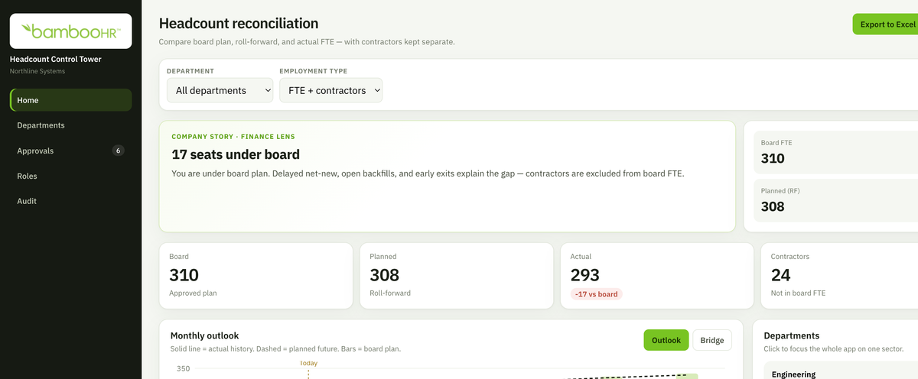
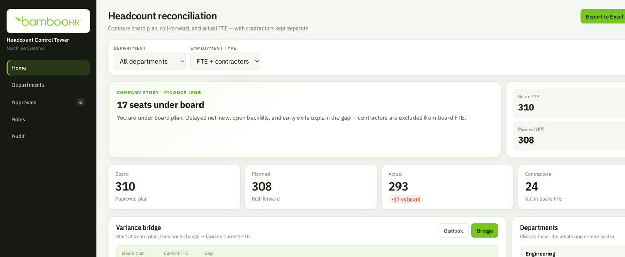
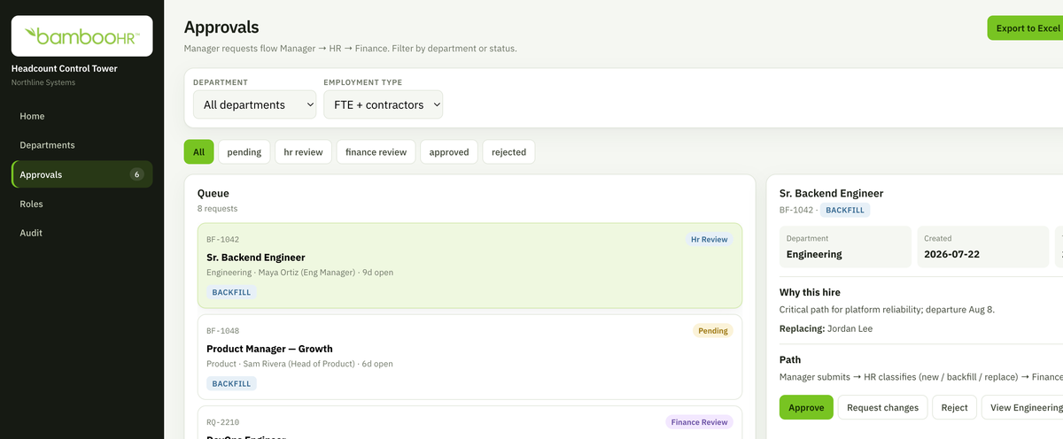
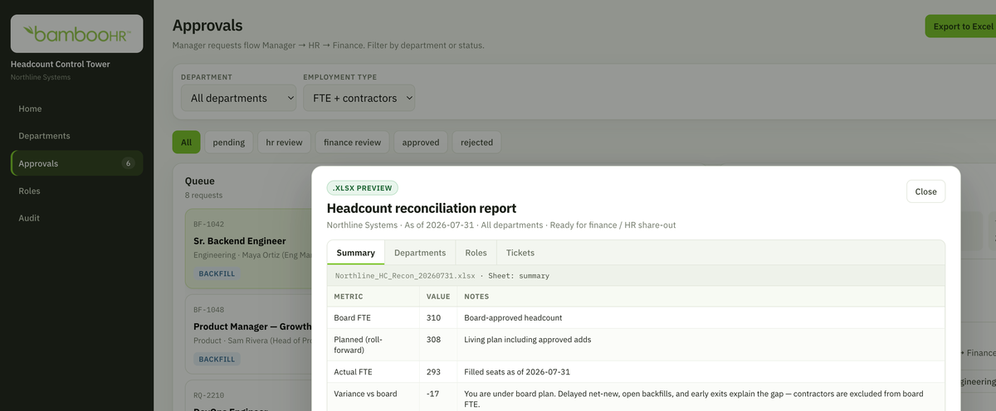
ITERATIONS
Build, Iterate, Launch
Story first · Approved plan · filled · named gap
Bridge · Backfill · not backfilling · pivot
Manual update · Mid-cycle edits systems miss
Export · Close-ready share-out
BambooHR interview case study
12/16
Notes:
Partner feedback drove cuts: contractors out; named Marketing −2; pivots; July close vs viewing date; manual update.

Slide 13
THE PROTOTYPE
What we built — and why
Each feature maps to a clear benefit for Finance and HR.
Company story first
Clear as-of dates
Benefit: Anyone can see plan vs filled, and what’s behind the gap, in seconds.
Benefit: No confusion between “today” and month-end close.
Variance bridge
Dispositions (backfill / not backfilling / pivot)
Benefit: The −2 is explained in plain steps, not buried in a grid.
Benefit: Finance and HR share one language for what happened to a role.
Manual update
Approvals + export preview
Benefit: Mid-cycle changes systems miss can still be logged and trusted.
Benefit: Requests and the close package live in the same story — not a separate maze.
BambooHR interview case study
13/16

Slide 14
SUCCESS METRICS
Measure understanding. Did this work?
Time to understand Headcount @ close date
Month-end reconciliation time
Disposition logged on attrition
< 30 seconds
Hours → minutes
% of exits tagged
Comprehension
Speed + resilience
HR–Finance cohesion
Unexplained dept gaps at close
Variance follow-ups / close
Weekly active Finance + HR
→ 0
Fewer threads
Both personas
Named drivers
Trust
Real use
BambooHR interview case study
14/16
Notes:
North star: time to understand headcount at a given close date.

Slide 15
ILLUSTRATIVE IMPACT
Potential Impact
Modeled for a ~ 300 Employee company
Redundancy in place
< 30 min
~40–60%
More than one person can explain the gap, so reconciliation isn’t a single point of failure
Target time to a trusted view. Saving time and headache for all departments involve
Reconciliation-time reductions seen in HRIS–FP&A integration cases
Answers the “hit by a bus” risk from Finance
North-star product goal
IJIRMPS / industry pattern — validate in pilot
BambooHR interview case study
15/16
Notes:
Stay humble on ROI. Point back to market recon-time evidence + partner’s lived spreadsheet pain.

Slide 16
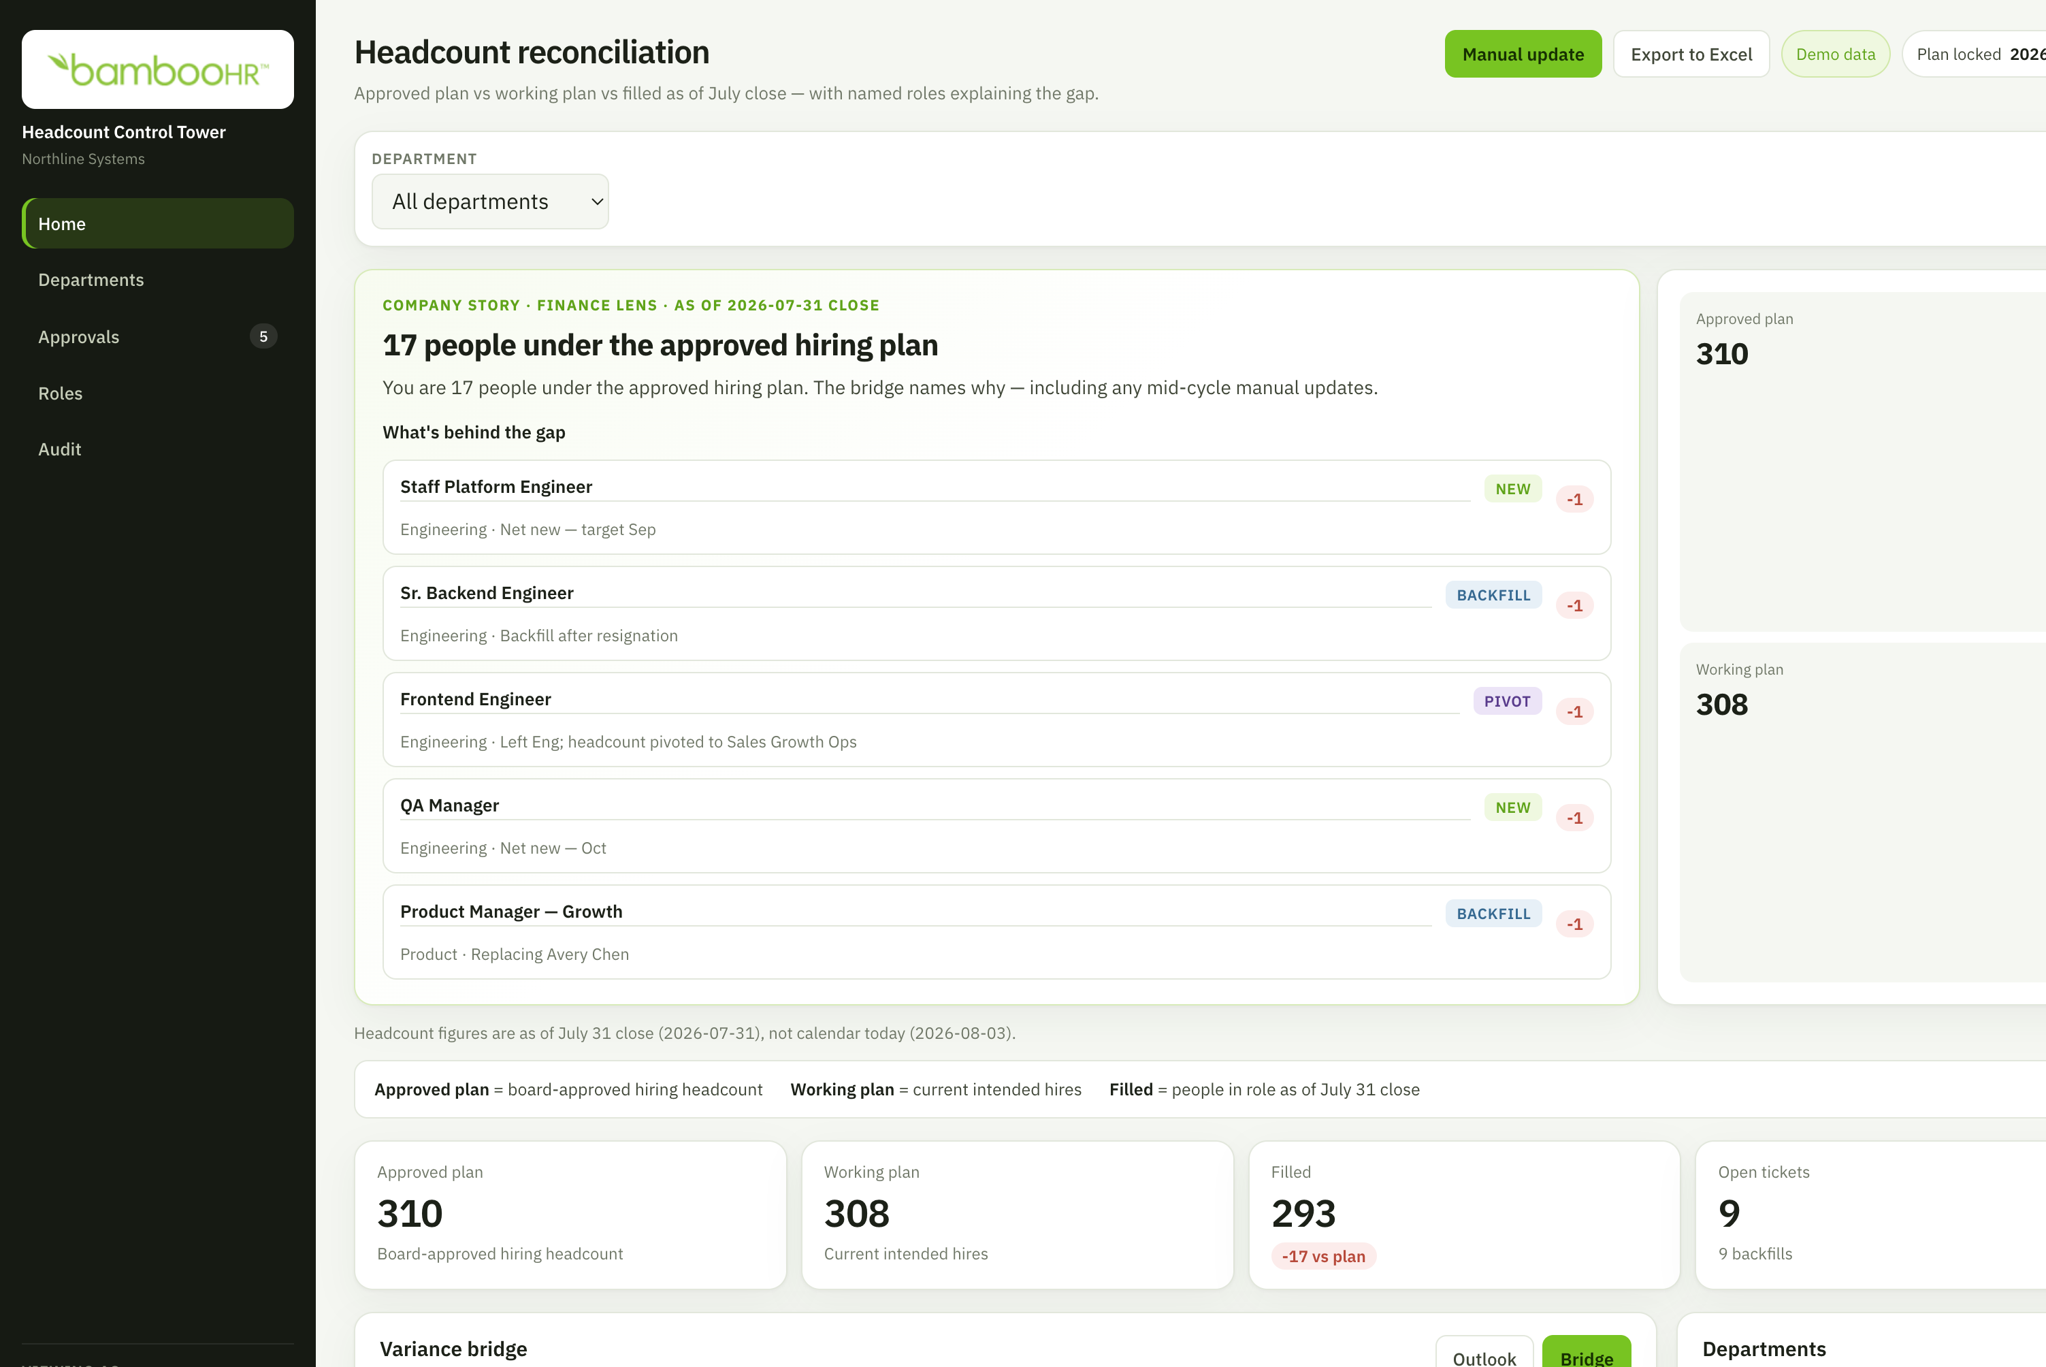
KEY TAKEAWAY
Headcount recon shouldn’t be complicated, live in one person’s head, or one spreadsheet.
With Headcount Control Tower, Finance and HR share one clear story.
Live prototype
headcount-reconciliation.vercel.app
Prototype home — story, gap drivers, and as-of in one view
BambooHR interview case study
16/16
Notes:
End on the bus-factor quote. Takeaway: resilience and shared understanding, not only speed. Offer the live prototype.

