Slide 1
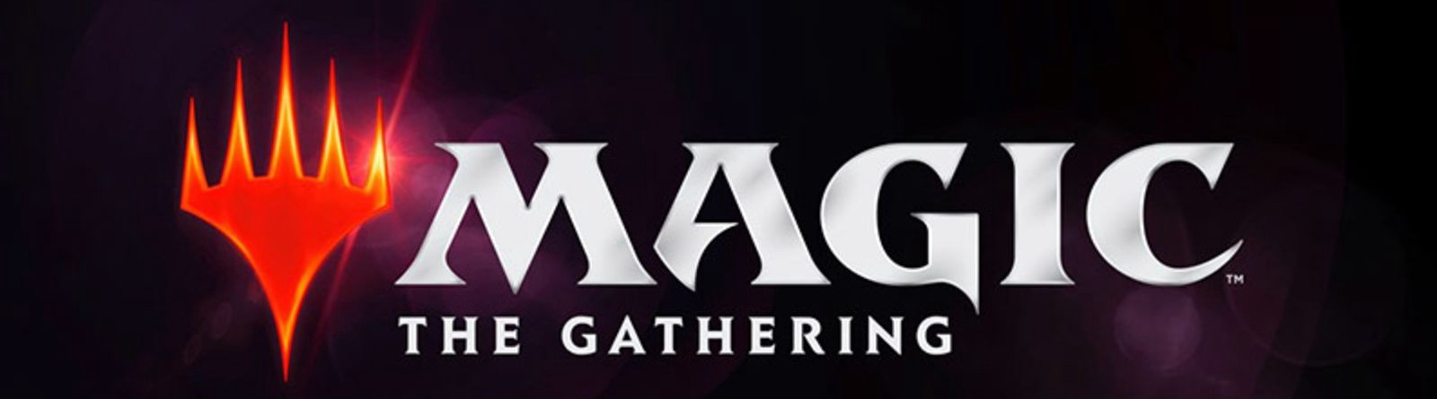
Dataset Generation and Meta Analysis
Philip Nelson
Brigham Michaelis

Slide 2
Initial Goal and Actual Work
We started the project with the lofty goal to make a novel deck ranker, even if it would be a bit naive.
What resulted was something a bit different.

Slide 3
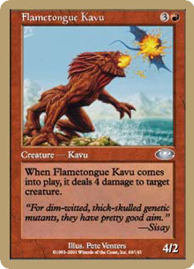
At the heart of our work is one question. How do you rank a deck/card?
Mana cost to play this card:
3 Wild, 1 Red
Card Name: Flametongue Kavu
Card Type: Creature
Special ability of card when it is played
Card Flavor Text
Power/Toughness: 4/2

Slide 4
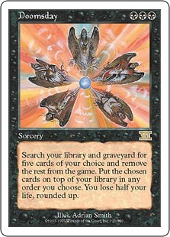
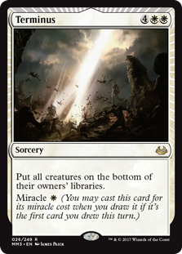
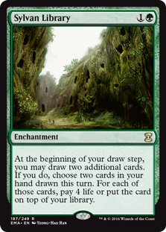
With over 20,000 cards, thousands of special rules, and unique card interactions, How do you rank a deck/card?

Slide 5
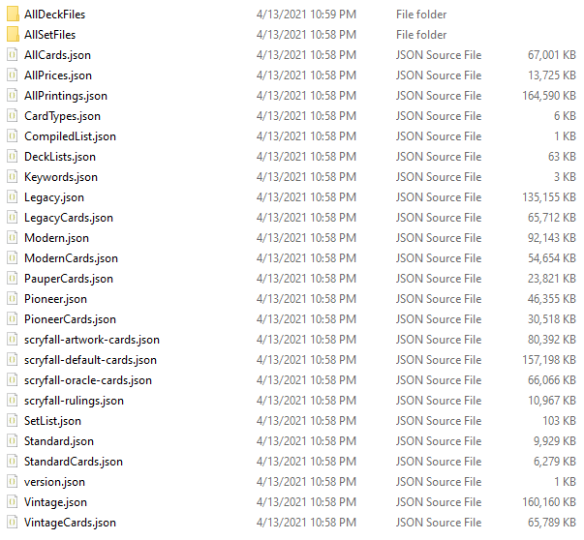
The start of the quest...
47,877 cards
20,920 reprints
4,430 promotional
3,629 online only
304 duplicates
20,363 unique cards
74 dimensions

Slide 6
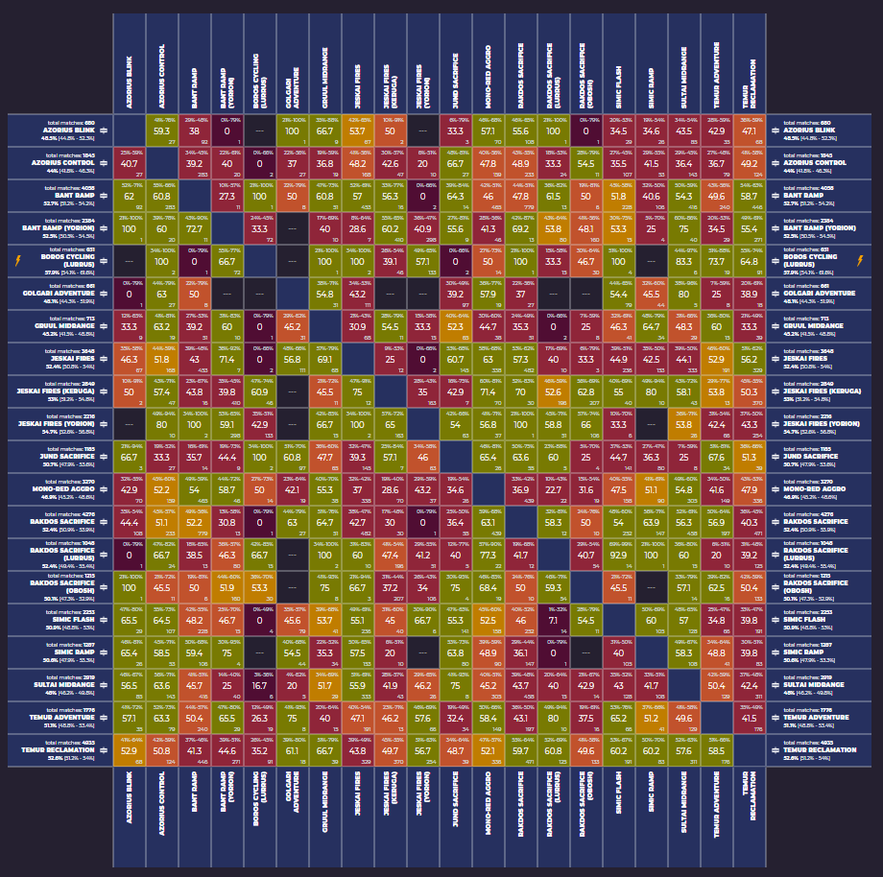
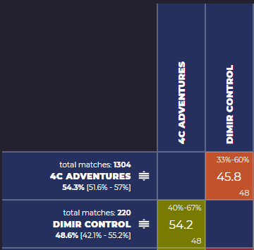
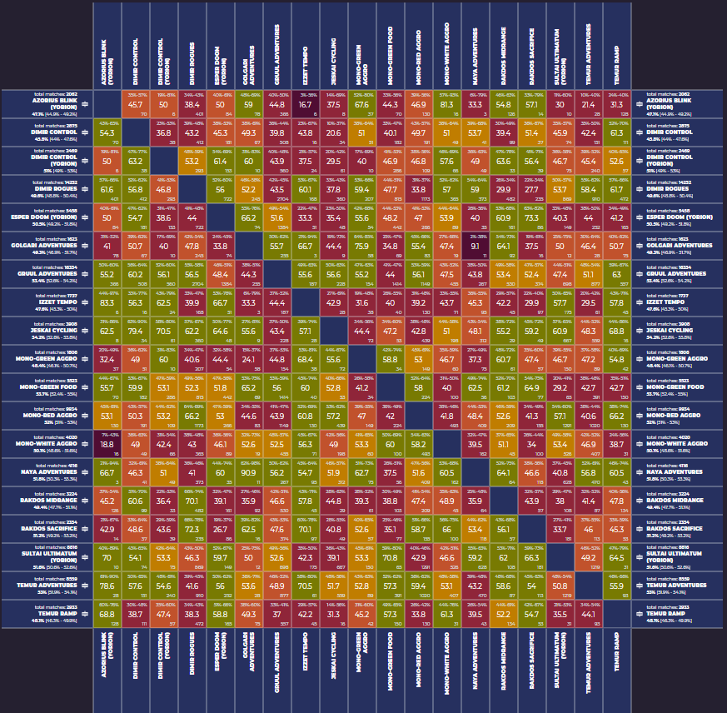
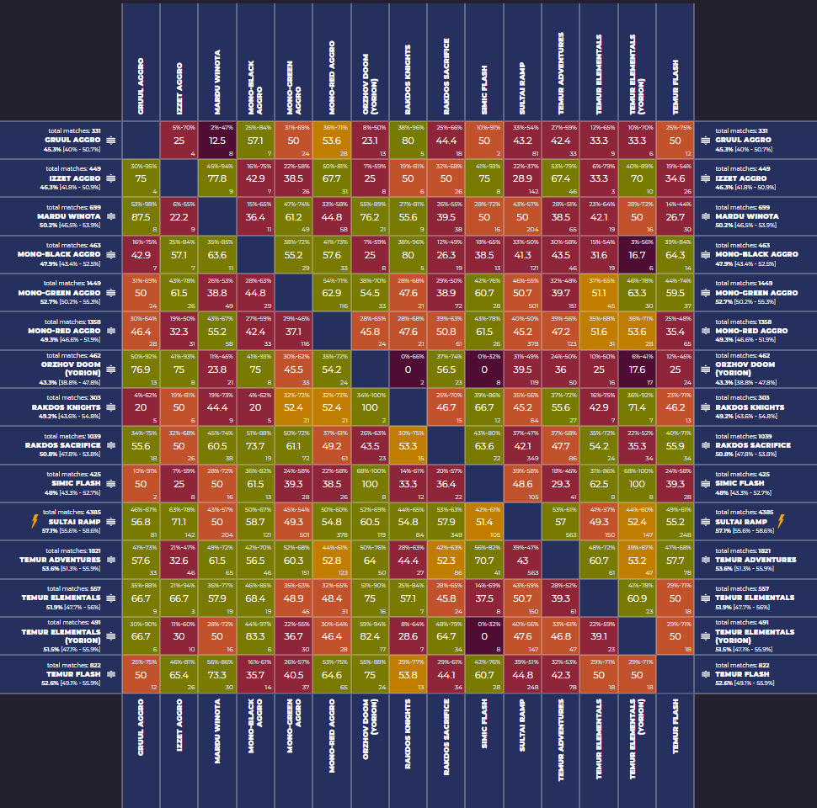
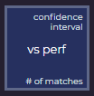
120 decks
4 Oct 2019 - 15 Apr 2021
~ last 18 months

Slide 7
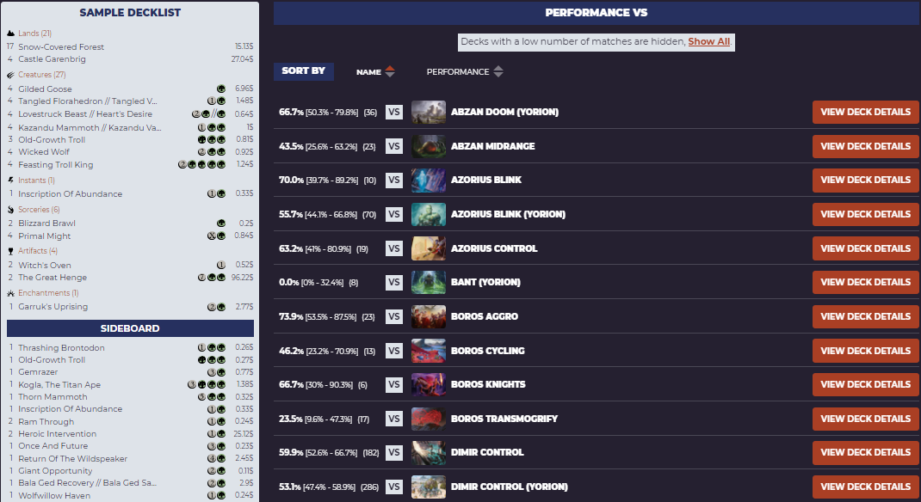

Through GBs of data we traveled…
All the while fighting off the dreaded
“Output was minimized for performance reasons”

Slide 8
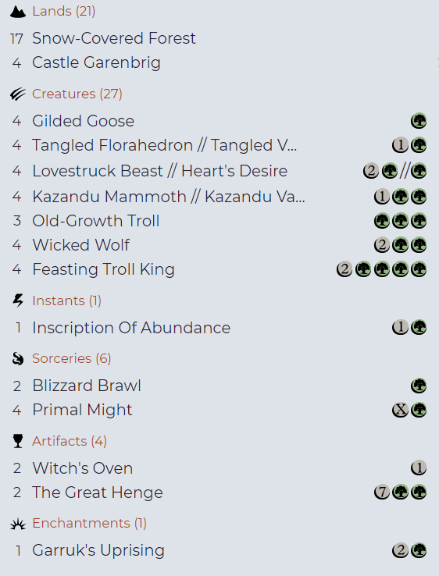

Color {2}{W/B}{U}
{#} Any color mana
{W} White mana
{U} Blue mana
{B} Black mana
{R} Red mana
{G} Green mana
A deck’s color is determined by the most common color of it’s cards

Slide 9

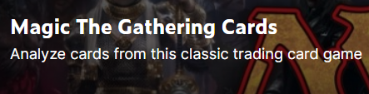
Finally with our goal in sight we combined the two datasets!
Now we can make “decks” from the special combinations of the two datasets!

Slide 10
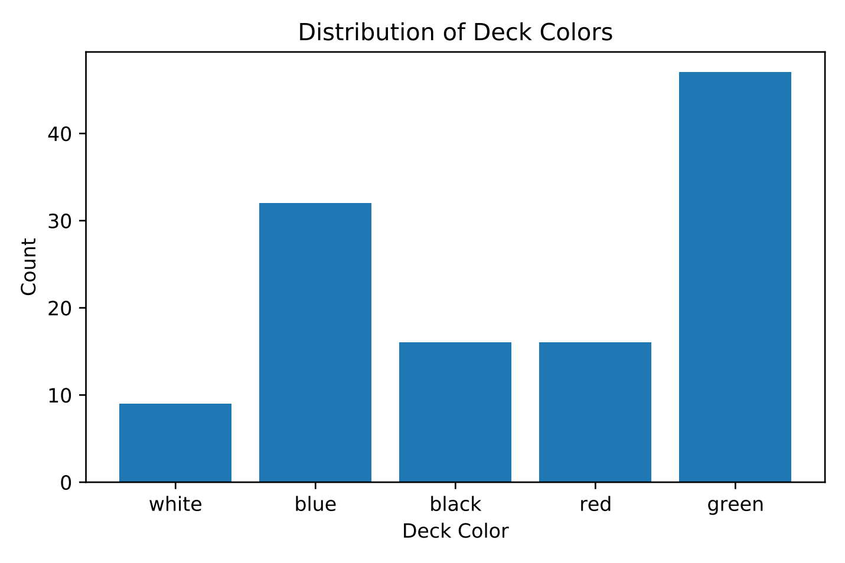
With our decks in hand, we could start asking the big questions.
Is there an even distribution of deck colors within popular decks?

Slide 11
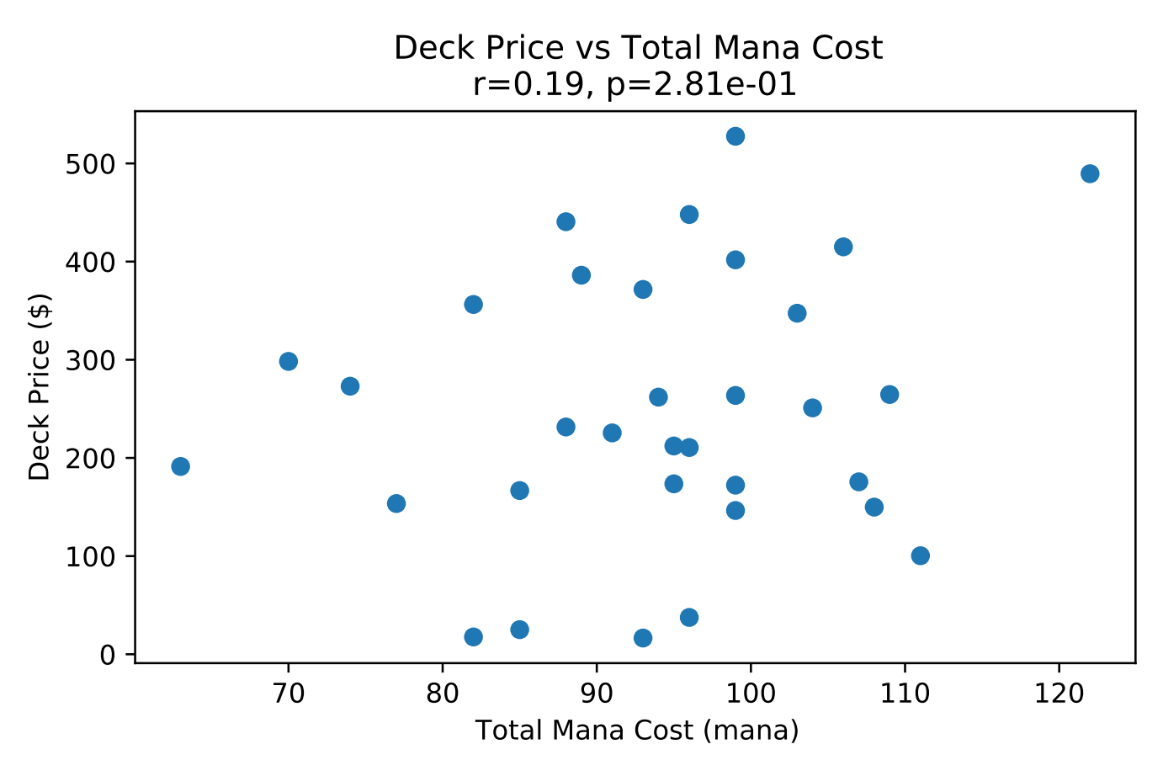
Is there a correlation between total mana cost and deck price?

Slide 12
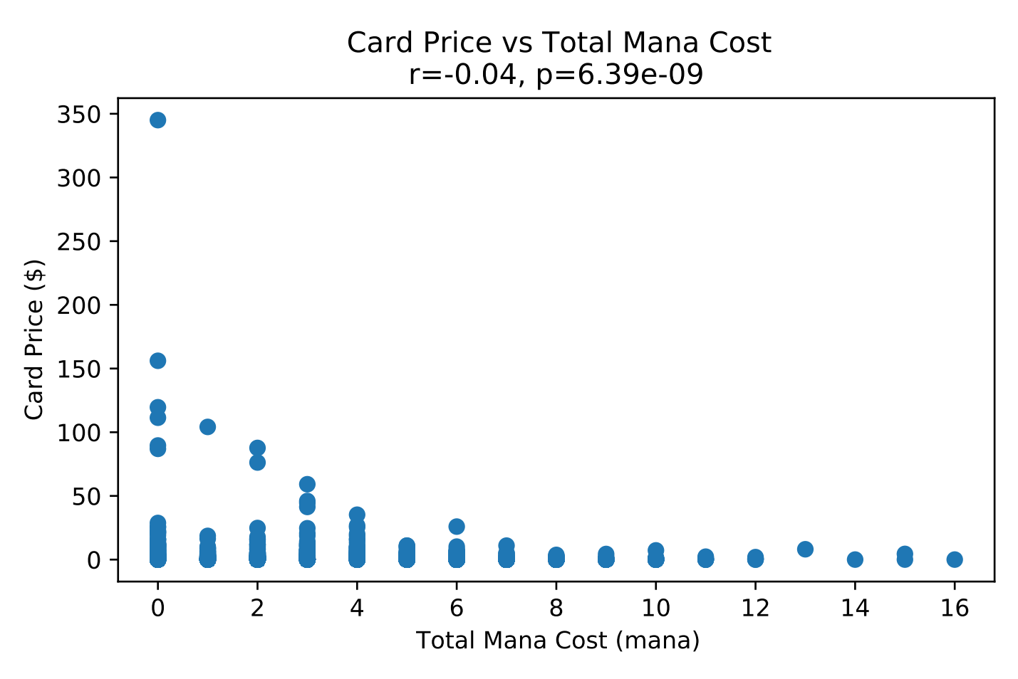
Does money talk in this game?

Slide 13
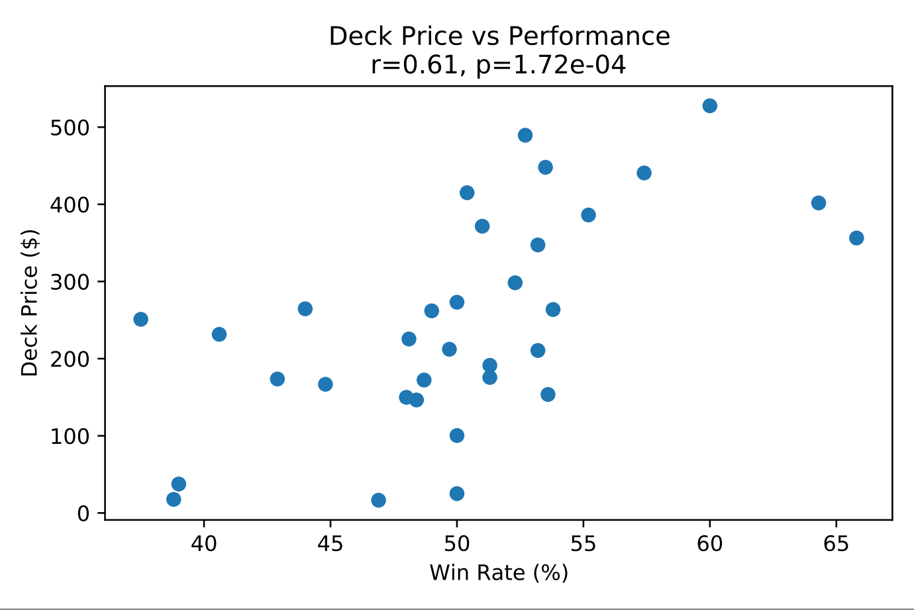
How good of a deck can I buy with my money?

Slide 14
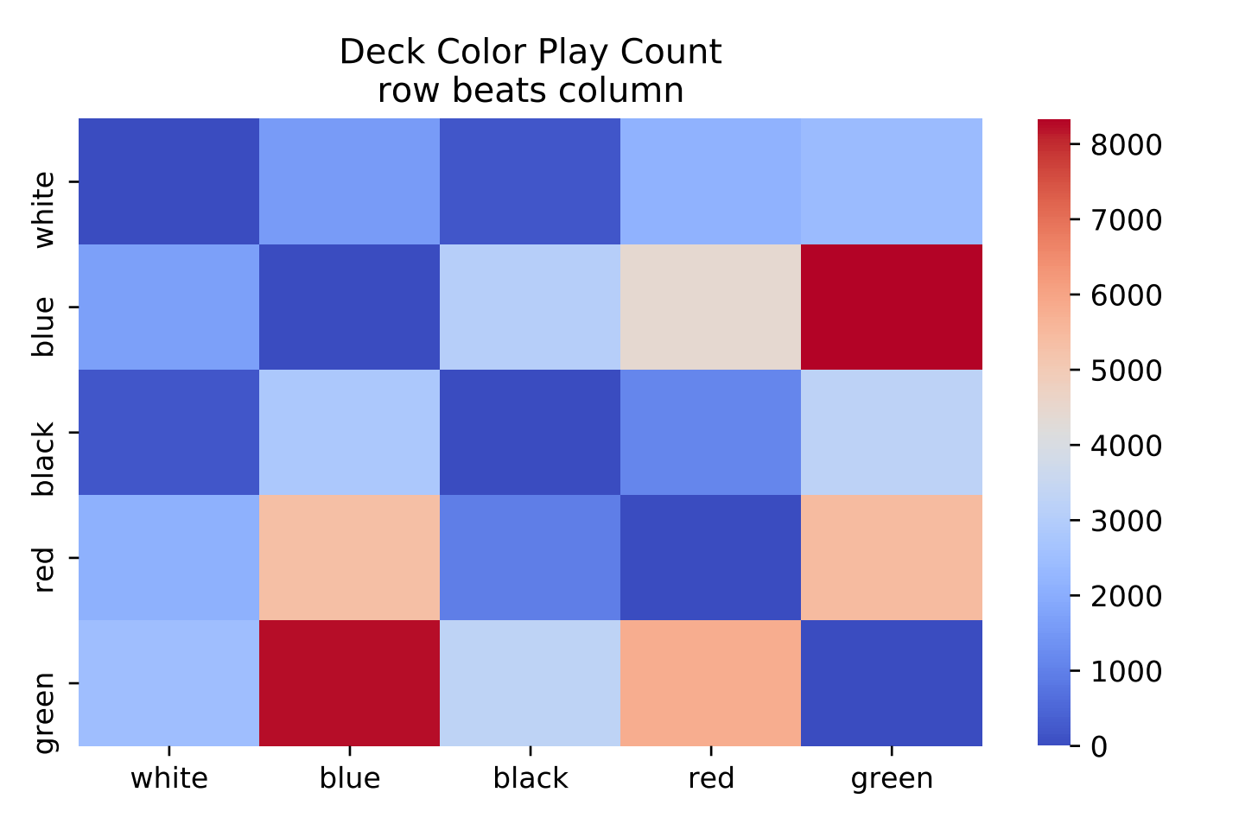
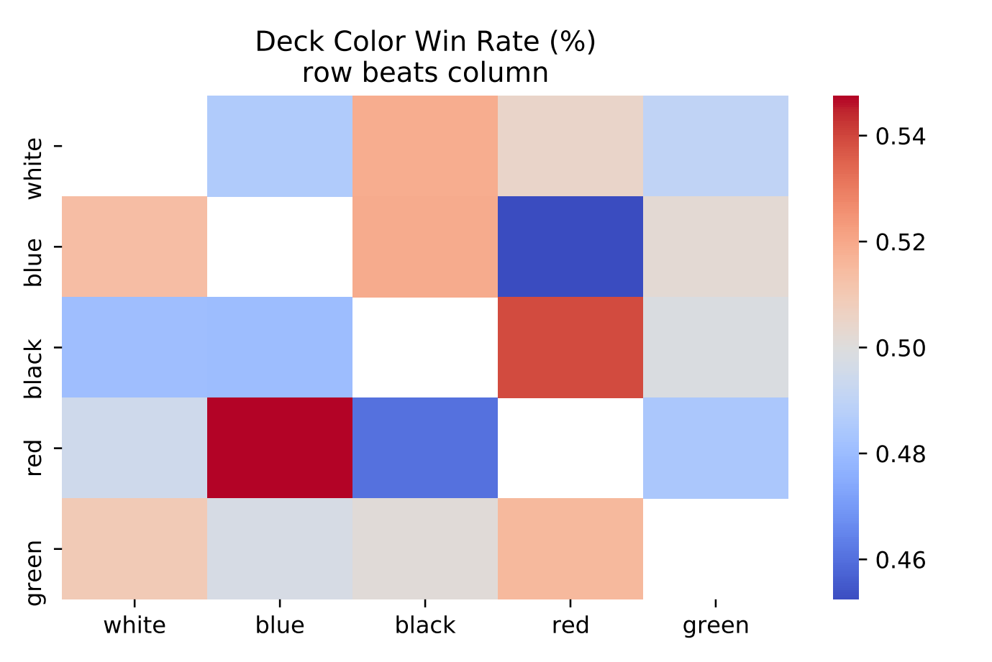
Finally, how do colors compete against each other?
Are there deck colors that are played together more often?
Are there deck colors that beat another more often?

Slide 15
RETROSPECTIVE
Our project was broken into two main parts: creating a dataset of decks and analyzing it
Is there anything we would have done differently?
YES! A lot of time went into cleaning and munging several hundred MBs of text!
Given more time we could have delved into more of the json files.
We could also have found older match data for decks to build a bigger deck dataset
The beauty of this game is that internet is replete with data on MTG; it is extremely popular and fun to play.
Possible future work?
Greater analysis capabilities are definitely possible given more time. There is so much data out there, and it becomes stale so quickly! It is an intriguing problem to try and find out what the current best deck is.
What changes, if any, did you make from your proposal?
Original goal was to build a novel deck ranking method. We ended up pivoting to building a dataset of cards and decks, then analyzing it.

Slide 16
Questions?

