Slide 1
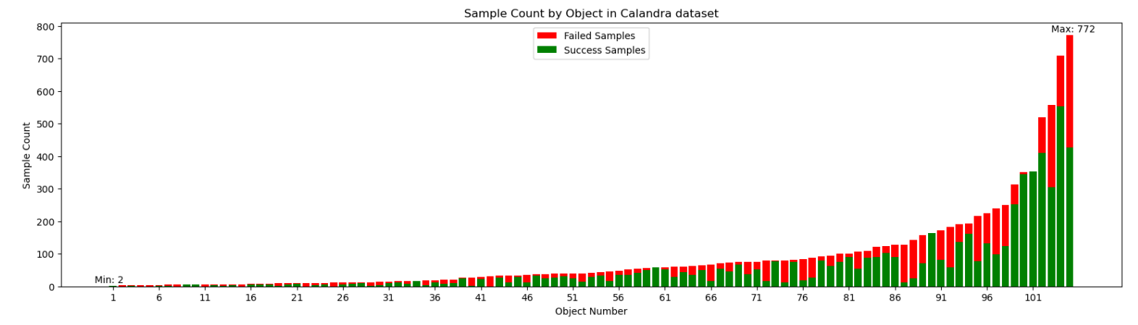
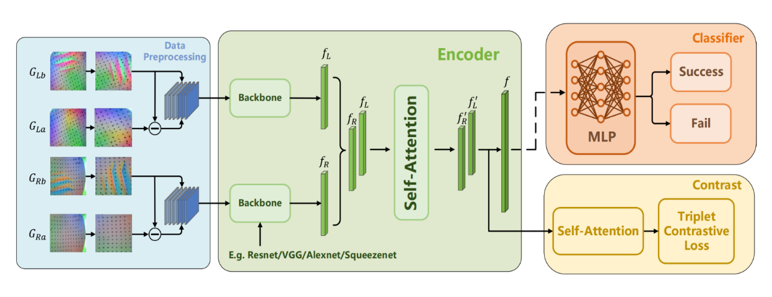
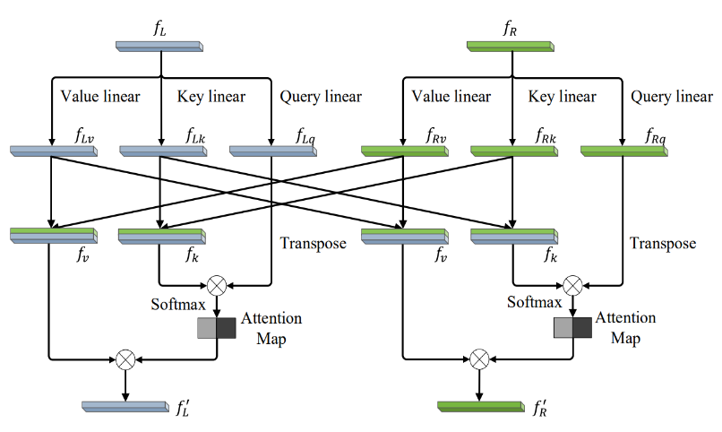
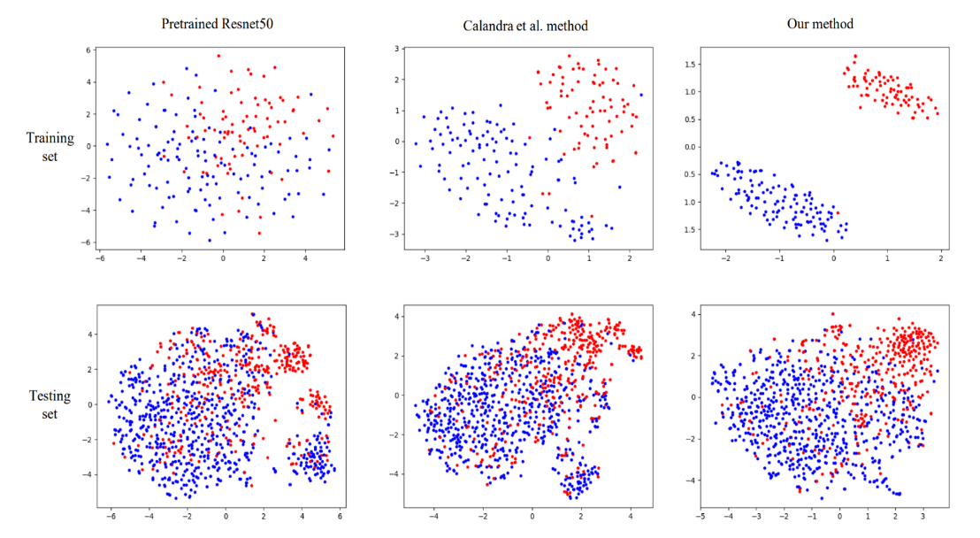
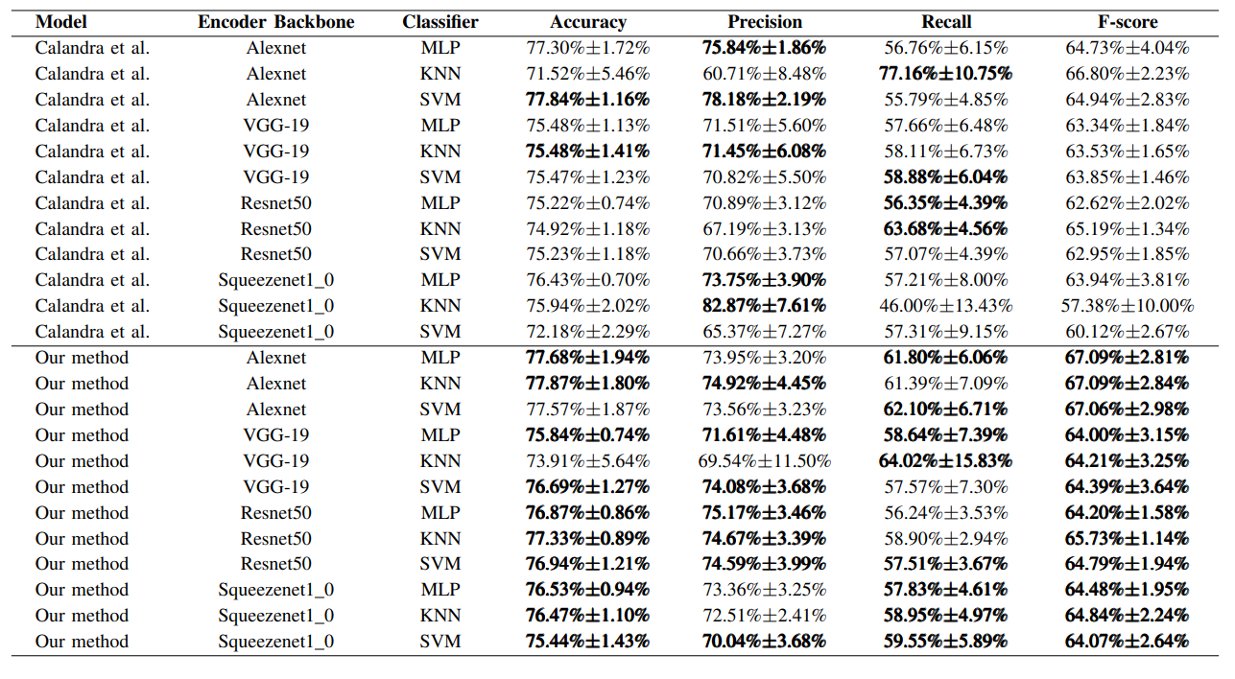
Notes:
- This work focuses on grasp outcome prediction using a limited Gelsight-based tactile dataset consisting of only 200 data points.
- In addition to conventional data augmentation techniques, we construct triplets for contrastive learning by randomly selecting two samples with the same label and one sample with a different label from the tactile grasping dataset, where a label represents the success of a grasping point. This approach allows us to generate a large number of training data units, mitigating the overfitting issue in small sample scenarios to some extent.
- We employ an interaction attention mechanism to generate new embeddings with context information from different fingers in the same grasp, using Gelsight tactile data embeddings. This enables our network to better utilize information from multiple tactile sensors, further enhancing grasp outcome prediction performance.
- We explore the incorporation of a self-attention non-linear projection head in the network and find in ablation studies that it contributes to improvements in accuracy, precision, and F-score metrics for grasp outcome prediction.
- Extensive experimental results validate the effectiveness of our proposed network, and ablation studies confirm the efficacy of the aforementioned improvements.

Slide 2
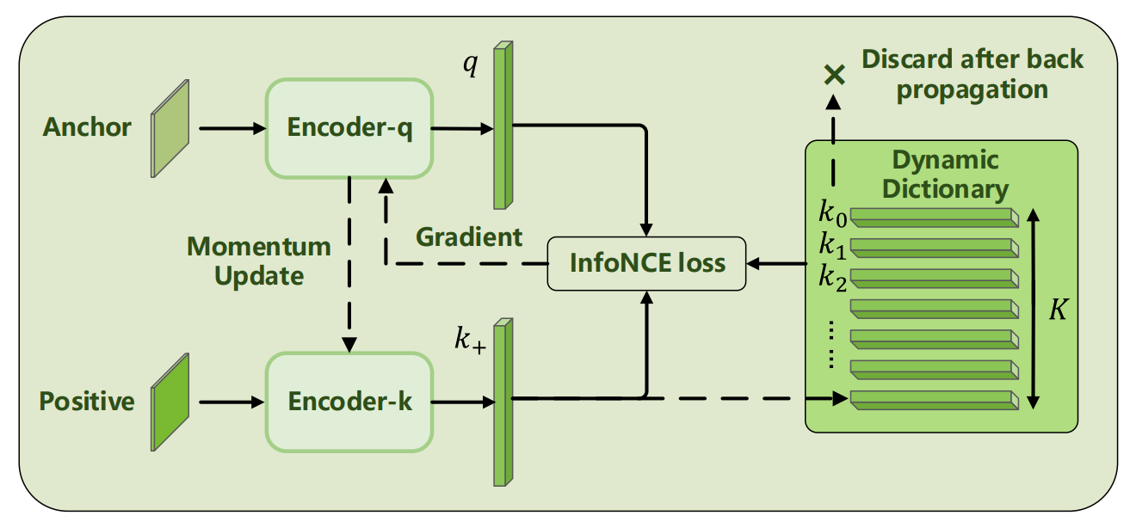
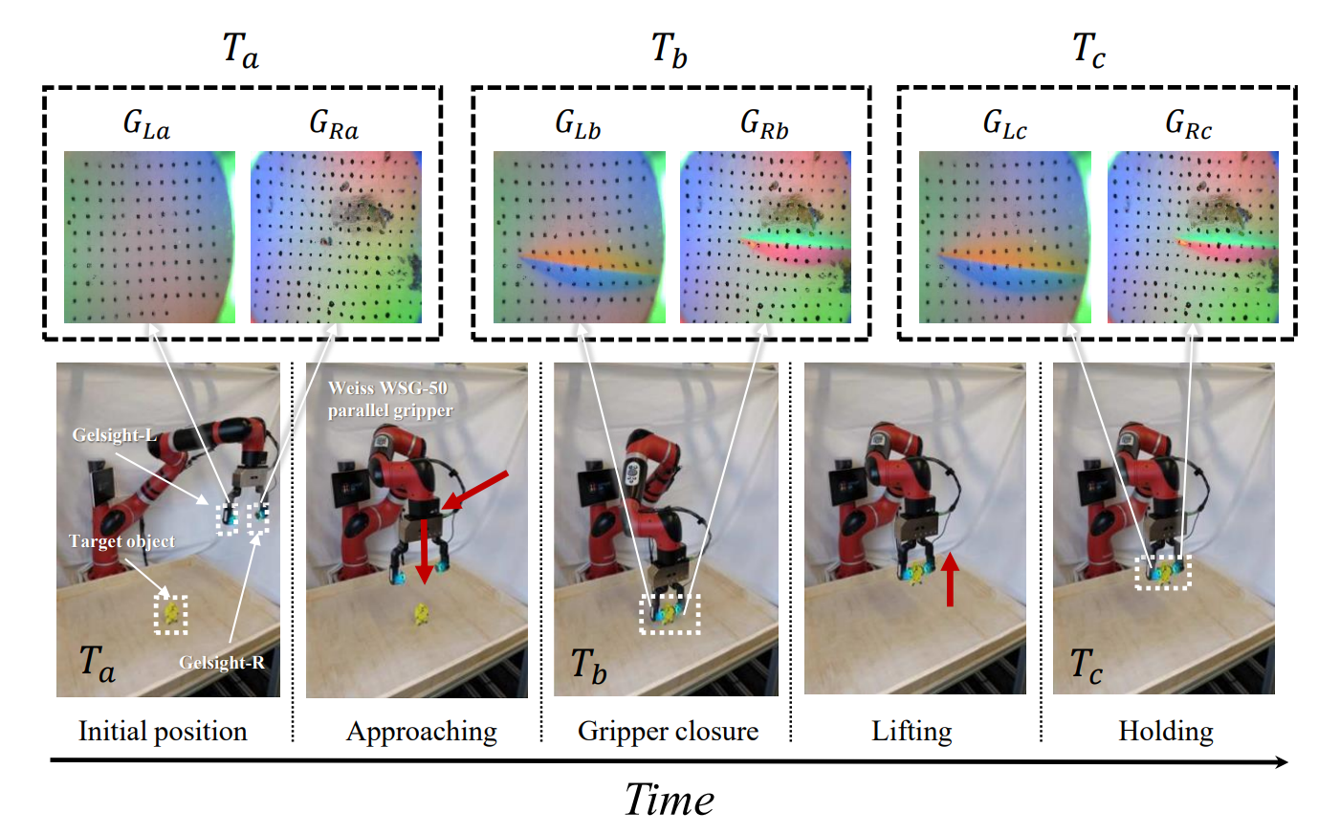
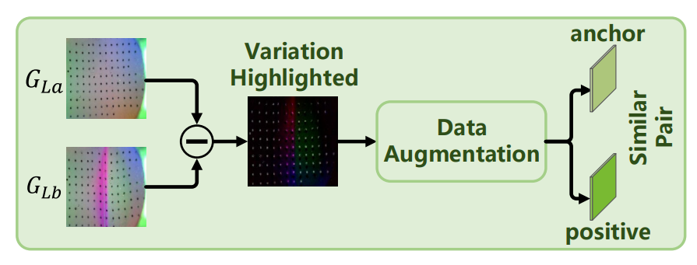
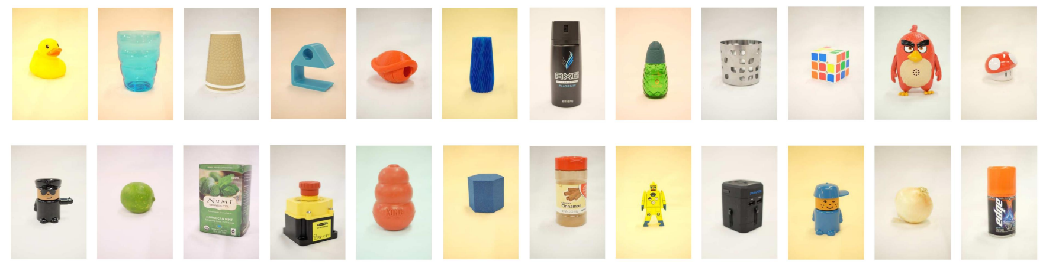
Notes:
- This work focuses on the grasp outcome prediction task by employing self-supervised contrastive learning methods, utilizing Gelsight-based tactile datasets.
- Inspired by simCLR, we explore the transferability of its data augmentation techniques to a Gelsight-based tactile dataset, and propose a contrastive learning network framework based on MoCo for grasp outcome prediction. Moreover, we compare the performance of various self-supervised learning methods within this context.
- The experimental results demonstrate the effectiveness of simCLR's data augmentation techniques on Gelsight-based tactile datasets, and reveal that our proposed framework outperforms other self-supervised learning methods in this domain.

