Slide 1
GOA: from swarm to measured evidence
Grasshopper Optimisation Algorithm
ทฤษฎี • ภาพการเคลื่อนที่ • ผลทดลองที่ทำซ้ำได้
Can social interactions find a good minimum?
Compare GOA with real-number GA and parallel RLS.
Two functions · 180 independent measured runs
12-minute talk | 2D visualization | All raw runs retained
Optimization Workshop · Aj. Eckart | 01/12
60 s
Notes:
Slide 1: GOA: from swarm to measured evidence
Allocated time: 60 seconds.
Use presentation/script_th.md, section 1.
All performance claims use results/workshop/summary.json.
See docs/methodology.md for normalization and fair-budget details.

Slide 2
The GOA update rule
Social interaction
s(r) = 0.5 exp(−r/1.5) − exp(−r)
xᵢᵈ(t) = Tᵈ(t−1) + cₜ Σⱼ≠ᵢ [ cₜ (ubᵈ−lbᵈ)/2 · s(rᵢⱼᵈ) · uᵢⱼᵈ ]
cₜ = 1 − t (1 − 10⁻⁵) / 100; t = 1, …, 100
T = best-so-far archive; u = unit direction from i to j.
Eq. 2.7/2.8 of Saremi et al. (2017), with a documented normalization choice.
Optimization Workshop · Aj. Eckart | 02/12
75 s
Notes:
Slide 2: The GOA update rule
Allocated time: 75 seconds.
Use presentation/script_th.md, section 2.
All performance claims use results/workshop/summary.json.
See docs/methodology.md for normalization and fair-budget details.

Slide 3
Exploration → exploitation
Early: explore
Late: exploit
Higher c → stronger interactions
Repulsion spreads nearby agents
Attraction links distant agents
Lower c → smaller movement
Search around the best archive
Clustering can still miss the optimum
rᵢⱼᵈ = 1 + 3 |xⱼᵈ − xᵢᵈ| / (ubᵈ − lbᵈ) ∈ [1, 4]
This coordinate/bound mapping is our explicit implementation choice.
Synchronous updates · clip to bounds · both c factors retained · no claim of exact paper replication
Optimization Workshop · Aj. Eckart | 03/12
65 s
Notes:
Slide 3: Exploration → exploitation
Allocated time: 65 seconds.
Use presentation/script_th.md, section 3.
All performance claims use results/workshop/summary.json.
See docs/methodology.md for normalization and fair-budget details.

Slide 4
Where GOA can be applied
Structural design: minimize weight subject to stress limits
Design variables → cross-sectional areas
Objective → material / structural weight
Constraints → stress or deflection limits
The original paper studies truss and cantilever design.
Our workshop tests are unconstrained mathematical functions;
we do not claim new engineering results.
Optimization Workshop · Aj. Eckart | 04/12
50 s
Notes:
Slide 4: Where GOA can be applied
Allocated time: 50 seconds.
Use presentation/script_th.md, section 4.
All performance claims use results/workshop/summary.json.
See docs/methodology.md for normalization and fair-budget details.

Slide 5
A reproducible comparison
Sphere: [−5, 5]² Rosenbrock: [−2, 2]²
2 dimensions · 30 agents · 100 iterations · 30 runs per method
Seeds: 20260930 + 10000 × function index + run index
Same initial points for all three methods within a function/run
3,030 actual objective calls per run: 30 + 100 × 30
GA: pc = 0.8, pm = 0.1; mutation σ = 0.1 × bound width; no elitism
RLS: Gaussian step σ = 0.3; accept only non-worse moves
All methods archive best-so-far; time excludes graphics/export
Optimization Workshop · Aj. Eckart | 05/12
70 s
Notes:
Slide 5: A reproducible comparison
Allocated time: 70 seconds.
Use presentation/script_th.md, section 5.
All performance claims use results/workshop/summary.json.
See docs/methodology.md for normalization and fair-budget details.

Slide 6
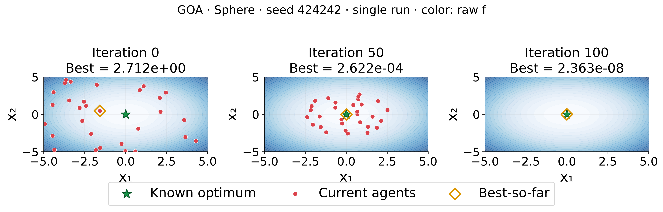
Sphere: a smooth bowl
f(x) = x₁² + x₂²; optimum (0, 0), f* = 0
Single illustration · preselected seed 424242 · final best = 2.363e-08
Green star = known optimum; orange diamond = archive; red points = current agents
▶ Open GIF / MP4 (16.8 s)
Optimization Workshop · Aj. Eckart | 06/12
75 s
Notes:
Slide 6: Sphere: a smooth bowl
Allocated time: 75 seconds.
Use presentation/script_th.md, section 6.
All performance claims use results/workshop/summary.json.
See docs/methodology.md for normalization and fair-budget details.

Slide 7
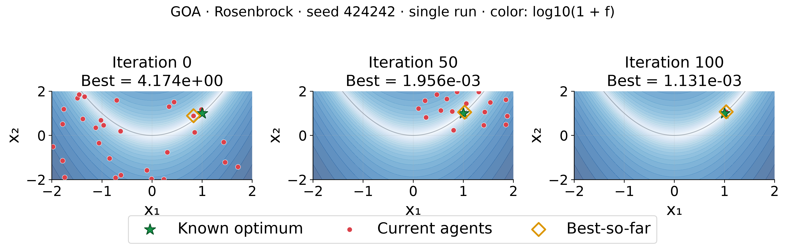
Rosenbrock: a narrow curved valley
f(x) = 100(x₂ − x₁²)² + (x₁ − 1)²; optimum (1, 1), f* = 0
Contour: log10(1 + f)
Single illustration · preselected seed 424242 · final best = 1.131e-03
Green star = known optimum; orange diamond = archive; red points = current agents
▶ Open GIF / MP4 (16.8 s)
Optimization Workshop · Aj. Eckart | 07/12
90 s
Notes:
Slide 7: Rosenbrock: a narrow curved valley
Allocated time: 90 seconds.
Use presentation/script_th.md, section 7.
All performance claims use results/workshop/summary.json.
See docs/methodology.md for normalization and fair-budget details.

Slide 8
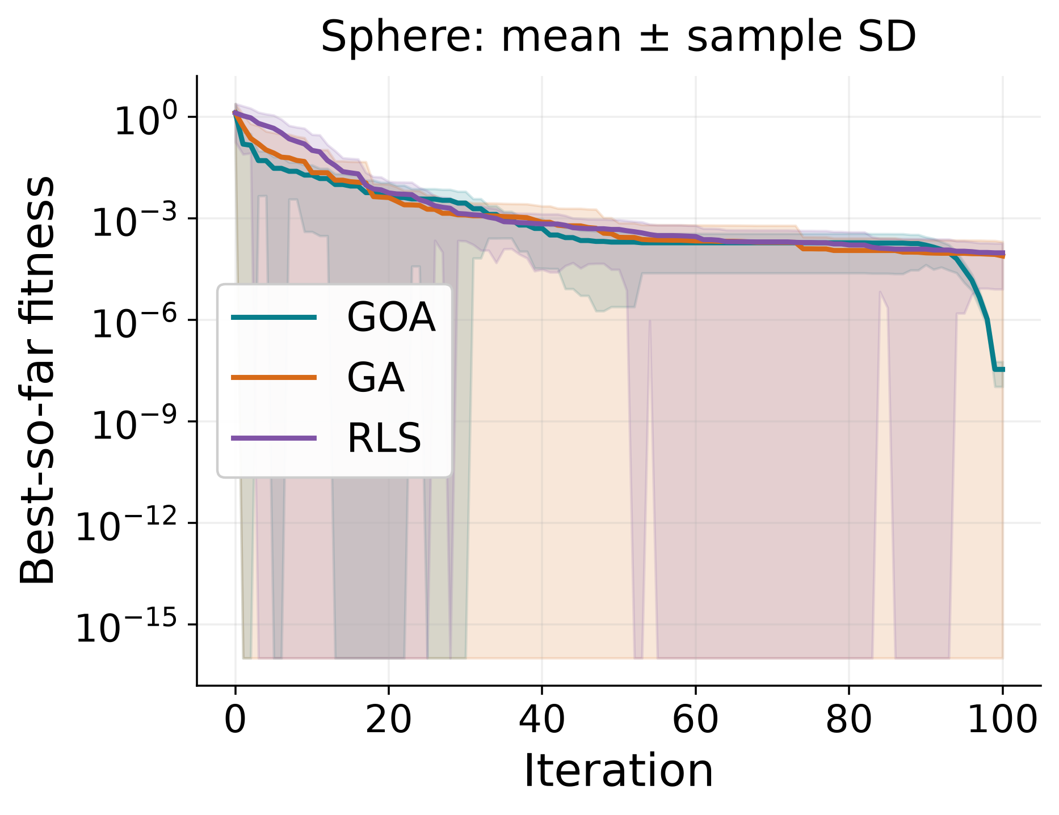
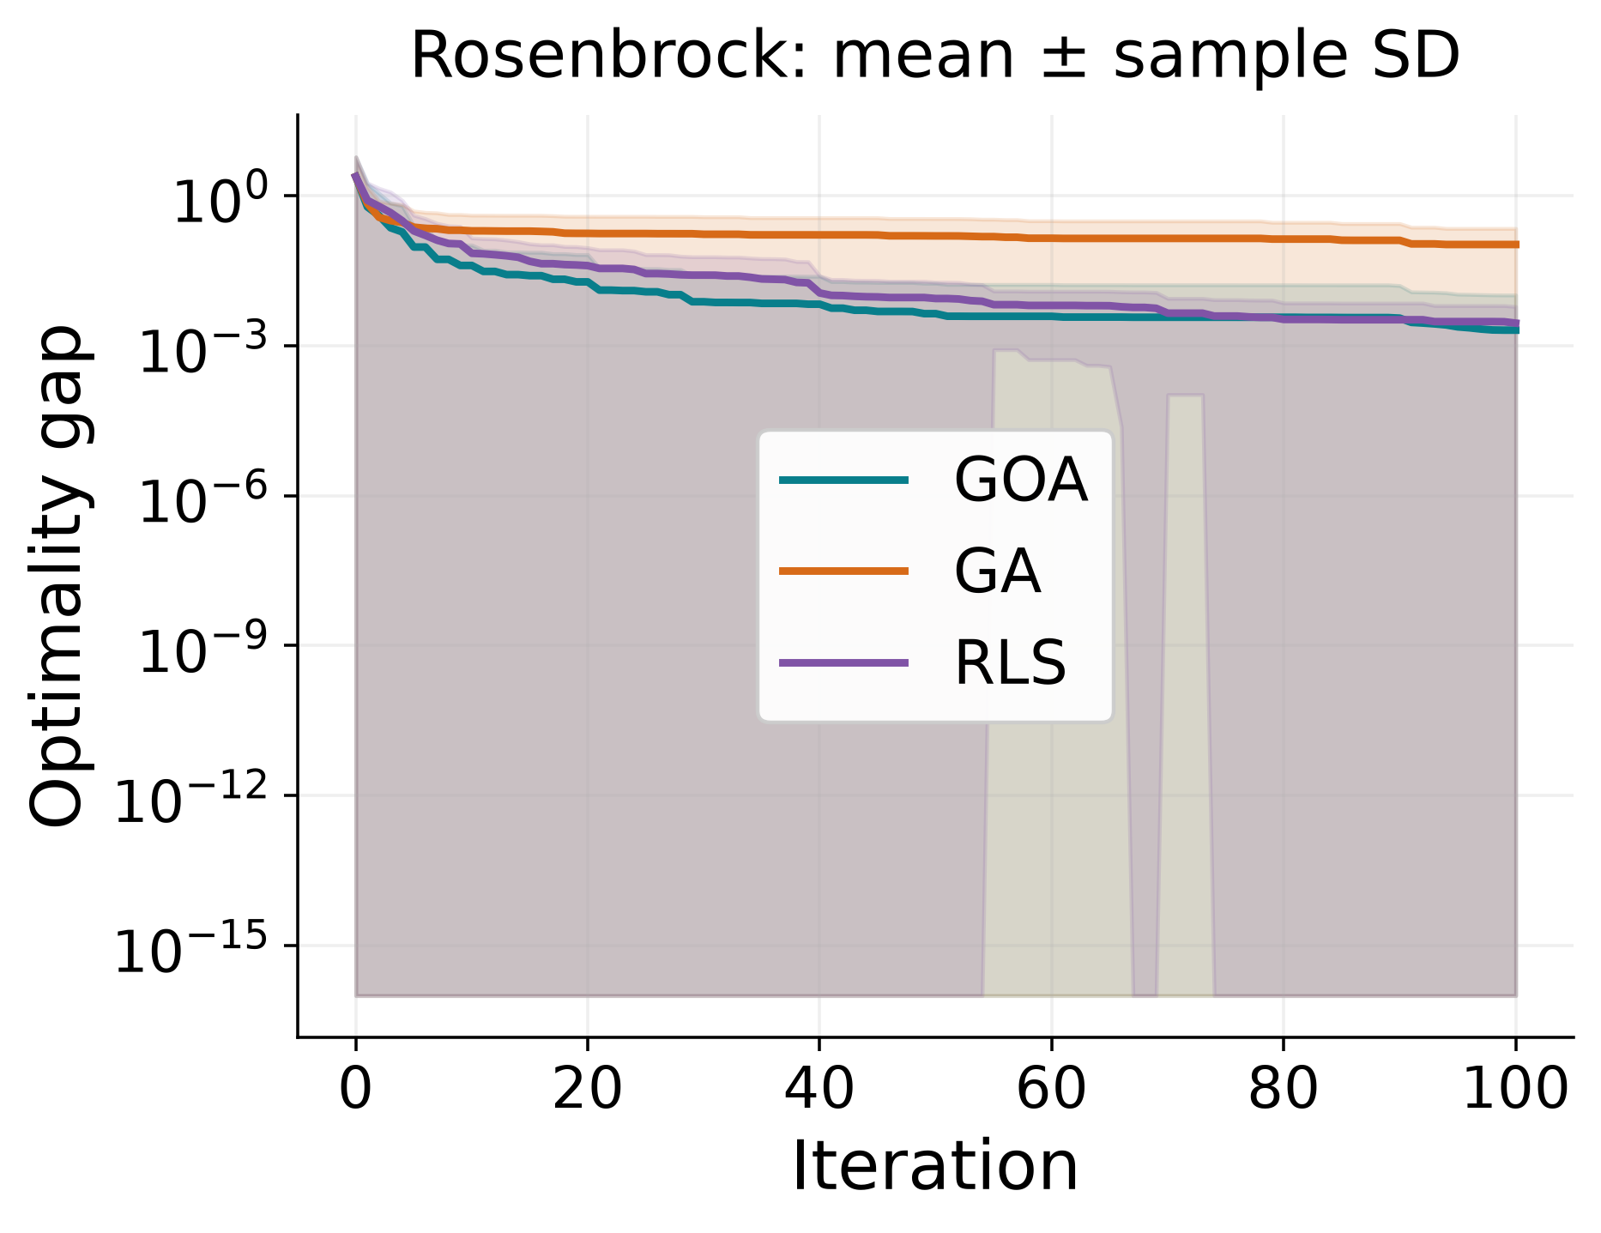
Mean convergence and optimality gap
Each line averages best-so-far over all 30 independent runs.
Shading = ± sample SD. Gap = fitness here (f* = 0); log display floor = 10⁻¹⁶.
Optimization Workshop · Aj. Eckart | 08/12
70 s
Notes:
Slide 8: Mean convergence and optimality gap
Allocated time: 70 seconds.
Use presentation/script_th.md, section 8.
All performance claims use results/workshop/summary.json.
See docs/methodology.md for normalization and fair-budget details.

Slide 9
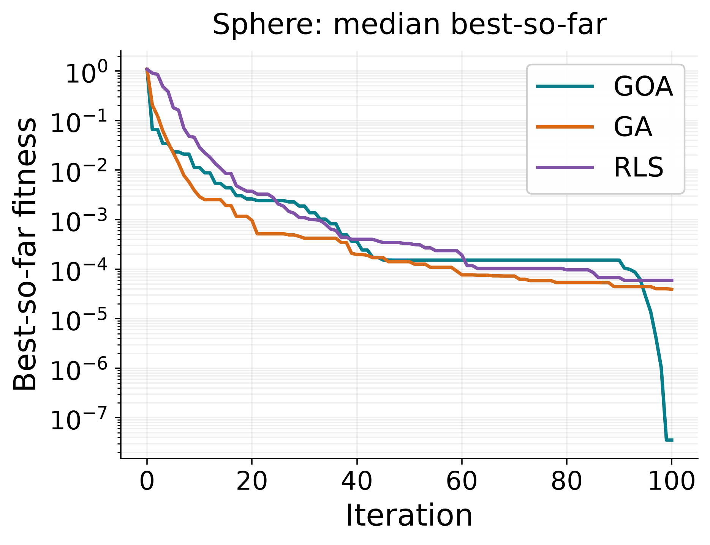
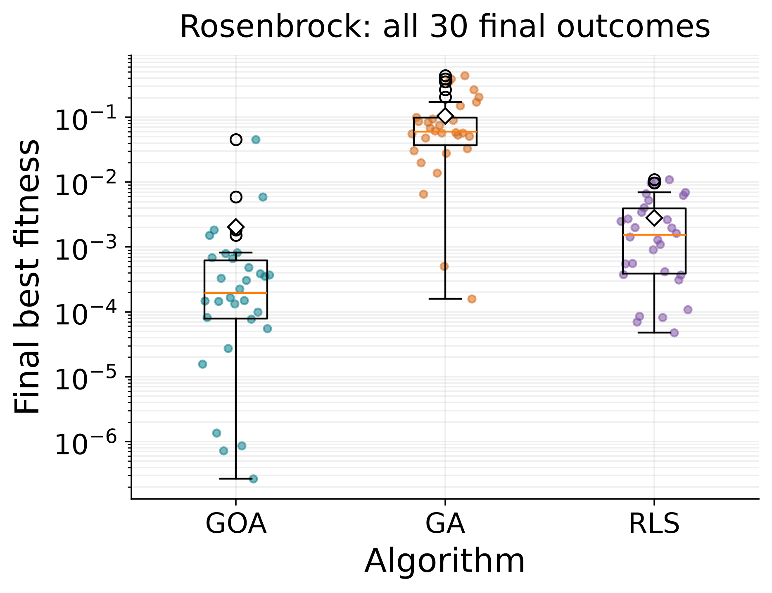
Typical performance and run variability
GOA has the lowest median on both functions in this setup.
Rosenbrock: GOA’s long upper tail means some runs still stall.
Optimization Workshop · Aj. Eckart | 09/12
70 s
Notes:
Slide 9: Typical performance and run variability
Allocated time: 70 seconds.
Use presentation/script_th.md, section 9.
All performance claims use results/workshop/summary.json.
See docs/methodology.md for normalization and fair-budget details.

Slide 10
What the 180 runs show
Final fitness ↓ · all 30 runs per method · lower is better
Function / method | Mean ± SD | Median | Best | Worst | Time (s)
Sphere / GOA | 3.43e-08 ± 2.37e-08 | 3.54e-08 | 8.29e-11 | 9.56e-08 | 0.0161
Sphere / GA | 7.70e-05 ± 1.26e-04 | 3.90e-05 | 6.57e-07 | 6.71e-04 | 0.0165
Sphere / RLS | 9.55e-05 ± 8.75e-05 | 5.92e-05 | 1.18e-06 | 2.97e-04 | 0.0094
Rosenbrock / GOA | 2.04e-03 ± 8.24e-03 | 1.96e-04 | 2.66e-07 | 4.53e-02 | 0.0234
Rosenbrock / GA | 1.05e-01 ± 1.15e-01 | 6.00e-02 | 1.58e-04 | 4.40e-01 | 0.0240
Rosenbrock / RLS | 2.81e-03 ± 3.22e-03 | 1.53e-03 | 4.79e-05 | 1.10e-02 | 0.0161
Equal measured budgets: 3,030 calls/run. Time = mean search time on this machine.
RLS is faster here; GOA has the lowest median, but Rosenbrock worst-case GOA > RLS.
Optimization Workshop · Aj. Eckart | 10/12
50 s
Notes:
Slide 10: What the 180 runs show
Allocated time: 50 seconds.
Use presentation/script_th.md, section 10.
All performance claims use results/workshop/summary.json.
See docs/methodology.md for normalization and fair-budget details.

Slide 11
Limits and conclusions
GOA performs well here; there is no universal winner.
Only two smooth 2D functions; no real design constraints tested
Fixed parameters; no tuning study or significance claim
GOA interactions: O(T N² D); may stagnate near an imperfect target
Swarm clustering ≠ proof that the known optimum was found
Next: higher dimensions, multimodal functions, sensitivity studies,
and constrained applications with explicit feasibility checks.
Optimization Workshop · Aj. Eckart | 11/12
35 s
Notes:
Slide 11: Limits and conclusions
Allocated time: 35 seconds.
Use presentation/script_th.md, section 11.
All performance claims use results/workshop/summary.json.
See docs/methodology.md for normalization and fair-budget details.

Slide 12
References & reproducibility
Saremi, Mirjalili & Lewis (2017). Grasshopper Optimisation Algorithm:
Theory and application. Advances in Engineering Software, 105, 30–47.
DOI: 10.1016/j.advengsoft.2017.01.004
Course material supplied in repository: workshop_objective_function.pdf
GA lecture: ScienceDirect/Algorithm_ws/l9-11.pdf
Our RLS baseline: algorithms/core.py (parallel Gaussian local searches)
Raw runs + config: results/workshop/ | Method audit: docs/methodology.md
Rebuild: python -m workshop all | Thai script + Q&A: presentation/
Optimization Workshop · Aj. Eckart | 12/12
10 s
Notes:
Slide 12: References & reproducibility
Allocated time: 10 seconds.
Use presentation/script_th.md, section 12.
All performance claims use results/workshop/summary.json.
See docs/methodology.md for normalization and fair-budget details.

