Slide 1
SPRING BOOT FUNDAMENTALS

Slide 2
GOAL OF THE COURSE
Solid basic understanding of Spring and Spring Boot
Know different projects and be able to create implementations with them
Be able to independently modify an existing Spring application

Slide 3
COURSE OVERVIEW
Introduction to Spring + Spring Boot + REST
More REST + Data
Testing + messaging services + microservices
Notes:
Day 3
● Spring Security
■ Authentication
■ Authorization
○ Spring Security Architecture
■ Filters
■ AOP
○ Security Configuration
○ Spring Boot Actuators
○ Exploring available Endpoints
○ Configuring Endpoint availability
○ Securing Endpoints
○ Creating custom Endpoints
● Spring Boot Configuration Deep Dive Spring Boot Actuator Deep Dive
○ Securing Actuator
○ Custom Health Indicators Spring Boot and APIs
Day 4
● Testing Spring Boot Applications
○ Mocking Spring Components
○ Testing Spring Boot REST APIs
● Spring Boot and Messaging Systems
● Spring Boot and Kafka
● Microservices
● Spring Boot and Microservices
○ Discovery
○ Client Side Load Balancing

Slide 4
TODAY’S CONTENT
RESTful services with spring
Spring MVC
Requests and responses
Write your own services
Introduction transaction management
Introduction Spring security

Slide 5
WHAT ARE WE DOING TODAY?
Spring
Make endpoints (Spring Rest), call endpoints (RestTemplates) and automagic databases (JPA)!
Spring REST
Controllers
Coding magic
Spring Data
Some more coding magic
Introduction security
Introduction transaction management
Notes:
Who already has any comprehension on any of these topics?
Or more broadly speaking, who has prior Spring (Rest)Controller or Spring Data experience and brings that to the table?

Slide 6
HOW ARE YOU?
How are you doing?
Do you expect any disturbances today?
What do you hope to learn today?

Slide 7
EXERCISE
Get some REST
Take 5 minutes to come up with a short explanation of what REST is.

Slide 8
WHAT IS A REST SERVICE?
Representational State Transfer
Follows 4 principles:
1. Resource identification through URI
e.g. <host>:<port>/application/persons)
2. Uniform interface
Manipulation of resources through CRUD operations.
3. Self-descriptive messages
Resources are decoupled from their representations so the content can be accessed in more than one format (plain text, HTML, XML, JSON etc etc). Metadata in the message is used to do authentication, detect errors, caching, access control etc etc…
4. Stateful interactions through hyperlinks
Every interaction with a resource is stateless. Stateful interactions can be done through URI manipulation, cookies or hidden form fields.
Notes:
Source: https://docs.oracle.com/javaee/6/tutorial/doc/gijqy.html

Slide 9
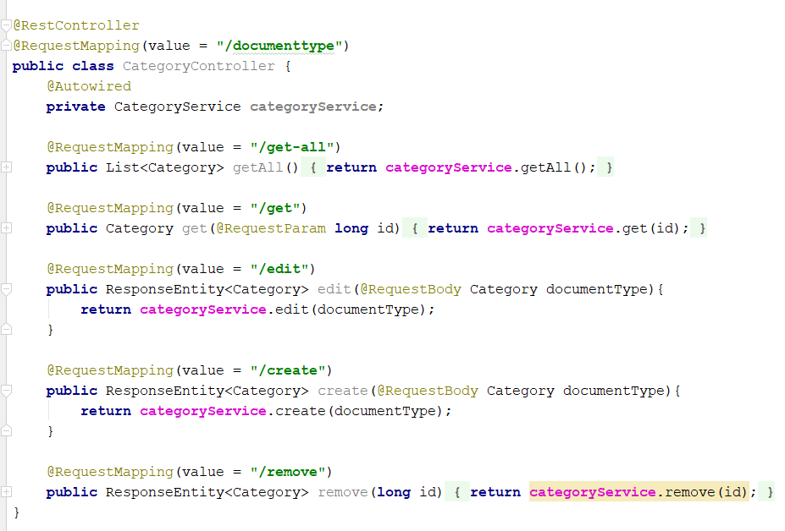
SPRING CONTROLLERS
What are they?
Used as endpoints, routing the calls from external applications or other microservices.

Slide 10
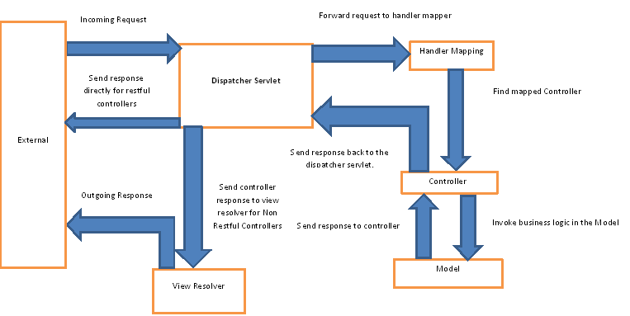
SPRING CONTROLLERS
Hint: They are part of the Spring (Web) MVC project
Notes:
For the full details; source: https://www.baeldung.com/spring-controllers
Please beware that direct interaction between the Controllers and the Models, although needed in the MVC architecture, is not the best practice for full Enterprise applications! (You want the Controllers to route your calls to Services that handle complex logic; the services will invoke your repositories. Splitting up the concerns of each layer as such).

Slide 11
CONTENT NEGOTIATION
The mechanism that determines the presentation of the request and the response, for example XML or JSON
Most commonly done with @ResponseBody
Notes:
https://www.javadevjournal.com/spring-mvc/spring-mvc-content-negotiation/

Slide 12
EXERCISE
Take 5 minutes to find the answer to this question:
What is the difference between a Spring Controller and a Spring RestController?

Slide 13
SPRING REST CONTROLLERS
What’s the difference between Spring Rest Controllers and Spring Controllers?
They are almost the same!
The difference is that for @RestController, Spring will help you (again) to make it less verbose.
@RestController == @ResponseBody and @Controller and marking the class as a request handler for RESTful web services.
If you don’t use @RestController, the Controller will try to return paths to the associated view.
Notes:
TODO @ PATHVARIABLE

Slide 14
SENDING PARAMETERS TO SPRING CONTROLLER
@RequestParam > gets values from URI after the ?
@PathVariable > gets values directly from specified place in URL . In the @RequestMapping the position of the path variable is specified with {}
@RequestBody > Automatically maps the body of the http request to the specified object type in the parameter list

Slide 15
CONTROLLER SERVICE REPOSITORY PATTERN
It is not officially called this as a pattern, but it is extremely common.
Controller: controls the incoming requests and routs them to the correct service
Service: this is where the logic is
Repository: called from service when data needs to be fetched, changed or stored

Slide 16
ASSIGNMENT 1
We need you!
Our Prime Minister needs your votes to build himself a wall! And he’s hoping for the people to give him support. Only problem is, they only have a red pencil system to vote, and sadly, there’s only one pencil left. They will need years to vote! So to help our PM out, we need a REST application where we can store the votes in a list. When you vote (‘anonymously’), you leave behind your name, age and vote (yes or no).
Technical description
Write a REST Spring application that is able to perform simple CRUD operations on an internal List of Objects (votes). Just an in memory HashMap is sufficient. The operations are called through any Postman-like application.
Bonus
Take into account the concurrent access of your ‘data’.
We also need an endpoint for getting the absolute numbers of yesses and no’s.
The key in your HashMap must be a unique set of characteristics of the Votee, used to prevent ‘double’ voting.
Literature
Why and when would you rather use a REST service than any other stateful service?
Notes:
https://www.tutorialspoint.com/spring_boot/spring_boot_rest_template.htm
https://howtodoinjava.com/spring5/webmvc/spring-dispatcherservlet-tutorial/

Slide 17
EVALUATING THE ASSIGNMENT
What did you do!?
You added: (Rest)controller(s);
Service(s);
Optional: Repository(-y + ies);
But did you look out for security aspects as who would be able to access the endpoints?
What if we tried to use our endpoints for malicious inquiries?
Notes:
Has someone used the Spring RestTemplate? is used to create applications that consume RESTful Web Services. You can use the exchange() method to consume the web services for all HTTP methods.
Please check the dearmrpresident project on our git: (INSERT GIT HERE)

Slide 18
CONSUMING REST SERVICES

Slide 19
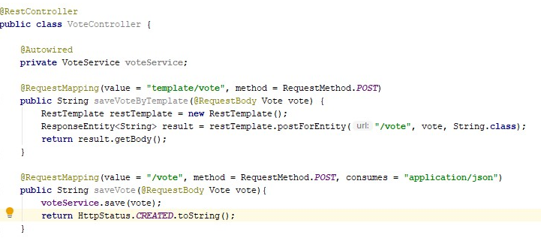
CONSUMING APIS: SPRING RESTTEMPLATE
What is a RestTemplate?
Spring class that can be used to consume another REST api’s/applications/interfaces. Using this RestTemplate results in formatted input/output, handles security issues and exceptions/errors.
You can fully customize this RestTemplate to do custom security and errorhandling.
RestTemplate is just the thing for executing synchronous HTTP requests in Spring
Notes:
https://spring.io/guides/gs/consuming-rest/
Postforentity vs postforobject
Q: waarom is code voorbeeld onzin?

Slide 20
HTTPCLIENT
Java 11 upgrade for the HttpURLConnection
Three core classes:
HttpRequest
HttpClient
HttpResponse
HttpRequest request = HttpRequest.newBuilder()
.uri(new URI("https://postman-echo.com/post"))
.headers("Content-Type", "text/plain;charset=UTF-8")
.POST(HttpRequest.BodyPublishers.ofString("Sample request body"))
.build();
Notes:
HttpRequest represents the request to be sent via the HttpClient.
HttpClient behaves as a container for configuration information common to multiple requests.
HttpResponse represents the result of an HttpRequest call.
https://www.baeldung.com/java-9-http-client

Slide 21
EXERCISE
Using a RestTemplate for rest endpoint consumption
Now consume one endpoint from this api: http://dummy.restapiexample.com/
Notes:
Rest Template is used to create applications that consume RESTful Web Services. You can use the exchange() method to consume the web services for all HTTP methods.
Let’s only do this when there’s time

Slide 22
SPRING DATA

Slide 23
TWO COMMON APPROACHES
SPRING DATA JPA
SPRING DATA JDBC
Read, create, update, and delete data in a relational database using Java objects (ORM)
Database agnostic
Unchecked exceptions
“Secretly”, JPA is based on JDBC under the hood
Communicating with the database using SQL
Database dependent
Checked exceptions (SQLException for example)
Notes:
https://www.baeldung.com/jpa-vs-jdbc

Slide 24
JPA
Java Persistence API
Remember the definition of Java EE? “Java EE is a very extensive guideline of best practices (protocols) to build and structure your application.”
Definition for JPA: “The Java Persistence API provides a specification for persisting, reading, and managing data from your Java object to relational tables in the database.”
It’s a specification on interaction between code and the database. Examples of implementations are Hibernate, Eclipse Link, Top Link etc…
Notes:
Let's first know the definition of JPA, Hibernate, and Spring Data JPA, so this will make it easy to discuss the difference between Hibernate and Spring Data JPA.

Slide 25
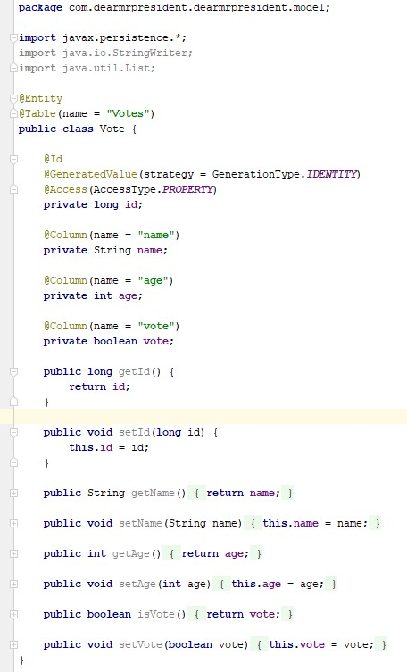
HIBERNATE
Making your life easier
Hibernate is a JPA provider/ implementation.
Use it to have your entities (models) mapped directly with your database and let the care of persistency, creation of queries etc be handled by your framework!
How to do it? Annotations! Of course!
Notes:
Good read: https://dzone.com/articles/what-is-the-difference-between-hibernate-and-sprin-1

Slide 26
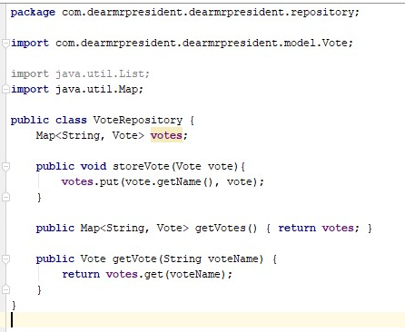
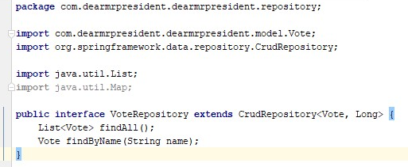
SPRING DATA JPA
Then came along Spring Data
Makes your repositories more awesome. Helps with implementing JPA repositories to easier access JPA data sources
Spring Data always needs a JPA provider like Hibernate or Eclipse Link
So: Spring Data and Hibernate are awesome together!
Notes:
@Repository TODO
On the right old stuff, on the left new stuff!

Slide 27
@REPOSITORY, @SERVICE, @CONTROLLER, @RESTCONTROLLER, @COMPONENT
@Component: registers class as Spring bean, which makes it possibe for them to be injected as a dependency
These annotations are doing the same as @Component during bean creation, but with some extra special treatment by the framework later based on the specific annotation:
@Service
@Controller
@Repository
@Component
@Controller
@Service
@Repository
Notes:
For example, DispatcherServlet will look for @RequestMapping on classes which are annotated using @Controller but not with @Component.
For example, @Repository's not only helping in annotation based configure but also catch Platform specific exceptions and re-throw them as one of Spring’s unified unchecked exception.
Though for that you also need to declare org.springframework.dao.annotation.PersistenceExceptionTranslationPostProcessor as Spring bean in your application context.
This bean post processor adds an advisor to any bean that’s annotated with @Repository so that any platform-specific exceptions are caught and then rethrown as one of Spring’s unchecked data access exceptions. You can also see Spring Framework 5: Beginner to Guru on Udemy for more details.

Slide 28
CRUDREPOSITORY VS JPAREPOSITORY
CRUDREPOSITORY
JPAREPOSITORY
Crud operations
Doesn’t depend on JPA
Extends CrudRepository and PagingAndSortingRepository
JPA specific functionality (e.g. flushing and deleting in batch)
Notes:
When to use which interface:
According to http://jtuts.com/2014/08/26/difference-between-crudrepository-and-jparepository-in-spring-data-jpa/
Generally the best idea is to use CrudRepository or PagingAndSortingRepository depending on whether you need sorting and paging or not.
The JpaRepository should be avoided if possible, because it ties you repositories to the JPA persistence technology, and in most cases you probably wouldn’t even use the extra methods provided by it.

Slide 29
SPRING DATA JPA - CACHEABLE
@Cacheable
What would be the advantages of using a cache in your data layer?
When would you use a cache?
Would you use it for data that changes often, or data that is more or less static, but often used?
Notes:
https://spring.io/guides/gs/caching/
The advantages of a cache are less database interaction and faster data retrieval. There is a tradeoff on application load vs database load.

Slide 30
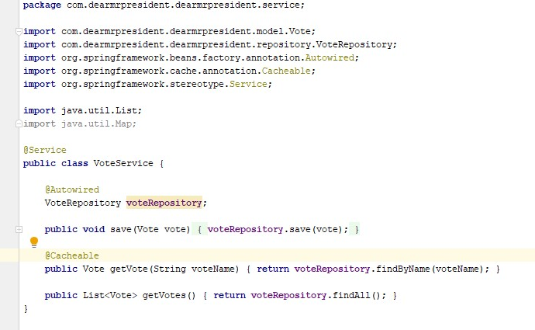
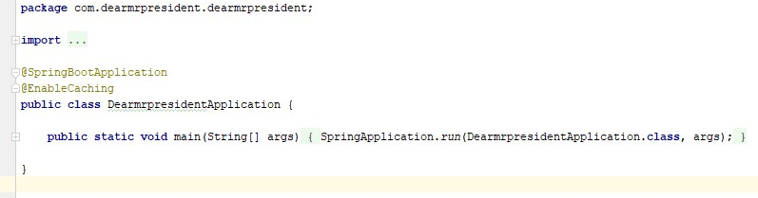
SPRING DATA JPA
Using @Cacheable in your code
Enable caching in your application class (@EnableCaching).
Mark the retrieval of data as @Cacheable(“name”).
Ease of use: your cache is taken care of for you.
@Cacheable vs manual cache: you have less control on refreshes/ storage of data if you do not know what happens in the background.

Slide 31
ADDING PROJECTS TO SPRING
Add the correct dependency to your POM.xml
And you’re good to go!
Using project? Usually annotations, sometimes a bit more work as we’ll see when we get to Security

Slide 32
ADDING THE H2 DATABASE
H2 is typically for testing purposes, in memory database
Flushed upon restart of the application
Use the following tutorial to add it in the next exercise: https://www.baeldung.com/spring-boot-h2-database

Slide 33
ASSIGNMENT 2
New insights, new application?
You can continue on what you started this morning... And change it to fullfill our next assignment!
Add a database to the application. >> Google H2
Add the repositories to use the database and make your operations.
Maybe you need to change something on your models?
Tip: You can also generate a new project from the Initializr with the new projects added and continue from there.

Slide 34
ASSIGNMENT 2B
Hibernate!
Expand your Vote object
Create a new Object Person, and give Vote a Person
Give person an object address. A person can have multiple addresses and persons can share addresses as well.

Slide 35
SPRING DATA REST
Notes:
https://spring.io/projects/spring-data-rest#samples

Slide 36
SPRING DATA REST
Quickstart for a REST project
Built on top of Spring Data project
Easy to configure and automatically builds APIs
Tutorial: https://www.baeldung.com/spring-data-rest-intro

Slide 37
INTRODUCTION TO TRANSACTION MANAGEMENT

Slide 38
TRANSACTIONS
What is a Transaction?
A Transaction is a set of statements that is considered as one. It is only possible for all the statements to take effect. If one of them fails, all the others are rolled back and non of it seems to have happened.
The transaction can be considered one single action.
Important when data integrity needs to be secured.
Transactions should adhere to ACID: Atomicity, Consistency, Isolation and Durability
Notes:
Compare to how db transaction work: if part fails, the entire transaction is rolled back
Atomicity − A transaction should be treated as a single action
Consistency − This represents the consistency of the referential integrity of the database, unique primary keys in tables, etc.
Isolation − There may be many transaction processing with the same data set at the same time. Each transaction should be isolated from others to prevent data corruption.
Durability − Once a transaction has completed, the results of this transaction have to be made permanent and cannot be erased from the database due to system failure.

Slide 39
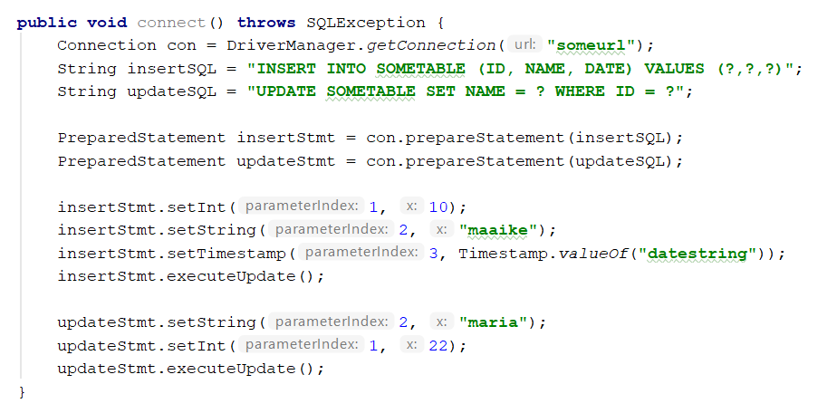
TRANSACTIONS
What does a Transaction look like?
Perform various deleted, update or insert operations using SQL queries.
If all the operation are successful then perform commit otherwise rollback all the operations.
What happens in this example?
What happens if you change “maria” with a super lengthy String that exceeds the reserved space for a String in the DB?
Notes:
This is an example without manual transaction management

Slide 40
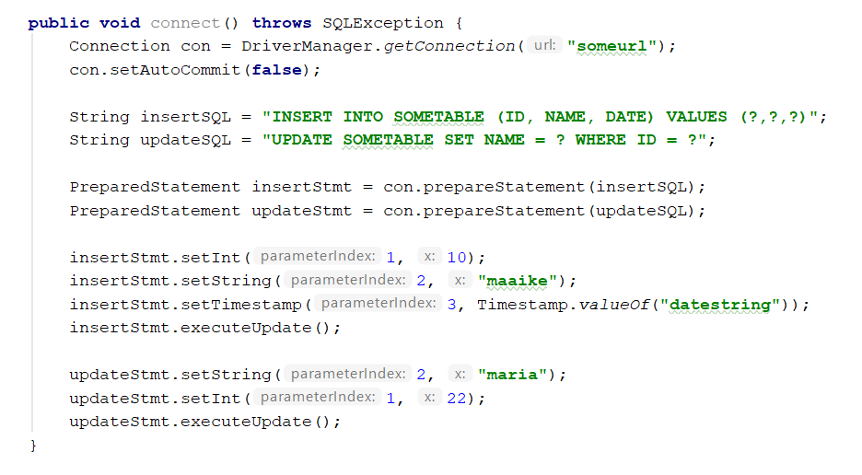
JDBC TRANSACTIONS
And with transaction handling
And what will be the end state of the DB in this example?
Notes:
Nothing, con.commit() is missing
https://www.mkyong.com/jdbc/jdbc-transaction-example/
Here’s an example on how you would implement this without any transaction manager provided by a framework implementation.

Slide 41
TRANSACTIONS
Local and Global Transactions
Local transactions: a transaction that takes place on one transactional resource like a JDBC connection or one message queue. Easy to implement transaction management, can be useful in a centralized system, where all components and resources reside in one place.
Global transactions: a transaction that uses multiple transactional resources (e.g. multiple relational databases, message queues etc).
Global transactions are harder for implementing transaction management than local transaction, but they are needed for a distributed system across multiple systems. Transaction management needs to be done across multiple systems so both local and global systems need to be managed.

Slide 42
SPRING TRANSACTIONS
Spring transaction abstraction
Spring Boot detects spring-jdbc and h2 on the classpath.
It will create a DataSource and a JdbcTemplate for you ready to use.
Also a DataSourceTransactionManager will be created for you: this is the component that intercepts the @Transactional annotated method.
Notes:
https://www.tutorialspoint.com/spring/spring_transaction_management.htm
Explanation on Spring managing transactions
https://www.mkyong.com/jdbc/jdbc-transaction-example/
This is how we would do it in the ‘no-framework-way’ by manually setting up the connection and executing transactions

Slide 43
@TRANSACTIONAL
It has some flavours!
@Transactional can be put on
An interface (all methods within become transactional);
a method of an interface;
a class definition (all public methods within become transactional);
a public method of a class. (You can safely put this on private methods, but it will simply be ignored)
@Transactional(readOnly = true)
This is not necessary, but does some optimizations under the hood for get calls (default is false).
@Transactional(norollbackFor/rollbackFor Y)
By default, a transaction will be rolling back on any RuntimeException and Errors but not on checked exceptions (business exceptions). This is how you can rollback on checked exceptions.

Slide 44
INTRODUCTION TO SPRING SECURITY

Slide 45
WHAT DID WE DO TODAY?
RESTful services with spring
Spring MVC
Requests and responses
Write your own services
Introduction transaction management

Slide 46
POP QUIZ!
What is the core functionality of RESTControllers?
What is the difference between JPA, Hibernate and Spring Data JPA?
What is the difference between @Component and @Service?
When would you use @Cacheable?

Slide 47
QUESTIONS?
Maaike.vanputten@brightboost.nl
Or Whatsapp: +31683982426
Don’t hesitate to contact me, I love to help!

