Slide 1
Modular programming

Slide 2
Overview
Modules
Creating and running modular programs
File module-info.java
Discovering modules
Named vs automatic vs unnamed modules
JDK dependencies
Migrating an application
Creating a service

Slide 3



MODULES
Big projects consists of many JAR files
Projects depend on other projects, so JAR files typically need other JARs to run
Version management of all these JARs can be tough
Modules are comparable to JAR files, but what’s accessible outside the module can be controlled by the developer
Java Platform Module System (JPMS) groups related packages
JPMS comes with command-line options for Java tools

Slide 4

Module
Contains module-info.java file
One or more Java packages
Java modules can depend on other modules

Slide 5
oH No!
Just imagine: Maven died. So did Gradle. And etc.

Slide 6
Benefits of modules I – ACCEsS control
Traditional options for access control:
Private
Default
Protected
Public
But what if we’d wanted something that’s accessible to some packages only? Without making it pulic?

Slide 7
Benefits of modules I – access control
Traditional options for access control:
Private
Default
Protected
Public
Protected and public accessible in other modules if the package that the public/protected members are in is exported

Slide 8
Benefits of modules II – dependency management
Libraries depend on other libraries
Not including the right library can result in runtime exceptions
Without Maven or Gradle, this is a hell to manage (with it’s still sometimes though)
Modules specify what dependencies they have and the program can check the module path and won’t run without it
No more double packages, a package is allowed to be supplied by one module only

Slide 9

Benefits of modules III - performance
During startup, only required modules need to be loaded during class loading
Improves starting times

Slide 10

Creating and compiling modular programs
Ingredients:
Files of your program
Plus module-info.java at the root of the project
Compiling modules:
javac --module-path location-dependencies-files-directory -d directory-for-class-files some-file.java
Instead of --module-path we can use -p

Slide 11

Running modules
java --module-path location-module-dependencies --module module.name/nl.brightboost.example.ClassName
--module can be replaced with –m
--module-path can be replaced with -p

Slide 12

Package modules
jar -cvf location-for-jar -C directory-to-be-packaged .
Run jar:
java -p mp-location -m module.name/nl.brightboost.example.ClassName

Slide 13
module-info.java
Basic module file that doesn’t allow any outside of package access:
module name.of.module {
}

Slide 14
module-info.java
Basic module file that allows outside of package access for exported package:
module name.of.module {
exports nl.brightboost.example;
}
Exporting means that all public classes, interfaces and enums are exported
The public and protected fields in these are visible

Slide 15
module-info.java
Basic module file that allows outside of package access for exported package to a specific module:
module name.of.module {
exports nl.brightboost.example to nl.brighboost.something;
}

Slide 16
module-info.java
Basic module file that allows outside of package access for exported package and requires another one:
module name.of.module {
exports nl.brightboost.example;
requires nl.brightboost.another;
}

Slide 17
Exercise
Go ahead and create the modules on page 459 - 472

Slide 18
module-info.java
Basic module file that allows outside of package access for exported package and requires another one:
module name.of.module {
exports nl.brightboost.example;
requires transitive nl.brightboost.another;
}
”requires transitive” means that anything that depends on this module also depends on the require transitive module
Same module cannot be required twice (so also not requires transitive and requires for the same module)

Slide 19
Exercise
Go ahead and improve the dependencies by using requires transitive

Slide 20
Other module-info.java keywords
Provides: specifies that a class provides an implementation of a service
provides nl.brightboost.example.SomeApi with nl.brightboost.example.SomeImplementation;
Uses: Specifies that a module relies on a service
uses nl.brightboost.example.SomeApi;
Opens: allows usage of reflection in the specified packages
opens nl.brightboost.example (to nl.brightboost.specific.package);

Slide 21
Discovering modules I
Describe module to know what a module requires and exports:
java -p location-of-module-jar --describe-module name.of.module
Get available modules:
java --list-modules
java -p location-of-mod --list-modules

Slide 22
Discovering modules II
Dependencies in the module with jdeps (jdeps does not have the -p to abbreviate --module-path)
jdeps (--summary) --module-path location-dependencies-mods location/name.jar

Slide 23

Named modules
So far, we have seen named modules
Names modules contain a module-info file
Named modules appear on the module path

Slide 24

Automatic modules
Appears on the module path but doesn’t have a module-info
Just a JAR file that’s placed on the module-path
Everything is being exported
Name is automatically generated:
If available in MANIFEST.MF >> that name
Uses jar name, -.jar and –version. Dashes are replaced with dots. Double and leading/trailing dots are removed.

Slide 25
Unnamed modules
On the classpath
If it contains a module-info file, it’s ignored (since it’s on the classpath)
No exports to named or automatic modules
It can use JARs on classpath and module path
It’s actually not really a module, just how Java was working before modules

Slide 26
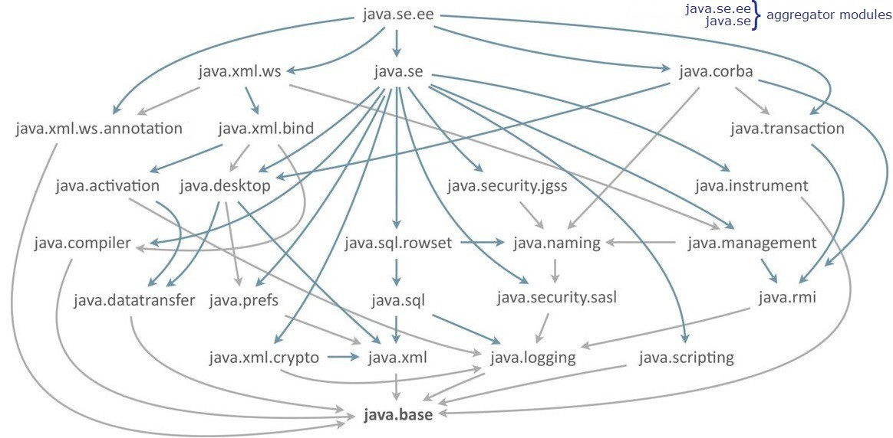
JDK dependencies
Requires java.base is implicit
https://medium.com/@dvsingh9/java-modules-a-complete-guide-part-1-dea3e6210177

Slide 27
Migrating an application I
Ordering modules to find the dependencies
Bottom-up migration:
Start with least dependencies
Add module-info and the necessary exports / requires
Move to module path, make sure others stay on the classpath until they’re migrated
Next with least dependencies until done

Slide 28

Migrating an application II
Top-down migration
Place all projects on the module path
Choose the one with most dependencies
Add module info, and exports and requires
Repeat with nextz most dependencies one, until done
Notes:
Especially useful when you don’t have control over the other projects / JAR files
Mix of names of named modules and automatic modules

Slide 29

services
Service:
Interface
Classes used by the interface
And a way of looking up implementations of the interface
(Implementations are not part of the service)

Slide 30
Consumer
Module that uses a service
Gets an implementation via the service locator

Slide 31
Service provider
Implementation of the service interface
Multiple available ones at runtime is possible
Module-info requires the interface, we don’t export the implementation directly, instead we provide it in module-info.java:
provides interfaceName with className;

Slide 32

Exercise
Follow along with the example in the book pages 823-830

