Slide 1
PROGRAMMING with Python
Day 4 – Maaike van Putten

Slide 2
Today’s schedule
Read different files
APIs 2.0
OOP
Flask
Jinja2
Write a web app
Pyinstaller

Slide 3
Csv reading
https://docs.python.org/3/library/csv.html on CSV support
Read CSV files with the CSV reader object
Example CSV format:
Name, city, job

Slide 4
CSV reading Example
import csv
with open("data.csv", 'r') as csvfile:
# Create a reader object
reader = csv.reader(csvfile)
# Let’s loop over de lines in the file
for row in reader:
# row is a list with the fields from a line
# print city
print(row[1])

Slide 5
CSV Writing – use CSV writer obj
import csv
data = [[“animals", “legs", “wings"],
[“dog", 4, 0],
[“bird", 2, 2]]
with open(‘animals.csv', 'w') as f:
writer = csv.writer(f)
for l in data:
# write a row
# please note: the argument for writerow must be a list
writer.writerow(data)

Slide 6
Exercise
Imagine we own a cable shop
Create a csv file with our products, prices, and number in stock
You can write to the csv file using a list of our products, list of prices and list of stocks
Try to import your csv in excel
Read the values of your csv and print them to the console per row
Notes:
import csv with open('shop.csv', 'a', newline='') as f: # Create a reader object reader = csv.writer(f) products = ['a', 'b', 'c', 'd'] prices = [1, 4, 9, 45] stocks = [10, 20, 30, 4] writer = csv.writer(f) for i in range(0, len(products)): row = [products[i], prices[i], stocks[i]] writer.writerow(row)

Slide 7
Xml
Xml: import xml.dom.minidom
In order to parse XML you’ll need to have the entire XML object in memory

Slide 8
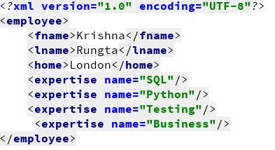
Parsing and writing xml
import xml.dom.minidom
def main():
# use the parse() function to load and parse an XML file
doc = xml.dom.minidom.parse("Myxml.xml");
# print out the document node and the name of the first child tag
print (doc.nodeName)
print (doc.firstChild.tagName)
# get a list of XML tags from the document and print each one
expertise = doc.getElementsByTagName("expertise")
print ("%d expertise:" % expertise.length)
for skill in expertise:
print (skill.getAttribute("name"))
# create a new XML tag and add it into the document
newexpertise = doc.createElement("expertise")
newexpertise.setAttribute("name", "BigData")
doc.firstChild.appendChild(newexpertise)
print (" ")
expertise = doc.getElementsByTagName("expertise")
print ("%d expertise:" % expertise.length)
for skill in expertise:
print (skill.getAttribute("name"))
if __name__ == "__main__":
main();
Source: https://www.guru99.com/manipulating-xml-with-python.html

Slide 9
json
import json # Opening JSON file f = open(‘example.json', ) # returns JSON object as # a dictionary data = json.load(f)
# Iterating through the json # list print(data[‘some'][‘keys']) # Closing file f.close()

Slide 10
How to figure out new stuff?
Gef files
How to find libraries for these purposes?
Go to https://pypi.org and search for gef

Slide 11
GETTING VALUES OUT OF GEF FILE
Pip install pygef
Check documentation: https://github.com/ritchie46/pygef

Slide 12
Exercise: Read gef
Read the GEF
Convert it to CSV
Plot the GEF

Slide 13
Python and excel
Multiple libraries
Look through the docs to find details
from openpyxl import Workbook workbook = Workbook() sheet = workbook.active sheet['A1'] = 'Using' sheet['B1'] = 'Excel!' workbook.save(filename='test.xlsx') workbook.close()

Slide 14
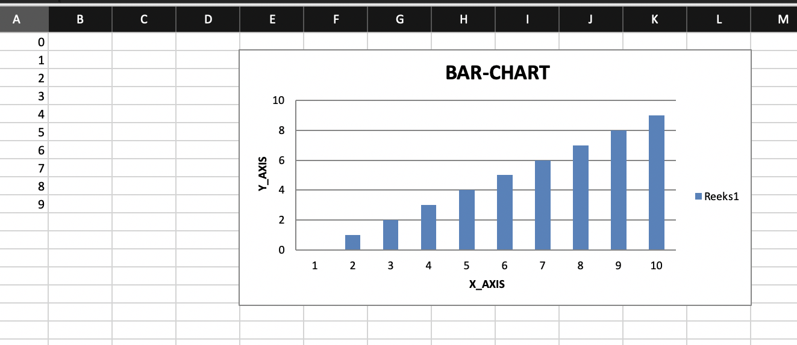
Create graph in excel
import openpyxl from openpyxl.chart import BarChart, Reference wb = openpyxl.Workbook() sheet = wb.active for i in range(10): sheet.append([i]) values = Reference(sheet, min_col=1, min_row=1, max_col=1, max_row=10) chart = BarChart() chart.add_data(values) chart.title = " BAR-CHART " chart.x_axis.title = " X_AXIS " chart.y_axis.title = " Y_AXIS " sheet.add_chart(chart, "E2") wb.save("examplegraph.xlsx")
https://www.geeksforgeeks.org/python-plotting-charts-in-excel-sheet-using-openpyxl-module-set-1/

Slide 15
Combine gef and excel
Write gef to excel
Bonus: can you save the plot to excel?

Slide 16
pandas
Data analysis and processing tool / library
Docs: https://pandas.pydata.org/docs/
Tables / tabular data are called DataFrame
Often combined with numpy in order to support large multi dimensional arrays and provides many mathematical functions to work with these multi dimensional arrays

Slide 17
Pandas demo
https://www.learnpython.org/en/Pandas_Basics

Slide 18
Console application!
We are starting a restaurant that delivers food
You can choose the restaurant and make it about your favorite foods
In the console application the user can communicate with the restaurant and sign up as a new user
Choose dishes and drinks
Enter delivery options
End order
Handle the user input with try / except
Read the dishes from a csv
Write new customers to a csv
Write new orders to a csv
Make sure to use functions to structure your code

Slide 19
Api headers
Meta data for the API request and response
Contain important information about authorization, caching, cookies, etc
requests.post(posturl, json=data, headers={"User-Agent": "XY"}, cookies={'blabla': 'true'}

Slide 20
GUI: tkinter
https://docs.python.org/3/library/tk.html
Demo

Slide 21
exercise
Create a little tkinter app that calls a corona API when it is given country input
This API can be used for example: https://lab.isaaclin.cn/nCoV/en
Bonus: make an executable of this little app

Slide 22
Final exercise
Create a GUI using tkinter
Add a field to upload a csv file or json file
If it’s not csv or json, print a message requesting csv or json
Use pandas to calculate the average of the column with numeric values
Print the result to the screen

Slide 23
Object oriented programming (OOP)
Not that new
Plato (Theory of forms)
OOP fundamentals in 1950/60, as of 80/90 OOP increased popularity

Slide 24
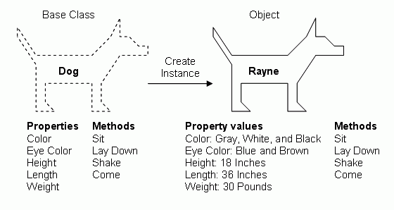
Object oriented thinking
Organising logic in classes
Classes can extend other classes
Classes have properties and functions
Classes can be instantiated

Slide 25
pillars OOP
Encapsulation
Inheritance
Polymorphism
Notes:
Encapsulation is:
Binding the data with the code that manipulates it.
It keeps the data and the code safe from external interference
Looking at the example of a power steering mechanism of a car. Power steering of a car is a complex system, which internally have lots of components tightly coupled together, they work synchronously to turn the car in the desired direction. It even controls the power delivered by the engine to the steering wheel. But to the external world there is only one interface is available and rest of the complexity is hidden. Moreover, the steering unit in itself is complete and independent. It does not affect the functioning of any other mechanism.
Similarly, same concept of encapsulation can be applied to code. Encapsulated code should have following characteristics:
Everyone knows how to access it.
Can be easily used regardless of implementation details.
There shouldn’t any side effects of the code, to the rest of the application.
***

Slide 26
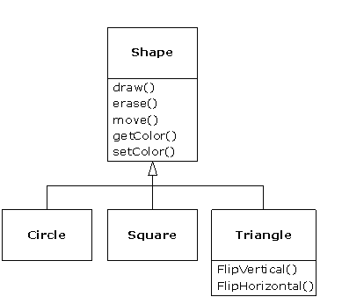
Object oriented thinking

Slide 27
Draw class diagram
It should contain pets
Make a logical division to include:
Fish
Cat
Dog
Horse
Cow
Squirl
Bird
Parrot
Rabbit
Snake
Frog
Turtle
Etc

Slide 28
Python classes
class Person:
def __init__(self, name, age):
self.name = name
self.age = age
def myfunc(self):
print("Hello my name is " + self.name)
p1 = Person("John", 36)
p1.myfunc()
class Subclass(Person):
pass
What about the self? The self can be named anything, theoretically. It refers to the current instance of the class. But it always has to be the first parameter of the methods in a class.
Notes:
Make a class Dog
Give dog a name, an age, and a specific type of dog
Give dog a method to roll over, sit, and say woof

Slide 29
Exercise
Make a class Dog
Give dog a name, an age, and a specific type of dog
Give dog a method to roll over, sit, and say woof

Slide 30
Inheritance
Class inherits from another class all properties / attributes
class Employee(Person):
def __init__(self, name, age, job):
super().__init__(self, name, age)
self.job = job
def myfunc2(self):
print("Hello my name is " + self.name + “and my job is “ + self.job)
e1 = Employee("John", 36, “Programmer”)
e1.myfunc()
Notes:
Make a class Animal
Let dog extend from animal
Create another class Cat, make it inherit from the appropriate class
Create another class Feline, make it inherit from the appropriate class
Anything else you’d like to change after adding Feline?

Slide 31
Exercise
Make a class Animal
Let dog extend from animal
Create another class Cat, make it inherit from the appropriate class
Create another class Feline, make it inherit from the appropriate class
Anything else you’d like to change after adding Feline?

Slide 32
Exercise – code the class diagram

Slide 33
Python iterators
class MyNumbers:
def __iter__(self):
self.a = 1
return self
def __next__(self):
x = self.a
self.a += 1
return x
myclass = MyNumbers()
myiter = iter(myclass)
print(next(myiter))
Iterator has countable number of values
In Python an iterator can be defined by simply adding two methods:
__iter__()
__next__()

Slide 34
Mini introduction to flask
Flask is a microwebframework
This means that using flask you can easily set up web pages
Let’s write a hello world in Flask!

Slide 35
Flask templates
Instead of returning a string, it’s nicer to return an html page. This is where templates come in!
from flask import Flask, render_template
app = Flask(__name__)
@app.route('/')
def hello_world():
return render_template("hello.html")

Slide 36
Template syntax
Between {{ and }} : output value of a variabele
Between { % and % } : code like if or for
<ul>
{% for user in users %}
<li>{{ user.username|e }}</li>
{% endfor %}
</ul>

Slide 37
exercise
Create hello world Flask

Slide 38
Final exercise: write a web app
Create a web app with a form connected to an API: e.g. weather API
Call this API based on the input function
Display the output of the call on the webapp

Slide 39
Pyinstaller

Slide 40
Summary
OOP
Flask
Jinja2
Write a web app

