Slide 1
The Complete Prompt Engineering for AI Bootcamp
What are AI Agents
and AI Workflows?
Building AI Agents - Coding
1

Slide 2
Understanding the Landscape
The Complete Prompt Engineering for AI Bootcamp
2

Slide 3
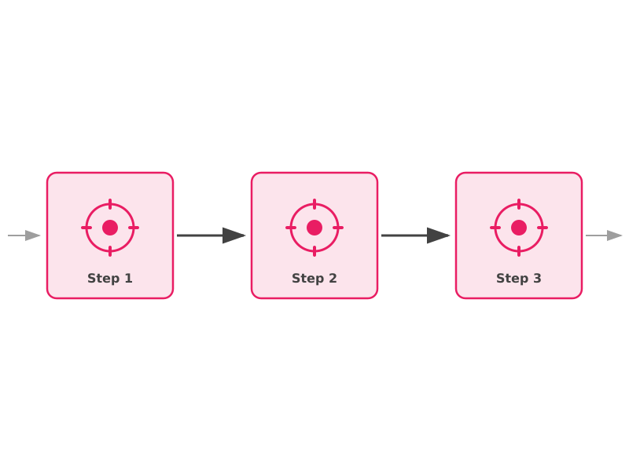
What is an AI Workflow?
A predefined sequence of steps where LLMs and tools are orchestrated by developer-defined code.
The developer controls the flow
Each step's input/output is pre-planned
Deterministic execution path
LLMs are components within the pipeline
Think: assembly line in a factory
The Complete Prompt Engineering for AI Bootcamp
3

Slide 4
Common Workflow Patterns
Sequential Chain
Parallel Pipeline
A → B → C
Each step feeds the next
A → [B1, B2, B3] → C
Run steps concurrently
Router Pattern
DAG (Directed Acyclic Graph)
A → switch(condition)
→ B1 or B2 or B3
Complex dependencies
with conditional branches
The Complete Prompt Engineering for AI Bootcamp
4

Slide 5
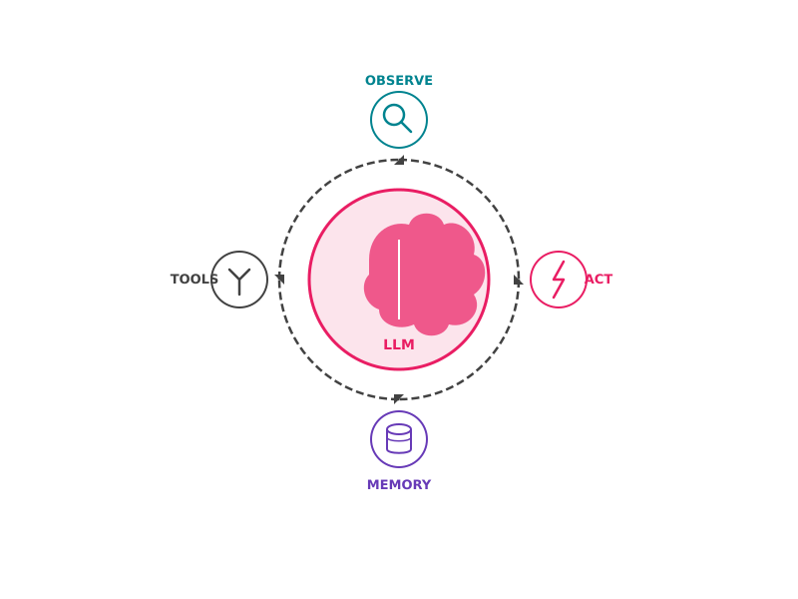
What is an AI Agent?
An autonomous system where the LLM dynamically directs its own processes and tool usage.
The LLM decides what to do next
Can use tools, search, and APIs on its own
Maintains memory across iterations
Loops until the goal is achieved
Think: a skilled employee who figures out the steps themselves
The Complete Prompt Engineering for AI Bootcamp
5

Slide 6
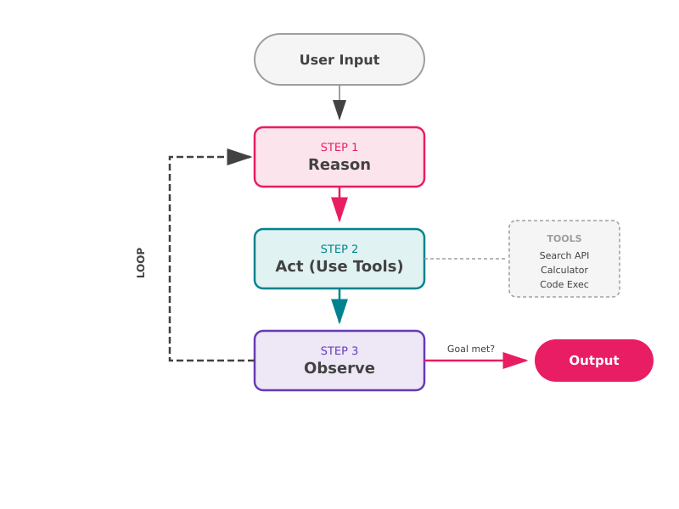
The Agent Loop (ReAct Pattern)
The Complete Prompt Engineering for AI Bootcamp
6

Slide 7
Agents vs Workflows
 | AI Workflow | AI Agent
Control Flow | Developer-defined | LLM-directed
Execution | Deterministic | Dynamic & adaptive
Tool Usage | Pre-planned | Autonomous selection
Error Handling | Explicit fallback logic | Self-correcting
Complexity | Lower, predictable | Higher, variable
Best For | Repeatable pipelines | Open-ended tasks
The Complete Prompt Engineering for AI Bootcamp
7

Slide 8
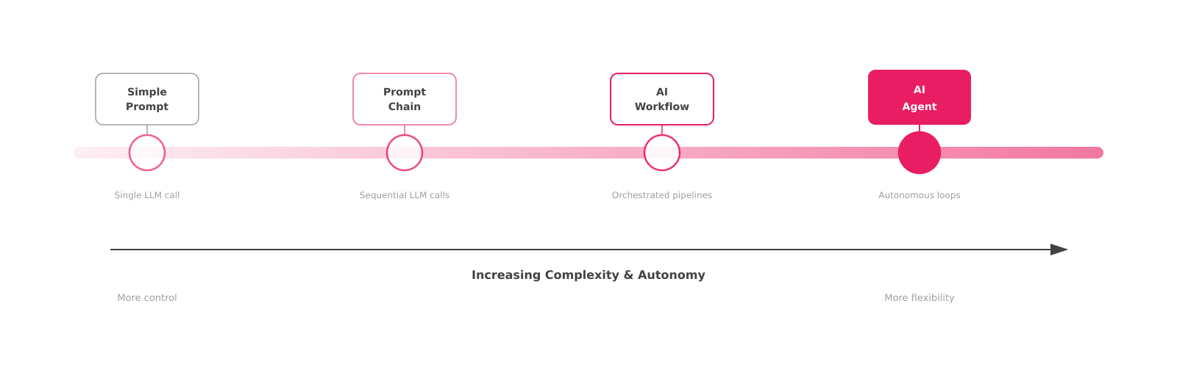
The Complexity Spectrum
Start simple. Only increase complexity when the problem demands it.
The Complete Prompt Engineering for AI Bootcamp
8

Slide 9
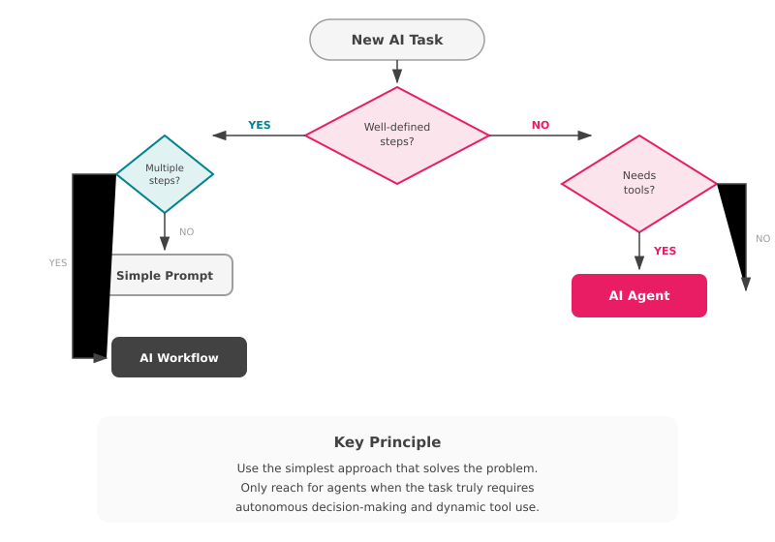
When Should You Use an Agent?
Use an Agent when:
The task requires multi-step reasoning
Steps can't be predetermined
Dynamic tool selection is needed
Self-correction is valuable
Use a Workflow when:
Steps are known in advance
Reproducibility is critical
You need cost/latency control
Reliability > flexibility
The Complete Prompt Engineering for AI Bootcamp
9

Slide 10
Key Takeaways
01
Workflows are orchestrated pipelines
Developer-defined control flow with LLMs as components. Deterministic and repeatable.
02
Agents are autonomous reasoning loops
The LLM decides what to do, which tools to use, and when to stop. Dynamic and adaptive.
03
Start with the simplest approach
Don't build an agent when a workflow will do. Complexity has real costs in reliability and latency.
04
The best systems often combine both
Use workflows for structured subtasks within an agent, or agents as steps in a larger workflow.
The Complete Prompt Engineering for AI Bootcamp
10

Slide 11
Let's Build!
Time to code our first AI agents
The Complete Prompt Engineering for AI Bootcamp
11

