Slide 1
The Complete Prompt Engineering for AI Bootcamp
Nano Banana
Gemini's Native Image Generation:
Capabilities & Limitations
1

Slide 2
What is Nano Banana?
Nano Banana is the name for Gemini's native image generation capabilities.
Gemini can generate and process images conversationally with text, images, or a combination of both
Create, edit, and iterate on visuals with unprecedented control
All generated images include a SynthID watermark
Two distinct models available:
Nano Banana — Gemini 2.5 Flash Image (speed)
Nano Banana Pro — Gemini 3 Pro Image Preview (quality)
The Complete Prompt Engineering for AI Bootcamp
2

Slide 3
Nano Banana vs Nano Banana Pro
Nano Banana
Nano Banana Pro
gemini-2.5-flash-image
gemini-3-pro-image-preview
Speed & efficiency optimised
Professional asset production
High-volume, low-latency
Advanced reasoning (Thinking)
1024px max resolution
Up to 4K resolution
Up to 3 input images
Up to 14 reference images
10 aspect ratios
Google Search grounding
The Complete Prompt Engineering for AI Bootcamp
3

Slide 4
Key Capabilities
Text to Image
Multi-turn Chat
Generate images from descriptive text prompts using natural language
Refine outputs iteratively through conversational back-and-forth
Image Editing
Up to 4K Output
Add, remove, or modify elements in existing images conversationally
Pro model supports 1K, 2K, and 4K resolution output
Style Transfer
Search Grounding
Apply artistic styles and transform visual aesthetics across images
Pro: generate images informed by real-time web data
The Complete Prompt Engineering for AI Bootcamp
4

Slide 5
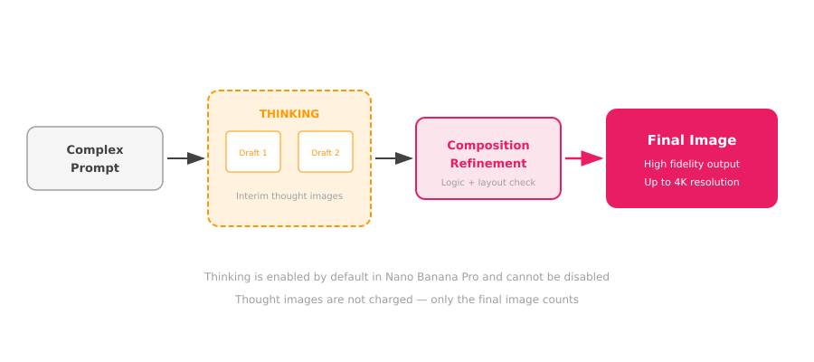
Pro Feature: Thinking Process
The Complete Prompt Engineering for AI Bootcamp
5

Slide 6
Prompting Best Practices
1
Describe, don't list keywords
4
Iterate conversationally
Narrative paragraphs beat keyword lists. The model thrives on natural language.
Use multi-turn chat: "Keep everything but make the lighting warmer"
2
Be hyper-specific
5
Use photographic language
"Ornate elven plate armor with falcon-wing pauldrons" > "fantasy armor"
Camera angles, lens types, lighting setups guide photorealistic output
3
Provide context and intent
6
Use semantic negatives
Explain the purpose: "A logo for a high-end minimalist skincare brand"
Instead of "no cars" say "an empty, deserted street with no traffic"
The Complete Prompt Engineering for AI Bootcamp
6

Slide 7
Limitations
1
Language support
Best in English + 14 supported languages (ar, de, es, fr, hi, id, it, ja, ko, pt, ru, ua, vi, zh)
2
No audio or video input
Image generation only accepts text and image inputs — no audio or video
3
Output count not guaranteed
The model may not match the exact number of images you request
4
Input image limits
Flash: up to 3 images | Pro: 5 high-fidelity + up to 14 total
5
SynthID watermark
All generated images include an invisible SynthID watermark for provenance
The Complete Prompt Engineering for AI Bootcamp
7

Slide 8
Choosing the Right Model
 | Nano Banana | Nano Banana Pro | Imagen 4
Model | gemini-2.5-flash-image | gemini-3-pro-image-preview | imagen-4.0-generate-01
Best For | Speed, high-volume tasks | Pro assets, complex prompts | Specialised image gen
Max Resolution | 1024px | 4K (4096px) | Varies
Thinking | No | Yes (default on) | No
Search Grounding | No | Yes | No
Text Rendering | Good | Excellent | Good
Start with Nano Banana for speed. Upgrade to Pro when you need 4K, Thinking, or Search Grounding.
The Complete Prompt Engineering for AI Bootcamp
8

