Slide 1
The Complete Prompt Engineering for AI Bootcamp
Structured Outputs
From Free Text to Validated Data
1

Slide 2
Why Structured Outputs?
LLMs generate free-form text — but applications need predictable, structured data.
Without structure, you're left parsing messy strings, hoping the model follows your format
One wrong field or missing bracket can break an entire pipeline
Regex and string matching are fragile and hard to maintain
Structured Outputs solve this by:
Constraining the LLM to produce valid JSON that matches a defined schema
Guaranteeing type safety — no more guesswork
The Complete Prompt Engineering for AI Bootcamp
2

Slide 3
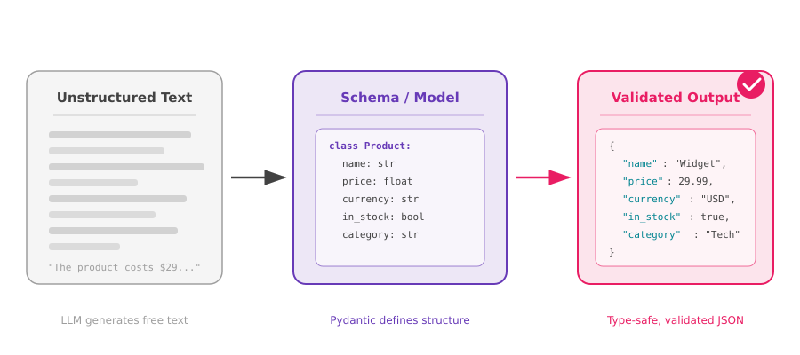
The Transformation
The Complete Prompt Engineering for AI Bootcamp
3

Slide 4
JSON & Pydantic
JSON
Pydantic
JavaScript Object Notation
Python Data Validation Library
Lightweight data interchange format
Define data models as Python classes
Key-value pairs, arrays, nesting
Automatic type validation & coercion
Universal — every language can parse it
Generates JSON schemas from models
Human-readable and machine-readable
Rich error messages on invalid data
The standard for API communication
OpenAI uses Pydantic under the hood
The Complete Prompt Engineering for AI Bootcamp
4

Slide 5
Use Cases
Data Extraction
Classification
Pull structured fields from emails, documents, or web pages — names, dates, amounts, entities
Categorise text with confidence scores, labels, and reasoning — sentiment, intent, topics
API Responses
Content Generation
Ensure LLM output matches your API contract — typed fields, enums, required properties
Generate blog posts, product descriptions, or reports with consistent structure and metadata
Form Filling
Function Calling
Map natural language input to form fields — addresses, applications, surveys, intake forms
LLM decides which function to call and provides correctly-typed arguments to execute it
The Complete Prompt Engineering for AI Bootcamp
5

Slide 6
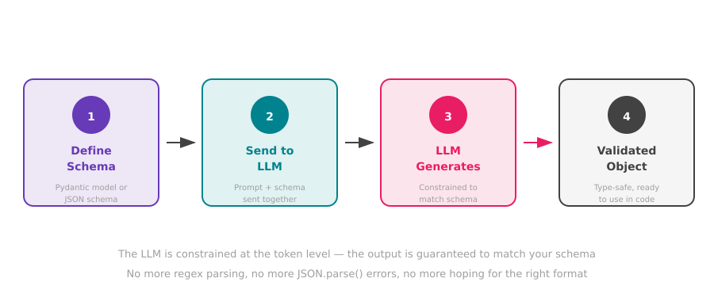
How It Works
The Complete Prompt Engineering for AI Bootcamp
6

Slide 7
What's Next
Now that you understand why structured outputs matter, let's build with them.
Coming up — OpenAI Structured Outputs in Code:
Define Pydantic models for your data schemas
Use response_format to constrain OpenAI completions
Handle nested objects, enums, and optional fields
Build real extraction and classification pipelines
Key takeaway: Structured outputs turn LLMs from text generators into reliable data engines.
The Complete Prompt Engineering for AI Bootcamp
7

