Slide 1
The Complete Prompt Engineering for AI Bootcamp
Model Context Protocol
A Universal Standard for Connecting
AI Applications to External Tools & Data
1

Slide 2
The Problem MCP Solves
Every AI application reinvents how it connects to external tools and data sources.
N apps × M tools = N×M custom integrations
Each provider builds its own plugin system (OpenAI plugins, Gemini extensions, etc.)
Developers rewrite the same connector logic for every AI platform
MCP fixes this with one universal protocol:
Build an MCP server once → it works with Claude, VS Code, Cursor, and any MCP host
Like USB-C for AI — one standard connector for all devices
The Complete Prompt Engineering for AI Bootcamp
2

Slide 3
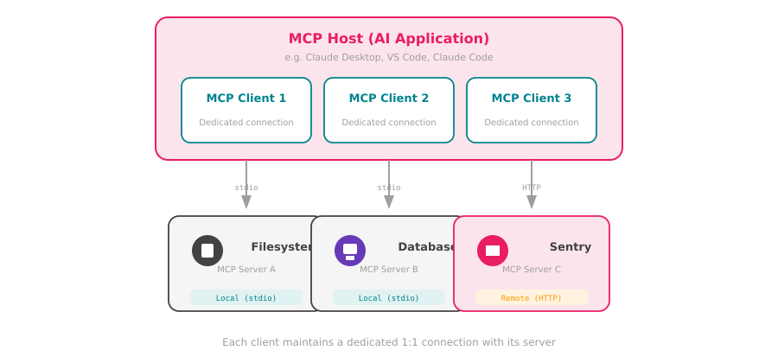
MCP Architecture
The Complete Prompt Engineering for AI Bootcamp
3

Slide 4
The Three Server Primitives
Tools
Resources
Prompts
Executable functions the AI can call to perform actions
Data sources providing contextual information to the AI
Reusable templates that structure LLM interactions
Examples:
Examples:
Examples:
File operations, API calls,
database queries, calculations
File contents, DB records,
API responses, config data
System prompts, few-shot
examples, task templates
tools/list → tools/call
resources/list → resources/read
prompts/list → prompts/get
The Complete Prompt Engineering for AI Bootcamp
4

Slide 5
Two Layers
Data Layer (Inner)
Transport Layer (Outer)
JSON-RPC 2.0 Protocol
How messages travel between client & server
Lifecycle management (init, negotiate, close)
Stdio — local process communication
Capability discovery between client & server
Streamable HTTP — remote servers + SSE
Tool, resource, and prompt operations
Connection establishment & framing
Sampling — server asks LLM for completions
Auth: OAuth, bearer tokens, API keys
Notifications for real-time updates
Same JSON-RPC format across all transports
The Complete Prompt Engineering for AI Bootcamp
5

Slide 6
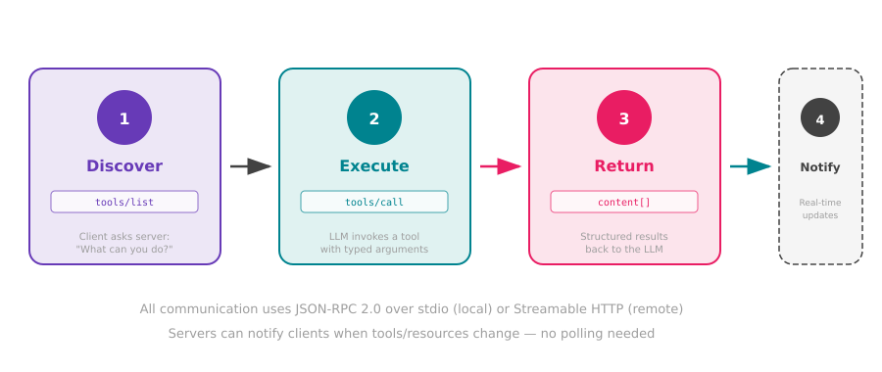
Tools in Action
The Complete Prompt Engineering for AI Bootcamp
6

Slide 7
Where MCP is Used Today
Claude Desktop
Custom Applications
Anthropic's desktop app connects to local & remote MCP servers for file access, databases, and more
Any app can become an MCP host using the open-source SDKs (Python, TypeScript, Java, C#, and more)
Claude Code
Growing Ecosystem
Anthropic's CLI coding tool uses MCP to integrate with development tools, git, and project context
Thousands of community MCP servers: Slack, GitHub, Sentry, databases, file systems, APIs, and more
VS Code / Cursor
Open Standard
IDE integrations that use MCP servers for code context, linting, testing, and external service access
Created by Anthropic, open-sourced for the entire AI community — not locked to any one provider
The Complete Prompt Engineering for AI Bootcamp
7

Slide 8
What's Next
Now you understand the protocol — let's build with it.
Coming up — Building MCP Servers & Clients:
Build an MCP server that exposes tools, resources, and prompts
Connect to MCP servers from Python and TypeScript clients
Use stdio transport for local servers and HTTP for remote
Integrate MCP into your own AI applications
Key takeaway: MCP is the universal standard that makes AI tools interoperable — build once, connect everywhere.
The Complete Prompt Engineering for AI Bootcamp
8

