Slide 1
Give Direction
Describe the desired style in detail, or reference a relevant persona.

Slide 2
Prompting ChatGPT
This is a simple prompt for ChatGPT we can use to generate a list of product names when we have a new business idea.
ChatGPT
Demonstration
You
Can I have 10 product names for a pair of shoes that can fit any foot size?
AI
1. FlexiFit
6. OneSizeStride
2. UniversalSole
7. OmniFit
3. SizeMaster
8. VersaSole
4. PerfectFit
9. InfiniteStep
5. AdaptiStep
10. AllFitFootwear
Send a message…
↑
Notes:
Can I have a 10 product names for a pair of shoes that can fit any foot size?

Slide 3
Prompt Engineering
AI Assistant
Example
You
Brainstorm a list of product names for a shoe that fits any foot size, in the style of Steve Jobs. Format as a markdown table.
## Examples
Product description: A refrigerator that dispenses beer
Product names: iBarFridge, iFridgeBeer, iDrinkBeerFridge
Product description: A watch that can tell accurate time in space
Product names: iNaut, iSpace, iTime
Product description: A home milkshake maker
Product names: iShake, iSmoothie, iShake Mini
Rate the product names based on their catchiness, uniqueness, and simplicity on a scale from 1-5, with 5 being the highest score.
Follow these steps:
1. Generate a diverse set of candidate product names based on the examples.
2. Rate the candidates according to the evaluation criteria.
3. Rank the three highest candidates at the top.
This is a prompt template we discovered that reliably yields useful or desired results when generating a list of ideas for product names.
AI
Product name | Catchiness | Uniqueness | Simplicity
iFitShoe | 4 | 3 | 4
iAdapt | 3 | 4 | 3
iUniversalStep | 2 | 5 | 2
Notes:
Brainstorm a list of product names for a shoe that fits any foot size, in the style of Steve Jobs. Format as a markdown table.
Return the results as a comma separated list, in this format:
Product description: A shoe that fits any foot size
Product names: [list of 3 product names]
## Examples
Product description: A refrigerator that dispenses beer
Product names: iBarFridge, iFridgeBeer, iDrinkBeerFridge
Product description: A watch that can tell accurate time in space
Product names: iNaut, iSpace, iTime
Product description: A home milkshake maker
Product names: iShake, iSmoothie, iShake Mini
Rate the product names based on their catchiness, uniqueness, and simplicity on a scale from 1-5, with 5 being the highest score.
Follow these steps:
1. Generate a diverse set of candidate product names based on the examples.
2. Rate the candidates according to the evaluation criteria.
3. Rank the three highest candidates at the top.

Slide 4
Give Direction
You
Brainstorm a list of product names for a shoe that fits any foot size,
in the style of Steve Jobs.
AI Assistant
Product description: A shoe that fits any foot size
Product names:
iFitShoe, iAdapt, iUniversalStep
Describe the desired style in detail, or reference a relevant persona.
Identify what others are doing to decide what to copy and where to innovate.
Notes:
Generic teaching interface. Edit the named prompt, response, and highlight objects directly in PowerPoint. Examples preserve the supplied course outputs and do not guarantee a particular model response. For evergreen narration, refer to an AI assistant or image generator and describe the prompting principle rather than product controls.

Slide 5
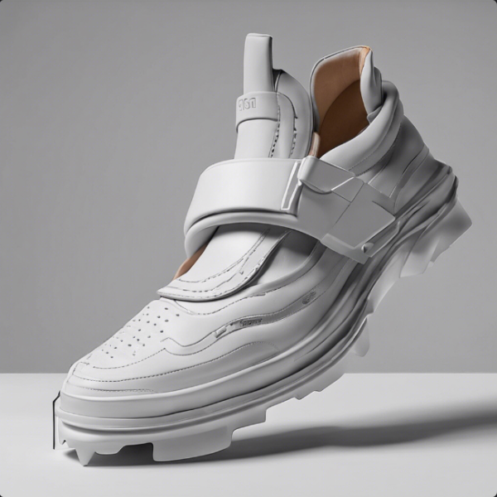
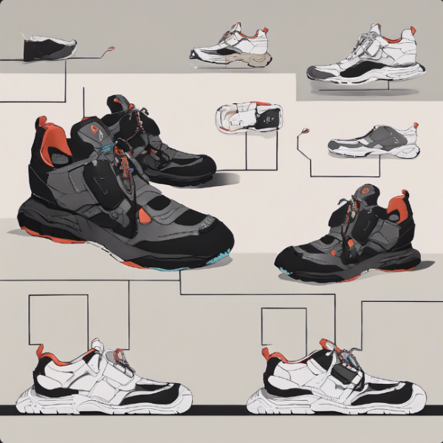
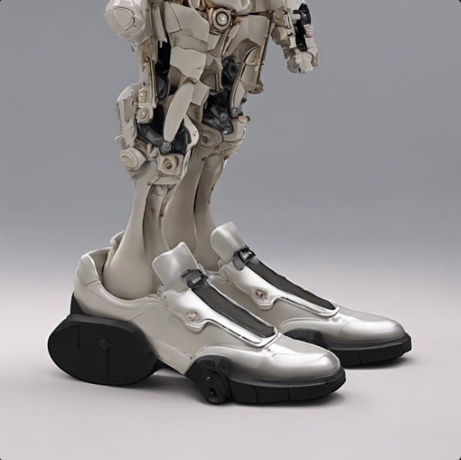
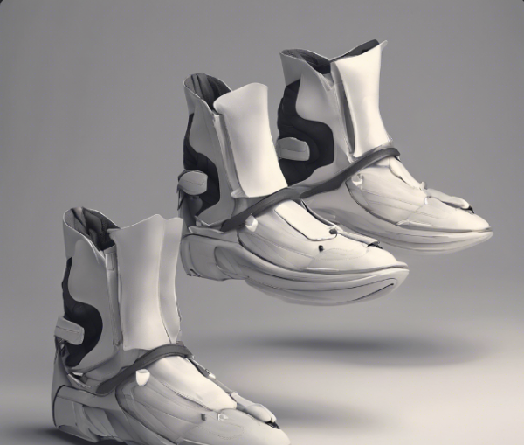
Prompting an Image Generator
Image Generator
Example
This is a simple prompt we can use with an image generator when generating an image of a product idea.
Prompt
A shoe that can fit any foot size
Notes:
a shoe that can fit any footsize
Generic teaching interface. Edit the named prompt, response, and highlight objects directly in PowerPoint. Examples preserve the supplied course outputs and do not guarantee a particular model response. For evergreen narration, refer to an AI assistant or image generator and describe the prompting principle rather than product controls.

Slide 6
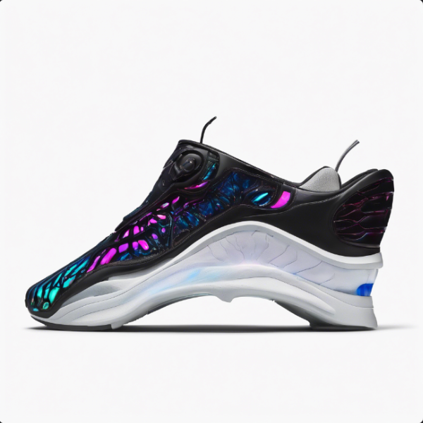
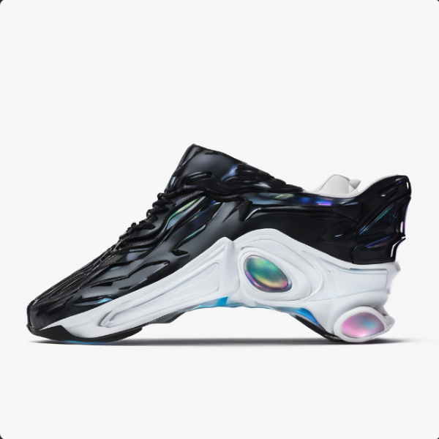
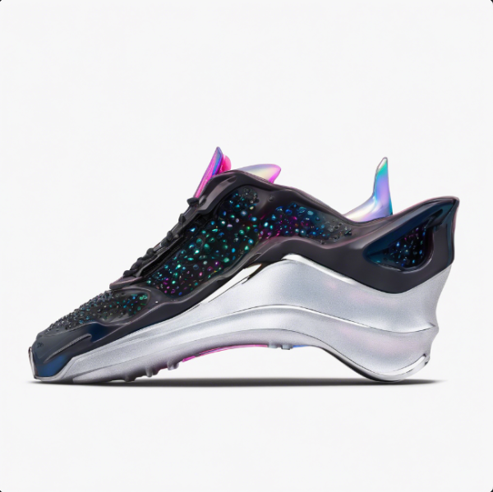
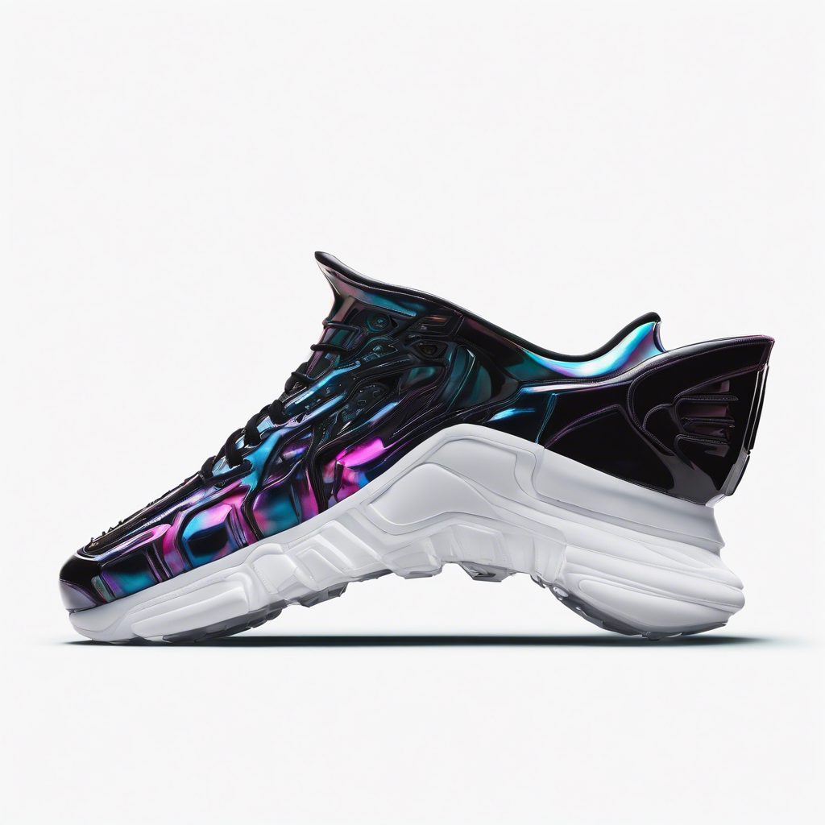
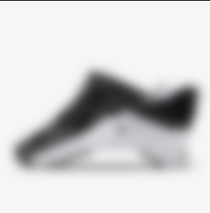
Prompt Engineering
Image Generator
Example
This is a prompt template we discovered that reliably yields useful or desired results when generating an image of a product idea.
Prompt
neon pink and blue sneakers, intricate demonic, scary, beautiful, platemail armor, sleek iridescent details, designed by ridley scott alien. product photography, extremely detailed, studio lighting, 3 5 mm, dslr
Negative prompt
soft, misshapen, corners, straps, laces
Reference image
Notes:
Prompt:neon pink and blue sneakers, intricate demonic, scary, beautiful, platemail armor, sleek iridescent details, designed by ridley scott alien. product photography, extremely detailed, studio lighting, 3 5 mm, dslr
Negative: soft, misshapen, corners, straps, laces
Image: https://www.nike.com/gb/t/go-flyease-easy-on-off-shoes-nfbRvV/DR5540-002
Generic teaching interface. Edit the named prompt, response, and highlight objects directly in PowerPoint. Examples preserve the supplied course outputs and do not guarantee a particular model response. For evergreen narration, refer to an AI assistant or image generator and describe the prompting principle rather than product controls.

Slide 7
Give Direction
Prompt
neon pink and blue sneakers, intricate demonic,
scary, beautiful, platemail armor, sleek iridescent
details, designed by ridley scott alien.
product photography, extremely detailed,
studio lighting, 3 5 mm, dslr
Describe the desired style in detail, or reference a relevant persona.
Identify what others are doing to decide what to copy and where to innovate.
Notes:
Generic teaching interface. Edit the named prompt, response, and highlight objects directly in PowerPoint. Examples preserve the supplied course outputs and do not guarantee a particular model response. For evergreen narration, refer to an AI assistant or image generator and describe the prompting principle rather than product controls.

Slide 8
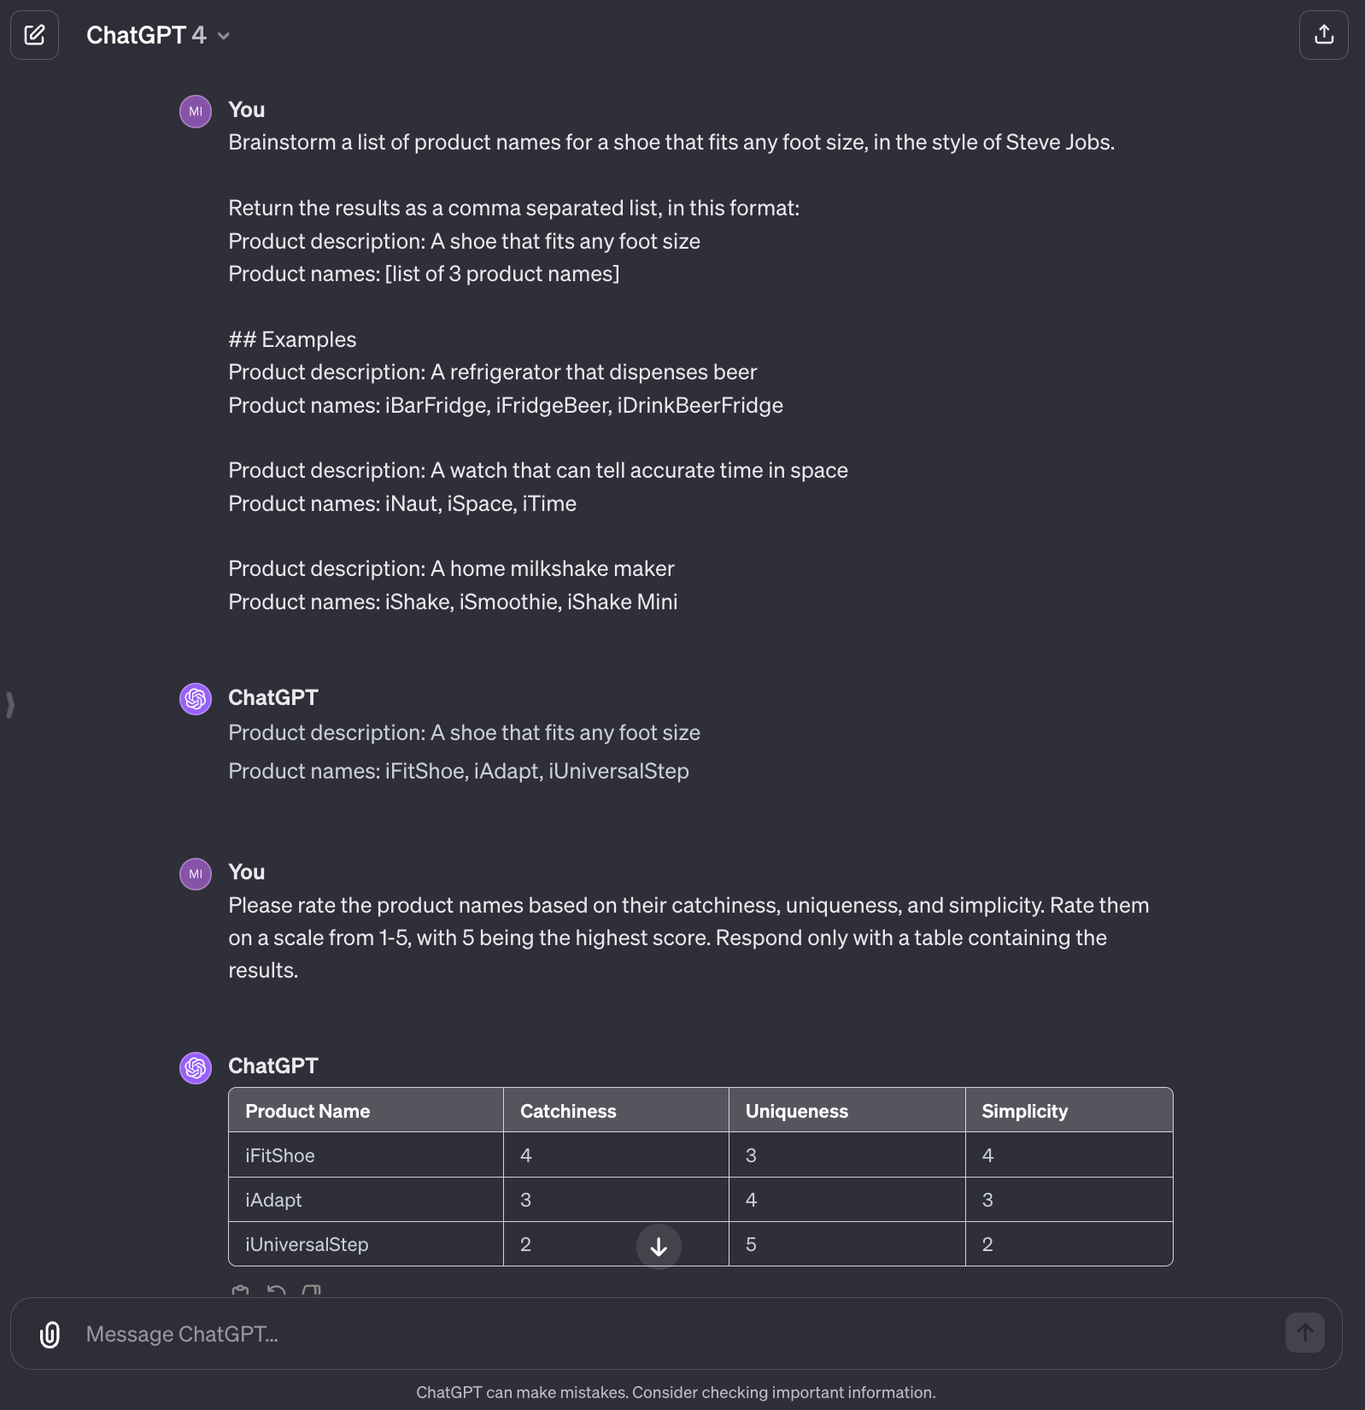
Prompt Engineering
This is a prompt template we discovered that reliably yields useful or desired results when generating a list of ideas for product names.
Notes:
Brainstorm a list of product names for a shoe that fits any foot size, in the style of Steve Jobs.
Return the results as a comma separated list, in this format:
Product description: A shoe that fits any foot size
Product names: [list of 3 product names]
## Examples
Product description: A refrigerator that dispenses beer
Product names: iBarFridge, iFridgeBeer, iDrinkBeerFridge
Product description: A watch that can tell accurate time in space
Product names: iNaut, iSpace, iTime
Product description: A home milkshake maker
Product names: iShake, iSmoothie, iShake Mini
Please rate the product names based on their catchiness, uniqueness, and simplicity. Rate them on a scale from 1-5, with 5 being the highest score.
Follow these steps:
Generate a diverse set of candidate product names based on the examples.
Rate the candidates in a table and rank them from highest to lowest.
Select the three highest-rated names.

Slide 9
Prompt Template
Brainstorm a list of product names for a {product_description}, in the style of {famous_inventor}.
Return the results as a comma separated list, in this format:
Product description: A shoe that fits any foot size
Product names: [list of 3 product names]
## Examples
{product_examples}
Please rate the product names based on their catchiness, uniqueness, and simplicity. Rate them on a scale from 1-5, with 5 being the highest score.
Follow these steps:
1. Generate a diverse set of candidate product names based on the examples.
2. Rate the candidates in a table and rank them from highest to lowest.
3. Select the three highest-rated names.

Slide 10
Give Direction
Describe the desired style in detail, or reference a relevant persona.
Identify what others are doing to decide what to copy and where to innovate.

Slide 11
Impact on Results
Variable | Results
Elon Musk | ShoeX, MarsFit, The Shoe Company
Walt Disney | Enchanted Slippers, Magic Step, Whimsoles
Marc Jacobs | Morph by Marc, The Marc Jacobs Flexible Shoe, FlexForm Oxfords

Slide 12
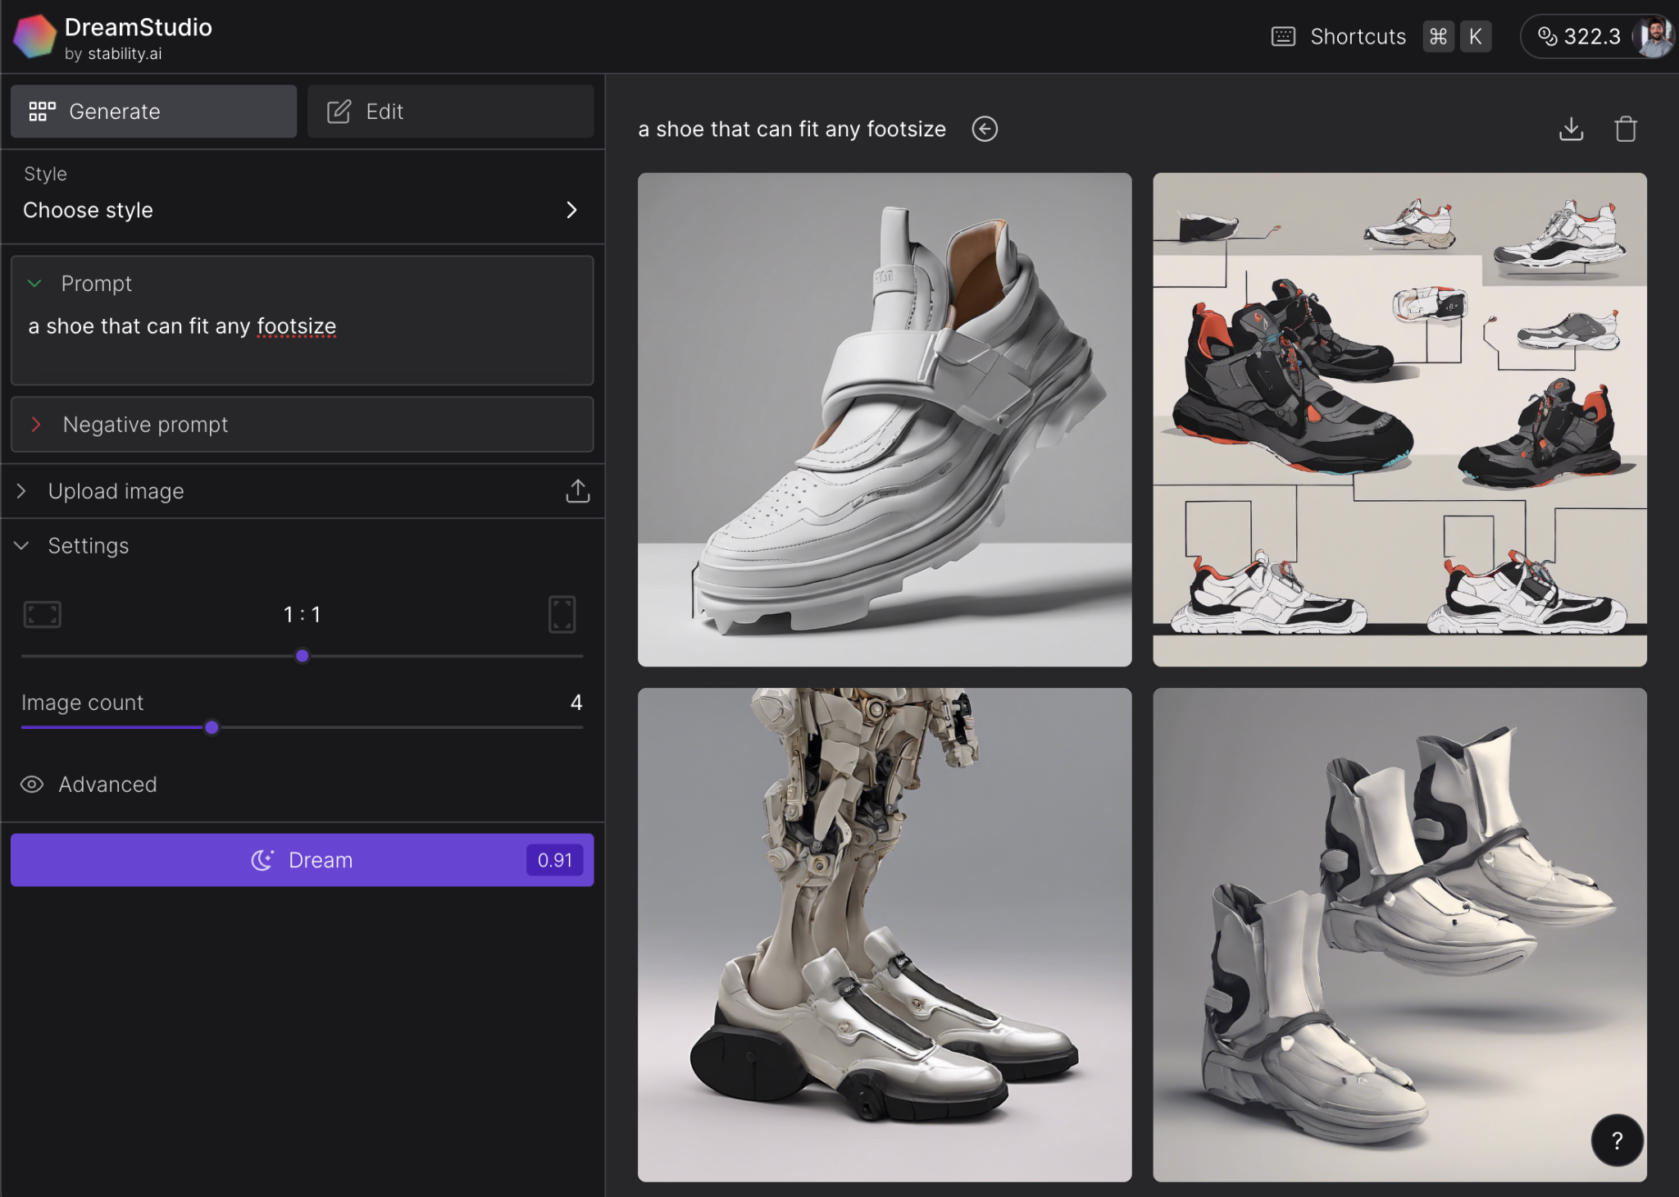
Prompting Stable Diffusion
This is a simple prompt we can use with Stable Diffusion when generating an image of a product idea.
Notes:
a shoe that can fit any footsize

Slide 13
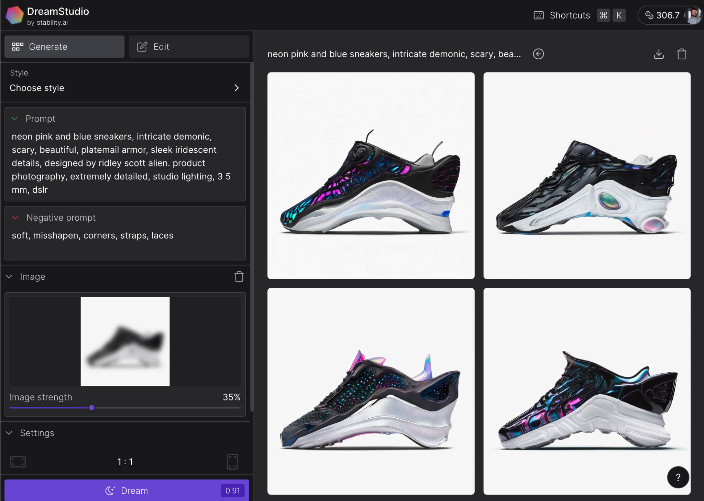
Prompt Engineering
This is a prompt template we discovered that reliably yields useful or desired results when generating an image of a product idea.
Notes:
Prompt:neon pink and blue sneakers, intricate demonic, scary, beautiful, platemail armor, sleek iridescent details, designed by ridley scott alien. product photography, extremely detailed, studio lighting, 3 5 mm, dslr
Negative: soft, misshapen, corners, straps, laces
Image: https://www.nike.com/gb/t/go-flyease-easy-on-off-shoes-nfbRvV/DR5540-002

Slide 14
Prompt Template
{product_type}, {style_details}, designed by {artist}. product photography, extremely detailed, studio lighting, 3 5 mm, dslr

Slide 15
Give Direction
Describe the desired style in detail, or reference a relevant persona.
Identify what others are doing to decide what to copy and where to innovate.

Slide 16
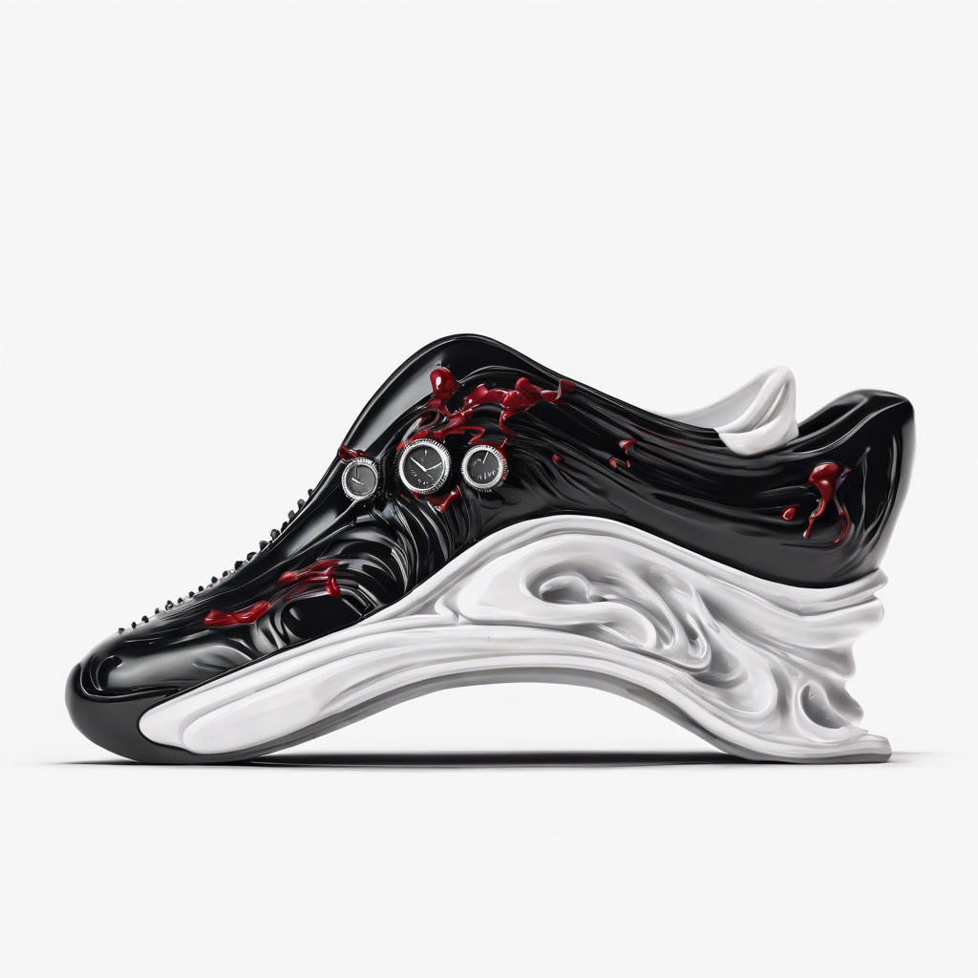
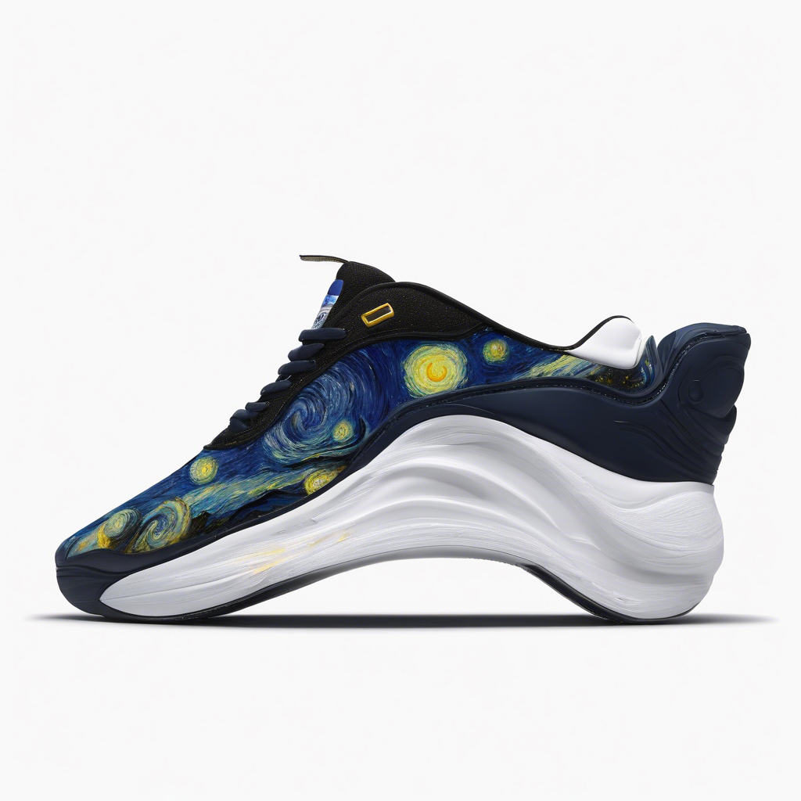
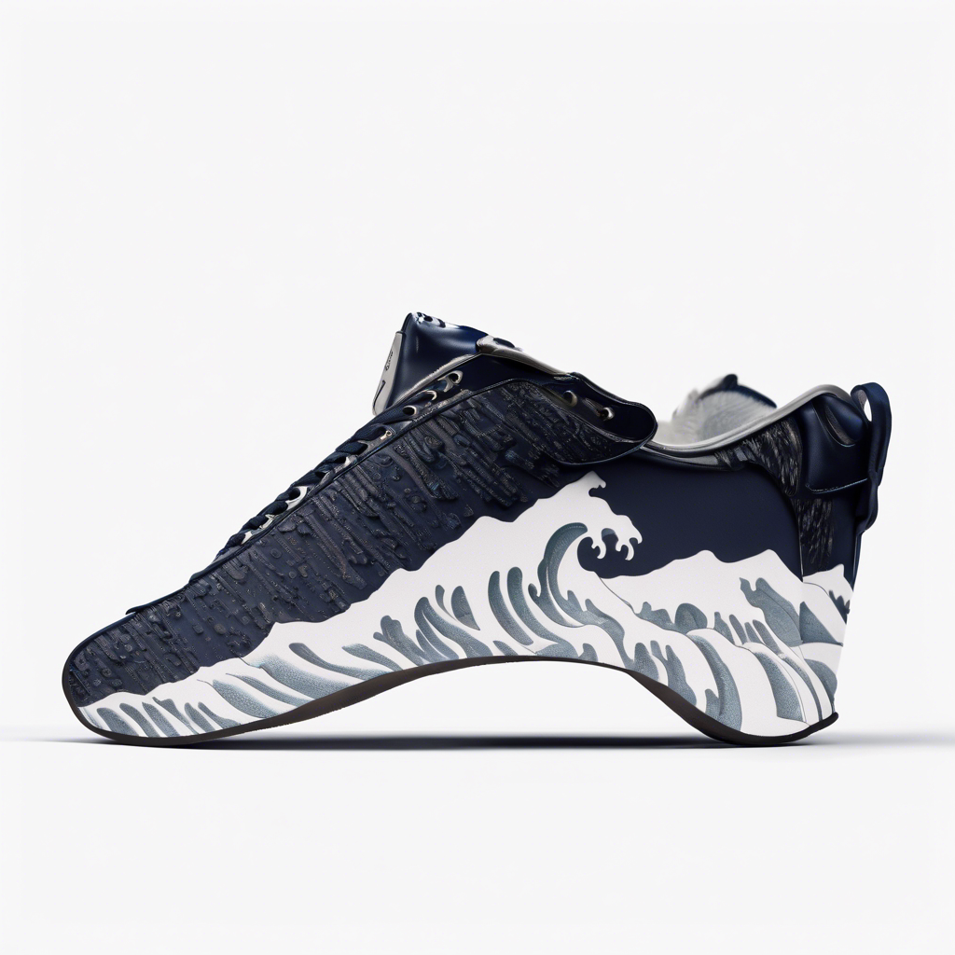
Impact on Results
Variable | Salvador Dali | Van Gogh | Great Wave
Results

