Slide 1
What Is Codex and /goal
An agent that works in your files, and a way to hand it an objective instead of a prompt.

Slide 2



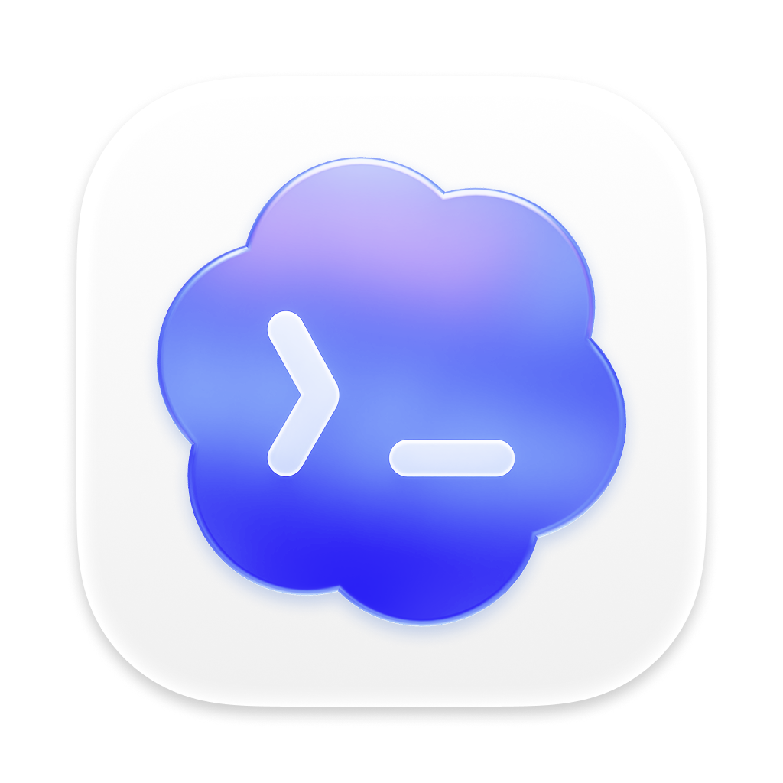



Codex Does the Work, Not Just the Talking
You Ask
It Answers
You Copy and Run It
You Paste Errors Back
ChatGPT
You Set the Task
It Reads the Files
It Edits and Tests
It Hands Back Changes
Codex
You
The AI
Same account. The difference is who runs the loop.

Slide 3




When to Reach for Codex
Explain an Idea or Draft an Email
ChatGPT
One answer, nothing to run
Fix a Bug or Add a Feature
Codex
It edits code and runs tests
Build a Report from 40 Files in a Folder
Codex
It can open every file itself
Change the Same Thing Across Many Files
Codex
It works through them one by one
Rule of thumb: if the work lives in files, give it to Codex.

Slide 4




How It Works - /goal Keeps Codex Working Until It Is Done
The Commands
Plan
The Next Step
/goal <objective>
Start
/goal
See Progress
Done?
Act
/goal pause
Stop or Go Again
Edit, Run, Build
Stop for Now
For Hours If Needed
/goal resume
Carry On
Check
/goal clear
Against the Goal
End It

Slide 5



A Prompt Steers One Turn, a Goal Defines Done
A Prompt
You
AI
You
AI
You
AI
You
AI
You Steer Every Turn
A Goal
You
Codex: plan, act, check, repeat
Runs to the Stop Line
Every Goal Has Four Parts
Objective
Limits
Proof
Stop
What to Achieve
No-Go Areas
How to Check It
When to Finish
Can't say how to check it? Use a prompt and steer instead.

Slide 6

Anatomy of a Good Goal
Codex
Example
Objective
The /goal Line
User
/goal Turn the 40 interview transcripts in /interviews into a findings report.
Read First
Where to Start
Read first: questions.md and every transcript.
Limits
Don't change: the transcripts themselves.
What Not to Change
Prove it: each finding cites two or more transcripts.
Proof
Stop when: all five questions are answered.
How to Check Each Finding
And every quote matches its source file.
Stop
Message Codex…
↑
When to Finish
These let it run without you.

Slide 7
Let's See It in Action
Next lecture: a second AI reviews the work before you do.
1
2
3
Open a Folder
Set One Goal
Watch the Loop
In Codex
With a Stop Line
Then Check the Work

