Slide 1
What Are Tokens?
The unit of text a model reads, writes, counts and charges for.

Slide 2
A Sequence of Characters, Not a Word
Unbelievably, tokenisation is unpredictable.
A token is a sequence of characters common enough to be stored as one unit. Frequent words survive whole; rarer ones arrive in pieces.
Un
bel
ievably
,
token
isation
is
unpredictable
.
Four words. Nine tokens.

Slide 3
Why the Count Is Never the Word Count
What you send | Characters | Tokens | Chars per token
A short English sentence | 37 | 7 | 5.3
The same sentence in Japanese | 20 | 16 | 1.3
One line of Python | 64 | 14 | 4.6
A written-out money figure | 43 | 14 | 3.1
English runs at roughly four characters to the token. Other scripts, code and long numbers all break into smaller pieces, so the identical sentence can cost twice as many tokens in Japanese as in English.

Slide 4
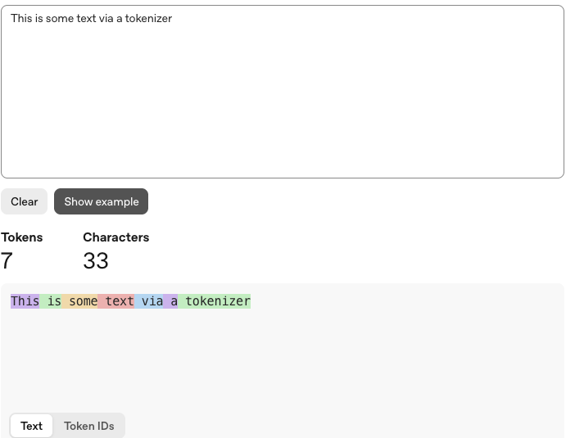
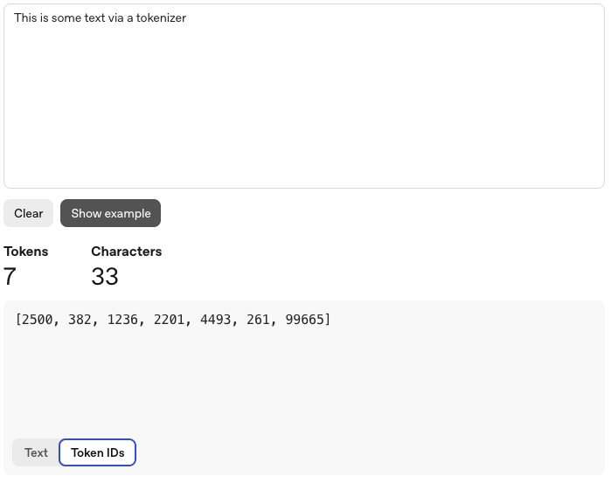
See a Sentence Become Tokens
EXERCISE · 1 MINUTE
1
Open the OpenAI tokeniser.
2
Paste a sentence of your own.
3
Switch to Token IDs.
4
Try it in another language.
The same seven tokens, coloured
and the numbers behind them
platform.openai.com/tokenizer

Slide 5
What a Token Is Not
Not this
This
— One token, one word
— A frequent sequence of characters
— The same count in every language
— A fixed vocabulary, learned once
— Something you can eyeball
— Countable, before you send it
Every model ships with its vocabulary already fixed, so a given sentence has one token count and you can know it in advance.

Slide 6
How It Works - Split, Number, Predict, Repeat
Your text
Split
Numbered
Predicted
typed as normal
into known chunks
one ID per chunk
the next ID, then the next
The model never sees your letters. It sees a list of numbers, and it answers by choosing the next number over and over - which is why a reply arrives in pieces rather than all at once:
Rough
ly
four
characters
to
the
token
…

Slide 7
What Has to Fit in the Context Window
ChatGPT
Demonstration
The context window
System
You are a helpful assistant.
Everything inside the bracket is sent again, in full, on every turn. The model remembers nothing between turns - it only has this.
User
Summarise this report in five points.
AI Assistant
1. Revenue is flat. 2. Churn is up. 3. …
What you just typed is one line of it.
User
Now turn that into a tweet.
Fill the window and something gives: the reply is cut short, or the oldest turns stop being sent.
Send a message…
↑

Slide 8
Every Turn Re-sends the Whole Thread
ChatGPT
Demonstration
A model holds nothing between requests. Each turn re-sends everything above it, so a long thread is counted again with every message you add.
User
Summarise this report in five points.
AI Assistant
1. Revenue is flat. 2. Churn is up…
User
Now turn that into a tweet.
Sent with the second turn
The report, both questions, the answer
Send a message…
↑

Slide 9
Token Limits - Set by the Model You Pick
Input limit
Output limit
— How much you may send
— How much it may write back
— Prompt, thread, files, all of it
— Far smaller than the input limit
— Hit it and the request is refused
— Hit it and the answer is cut off
These are not settings you tune - they come with the model you chose, so picking a model is picking a budget. Two failures that look alike: a refused request means you sent too much, a truncated answer means you left it too little room.

Slide 10
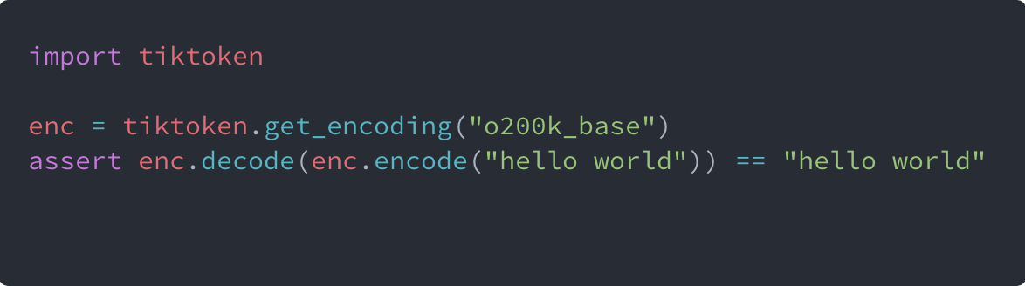
Counting Them Without Guessing
The tokeniser is a library, not a mystery: the same rules the model uses, available to you. Count before you send, and a limit stops being something you discover by hitting it.
Encode to count. Decode to prove nothing was lost.

Slide 11
When the Window Fills Up
What happens
What you do about it
The message is refused outright
Or the oldest turns quietly drop out
Or they are compressed into a summary you cannot read
Send the relevant extract, not the whole file
Work in chunks, then combine the results
Carry a summary forward instead of the transcript
Start a fresh conversation for a fresh task

Slide 12
Why It Matters - A Token Has Three Prices, Not One
Cached input
a fraction of input
an opening seen before
Input
the baseline
your prompt and thread
Output
several times the input rate
every word it writes back
The bars show the ordering, not a scale. Providers publish these three rates separately and revise them constantly - the ordering is what has held, and it is the part worth memorising.

Slide 13
Caching Pays for the Part It Recognises
First time
all of it new - full price
nothing to recognise
Ask again
matched - cheap
new - full price
same opening, new question
Edit the top
the match broke here - full price again
one word changed early
The match runs from the very first character and stops at the first difference, so a date or a reordered line near the top throws the whole discount away. Stable material first; the part that changes, last.

Slide 14
Which of These Prices Do You Actually Pay?
On a ChatGPT subscription
Building on the API
— You never see a per-token bill
— You pay per token, in the three buckets
— You get an allowance per model instead
— Caching is a real lever you control
— Allowances refill on a rolling window, with a weekly cap on top
— Prompt order becomes an engineering decision
— Hit one and you wait for the reset, or switch model
— We come back to this properly later in the course
Same tokens underneath, billed two different ways. On a subscription the cost of a long thread is not money, it is your allowance - which is why a runaway conversation quietly eats your week.

Slide 15
What That Changes About How You Prompt
Cheaper than it looks
Dearer than it looks
— A long brief, pasted once
— A long essay written back
— Worked examples of what you want
— "Give me ten versions"
— Standing instructions you reuse
— Re-generating instead of editing
Be generous with the context you give, specific about the length you ask for, and consistent about the order you give it in. The expensive half of a conversation is the half you did not write.

Slide 16
Let's See It in Action
That is the principle. Now we go and count some tokens for real.
1
2
3
Count a sentence
Try another language
Read a price table
paste it into a tokeniser
same meaning, more tokens
three columns, not one

