Slide 1
What Is ChatGPT?
An assistant built on a next-token predictor, which now also searches, computes and acts on your behalf.

Slide 2
A Next-token Predictor with a Product Wrapped Around It
ChatGPT
Demonstration
Every reply is produced one token at a time. The model scores its whole vocabulary against the text so far, picks one, and scores again.
User
The students opened their
Candidate next tokens
books · 31%
laptops · 24%
minds · 12%
exams · 7%
Chosen
books

Slide 3
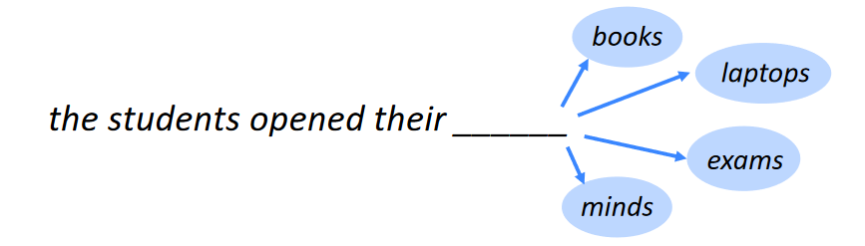
What Would Be the Next Word in This Sentence?
Every one of those is a reasonable continuation. The model does not choose the right word - it scores them all, and one of them wins.

Slide 4
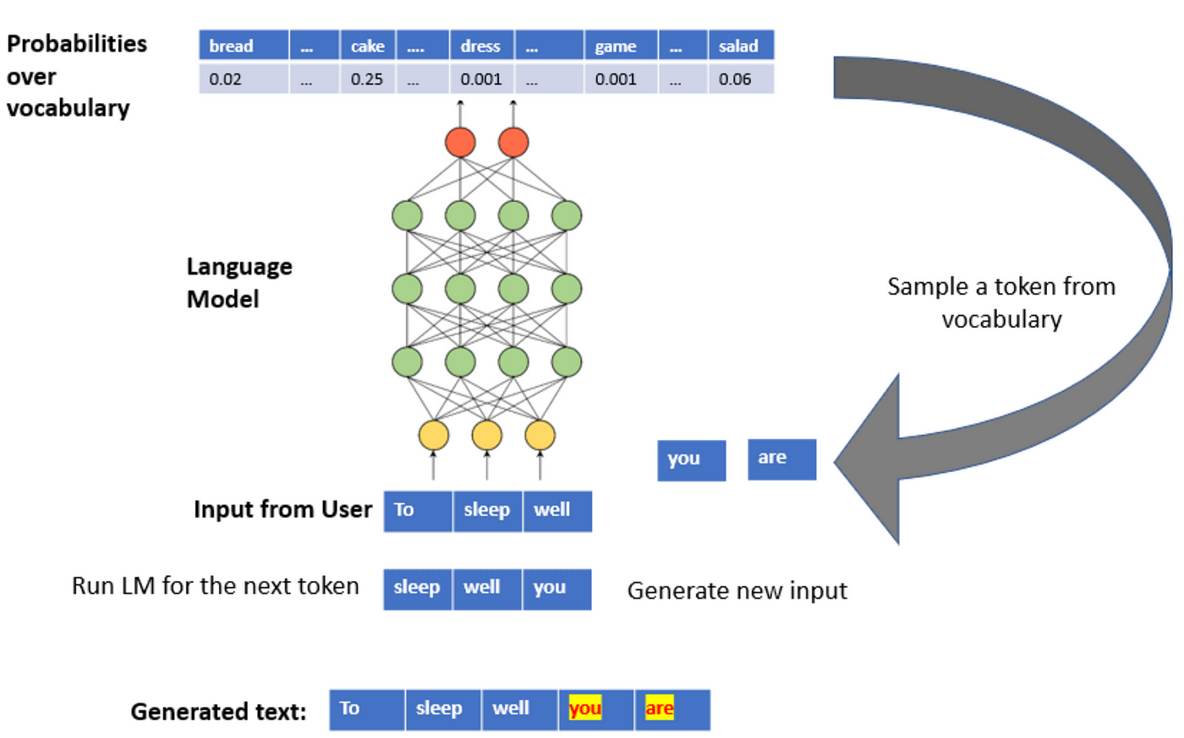
Predicting the Next Word (Token)
A large language model is selecting the next most probable token, given a known vocabulary - then feeding its own answer back in and doing it again.

Slide 5
Six Core ChatGPT Features
Capability | What it adds to a plain answer
Web Search | Live pages, read and cited at the moment you ask
Deep Research | A long multi-source investigation, returned as a report
Data Analysis | Code written and run over your files, rather than guessed at
Agent Mode | Multi-step tasks it carries out in a browser for you
Plugins | Connections to outside services, and the actions they allow
Skills | A workflow you wrote once, followed the same way every time
Each gets its own lecture later. Every one of them also costs something: time, tokens, or a service you have to trust.

Slide 6
One Model, Many Surfaces
The web app
Desktop and mobile
The API
Inside other tools
where most people meet it
the same account, everywhere
the engine, with no product
reached through plugins
One family of models underneath
ChatGPT is the product built around it
The same model reaches you through all four. Which one you pick changes the tools it can call and the price you pay, not the intelligence underneath.

Slide 7
What It Is Not
A common picture
What is actually happening
— It looks the answer up
— It predicts a likely continuation
— It knows what happened today
— It knows nothing until it fetches
— It obeys your instructions
— It generates tokens based on the current context
The gap between those two columns is where most disappointing answers come from.

Slide 8
How It Works - Train It to Predict, Then Tune It to Assist
1
Pre-train on text until it predicts well
Step one buys fluency. Steps two and three buy manners: helpful, ordered, willing to refuse.
Step four is the part that has moved most recently, and it is what the rest of this deck is about.
2
Tune on answers humans ranked as better
3
Let it practise against that ranking
4
Wrap it in tools, and ship it as a product

Slide 9
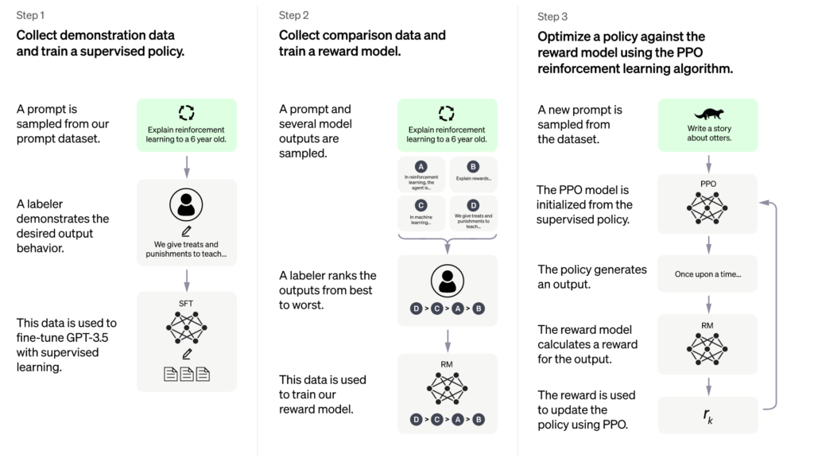
Training ChatGPT
Three passes: learn to predict text, learn what people preferred, then optimise against that preference.

Slide 10
A Turn Is a Loop, Not a Single Shot
You ask
It plans
It uses a tool
It answers
the question
what it needs to find out
search, code, a connected service
from what came back
each result is appended, and it decides again
Nothing about the tools is magic. Whatever one returns is pasted back into the same block of text the model is reading - its context - and it carries on predicting from there.

Slide 11
Every Setting You Touch Ends Up Here
Standing instructions
set once, sent every time
What it remembers of you
carried between chats
Nothing on this stack is privileged. A page it retrieved and a sentence you typed look the same to the model.
That is why one bad source spoils an answer, and why saying plainly what you want still beats anything clever.
Files and pages fetched
pulled in for this task
Results from tools it ran
code output, search hits
Your message
typed just now
It all arrives as one prompt

Slide 12
Fast Answers, or Slow Ones
 | Answers straight away | Thinks before answering
Good for | Recall, drafting, chat | Maths, planning, code
It costs you | Almost nothing | Time, and far more tokens
You get it wrong by | Asking something hard | Asking something trivial
Each new generation moves the same three dials: better reasoning, a longer context window, a lower price per token. The model names will have changed by the time you watch this. The dials will not.

Slide 13
Why It Matters - The Failure Modes Become Predictable
What goes wrong | Why | What fixes it
A confident wrong fact | Nothing was fetched | Give it sources
Yesterday's answer | Trained, not live | Let it search
Arithmetic that looks right | Text, not calculation | Make it run code
Your instruction ignored | Buried in a long context | Say it up front
None of these is the model being stupid. Each one is a missing tool, or a context you did not supply.

Slide 14
When to Reach for It, and When Not To
Worth handing over
Keep it yourself
Work you can describe but do not want to start
Reading that already exists and just needs doing
A process you would otherwise repeat by hand
Judgement you are accountable for
Anything you will not read before sending
Work where the struggle is the point

Slide 15
What This Looks Like in One Turn
ChatGPT
Demonstration
Same text box, same predictor. What is different is that it went and fetched things first, and that the answer says where they came from. That is the shift the rest of this course is built on.
User
Compare our three pricing pages, and check what rivals changed this quarter.
Ran
a web search, then code over your data
AI Assistant
Page B converts 2.1x better than A. Two rivals dropped their entry tier in March - sources listed below.
Send a message…
↑

Slide 16
Let's See It in Action
That is the principle. Now let's open it up and drive.
1
2
3
Open a fresh chat
Ask something live
Hand it a file
and look at what it offers
watch it search before it answers
and let it run code over it

