Slide 1
Local Models with LM Studio
How to run an AI model on your own machine and call it like a cloud API.

Slide 2
A Model That Runs on Your Own Machine
Why Run It Locally
What You Give Up
• Prompts stay on your machine
• Smaller models, less capable
• No per-token bill
• Limited by your RAM and GPU
• Works offline
• You download and update models
• Free to experiment and repeat
Reach for local when privacy or volume matters more than peak quality.

Slide 3
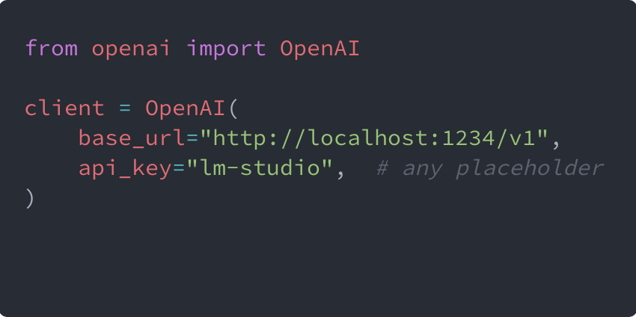
How It Works - Same SDK, Different Address
LM Studio serves the loaded model behind an OpenAI-compatible endpoint on your machine. Point the client at it and the rest of your code stays the same.
Change the address and key; name the local model.

Slide 4
Let's See It in Action
That is the principle. Now we run it on this machine.
1
2
3
Load a Model
Start the Server
Change the Base URL
In LM Studio
On Localhost
And Run the Notebook

