Slide 1
-Classifying the Existence of Galaxy via Quantum Machine Learning -
Team Voyager
Hoyeon Kook, Dasan Kim, Saesun Kim, Bumkyu Park, Jumin Lee, Byeongoh Hwang

Slide 2
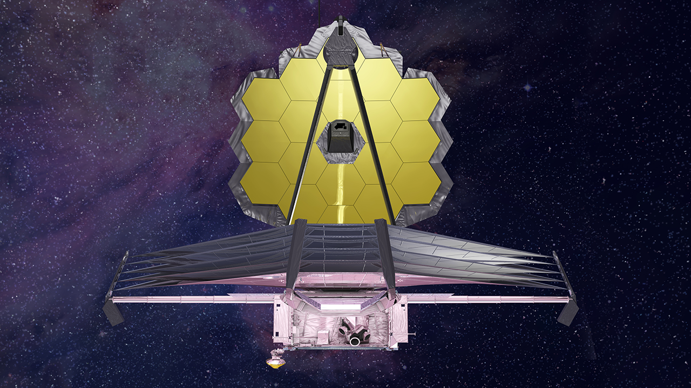
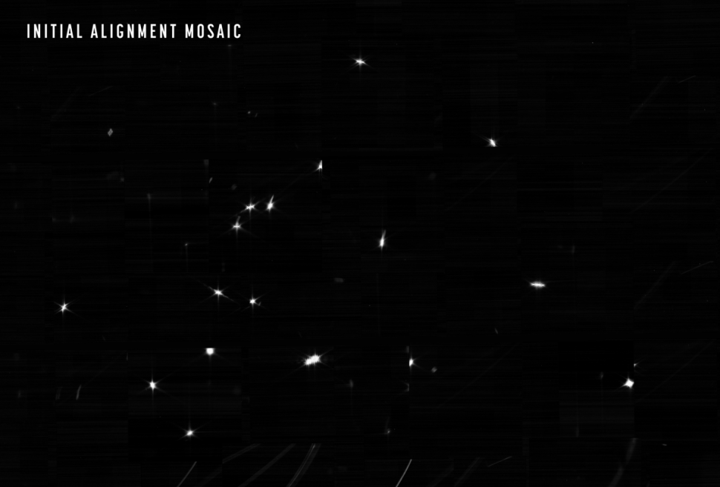
01
QML and Astronomy
About the project
- James Webb Space Telescope
Source: https://www.space.com/james-webb-space-telescope-first-photos-unveiled
Source: https://www.space.com/james-webb-space-telescope-locks-first-star

Slide 3

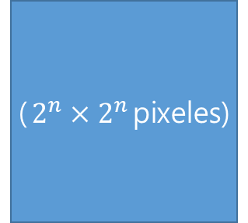

01
About the project
($2^{n}×2^{n}$pixeles)
Bit expression: 4
Bit expression: 16
Bit expression: 64
Bit expression:$4^{n}$
Qubit expression: 2
Qubit expression: 4
Qubit expression: 6
Qubit expression: $2n$
Galaxy detection method using QML(Quantum Machine Learning)

Slide 4
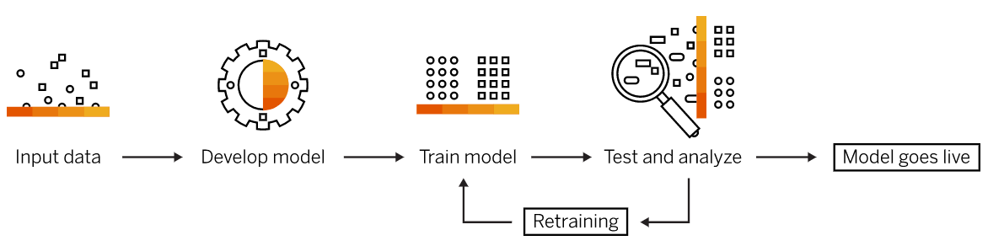
02
Quantum Machine Learning
(Optimizer)
(Data Embedding)
(Circuit No.15)
Source: https://www.sap.com/korea/insights/what-is-machine-learning.html

Slide 5
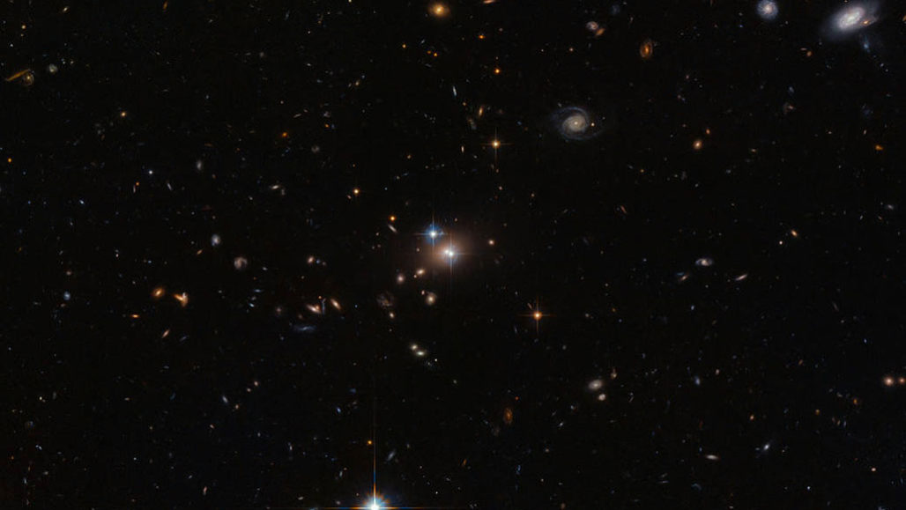


03
Data Preprocessing

Slide 6
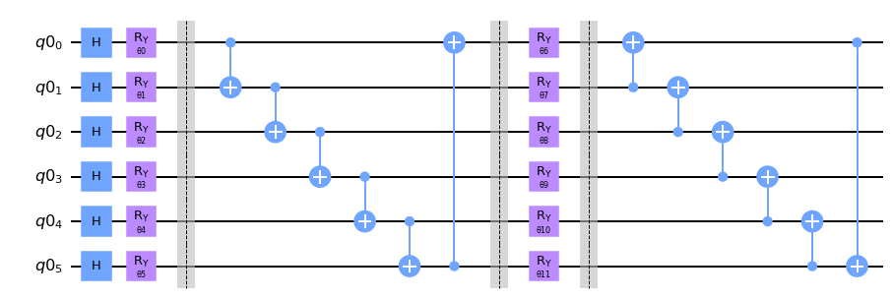
04
Train Model
Circuit 15
PQC from Hannah Sim https://arxiv.org/pdf/1905.10876.pdf circuit 15

Slide 7
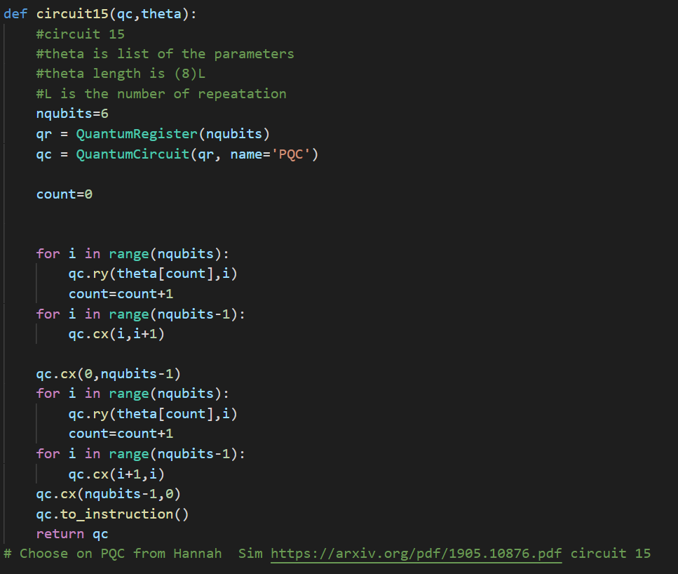
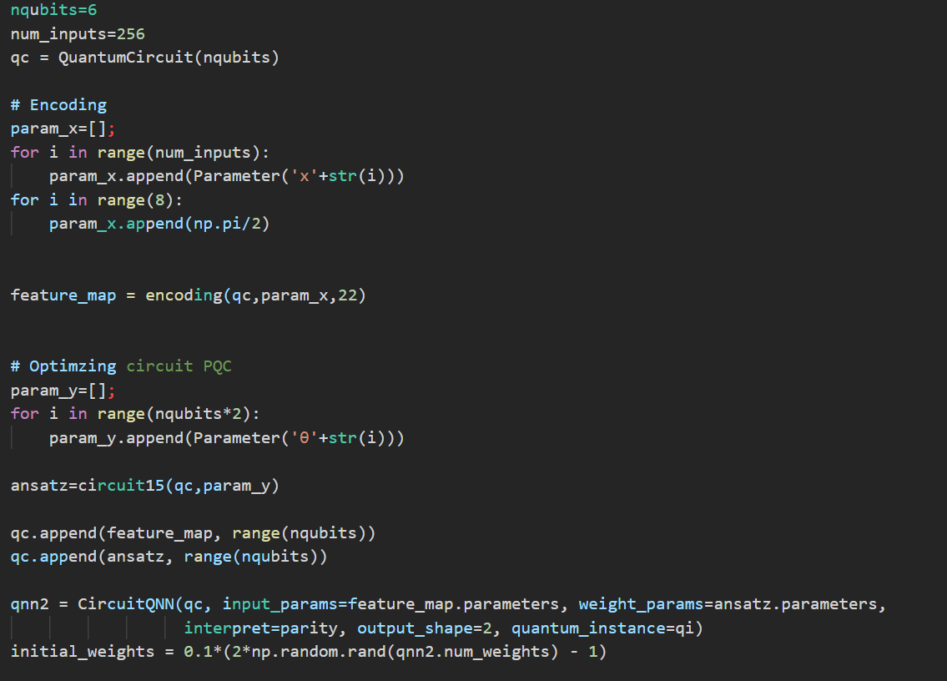
Code Example

Slide 8
05
Results

Slide 9

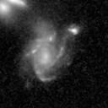
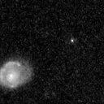
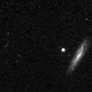
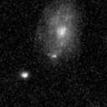
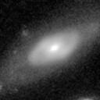

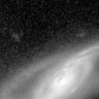
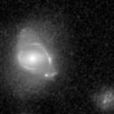
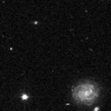
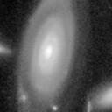
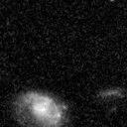
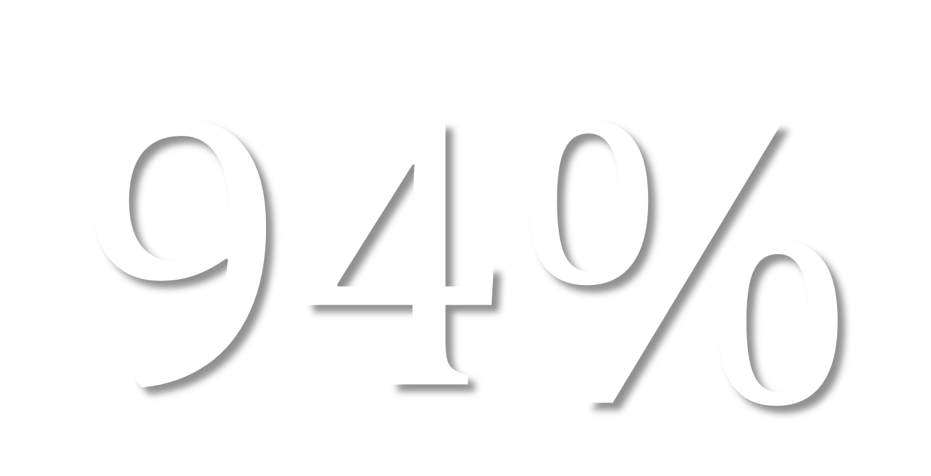
$$94\%$$
06
Conclusion

Slide 10
THANK YOU
FOR LISTENING

