Slide 1
Brightcove Analytics
Robert Crooks
Director of Brightcove Learning Services

Slide 2
Agenda
The new analytics UI
The new analytics API
Analytics API solutions

Slide 3
The new analytics UI

Slide 4
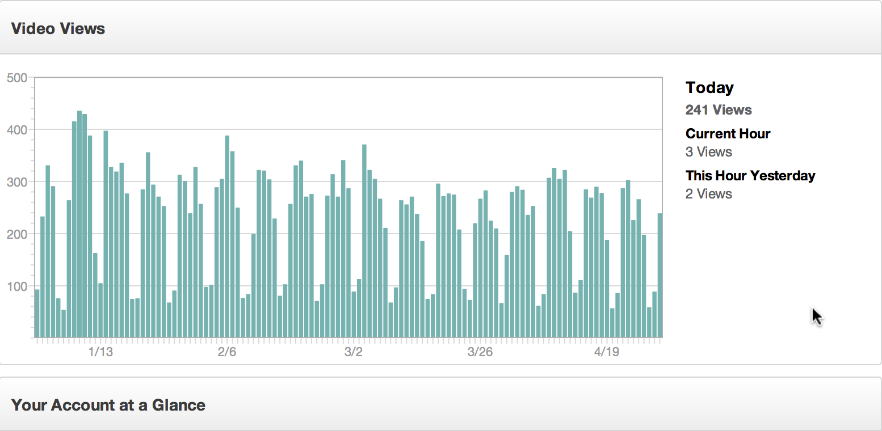
The New Analytics UI
Gives you predefined reports and charts
Customize with date ranges
Drill down into more specific data
Built entirely in HTML, so viewable on all devices
Real-time data/updates

Slide 5
Demo

Slide 6
The new analytics API

Slide 7
The new analytics API
The backend for UI
A REST-based API that you can access from any programming language/application
Allows you to retrieve the data directly and use it in any way you like
Provides account rollups and detailed reports
Multiple dimensions and filters to allow you to retrieve just the data you want
Sample request:
https://data.brightcove.com/analytics-api/videocloud/account/20318290001?from=alltime&to=now

Slide 8
Sample solutions
API Request Builder
Most Popular Videos

Slide 9
Two Basic Categories of Solutions
Custom Reports
Get a specific data-set that the built-in reports don’t provide
Represent the data differently
Example:
http://solutions.brightcove.com/bcls/analytics-api/aapi-request-builder.html
Do something (like create a playlist) based on analytics data
Most popular videos
Trending videos
Choose most popular among a set of relevant videos
Example
http://solutions.brightcove.com/bcls/analytics-api/most-popular-videos.html

Slide 10
Thank you
rcrooks@brightcove.com

