Slide 1
EXAMPLE CODE REVIEWS
Display views in controlbar
Bulk update video metadata
Video engagement graph

Slide 2
DISPLAY VIEWS IN CONTROLBAR
Display Views in Controlbar (Brightcove Player related)
https://player.support.brightcove.com/code-samples/brightcove-player-sample-display-views-controlbar.html

Slide 3
UPDATE VIDEOS
Bulk update a set of video’s metadata
https://apis.support.brightcove.com/cms/code-samples/cms-api-sample-update-videos.html

Slide 4
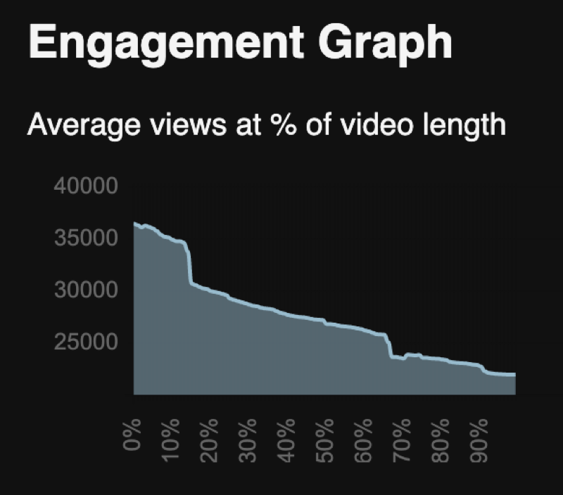
VIDEO ENGAGEMENT GRAPH
Bulk update a set of video’s metadata
https://apis.support.brightcove.com/cms/code-samples/cms-api-sample-update-videos.html

