Slide 1
The Smart Player and Media APIs
Robert Crooks, Director of Learning Services (rcrooks@brightcove.com)

Slide 2
Agenda
Introduction to the Smart Player API
Introduction to the Media API
Video Cloud for Business Users and Developers
What it does and doesn't do
Typical use cases
What it does and doesn't do
Typical use cases
Brightcove vs. the competitlon

Slide 3
Video Cloud from the perspective of Business Users and Developers

Slide 4
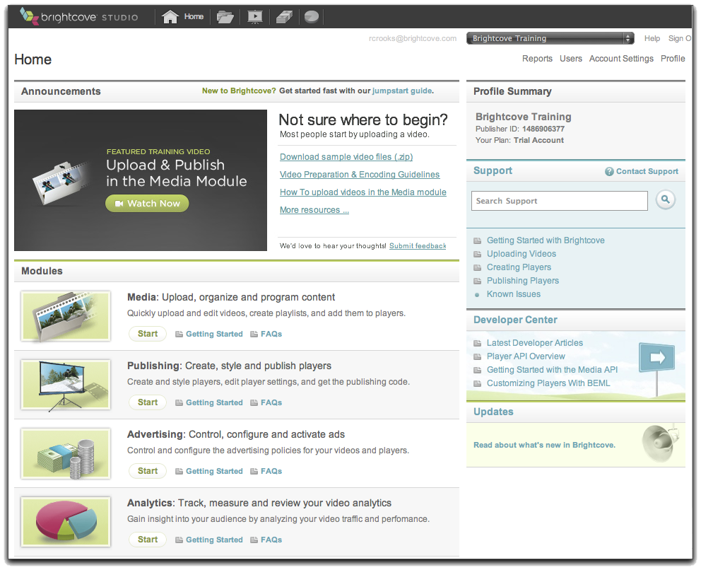
Video Cloud – Business User Perspective
Publishing code
(Publisher, Player
Video IDs, Player
Dimensions)
Transfer videos
Your Web Server
Content Delivery Network
(CDN)
Video Cloud Servers
Transcode and
store videos with
metadata, playlists,
player settings
Requested page
with references
to player and
videos
Upload video,
add settings
Viewer
Your System
Video Cloud Studio

Slide 5
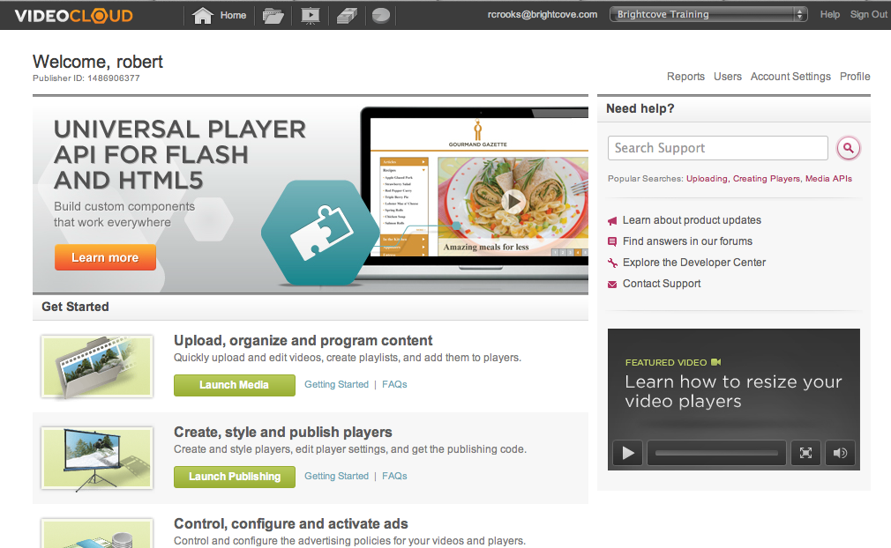
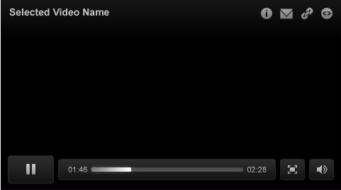
Video Cloud – Developer Perspective
Transcoding Service
System
User-Initiated
Video Cloud
Media Repository
BEML
CDN
Media API
Batch Provisioning
Aspera
Smart Player API
My Site
My Media
Player
Flash-Only Player API

Slide 6
Introduction to the Smart Player API
A JavaScript API – requires JavaScript programming

Slide 7
What it does and doesn't do
It does…
Allow you to manipulate the video player in the browser
Allow you to create content in the page that interacts with the player
Work for both Flash and HTML5 players
Allow you to set ad policies dynamically
Retrieve videos or playlists from the Video Cloud server
Load videos into the player
Act in response to cue points or video progress
Update video properties for a video in the player
It does not…
Modify videos in your account or account settings in any way
Allow you to modify the player itself, except for overall resizing

Slide 8
Typical Use Cases
Chaptered video
Call-to-action
Video Portals / "Playlists" in the page, not the player
Lightbox players
Player overlays

Slide 9
Introduction to the Media API
A REST-based API – requires programming in any language (Java, .NET, PHP, Ruby, etc.)

Slide 10
What it does and doesn't do
It does…
Allow you to search for videos
Allow you retrieve video metadata
Allow you to update video metadata
Upload videos (good for UGC, not volume uploading)
Add captions and logo overlays to videos
Share and unshare videos
Get the status of uploaded videos (when it's playable)
It does not…
Interact with the player in any way
Allow you to modify the player itself, except for overall resizing

