Slide 2

Building Native Experiences with the Video Cloud Player SDK for Android
Tom abbott, developer evangelist

Slide 3
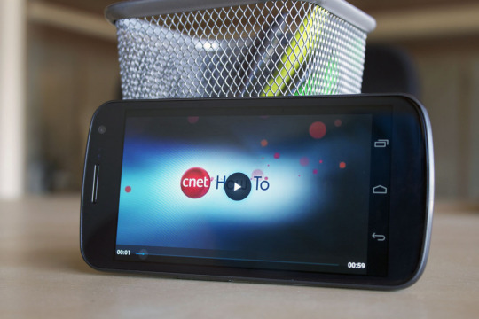

Getting your Video Content on Mobile isn’t easy
What keeps developers up at night?
Fragmentation of adaptive streaming support
Fragmented Pre-buffering support
Monetizing with ads
Analytics
End user experience
Content providers don’t have it easy either…
Content is king
Smaller screens
Diversity in screens
Videos must look good on all connection types

Slide 4
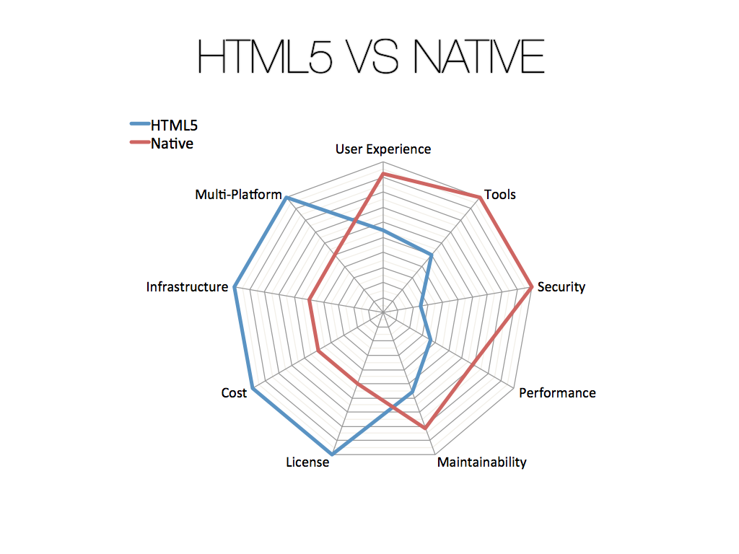
Native vs. HTML5 - Why Native?
Adaptive streaming
Memory Management
Tooling Support
DRM
HTML5 Video is incomplete..
No DRM
Spotty adaptive streaming
No accessibility spec
Spotty support for media formats
Source: http://www.icapps.com/wp-content/uploads/2012/06/04-HTML5-vs-Native.pdf

Slide 5
Introducing Video Cloud SDKs
Designed for media & broadcast customers
Enabling high-quality video experiences
Easy to extend and customize
Integrated with leading advertising platforms
Integrated support for content protection
Automatic buffering and playlist support
Plug-in HLS support for older versions of Android
Easily customizable controls and layout
Rich set of cross-platform events & APIs
Easy to integrate into existing apps
Designed for partner extensibility
Support for leading analytics systems

Slide 6
Current State of the SDKs
Status
SDKs and plugins are in limited commercial availability
Includes plugins for advertising, analytics, and Widevine, HLS support
Significant update planned for August
Pre-release program planned for July
Contact your account manager if interested

Slide 7
What is Available in Android for Video
android.media.*
MediaPlayer, MediaController, VideoView
Supports
Online/Offline
H.263/4, MPEG-4, VP8
State-based
Prepared
Completed
Error
Initialized
Started, Paused Stopped..
Supports cool features
Wake Locks
Wi-Fi Locks
Timed Text
Media Routing
Why is any of this important – Doesn’t Brightcove have their own SDK?

Slide 8
Android Video Architecture
Apps
YouTube
Washington Post
Media Player App
Application
Framework
android.media
MediaPlayer
MediaExtractor
MediaRecorder
Libraries
libmedia
libmediaplayerservice
libmediaplayer
Unix
Kernel
Display
Drivers
Audio
Drivers
Memory
Drivers
CPU
Drivers

Slide 9


Brightcove Android SDK Architecture
Built on top to enhance existing android media framework
Similar naming convention for entry points
VideoView vs. BrightcoveVideoView
Makes it simple to communicate with Video Cloud
Designed around ‘Components’ and ‘Events’
Handles the complexities associated with native platforms
Brightcove
Video Cloud SDK
android.media

Slide 10
Highlighting Classes
Brightcove
Video Cloud SDK
BrightcoveVideoView
Analytics
CuePoint
Catalog
Video
Playlist
VideoStill
Events
EventEmitter

Slide 11

Plug-ins
Add functionality to the existing SDK
Built on the SDK using the event and component architecture
More on this later!
DoubleClick
Freewheel
Omniture
Widevine

Slide 12
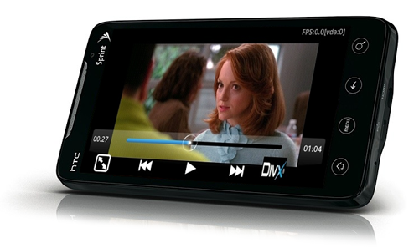
Installation
Installation -
Download the SDK
Add the jar to your Android App
Add the jar to the Library
Order and Export
What do you get?
Pre-buffering support
OOB Player Controls
Brightcove Analytics
Cue Points
…

Slide 13
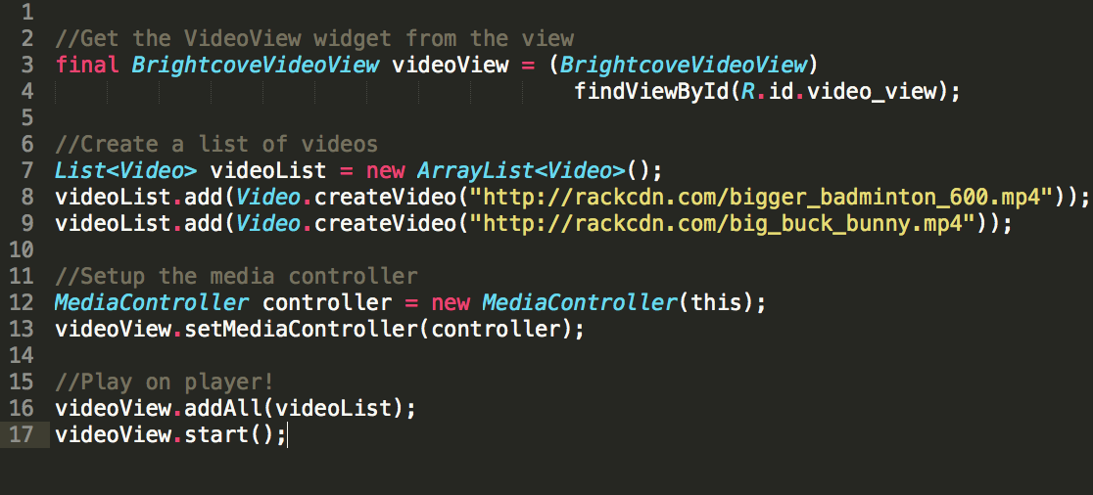
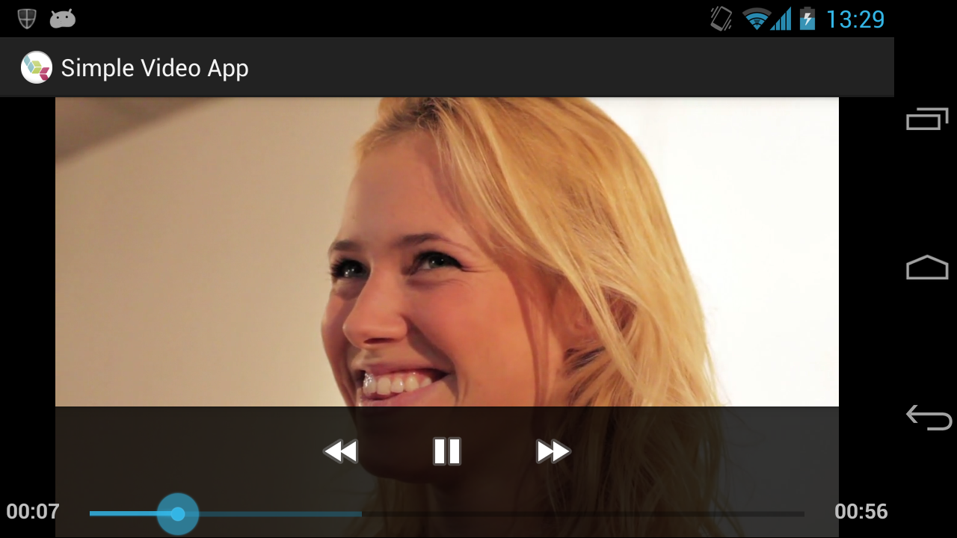
Let’s get into some code -

Slide 14
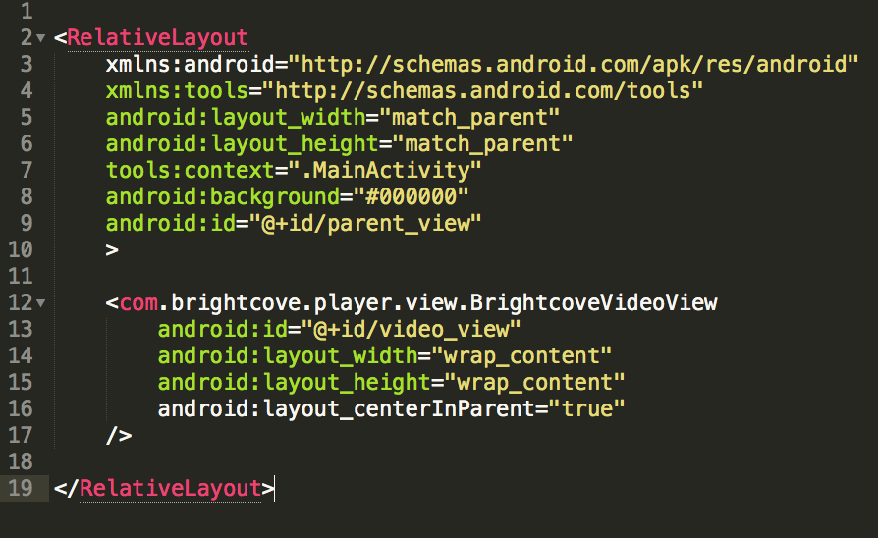
BrightcoveVideoView
Widget replacement for Android’s Video View
Implements Component
Manages the list of videos
Uses VideoDisplayComponent and VideoPlaybackComponent
Contains an Android ImageView as a child to handle image stills
Has one Event Emitter! (more on this later)
Can be used with Android’s MediaController

Slide 15

Events and Event Emitter
Getting an Event Emitter
Create your own and set it on the BrightcoveVideoView
Get it from an already created BrightcoveVideoView
Use the Event Emitter to listen to and emit events
Can also Request/Respond
Events can be stopped / prevented
Events have properties!
Did Advance | Did Play | Hide Controls | Seek to
Did Set Still | Paused | Ready to Play | Slider Begin
Cue Point | Progress | Found Video | Select Rendition

Slide 16

Illustrating The Event Emitter
Listens for Progress
Progress Bar
Emits Progress
Event Emitter
Video View
Listens for
Play Pause Skip
Emits Play Pause Skip
Controls

Slide 17
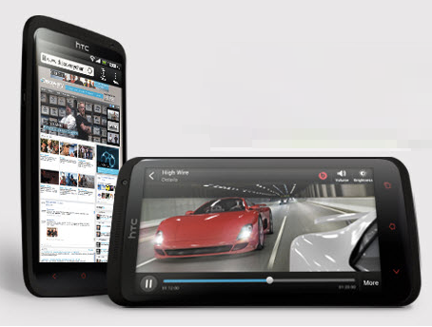
Workflows with Events
Custom Controls
Showing a loading indicator when buffering
Let the user know that an Ad is going to play
Any other common workflows?

Slide 18

Components
Basic building blocks for integrating with the Brightcove SDK
BrightcoveVideoView is a component
Analytics is a component
Catalog is a component
Plug-ins are components

Slide 19
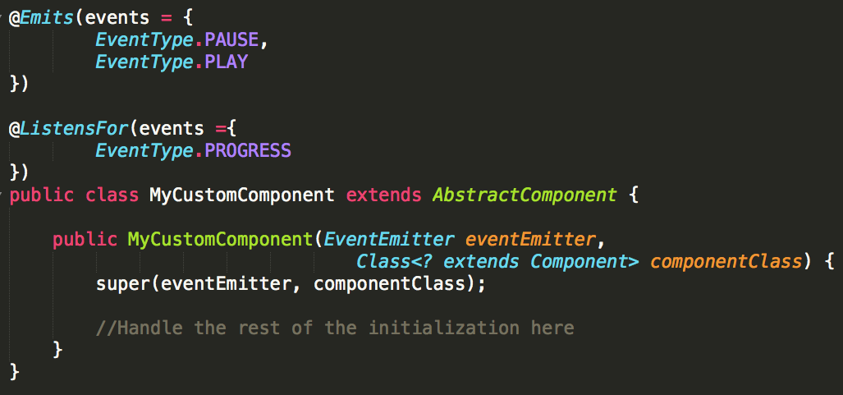
Components
Creating a Component is easy!
Extend AbstractComponent
Set up the annotations to describe what the component can Emit and ListenFor
Call super
Listen to events, emit events as your component is designed to do
Visual vs. Non-visual Components

Slide 20





Plug-ins
Brightcove
Video Cloud
SDK
3rd Party SDK
Plug-in
A component that delegates communication between SDKs
Brightcove SDK and 3rd Party SDK are unaware of each other

Slide 21
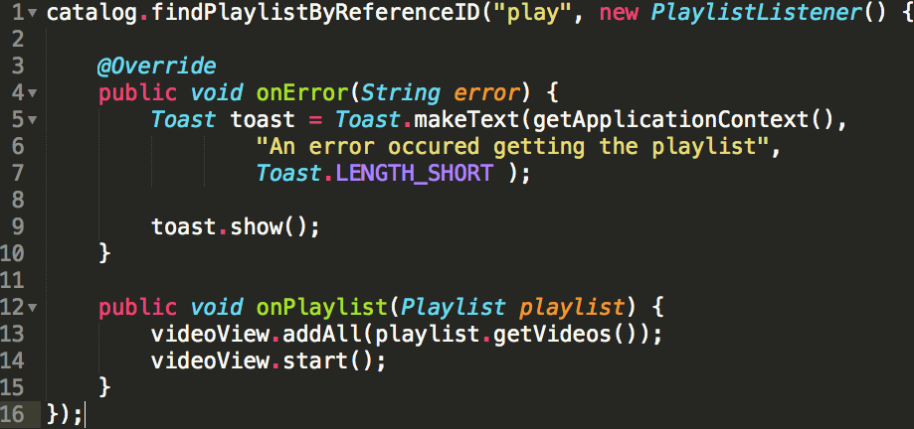
Getting Videos from Video Cloud
Use the Catalog!
Highly optimized to minimize traffic
Can retrieve videos or playlist by ID or Reference ID

Slide 22
Code Demo Time
As ray arnold says… ‘hold on to your butts’

Slide 23
Troubleshooting
Don’t call 911!
EventLogger
SOURCE_NOT_PLAYABLE
SOURCE_NOT_FOUND
ERROR
Android Debugging
http://developer.android.com/tools/debugging/index.html

Slide 24
exit (0) //Thanks!
Questions?
Keep in touch!
@omgitstom
tabbott@brightcove.com
Brightcove Developers Group

Slide 25
Scrap Slide
Brightcove
Video Cloud SDK
DoubleClick
Freewheel
Widevine
Omniture
HLS

