Slide 1
Home Depot Training
15 May 2012

Slide 2
AGenda
10-11am EST Brightcove platform Training/open questions – 1 hour
11.12.30 am EST SEO best Practices Training /open questions – 1.5 hours
1.30 to 2.30 am EST Syndication Training/open questions – 1 to 1.5 hours
2.30 to 3.30 am EST Analytics Training/open questions – 1 hour

Slide 3
The Brightcove Video Cloud Platform

Slide 4
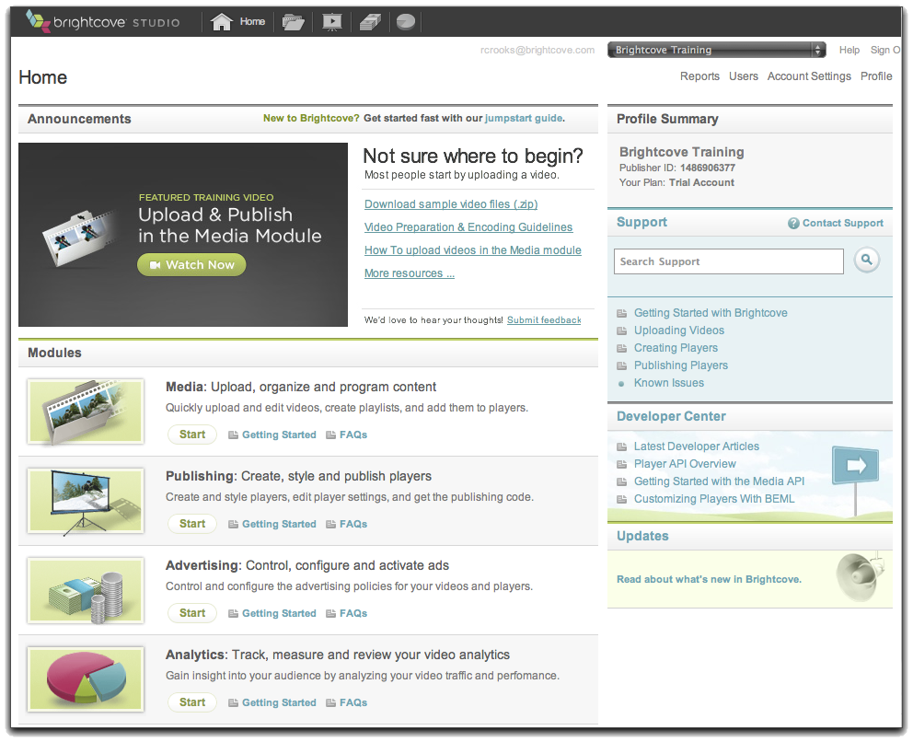
Video Cloud Platform – Publisher View
Transfer videos
Your Web Server
Content Delivery Network
(CDN)
Video Cloud Servers
Requested page
with references
to player and
videos
Publishing code (Publisher, Player, Video IDs, Dimensions)
Transcode and
store videos with
metadata, playlists,
player settings
Upload video,
add settings
Video Cloud Studio
Viewer
Your System

Slide 5
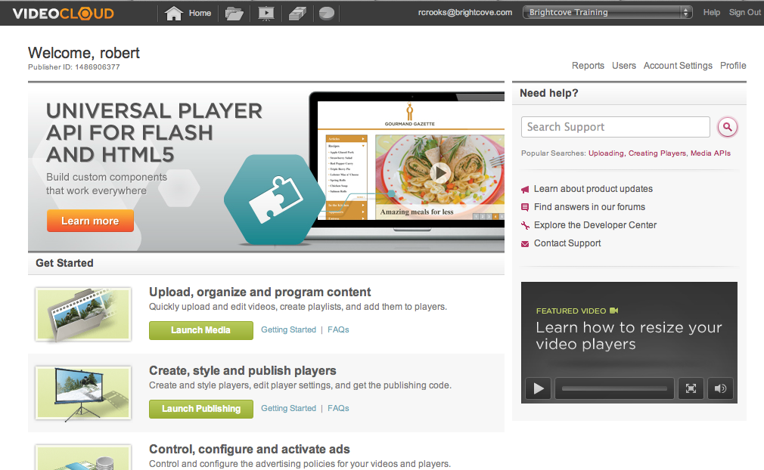
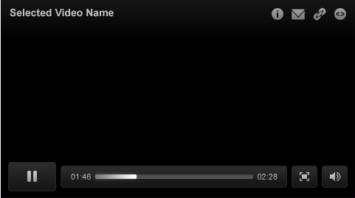
Platform Architecture – Developer View
Transcoding Service
System
User-Initiated
Video Cloud
Media Repository
BEML
Media API
Analytics API
Batch Provisioning
CDN
My Site
Smart Player API
My Media
Player
Flash-Only Player API

Slide 6
SEO Best Practics

Slide 7
Factors that Affect SEO
Page Content: Video metadata in the page content is the most important thing
Sitemaps: Video sitemap preferred, MRSS feed helps also
Page Metadata: Make sure a video title, description, and tags are used appropriately in page meta tags
Crawlability: Ensure a site is navigable without JS, and that all pages can be reached by organic browsing
Semantic HTML: Using the appropriate HTML elements to ensure focus is given to the right page content
General Content Tips: Fresh content, making sure there's text on the page to index, making sure videos relate to the majority of text on the page
Locale: In multinational sites, making sure your site specifies the content's language
Link Tips: Make sure link text is unambiguous, keep URLs as simple as possible
Error Pages: Making sure a site handles errors correctly and throws the right HTTP response headers to keep search engines from indexing erroneous data over valid page data
Page Speed: load time affects ranking

Slide 8
Metadata in page and Video Sitemaps
Must be generated server-side – data generated client-side doesn't help
Nothing inside a Flash container helps
Use the Media API
Use of Media APIs wrappers (http://opensource.brightcove.com) recommended to simplify development
Examples:
Playlist in the HTML, not the player
Video Sitemap

Slide 9
Syndication

Slide 10
Syndication Considerations
The Media API is the vehicle
Media API wrappers recommended to simplify development: http://opensource.brightcove.com
Default output is JSON; &output=rss/mrss to get XML
But who are you syndicating to? Ask what they want (most developers would rather work with JSON)
How often to refresh – Media API read calls cached for up to 20 min / how often does your content change
Limit bandwidth by pulling the fields you need: what you want to display + video ID (not an issue if you're outputting rss or mrss)
Generating feeds versus letting syndication partners pull their own
sample call
http://api.brightcove.com/services/library?command=search_videos&video_fields=id,name,thumbnailURL&page_size=4&get_item_count=true&token=WDGO_XdKqXUpy8fzD41MKA8kAhQRAmdux8cu8LNhRzAywCnuBpgV_A..

Slide 11
Analytics

Slide 12
The Analytics Module in Studio
Common features of the reports
Understanding and using the reports

Slide 13
Brand new: The Analytics API
To be released this week
Limited availability – ask your Account Manager to request access
REST-based API similar to Media Api
Authentication must be provided in the request header: Authorization: Bearer <token from Brightcove>
One API for Video Cloud / App Cloud
General form of the request:
http: //data.brightcove.com/analytics-api/data/{domain}/account/{accountId}/{domain-specific params}?{query params}
domain: videocloud or appcloud
domain-specific params (Video Cloud): /player(/playerID) or /video/(videoID)
query params: from, to (epoch time in milliseconds default in now – 31 days)
coming soon: sort, limit, skip

