Slide 1
Video Cloud in a nutshell
Robert Crooks (rcrooks@brightcove.com

Slide 2
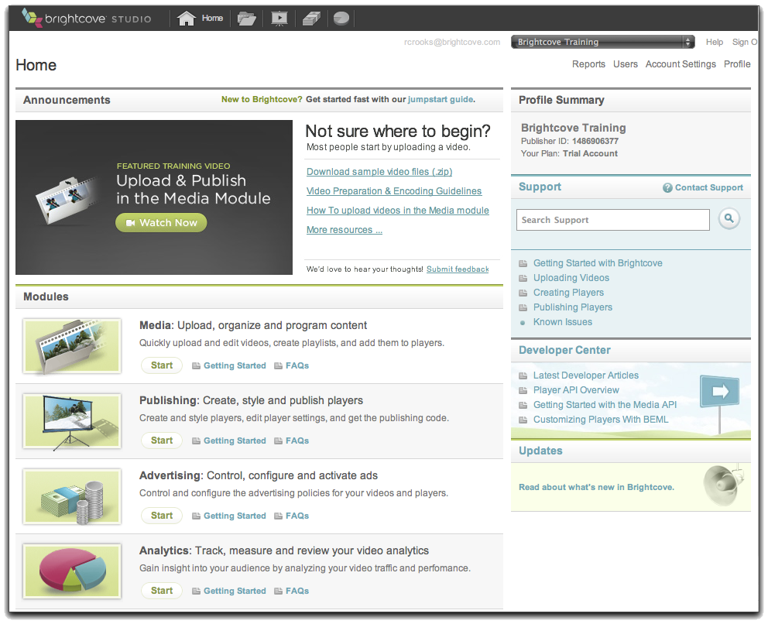
Video Cloud – Business User Perspective
Publishing code
(Publisher, Player
Video IDs, Player
Dimensions)
Transfer videos
Your Web Server
Content Delivery Network
(CDN)
Video Cloud Servers
Transcode and
store videos with
metadata, playlists,
player settings
Requested page
with references
to player and
videos
Upload video,
add settings
Viewer
Your System
Video Cloud Studio

Slide 3
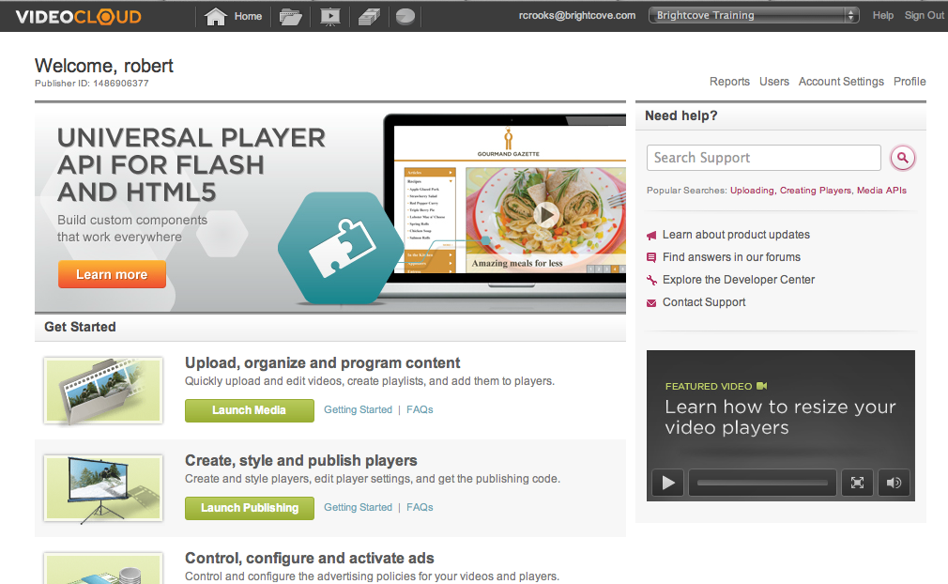
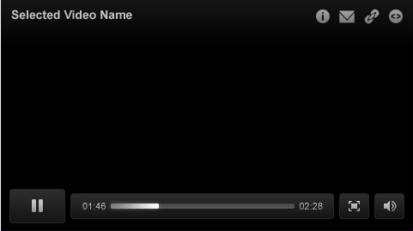
Video Cloud – Developer Perspective
Transcoding Service
System
User-Initiated
Video Cloud
Media Repository
BEML
CDN
Media API
Batch Provisioning
Aspera
Smart Player API
My Site
My Media
Player
Flash-Only Player API

