Slide 1
AllianceBernstein
Day 1 (9:00 - 1:00) (for all audiences; no programming knowledge required)

Slide 2
Agenda
Video Cloud and App Cloud (15 min)
Using Video Cloud Studio
Account Settings (30 min)
Uploading/managing media (90 min)
Stills and thumbnails
Best practices surrounding using tags/reference IDs
Replacing/re-transcoding videos
Setting cue points for chaptered videos
Managing Players (90 min)
Creating single and multi-video players
Single Player and Multi-player use - Benefits of using one v. the other.
Simple modifications to player templates
Basic player sizing techniques
Analytics and Reports - now and the future (30 min)
Troubleshooting players/playback issues (30 min)

Slide 3
Video Cloud and App Cloud
Video Cloud
Online Video Platform
Store/manage videos
Create/manage Video players
Deploy video players on web sites or in apps (via SDKs)
Basic functions require no developer skills
App Cloud
Content App Platform
Create/manage content-centric apps
Videos, photos, blogs, etc.
Use webkit technologies (HTML5, CSS3, JavaScript) – no need to learn advanced languages like Cocoa and Java
Deploy single app to iOS/Android + phones/tablets
Content optimization services
Push notification services
Update content/style without republishing
Developer skills required

Slide 4
Using Video Cloud Studio
Video Cloud Platform Architecture
Account Settings
Managing users
Logo overlay
Transcode settings
Required fields and custom fields
Uploading and managing media
Stills and thumbnails
Best practices surrounding using tags/reference IDs
Replacing/re-transcoding videos
Setting cue points for chaptered videos (part of the solution – displaying chapters tomorrow)
Creating and managing players
Single video players vs. playlist players
Player settings and styling
Simple modifications to players
Publishing video players and ways to share videos
Reports and analytics

Slide 5
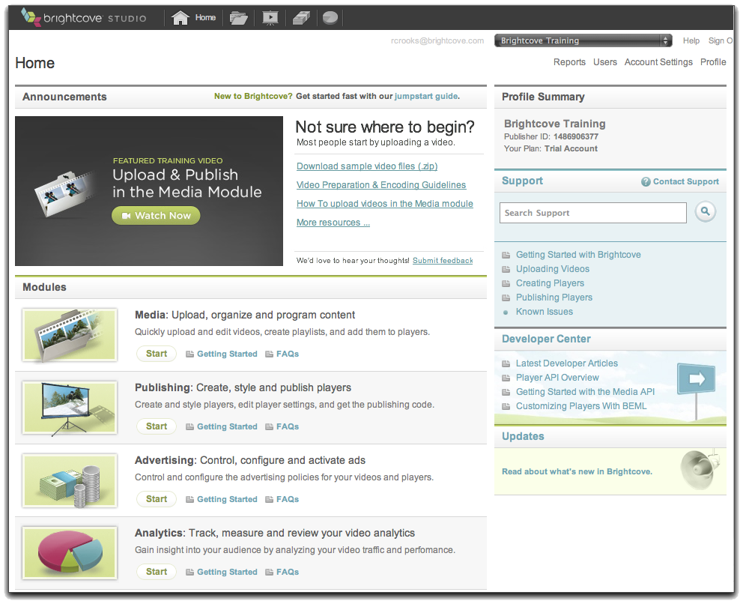
Video Cloud Platform Architecture
Publishing code
(Publisher, Player
Video IDs, Player
Dimensions)
Transfer videos
Your Web Server
Content Delivery Network
(CDN)
Video Cloud Servers
Transcode and
store videos with
metadata, playlists,
player settings
Requested page
with references
to player and
videos
Upload video,
add settings
Viewer
Your System
Video Cloud Studio

Slide 6
Troubleshooting players/playback issues
There’s no magic formula, but there is a player debugger – Flash only – if videos aren’t playing back at all, that’s a good place to start
Common issues
Rendition issues – check them in the video settings to make sure they are ok
HTML5 specific issues
HLS renditions required for longer videos
Some styling in players can prevent functioning in HTML5 mode

Slide 7
AllianceBernstein
Day 2 (9:00 - 1:00) (programming knowledge required)

Slide 8
Agenda
The new Analytics API (30 min)
Resizing players (60 min)
Understanding absolute and relative sizing
Resizing via the Player API
Responsive resizing via CSS
Fixing a player on a page (more players and CSS) (30 min)
Chaptered video solution (more Player API) (60 min)
Playing different videos in the same player - different approaches (60 min)

Slide 9
Video Cloud Studio Overview

Slide 10
Introduction to the new Analytics API
A RESTful API
Make HTTP GET requests
Get back JSON data
http://files.brightcove.com/BCL-analytics-api-reference.html

Slide 11
Resizing Players
Resizing via the publishing code
<param name="width" value="320" />
<param name="height" value="180" />
Limitations
A few players don’t resize well because components have fixed sizes
Careful with aspect ratio!
Resizing via the Player API
Works well for Flash player, not so well for HTML
Resizing via CSS
Wrap the player in a <div>
Set player width and height to 100%
Size the <div> directly or via JavaScript

Slide 12
Using CSS for responsive player sizing
Requires only CSS
Useful when the overall contents expand and contract with the window size
The main technique is simply sizing blocks based on percentages, so they can expand and contract
The key is using padding properties in a wrapper for the player to maintain the aspect ratio during resizing
http://files.brightcove.com/BCL_responsive-player-sample.html

Slide 13
Fixing the player on a page
Again, simple CSS is the best solution: CSS positioning
You can fix just the player, but then during scrolling, other content will flow over or under it
To prevent that, fix a whole column
http://files.brightcove.com/BCL-fixedplayer.html

Slide 14
Chaptered Video
Requires the Smart Player API
Relies on cue points set for the video to mark the chapter beginnings
You need to store the chapter name and anything else you want to display (like a link to a thumbnail image)
The name and metadata properties for the cue points are a convenient place
This data is available through the API when a cue point is hit, or when you read out the whole cue point set
Basic technique
Read the cue point data when the video loads
Set up the display using the name and metadata
Use the times for the cue points to seek to that point
Optionally, set up a cue point listener to act when the cue point is hit (highlight the chapter, etc.)
Gotchas:
Seek only works while the video is playing
Video playback on iOS must be initiated by the user
If you authenticate users or use cookies, you could save the last viewed chapter

Slide 15
Playing different videos in the same player
Basic technique: use Quick Publishing
<param name="@videoPlayer" value="1195804260001" />
Another way: use a URL parameter
http://files.brightcove.com//BCL-player-test.html
http://files.brightcove.com//BCL-player-test.html?bctid=1807962446001
Another way: use the Smart Player API (possibly with the Media API)
There’s a simple method: loadVideoByID()
The question is where do the IDs come from
http://files.brightcove.com/BCL-MediaAPI_Ex2.html

