Slide 1
The New Video Cloud Analytics
Robert Crooks | Director of Learning Services

Slide 2
Agenda
What are analytics
The new analytics UI
The new analytics API
Analytics API solutions

Slide 3
What Are Analytics?
Data on the performance of your video content
Uses – helps you answer questions to refine your video strategy
Which of my videos are most popular?
Which of my videos are trending?
Where is the best place on my site to place videos to maximize consumption?
How engaging are my videos? Are there places where I lose lots of viewers?
Where are my users coming from? Other domains? Search engines – what were they searching for?
What devices are my videos being watched on?

Slide 4
The New Analytics UI

Slide 5
The New Analytics UI
Gives you predefined reports and charts
Customize with date ranges
Drill down into more specific data
Built entirely in HTML, so viewable on all devices
Real-time data/updates

Slide 6
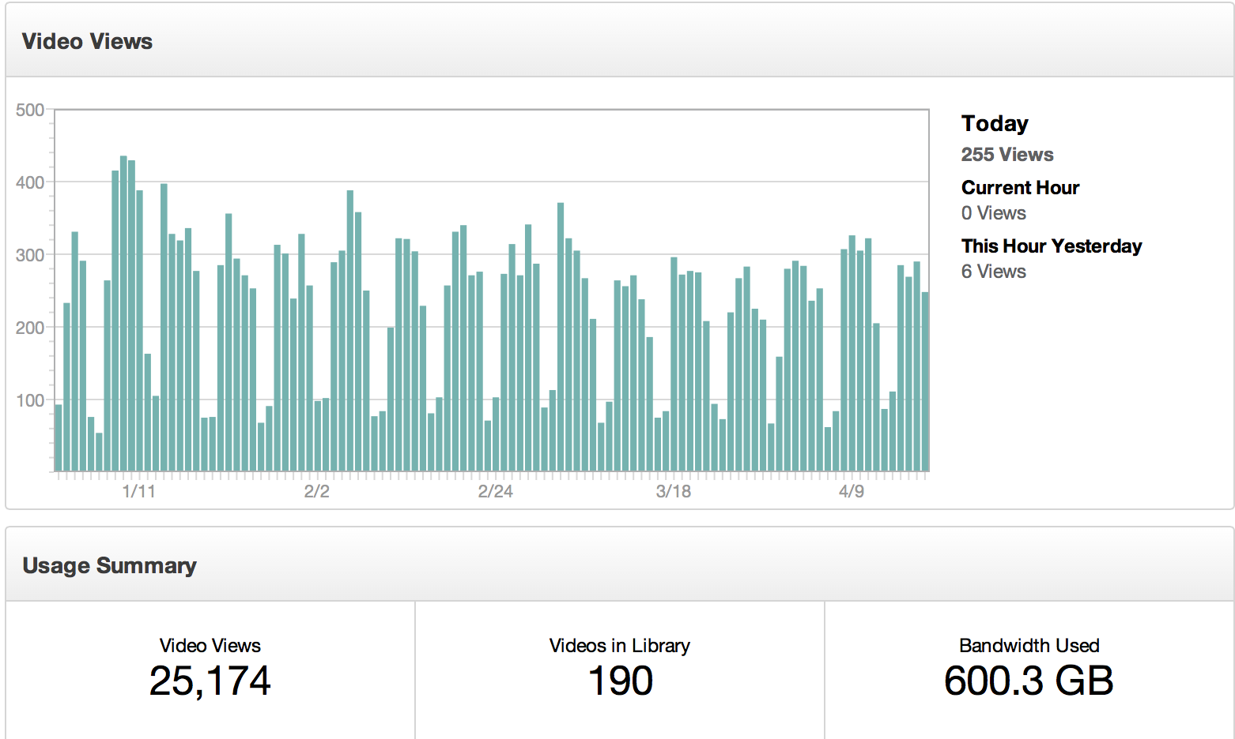
The New Analytics UI

Slide 7
Demo

Slide 8
The New Analytics API

Slide 9
The New Analytics API
The backend for UI
A REST-based API that you can access from any programming language/application
Allows you to retrieve the data directly and use it in any way you like
Provides account rollups and detailed reports
Multiple dimensions and filters to allow you to retrieve just the data you want
Sample request:
https://data.brightcove.com/analytics-api/videocloud/account/20318290001?from=alltime&to=now

Slide 10
Dimensions
Dimension | Explanation
account | The id for the Video Cloud account — the account dimension is required for all requests
video | The video dimension gives you reports organized by video, or allows you to filter the response by a specific video.
player | The player dimension gives you reports organized by player, or allows you to filter the response by a specific player.
referrer_domain | The referrer_domain dimension is the top private domain of the referrer URL on a page where video events are collected.
search_terms | The search_terms dimension is the keywords used if the traffic source that resulted in events being collected for activity metrics was a search engine,

Slide 11
Filters
Filter | Explanation
from | Start of the range in which to return data
to | End of the range in which to return data
where | Dimension value to filter on
limit | The number of results to return
offset | The number of results to skip
sort | The metric to sort the results by

Slide 12
Sample Requests Decyphered
Rollup for a specific video
https://data.brightcove.com/analytics-api/videocloud/account/20318290001?where=video==731212891001&from=1357732800000&to=1357776000000
Report on all videos for an account
https://data.brightcove.com/analytics-api/videocloud/account/20318290001/report?dimensions=video&from=1362103200000&to=1362189600000
Report on referrer_domains for a specific player
https://data.brightcove.com/analytics-api/videocloud/account/20318290001/report?dimensions=referrer_domain&from=1349798400000&where=player==1039236672001

Slide 13
The Response
JSON
Example:
{
"account": "20318290001",
"item_count": 4,
"items": [
{
"player_load": 116,
"source_type": "direct",
"video_impression": 116,
"video_view": 46
} ],
"player": "1922430209001"
}

Slide 14
Metrics
Metric | Explanation
active_media | Number of active videos at the beginning and end of the time period
bytes_in | Data related to inbound http requests, headers, etc. — measurements taken once per day
bytes_out | Data sent from the server out to the viewer — measurements are taken once per day
bytes_overhead | TCP and FMS overhead expended inside the CDN network
bytes_player | A time-based series showing the number of player loads for each step, typically an hour
player_load | A time-based series showing the number of player loads for each step, typically an hour
video_impression | A time-based series showing the number of video loads for each step, typically an hour
video_view | A time-based series showing the number of video views for each step, typically an hour
video_engagement | A percentile-based series — engagement divides videos into 100 equal segments, the numbers in the series show the number of views recorded in each segment
video_percent_viewed | A time-based series giving the aggregate percentage of videos viewed during the step
video_seconds_viewed | A time-based series showing the number of video seconds viewed for each step

Slide 15
Metrics by Dimension
Metric | account | player | video | referrer_domain | source_type | search_terms | device_type | device_os
active_media | x
bytes_in | x
bytes_out | x
bytes_overhead | x
bytes_stored | x
bytes_player | x
player_load | x | x |  | x | x | x | x | x
video_impression | x | x | x | x | x | x | x | x
video_view | x | x | x | x | x | x | x | x
video_engagement | x | x | x
video_percent_viewed | x | x | x | x | x | x | x | x
video_seconds_viewed | x | x | x | x | x | x | x | x

Slide 16
Sample Solutions
API Request Builder
Most Popular Videos

