Slide 1
USING BRIGHTCOVE’S REST APIs
An Introductory Look
Matthew Boles | Sr. Learning Specialist | mboles@brightcove.com

Slide 2
AGENDA
What Are REST APIs?
Why Use the Brightcove REST APIs?
High Level Implementation View
Understanding the Client-Side Code
Example Code Reviews
Wrap It Up!

Slide 3
WHAT ARE REST APIs?
Simple definition

Slide 4
REST APIs DEFINITION
REpresentational State Transfer Application Programming Interface
Probably not helpful
A design pattern that:
Defines web services
Uses HTTP requests to GET, PUT, POST, PATCH and DELETE data
Request and response bodies are usually in JSON format
Consists of client and the web service resource

Slide 5
WHY USE REST APIs?
Add functionality
Location of samples
Demonstration of a few samples
Lots of functionality

Slide 6
ADD FUNCTIONALITY NOT AVAILABLE BY DEFAULT
General use cases
Searching to build custom reports/playlists
Combine functionality from multiple REST APIs
Integrating systems (such as Video Cloud with a CMS)
Specific use cases
Build a playlist from the newest videos
Get analytics by playlist
Retrieve data and display in player

Slide 7
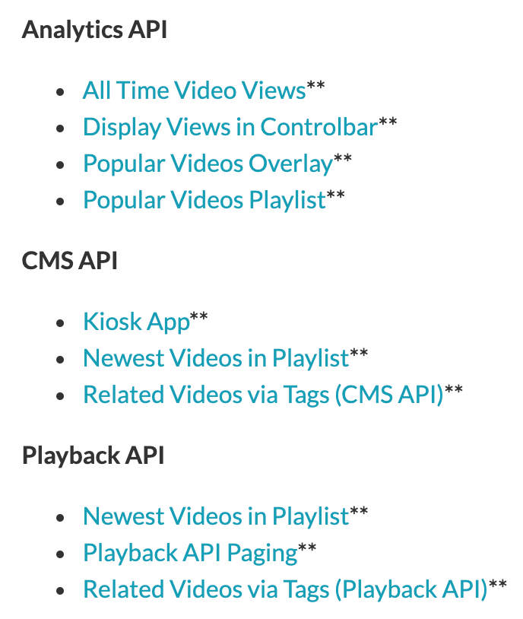
LOCATIONS OF SAMPLES
Check REST APIs index page for samples per API
https://apis.support.brightcove.com/
Brightcove Player samples
https://player.support.brightcove.com/code-samples/

Slide 8
DEMONSTRATION OF SAMPLES
Display Views in Controlbar (Brightcove Player related)
https://player.support.brightcove.com/code-samples/brightcove-player-sample-display-views-controlbar.html
Newest Videos in Playlist (Brightcove Player related)
https://player.support.brightcove.com/code-samples/brightcove-player-sample-newest-videos-playlist.html
Identifying Low Performing Content (API app)
https://apis.support.brightcove.com/cms/managing-videos/identifying-low-performing-content.html

Slide 9
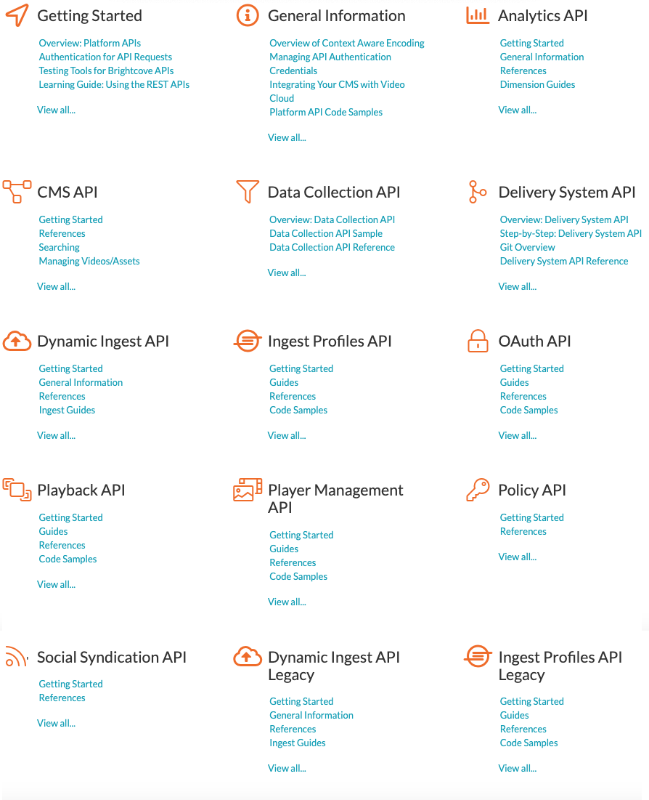
LOTS OF FUNCTIONALITY
https://apis.support.brightcove.com/

Slide 10
HIGH LEVEL IMPLEMENTATION VIEW
Three entities involved
Entity interaction

Slide 11
THREE ENTITIES INVOLVED
Client code
Requests data from the API
Displays returned data
Proxy server (for web apps)
For security reasons Brightcove REST APIs will not accept request directly from client
Server based apps can make requests directly
You must setup a proxy server under your control
Demos use a web app and PHP proxy
https://player.support.brightcove.com/getting-started/learning-guide-using-rest-apis.html#Proxy_code
REST APIs
GET, PUT, POST, PATCH and DELETE data

Slide 12
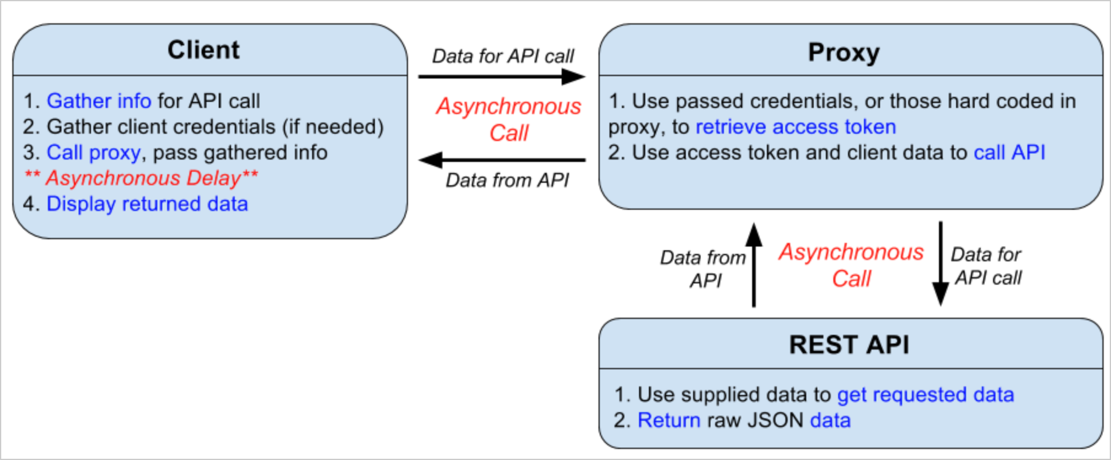
ENTITY INTERACTION

Slide 13
UNDERSTANDING THE CLIENT CODE
Client functionality overview
Function makeRequest – Reusable!
You write the code: Build the request
You write the code: Display returned data

Slide 14
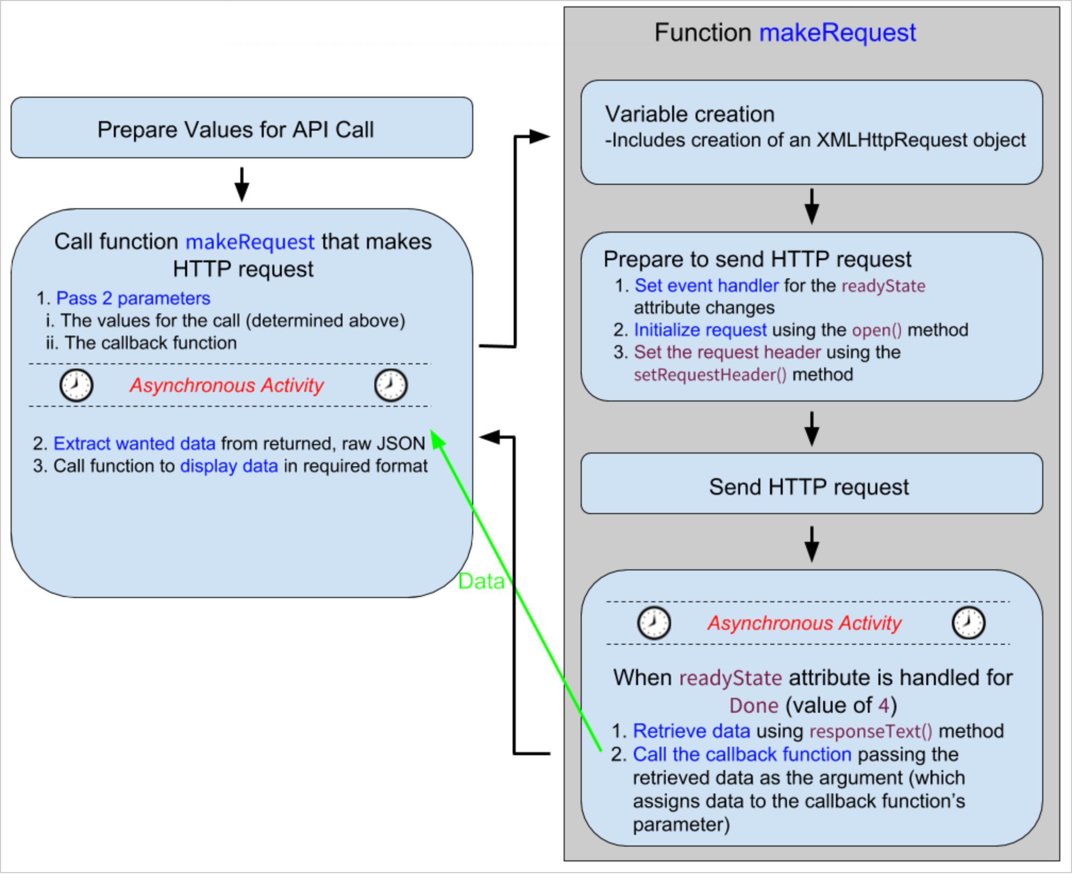
CLIENT FUNCTIONALITY OVERVIEW

Slide 15
FUNCTION makeRequest – REUSEABLE!
function makeRequest(options, callback) //function signature
Parameters (in blue)
options: At a minimum
@param {String} options.url the full API request URL
@param {String="GET","POST","PATCH","PUT","DELETE"} HTTP type for the request
@param {String} options.proxyURL proxyURL to send the request to
Either pass in credentials in the options object or hard code them in the proxy server code
callback: A callback function in which the returned data will be contained
makeRequest(options, function (response) {…}
Data will be returned in the response parameter

Slide 16
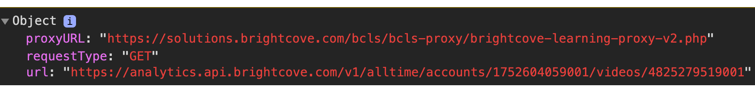
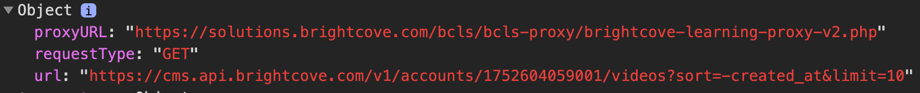
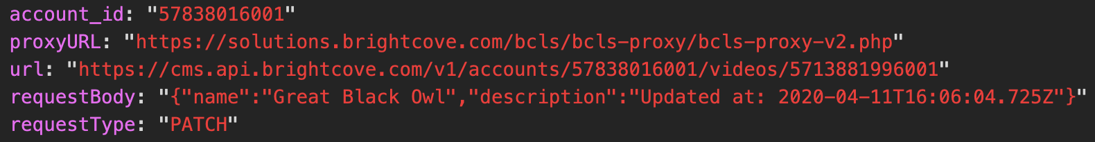
YOU WRITE THE CODE: BUILD THE REQUEST
Build the options parameter object
Specify proxy URL
Specify HTTP method
Build the API call URL

Slide 17
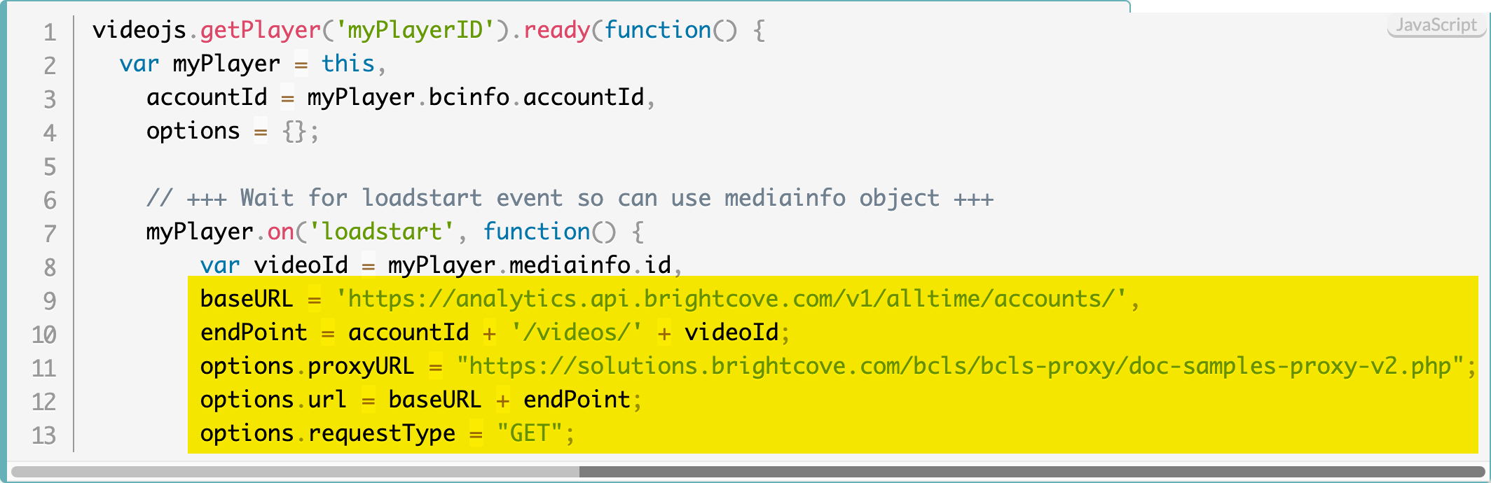
YOU WRITE THE CODE: BUILD THE REQUEST

Slide 18
YOU WRITE THE CODE: DISPLAY DATA
Examples
Place results in the player’s controlbar
Build an MRSS feed
Display in JSON or CSV

Slide 19
YOU WRITE THE CODE: DISPLAY DATA
/** * Dynamically build a div that is then * placed in the controlbar's spacer element */ function placeCountInControlbar(viewsCount) { var spacer, newElement = document.createElement('div’); //Place data in div newElement.textContent = "Total Views: " + viewsCount; //Get the spacer in the controlbar spacer = document.getElementsByClassName('vjs-spacer')[0]; //Right justify content in the spacer and add top margin spacer.setAttribute('style', 'justify-content: flex-end; margin-top: 10px’); //Add the dynacmially built div to the spacer in the controlbar spacer.appendChild(newElement); }

Slide 20
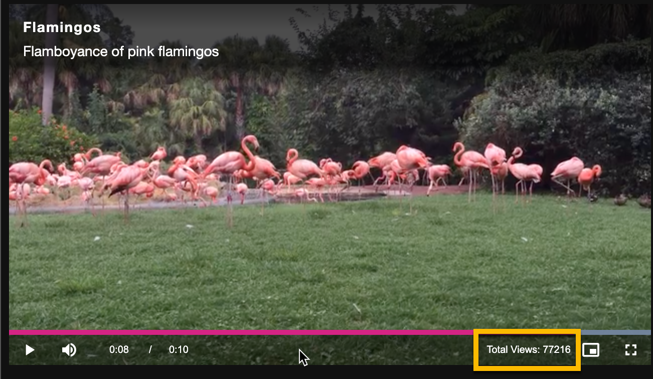
YOU WRITE THE CODE: DISPLAY DATA

Slide 21
EXAMPLE CODE REVIEWS
Display views in controlbar
Bulk update video metadata
Video engagement graph

Slide 22
DISPLAY VIEWS IN CONTROLBAR
Display Views in Controlbar (Brightcove Player related)
https://player.support.brightcove.com/code-samples/brightcove-player-sample-display-views-controlbar.html

Slide 23
UPDATE VIDEOS
Bulk update a set of video’s metadata
https://apis.support.brightcove.com/cms/code-samples/cms-api-sample-update-videos.html

Slide 24
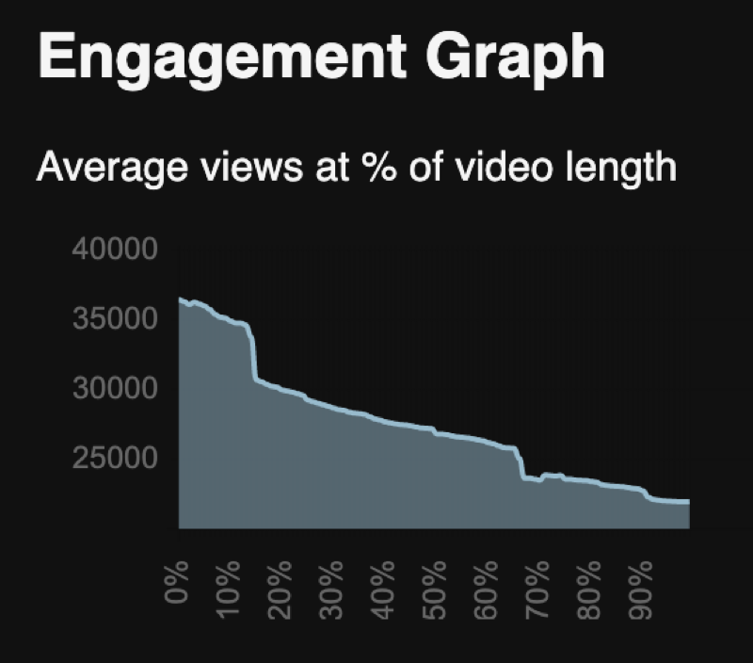
VIDEO ENGAGEMENT GRAPH
Bulk update a set of video’s metadata
https://apis.support.brightcove.com/cms/code-samples/cms-api-sample-update-videos.html

Slide 25
SESSION SUMMARY
MAIN LEARNING POINTS
What/Why REST APIs
3 key entities: Client/Proxy/REST API
makeRequest() function reusable code to actually call REST API
For each application, you must write code to
Build the request
Display the returned data

Slide 26
KEY RESOURCES
Learning Guide: Using the REST APIs
https://player.support.brightcove.com/code-samples/brightcove-player-sample-display-views-controlbar.html
Video Cloud Platform APIs Documentation
https://apis.support.brightcove.com/
Player Samples
https://player.support.brightcove.com/code-samples/

