Slide 1
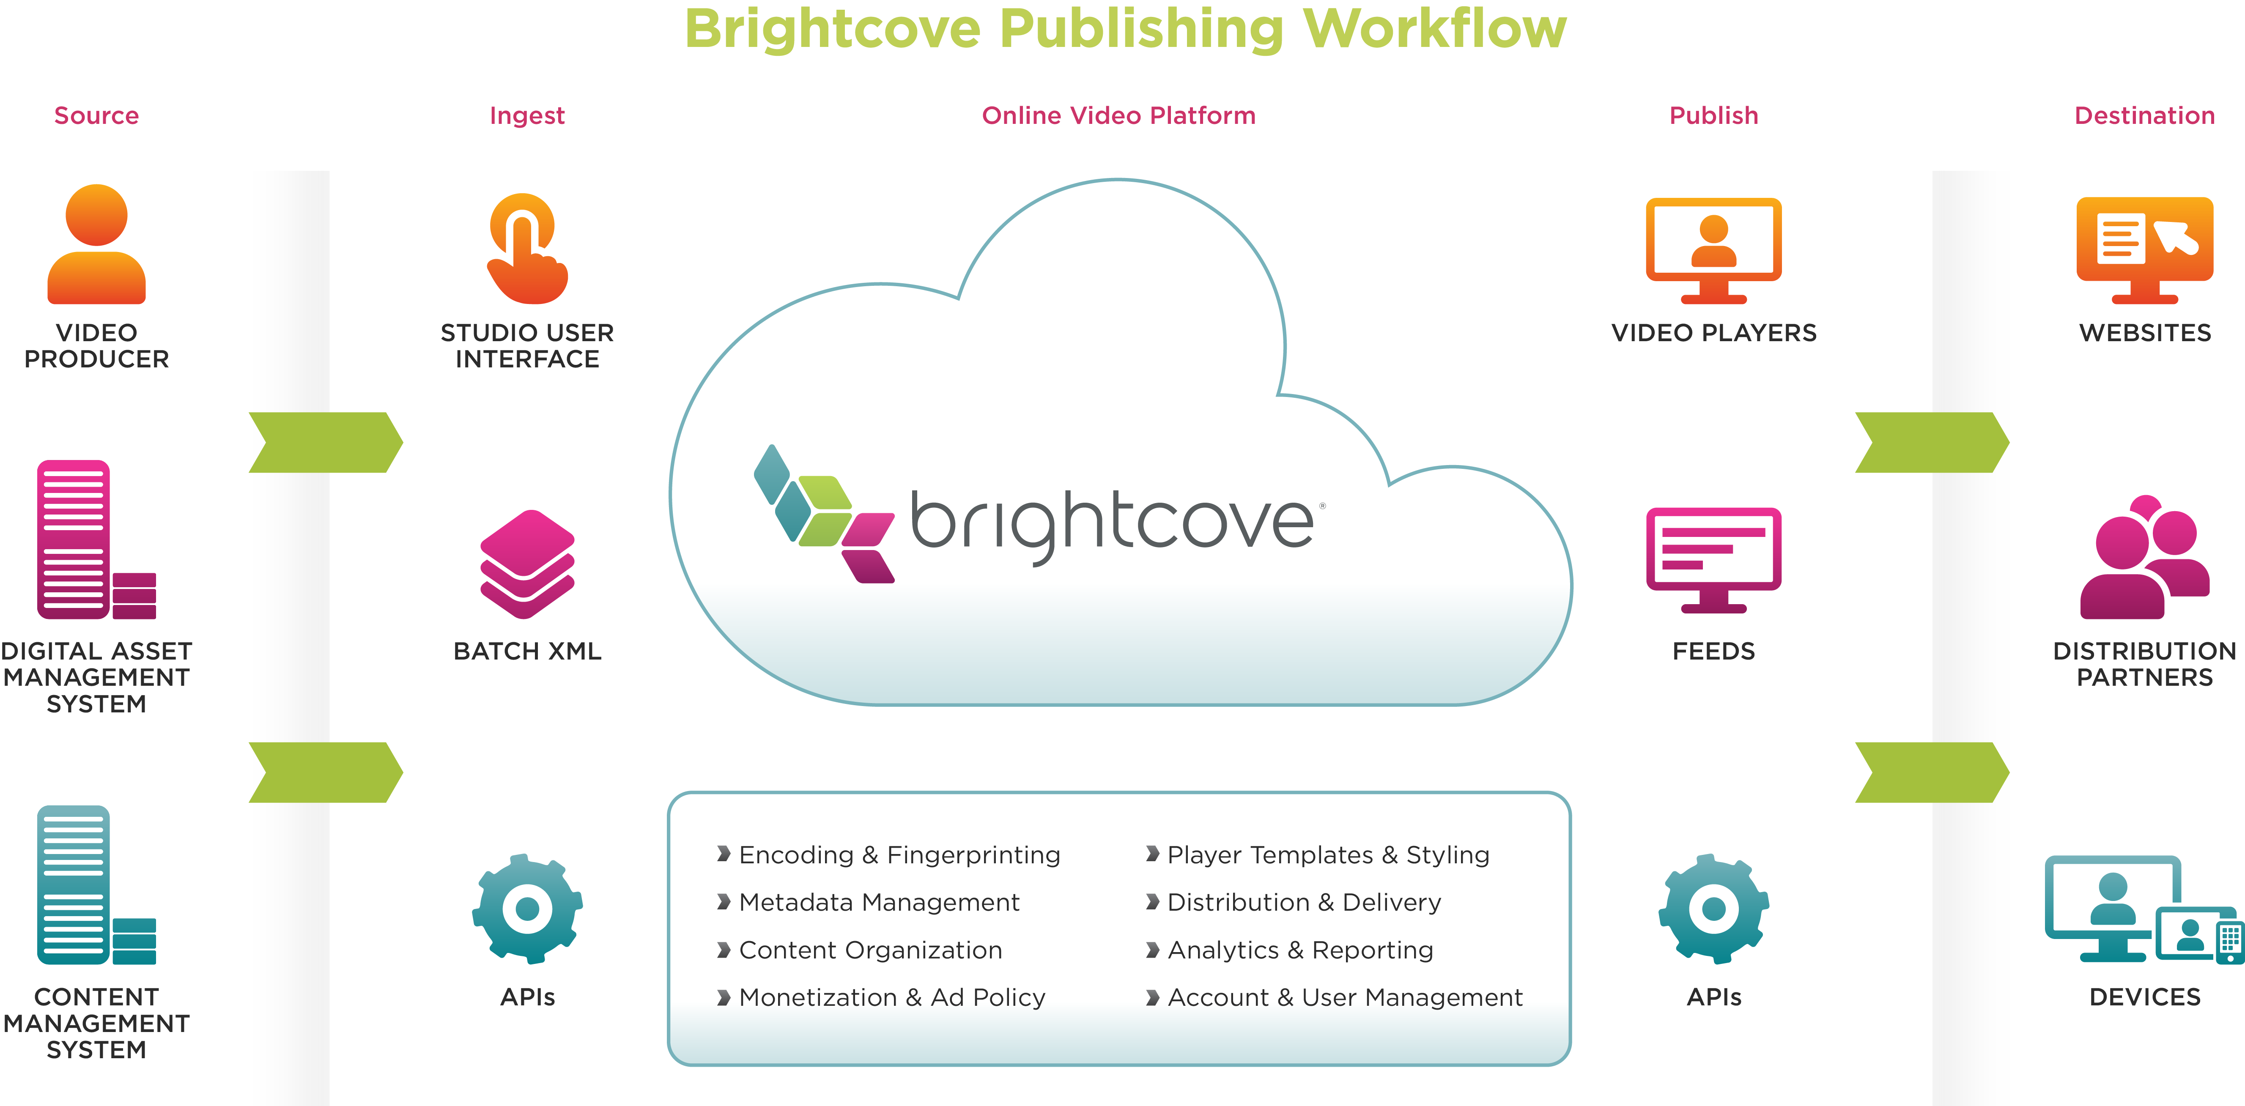
The Brightcove Online Video Platform
Easily Upload
Videos Manually or Programmatically
Easily Deliver to any Device, Destination,
or Distribution Partner
Encoding, Store and Organize
Custom Branded Players Advertising, Analytics
Live, Mobile and more

