Slide 1
Developing with the Flash-Only Player API
Brightcove Video Cloud Training

Slide 2
Agenda
About the Class
Introduction
Getting Started
Accessing Modules and Data
Handling Events
Handling the Menu
Performing Searches
Manipulating Player Components
Using Video Metadata to Modify Player Components
Responding to Cue Points
Implementing Captions

Slide 3
Set Up
Brightcove Account
All the course samples work off of a Developer Training account, but they should work with your own players as well
Samples
Can be viewed in any web browser
You will also need an editor for HTML/JavaScript
Any plain text editor will work
An editor such as Espresso, Coda, Dreamweaver, BBEdit, or CoffeeCup, that provides code-hinting and syntax highlighting is recommended
3
Notes:
3
WAMP Package on USB Drive / CD-R
Copy Folder XAMPP to C:\
Run C:\XAMPP\xampp_setup.bat
Run C:\XAMPP\xampp_start.bat
This will be part of the set up ….
WAMP Package on USB Drive / CD-R
Copy Folder XAMPP to C:\
Run C:\XAMPP\xampp_setup.bat
Run C:\XAMPP\xampp_start.bat
What are the instructions to restart the sandbox

Slide 4
Players Used in the Course
Three players are used in the course, two built from the same template – one has a playlist added to it, the other does not – and the third built from a slight modified template
The third player is used only in Exercise 8
The BEML code for the main template is contained in PlayerAPI_BEML.xml
The BEML code for the Exercise 8 template is in PlayerAPI_ViewStackPlayer_BEML.xml
Review these files now and refer back to as needed to get component IDs and other information

Slide 5
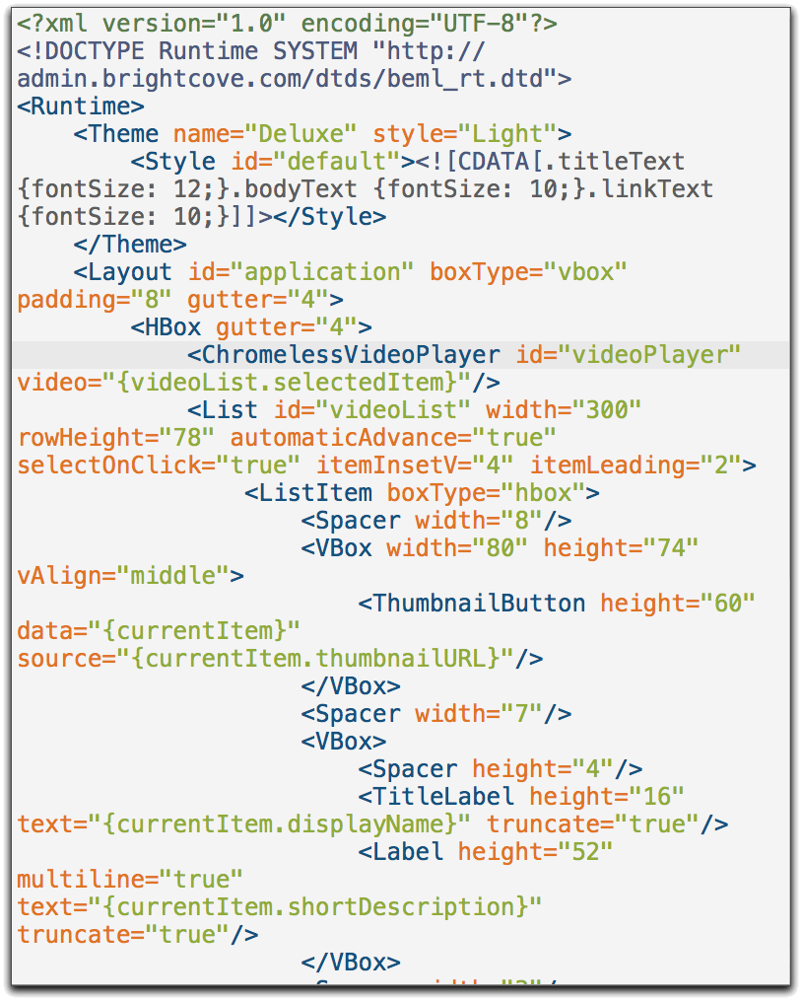
Demo: Examine the Player Templates

Slide 6
Introduction

Slide 7
The Player API
Customize, integrate with or add functionality to your players through external scripts. The API:
Exposes objects and events in the player
Offers methods to control or alter functionality
Allows for reporting or acting on player events
JavaScript and ActionScript interfaces provided
NOTE: in this class we will use the JavaScript version to avoid the need for specialized tools like Flash or Flex, but all the techniques taught in this class can be implemented in ActionScript as well
For more information on using the ActionScript Player API see http://support.brightcove.com/en/docs/using-actionscript-player-api
7
Notes:
7
Need to get code from the publishing module to start.
You’ll be writing lots of code that deals with the different events.
If you need features we don’t provide,

Slide 8
Player API Classes
Brightcove Experience
Modules
Video Player Module
Content Module
Search Module
Menu Module
Captions
Advertising Module
Social Module
Cuepoints Module
Experience Module
Components
Banner
Button
Combo Box
Expanding Banner
Image
Label
Layout Box
Link
List
Media Controls
Playhead
SWFLoader
Tab Bar
Text Region
Tile List
Toggle Button

Slide 9
Reference
Player API Reference
http://docs.brightcove.com/en/player/
Lists all the supported objects, methods and events
Do not use undocumented methods!

Slide 10
The Player API is EVENT-DRIVEN
Function Foo()
{
Player = LoadPlayer();
Player.loadVideo(123);
Player.start();
}
Experience is created
instantiated in ActionScript
or
page load in browser
onTemplateReady()
Player is ready for interaction
10
Notes:
10

Slide 11
Getting Started
11
Notes:
11

Slide 12

Setup
In Brightcove Studio
Create player instance
Enable the APIs!!!
Get the JavaScript publishing code
Add param to specify the TemplateReady event handler
In JavaScript:
Include Brightcove JavaScript API File
Set up TemplateReady handler
Get references to API modules and components
Set up handlers for events
Bolded items are the most common errors!
Best Practice: create a namespace for variables to avoid name conflicts with other scripts and libraries – in the sample code, we’ll use a BCL (Brightcove Learning) namespace by creating a global object with that name and storing all “global” vars as properties of that object
12
Notes:
12

Slide 13
Studio Generated JS Code+API Script
<!-- Start of Brightcove Player -->
<script language="JavaScript" type="text/javascript" src="http://admin.brightcove.com/js/BrightcoveExperiences.js"></script>
<!-- add the following tag to import the Player API – you can move
both script tags somewhere else if you like -->
<script src="http://admin.brightcove.com/js/APIModules_all.js"> </script>
<object id="myExperience" class="BrightcoveExperience">
<param name="bgcolor" value="#FFFFFF" />
<param name="width" value=“486" />
<param name="height" value=“412" />
<param name="playerID" value="12000045388" />
<param name="publisherID" value="18786002"/>
<param name="isVid" value="true" />
<!-- specify TemplateReady handler -->
<param name="templateReadyHandler" value="BCL.onTemplateReady" />
</object>
<!-- End of Brightcove Player -->
13
Notes:
13

Slide 14
Getting Player and Module References
<!-- publishing code →
<object id="myExperience" class="BrightcoveExperience">
...
<param name="templateReadyHandler" value="BCL.onTemplateReady" />
...
<script type="text/javascript">
var BCL = {};
BCL.onTemplateReady = function(event) {
// check for API enabled and included
console.log("Template Ready");
BCL.player = brightcove.getExperience("myExperience");
BCL.experienceModule = BCL.player.getModule(APIModules.EXPERIENCE);
}
</script>
14
Notes:
14

Slide 15
Adding Event Listeners
var BCL = {};
BCL.onTemplateReady = function(event) {
BCL.player = brightcove.getExperience("myExperience");
BCL.experienceModule =
BCL.player.getModule(APIModules.EXPERIENCE);
BCL.videoPlayer = BCL.player.getModule(APIModules.VIDEO_PLAYER);
BCL.videoPlayer.addEventListener(BCMediaEvent.PLAY, BCL.onPlay);
}
BCL.onPlay = function(event) {
// handler code here
}
15
Notes:
15

Slide 16
Exercise 1: Preparing Player for JavaScript
Solution: /solution/PlayerAPI_Ex1.html
16
Notes:
16

Slide 17
Accessing Modules and Data

Slide 18
Player Modules
Higher level functional areas
Content retrieval
Search
Menu system
Social controls
Video Player is exception!
All modules include:
addEventListener(type, handler);
removeEventListener(type, handler);
18
Notes:
18
Started at 1:43
10 minutes for this exercise
1:50 it started

Slide 19
Accessing Modules
BCL.videoPlayer =
BCL.player.getModule(APIModules.VIDEO_PLAYER);
BCL.contentModule = BCL.player.getModule(APIModules.CONTENT);
BCL.searchModule = BCL.player.getModule(APIModules.SEARCH);
19
Notes:
19

Slide 20
Public Constants for Modules
ADVERTISING : AdvertisingModule
CAPTIONS : CaptionModule
CONTENT : ContentModule
CUE_POINTS : CuePointsModule
EXPERIENCE : ExperienceModule
MENU : MenuModule
SEARCH : SearchModule
SOCIAL : SocialModule
VIDEO_PLAYER : VideoPlayerModule

Slide 21
Data Transfer Objects
Data objects sent from server
Simple collection of properties (no methods)
Represent media and collections of media managed in Brightcove Studio media module
MediaDTO => VideoDTO
MediaCollectionDTO => PlaylistDTO
To get the VideoDTO for the video currently in the player, get a reference to the VideoPlayer Module, and then use the getCurrentVideo() method
Full listing of objects and properties in reference documentation
21
Notes:
21
Started at 1:43
10 minutes for this exercise
1:50 it started

Slide 22
Exercise 2: Accessing Data in Player
Solution: /solution/PlayerAPI_Ex2.html
22
Notes:
22

Slide 23
Handling Events

Slide 24
Event Objects
Sent to all handlers added through addEventListener()
Inherit from ActionScript Event object
Includes all super event properties (type)
Each event contains additional properties
BCMediaEvent includes media, position, duration
BCContentEvent includes media, mediaCollection
24
Notes:
24
Started at 1:43
10 minutes for this exercise
1:50 it started

Slide 25
Synchronous and Asynchronous Methods
Synchronous methods
Retrieve data for media loaded into the player
Return values to caller
Allow immediate access to data requested
getMedia(), getMediaCollection()
Asynchronous methods
Retrieve media data from the Brightcove server
Include “Asynch” in name
Return void
Require listeners set up to handle results
getMediaAsynch(), getMediaCollectionAsynch()
25
Notes:
25
Started at 1:43
10 minutes for this exercise
1:50 it started

Slide 26
Using Synchronous and Asynchronous Methods
function onTemplateReady(event) {
...
BCL.contentModule = BCL.player.getModule(APIModules.CONTENT);
var playlist = BCL.contentModule.getMediaCollection(playlistID);
if (playlist == null) {
BCL.contentModule.addEventListener(
BCContentEvent.MEDIA_COLLECTION_LOAD,
BCL.onMediaCollectionLoad
);
BCL.contentModule.getMediaCollectionAsynch(playlistID);
} else {
renderPlaylist(playlist);
}
}
BCL.onMediaCollectionLoad = function(event) {
var playlist = event.mediaCollection;
if (playlist != null) {
renderPlaylist(playlist);
}
}
26
Notes:
26

Slide 27
Event Classes
BCAdEvent
BCBEMLMouseEvent
BCCaptionsEvent
BCContentEvent
BCCuePointEvent
BCEmbedCodeEvent
BCErrorEvent
BCExperienceEvent
BCLoaderEvent
BCMediaEvent
BCMenuEvent
BCPropertyChangeEvent
BCSearchEvent
BCShortenedLinkEvent
Note: Prepend BC to the event classnames found in the API docs

Slide 28
Constant Names for Events – MediaEvent
Just a sample for the BCMediaEvent class
BEGIN = "mediaBegin"
BUFFER_BEGIN = "mediaBufferBegin"
BUFFER_COMPLETE = "mediaBufferComplete"
CHANGE = "mediaChange"
COMPLETE = "mediaComplete"
ERROR = "mediaError"
MUTE_CHANGE = "mediaMuteChange"
PLAY = "mediaPlay"
PROGRESS = "mediaProgress"
RENDITION_CHANGE_COMPLETE = "mediaRenditionChangeComplete"
RENDITION_CHANGE_REQUEST = "mediaRenditionChangeRequest"
SEEK = "mediaSeek"
STOP = "mediaStop"
VOLUME_CHANGE = "mediaVolumeChange"
Sample: add listener
BCL.videoPlayer.addEventListener(BCMediaEvent.BEGIN, BCL.onMediaBegin)

Slide 29
Exercise 3: Loading Additional Content
Solution: /solution/PlayerAPI_Ex3.html
29
Notes:
29

Slide 30
Handling the Menu
30
Notes:
30

Slide 31
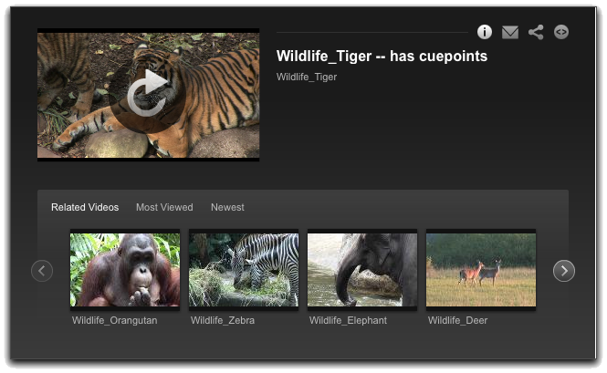
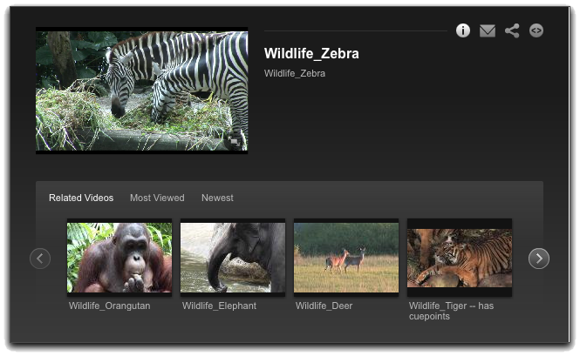
If the Menu Is Showing
In the last exercise, if you waited until a video stopped playing and then selected a new video, you saw that the new video played in the area where the video still of the previous video played
It’s not an image – it’s a video player

Slide 32
Getting Control of the Menu
We can easily prevent this:
Get a reference to the Menu Module
Before loading a video, check to see if the menu is open, and if so, close it
function onTemplateReady(event) {
...
BCL.menuModule = BCL.player.getModule(APIModules.MENU);
}
...
BCL.playVideo = function(videoID) {
// isMenuPageShowing() method returns a boolean
if (BCL.menuModule.isMenuPageShowing()) {
BCL.menuModule.closeMenuPage(); }
BCL.videoPlayer.loadVideo(videoID);
}

Slide 33
Exercise 4: Handle the Menu
Solution: /solution/PlayerAPI_Ex4.html
33
Notes:
33

Slide 34
Performing Searches

Slide 35
Search Methods
Search Module holds all methods for dynamic searches of media catalog
findAllVideos()
findRelatedVideos()
findVideosByText()
findVideosByTags()
VideoSearch
Object returned in search result
Can be used to page through search results
The collection of videoDTOs will be an array called “items,” which is a property of the event object
35
Notes:
35
Started at 1:43
10 minutes for this exercise
1:50 it started

Slide 36
Finding Related Videos
function onVideoChange(event) {
BCL.searchModule = BCL.player.getModule(APIModules.SEARCH);
BCL.searchModule.addEventListener(
BCSearchEvent.RESULT,
BCL.onSearchResult
);
BCL.searchModule.addEventListener(
BCSearchEvent.ERROR,
BCL.onSearchError
);
BCL.searchModule.findRelatedVideos(event.media.id);
}
BCL.onSearchResult = function(event) {
console.log(event.items);
console.log(event.videoSearch);
}
36
Notes:
36

Slide 37
Exercise 5: Adding Search
Solution: /solution/PlayerAPI_Ex5.html
37
Notes:
37

Slide 38
Manipulating Player Components
38
Notes:
38

Slide 39
Manipulating Player Components
Up to this point, we’ve been responding to player events by modifying the HTML page
Now we’ll see how we can manipulate the player components
This is much easier if the BEML code provides id values for the components you want to modify:
var videoPlayer = BCL.experienceModule.getElementByID(“videoPlayer”);
Some id values for our players:
Video Player: videoPlayer
List: videoList
Link: relatedLink
TitleLabel: videoTitle
Image: playerImage

Slide 40
Loading a Video List
In the last section, we saw that searches return an object that contains an array of VideoDTOs
Instead of writing that list into HTML elements, we can set it as the data for the List in the player

Slide 41
Exercise 6: Creating a Custom Playlist
Solution: /solution/PlayerAPI_Ex6.html
41
Notes:
41

Slide 42
Using Video Metadata to Modify Player Components

Slide 43
Changing Component Properties with Video Data
We already know how to use getCurrentVideo() to get the videoDTO for the current video
We can use metadata from the DTO to set properties on other components in the player
Note that the videos in our training account have the following custom fields:
dfxppath : URL for captions in DFXP format
imagepath : URL for an image associated with the video
videotopic : the topic of the video ( Air | Land | Sea | Training )
Remember that components have getters and setters for most properties
Image → setSource()
TitleLabel/Label → setText()

Slide 44
Exercise 7: Modify Components Using Video Metadata
Solution: /solution/PlayerAPI_Ex7.html
44
Notes:
44

Slide 45
Listening for Cue Points

Slide 46
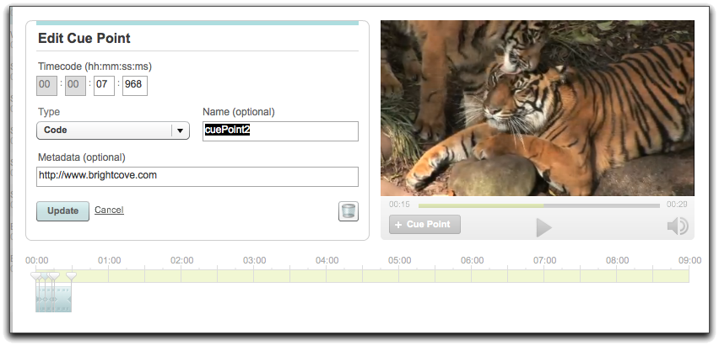
Using Cue Points
In addition to modifying your page and player on events like mediaLoad or mediaBegin, you may want to do things at different point during the media playback
You can do this using code cue points, which fire events you can listen for and respond to
Use the visual cue point editor in Studio to set cue points
There are also programmatic methods for adding cuepoints

Slide 47
Handling Cue Point Events
Get a reference to the CuePoint Module
Add a listener for Cue Point events (BCCuePointEvent.CUE)
Object returned when the event is broadcast will have the cue point name and metadata included as properties

Slide 48
Notes for Exercise 8
We’re building off of Exercise 7, but substituting a player that has a ViewStack that includes
the the List (id=videoList, index=0, displayed by default)
an Image (id=stackImage, index=1)
Remember from BEML that the ViewStack’s selected view can be set by 2 methods
setSelectedIndex(index)
setSelectedItemID(id)
The Tigers video has 3 code cue points; each has an image link as metadata

Slide 49
Exercise 8: Responding to Cue Points
Solution: /solution/PlayerAPI_Ex8.html
49
Notes:
49

Slide 50
Implementing Captions and Subtitles

Slide 51
The Captions Module
Supports only DFXP captions
DFXP file can contain captions for one or multiple languages
If there are multiple languages, getLanguages() and setLanguage() methods allow you to control which language the captions are displayed in
loadDFXP() method loads a DFXP file for a specific video
Brightcove generally recommends storing the path the DFXP file in a custom field, but it can also be stored as the related link URL or constructed dynamically if it is related to some unique item of metadata for the video, such as the videoID or referenceID
Captions are loaded asynchronously, will appear when loaded

Slide 52
Note on Exercise 9
If you just have captions in one language, captions are straightforward and you should fetch captions for all videos as soon as you can
If you have subtitles in multiple languages in a single DFXP file, then you can use setLanguage() to set which set of captions get shown
We will deal with a slightly more complex case where the different language subtitles are in multiple files that are named similarly
Our solution involves setting just the stub of a URL in the dfxppath custom field, which must then be completed programmatically based on a language selection by the user

Slide 53
Exercise 9: Displaying Captions
Solution: /solution/PlayerAPI_Ex8.html
53
Notes:
53

Slide 54
Thank you

