Slide 1
Setting Up

Slide 2
selecting an editor
You will need an editor for HTML/JavaScript
Any plain text editor will work
An editor such as Chocolat, Sublime Text, Dreamweaver, BBEdit, or CoffeeCup, that provides code-hinting and syntax highlighting is recommended

Slide 3
Test Media api requests
Use the Media API Test Tool to view video and playlist data returned from your account
Media API > Solutions > Media API Test Tool
http://solutions.brightcove.com/bcls/media/api-test-tool/media-api-test-tool.html

Slide 4
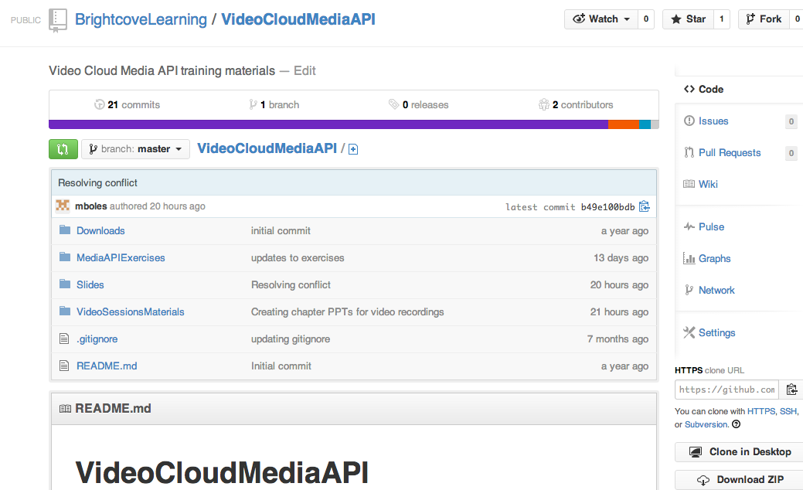
getting the student files
Get the student files and the slides
http://bit.ly/1eVbSth

Slide 5
Thank you
Brightcove Learning

