Slide 1
Developing with the Video Cloud Media API
Jeff Doktor, Learning Specialist
training@brightcove.com

Slide 2
Agenda
Introducing the Course
Setting Up
Understanding the Media API
Using Read Methods (Constructing requests, parsing returned data)
Controlling Responses (Limiting response size, sorting and paging)
Using Write Methods
Using Server-Side Calls
2

Slide 3
Introducing the Course

Slide 4
What is the Media API?
An API for accessing the content and metadata in your Brightcove account
API (Application Programming Interface)
Read requests allow you to search for videos or playlists
Write requests allow you to add, update, and delete videos and playlists
4
Notes:
4
Started at 3:04

Slide 5


Media API read requests
Read requests are REST based
REST (Representational State Transfer)
A standard way of accessing data stored remotely over HTTP
A cousin of SOAP = technology that powers "web services"
Abstracts the workings of the remote system
All your code needs to understand is the format of the returned data
Example Call
http://api.brightcove.com/services/library?command=search_videos&token=WDGO_XdKqXUpy8fzD41MKA8kAhQRAmdux8cu8LNhRzAywCnuBpgV_A..
5
Notes:
5
Started at 3:04

Slide 6
Media API write requests
Write requests use the JSON RPC protocol
JSON (JavaScript Object Notation)
An open standard format that uses human-readable text to transmit data objects consisting of attribute–value pairs
Used primarily to transmit data between a server and web application
Alternative to XML
6
Notes:
6
Started at 3:04

Slide 7
Media API write requests (cont)
RPC (Remote Procedure Call)
An inter-process communication
Allows a computer program to cause a subroutine or procedure to execute in another address space (commonly on another computer on a shared network)
A standard way of accessing data stored remotely over HTTP
Format includes the name of the method to be invoked, a parameter object and your write token
Example Call
{"method":"update_video","params":{"video":{"id":"2790007957001”,"Name":"Sea-Crab”,}, "token":"ZY4Ls9Hq6LCBgleGDTaFRDLWWBC8uoXQHkhGuDebKvjFPjHb3iT-4g.."}}
7
Notes:
7
Started at 3:04

Slide 8
why use the media api
Many examples in the Developer Documentation
http://docs.brightcove.com/en/video-cloud/media/index.html
8

Slide 9
who can use the media api
The Media API Read methods are available in the following editions
Express 3
Professional
Enterprise
The Media API Write methods are available in
Professional
Enterprise
You can use any programming language that than can make HTTP calls to work with the Media API
JavaScript is used in this course
9

Slide 10
course Audience and Prerequisites
Designed for developers, or project managers who want to understand the capabilities of the Media API
Some knowledge of HTML and some scripting/programming language will allow you to optimally benefit from the course
10

Slide 11
Setting Up

Slide 12
selecting an editor
You will need an editor for HTML/JavaScript
Any plain text editor will work
An editor such as Chocolat, Sublime Text, Dreamweaver, BBEdit, CoffeeCup or Brackets that provides code-hinting and syntax highlighting is recommended

Slide 13
Test Media api requests
Use the Media API Test Tool to view video and playlist data returned from your account
Media API > Solutions > Media API Test Tool
http://solutions.brightcove.com/bcls/media/api-test-tool/media-api-test-tool.html

Slide 14
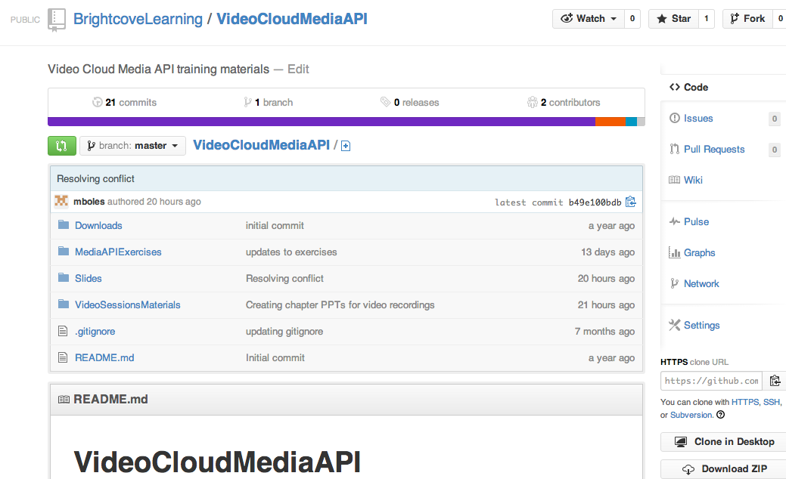
getting the student files
Get the student files and the slides
http://bit.ly/1eVbSth

Slide 15
Understanding the Media API

Slide 16
Media API details
The API allows you to interact with your Video Cloud media library
Use any programming language you choose
Works from the server side or client side
Read methods allow you to perform complex searches for videos or playlists
Write methods allow you to add, update, and delete video and playlist assets
16

Slide 17
media api reference
Reference documentation reflects the API's purpose
http://docs.brightcove.com/en/video-cloud/media/reference.html
17

Slide 18
Media api "speaks" json
Requests are formulated in JSON
Results are returned in JSON
18

Slide 19
JSON Format Details
Object
Unordered name/value pairs
Begins with { and ends with }
Name is followed by :
Name/value pairs are separated by ,
Array
Collection of values
Begins with [ and ends with ]
Values are separated by ,
If you are not familiar with JSON, see: http://www.json.org/
19
Notes:
19

Slide 20
json example
{
"items": [
{
"id": 1969844728001,
"name": "Water-Splashing",
"shortDescription": "Water-Splashing1"
}
],
"page_number": 0,
"page_size": 5,
"total_count": 1
}
20

Slide 21
Media API Security
Access to the API is protected with tokens that you pass as a parameter when making API calls
Tokens are generated for you by Brightcove and protected by you
There is a serious risk in including tokens in client-side scripts or SWFs, especially WRITE tokens
There are separate tokens for READ and WRITE access
This allows you to develop applications with role-based access
There are two kinds of READ tokens
URL Read token returns a link to the video rendition files; regular read token does not
Tokens generally end with one or more "." (Be careful not to drop these when you copy/paste)
21
Notes:
21

Slide 22
Understanding Read Methods

Slide 23
Read API – Typical Applications
Contextual Publishing
Displaying Video Metadata in the embedding web page or finding videos to match the page content
Search Engine Optimization
Using Metadata to optimize Search Engine pickup
CMS Integration
Integrating Metadata into your Corporate CMS
Syndication
Integrating your content into other portals & sites
23
Notes:
23

Slide 24
Read API Data Format
Methods which perform queries on our servers, and return sets of data in DTOs (Data Transfer Objects)
Data is cached for performance (up to 20 minutes)
Calling the READ API
HTTP GET Request
method-name and parameters in the URL
Must provide READ Token
Read API Parameters
All Read API Functions are defined in the online documentation:
http://docs.brightcove.com/en/video-cloud/media/index.html
24
Notes:
24

Slide 25
The Main READ APIs
Video READ
search_videos
find_video_by_id
find_videos_by_ids
find_modified_videos
Several "_unfiltered" methods
Playlist READ
find_all_playlists
find_playlist_by_id
find_playlists_by_ids
find_playlist_by_reference_id
find_playlists_by_reference_ids
find_playlists_for_player_id
Unfiltered methods return active as well as inactive, unscheduled or deleted assets
25
Notes:
25

Slide 26
The search_videos method
The recommended method for most video searches (Brightcove is actively working to enhance and optimize this method – use this instead of find methods)
Exceptions
You can’t find videos by id with search_videos – need to use find_video_by_id or find_videos_by_ids
Will not return inactive or deleted videos
search_videos allows for the most complex searches and is the only method that can search custom field values

Slide 27
Creating Read Requests

Slide 28
Constructing a Read API Request
Elements of a request
Base URL: http://api.brightcove.com/services/library?
Token: token=…
Command: &command=search_videos
Additional params:
&all=sea&any=tags:fish&any=bird&none=videotopic:mammal
Note: The all, any and none parameters will be discussed in detail in later content
&video_fields=id,name,customFields&page_size=3&get_item_count=true
Example: http://api.brightcove.com/services/library?command=search_videos&token=DNoR-SvA5yUqX2eE6KjgefOxRzQilw..&callback=onSearchResponse&any=wildlife
Parameter order does not matter
28
Notes:
base URL
token
command
additional params
all together now

Slide 29
Using the callback query parameter
The callback value is a user-defined function that will be called when the Media API responds to your request
The argument in your user-defined function will contain the data returned from the Media API
Example:
&callback=returnData
var returnData = function(jsonData){
console.log(jsonData);
}

Slide 30
Making the API read Request
Using the <script> tag
The src attribute loads an external JavaScript file
The external script is fetched and executed
The src attribute can also be used to pass a query string to the Media API
Example:
<script type="text/javascript" src="//api.brightcove.com/services/library?command=search_videos&callback=onSearchResponse&page_size=5&token=WDGO_XdKqXVJRVGtrNuGLxCYDNoR-SvA5yUqX2eE6KjgefOxRzQilw..">
</script>
30
Notes:
base URL
token
command
additional params
all together now

Slide 31
Demo 1: Constructing an API Read Request
31
Notes:
31

Slide 32
Introducing the MAPI Wrapper

Slide 33
Media api wrappers
There are wrappers for Media API methods for several languages on http://docs.brightcove.com/en/video-cloud/open-source/index.html
Reference Media API values and parameters by name instead of building the URL query string
Simplifies your coding and saves typos/errors
The BCMAPI object is defined in the wrapper, and then you reference values in this function
Example:
<script type="text/javascript" src="bc-mapi.js"></script>

Slide 34
Javascript Example
BCMAPI.token = document.getElementById("token").value;
BCMAPI.callback = "onSearchResponse";
params = {};
params.video_fields = getSelectValues(document.getElementById("videoFields")).join();
params.media_delivery = mediaDelivery.options[mediaDelivery.selectedIndex].value;

Slide 35
Demo 2: Creating an API Read Request with MAPI
35
Notes:
35

Slide 36
Parsing the JSON Response

Slide 37
Displaying returned data
Make the API Call
For example, search_videos
Parse the returned JSON String
Check for errors
Loop though the returned collection
Insert Into the Web Page (or other view)
Apply styling & formatting
37
Notes:
37

Slide 38
Parsing the JSON response
Client-side Javascript
Define a function that accepts a single parameter (the response object)
&callback=my_func
Insert the API call into a script tag on the page, and the response will be passed to your callback function
http://support.brightcove.com/en/docs/media-api-getting-started-using-javascript
Server-side
Use a library or built-in function from your language to convert JSON strings to native objects
38

Slide 39
Demo 3: Displaying Video Info
39
Notes:
39

Slide 40
Configuring the Request

Slide 41
Read API Results as XML
Good for syndication (but consider that an increasing number of developers are used to working with JSON, and many prefer it)
&output=rss
&output=mrss
Results are raw feeds, typically need additional processing to create nice MRSS feeds
41

Slide 42
Checking for Errors
Errors can be caused by typos or bad user input
In the JSON object
"error": a human-readable error name or message
"code": a numeric error code
Error code table: http://support.brightcove.com/en/docs/media-api-error-message-reference
{"error": "One or more validation errors have occurred","code":301}
42

Slide 43
Demo 4: Checking for Errors
43
Notes:
43

Slide 44
Limiting Response Size

Slide 45
Limiting Response Size by field name
Reasons to limit response size
Less bandwidth, better performance
Only request the metadata you need
Limit response size by using the video_fields parameter
A comma separated list of fields to include in the response data
Syntax
video_fields=id,name,…
playlist_fields=id,name,…
Some data fields are only returned when specifically requested
45

Slide 46
Limiting Response Size by search criteria
Limit response size by using the all, any, none parameters
all – all field:value pairs that MUST be present – logical AND
any – at least 1 field:value pair MUST be present – logical OR
none – field:value pairs that must NOT be present – logical AND
Syntax
all=field:value
all=value
any=[field:value, value]
none=field:value
If the field name is not specified, the displayName, shortDescription and longDescription are searched
46

Slide 47
Limiting Response Size by search criteria (cont)
Limit response size by using the all, any or none parameters
An input array is translated by BCMAPI as separate parameter pairs
Examples:
&all=tag:sea&all=fish
(returns videos that have both a tag value of sea and a value of fish)
&any=tag:sea&any=fish
(returns videos that have either a tag value of sea and a value of fish)
&none=tag:sea&none=fish
(returns videos that have neither a tag value of sea nor a value of fish)
47

Slide 48
Demo 5: Limiting Response Size
48
Notes:
48

Slide 49
Getting User Input Values

Slide 50
Dynamic Search Criteria
In many cases, you will be getting search criteria dynamically
From user input
From metadata for the currently playing video
From other content on the page
So far search criteria has been hard coded; there are times when you want user input
Add HTML form with input fields for dynamic data
Example
http://docs.brightcove.com/en/video-cloud/media/samples/search_videos.html
50

Slide 51
Demo 6: Using Dynamic Search Criteria
51
Notes:
51

Slide 52
Sorting Response Data

Slide 53
Sorting Data on the server
&sort_by=…
DISPLAY_NAME
PUBLISH_DATE
CREATION_DATE
MODIFIED_DATE
PLAYS_TOTAL
PLAYS_TRAILING_WEEK
The default sort order is ascending
You can specify the sort order by appending ASC or DESC
Example
DISPLAY_NAME:ASC
PUBLISH_DATE:DESC
Not all sorting options work for all methods---see reference docs
53

Slide 54
Sorting Data on the client
Sort response data using JavaScript sort() method
Playlist data can not be sorted on the server
Can create primary and secondary sort fields
Example
http://docs.brightcove.com/en/video-cloud/media/samples/search_videos_client_sort.html
54

Slide 55
Demo 7: Sorting Response Data
55
Notes:
55

Slide 56
Paging Results

Slide 57
Paging Response data
Handle large result sets in smaller groups
Improve performance
Loop through page data (total_count/page_size)
page_size limited to 100 items or less, depending on method
Recommend 25 items or less for best performance
Example
&page_size=5&page_number=0&get_item_count=true
57

Slide 58
Demo 8: Paging Response Data
58
Notes:
58

Slide 59
Understanding Write Methods

Slide 60
Write API – Typical Applications
Automate uploading of video assets
Upload directly from CMS or build into your local workflow
Useful for ongoing uploads or uploading User Generated Content
Not the best solution for initial upload of a large library, because Write requests are single-threaded – use Batch Provisioning instead
Data Consolidation
Populating ReferenceID's (with your Database's primary keys or whatever)
Populating Descriptions, tags, etc.
Moderation (providing limited access to your media library)
Giving partners or other affiliates the options they need without access to Video Cloud Studio
60
Notes:
60

Slide 61
Write API requests
Methods that create, update, or delete videos and playlists
Calling the WRITE API
Use an HTTP POST Request
The default format is application/x-www-form-urlencoded or multipart/form-data
The method-name and parameters in the body is in JSON-RPC format
You must provide a WRITE Token
Use ISO-8859-1 character set for special characters
Write methods should not be made on the client-side except in exceptionally secure situations, as your Write Token will be exposed in the source code
61
Notes:
61

Slide 62
Available WRITE methods
Video WRITE
create_video
update_video
delete_video
get_upload_status
share_video
unshare_video
add_image
add_logo_overlay
remove_logo_overlay
Playlist WRITE
create_playlist
update_playlist
delete_playlist
62
Notes:
62

Slide 63
Creating Write Requests

Slide 64
Write requests with JSON-RPC
Remote Procedure Calls with JSON
Request elements
The name of the method to be invoked
An array of parameter objects
Your WRITE token
Response elements
Result data returned from the called method
Error code
Request and response are well-defined JSON objects
http://json-rpc.org/
64

Slide 65
JSON-RPC Request
{
"method": "update_video",
"params": {
"token": "...",
"video" : {
"id" : 1234,
"name" : "new name"
}
}
}
65

Slide 66
JSON-RPC Response
{
"result": {
"video" : {
"id": 1234,
"name" : "new name"
}
},
"error": null
}
Either "result" or "error" will be null
66

Slide 67
Constructing a Write API Request
Elements of a request
Base URL: http://api.brightcove.com/services/post
Method name: {"method" : "update_video",
Parameters including WRITE token: "params" : {"token" : "…", …}}
Parameter order does not matter
Most methods use application/x-www-form-urlencoded, with "json" as the name of the JSON-RPC data
67

Slide 68
Write API Debugging Tools
Ensure your JSON post is valid
http://jsonlint.com
Verify that your POST is formed correctly with an HTTP proxy
http://www.charlesproxy.com/
http://www.kevinlangdon.com/serviceCapture/
68

Slide 69
Demo 9: Constructing an API Write Request
69
Notes:
69

Slide 70
Using Server-Side Calls with the Media API

Slide 71
Media API Security
There are serious risks with including your tokens in client-side scripts or SWFs, especially your WRITE tokens
Protect your tokens
Create a server-side script (in PHP for example) with tokens defined
Put your tokens in an external file which is read from your script
Add security to your Media API calls by using HTTPS instead of HTTP
Instructs browser to encrypt the transaction, including your token
71

Slide 72
Demo 10: Making Server-Side Requests
72
Notes:
72

Slide 73
Topics review
Introducing the Course
Setting Up
Understanding the Media API
Using Read Methods (Constructing requests, parsing returned data)
Controlling Responses (Limiting response size, sorting and paging)
Using Write Methods
Using Server-Side Calls
73

Slide 74
Thank you
Brightcove Learning
74

