Slide 1
Setting Up

Slide 2
requirements to use the media api use
Appropriate account
The Media API Read methods are available in the following editions
Express 3
Professional
Enterprise
The Media API Write methods are available in
Professional
Enterprise
You will also need an editor for HTML/JavaScript
Any plain text editor will work
An editor such as Chocolat, Sublime Text, Dreamweaver, BBEdit, or CoffeeCup, that provides code-hinting and syntax highlighting is recommended

Slide 3
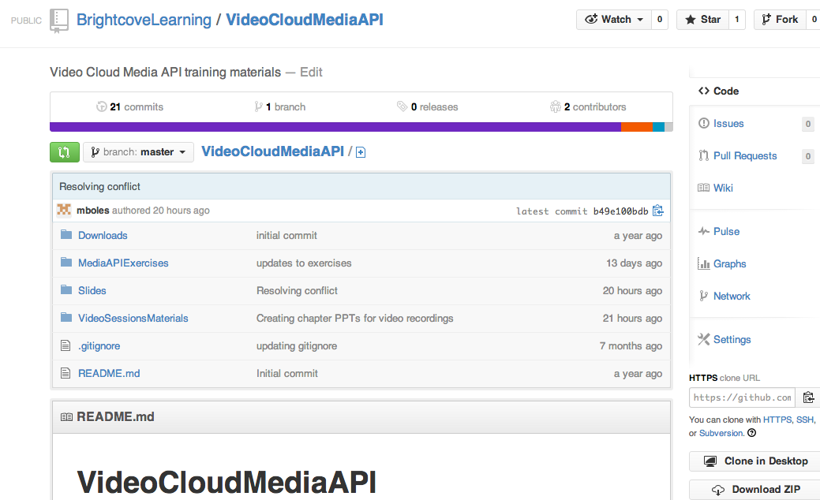
getting the student files
Get the student files and the slides
http://bit.ly/1aDeSpP

Slide 4
Title
Content

Slide 5
Title
Content

Slide 6
Title
Content

Slide 7
Thank you
Brightcove Learning

