Slide 1
Setting Up to Use the
Smart Player API

Slide 2
Set Up
Brightcove Account
All the course samples work off of a Developer Training account, but they will work with your own players as well
You will also need an editor for HTML/JavaScript
Any plain text editor will work
An editor such as Chocolat, Sublime Text, Dreamweaver, BBEdit, or CoffeeCup, that provides code-hinting and syntax highlighting is recommended
2
Notes:
2
WAMP Package on USB Drive / CD-R
Copy Folder XAMPP to C:\
Run C:\XAMPP\xampp_setup.bat
Run C:\XAMPP\xampp_start.bat
This will be part of the set up ….
WAMP Package on USB Drive / CD-R
Copy Folder XAMPP to C:\
Run C:\XAMPP\xampp_setup.bat
Run C:\XAMPP\xampp_start.bat
What are the instructions to restart the sandbox

Slide 3
Players Used in the Course
The Smart Player API will work with any Brightcove Player
In this course we will be using the standard Chromeless for all examples

Slide 4
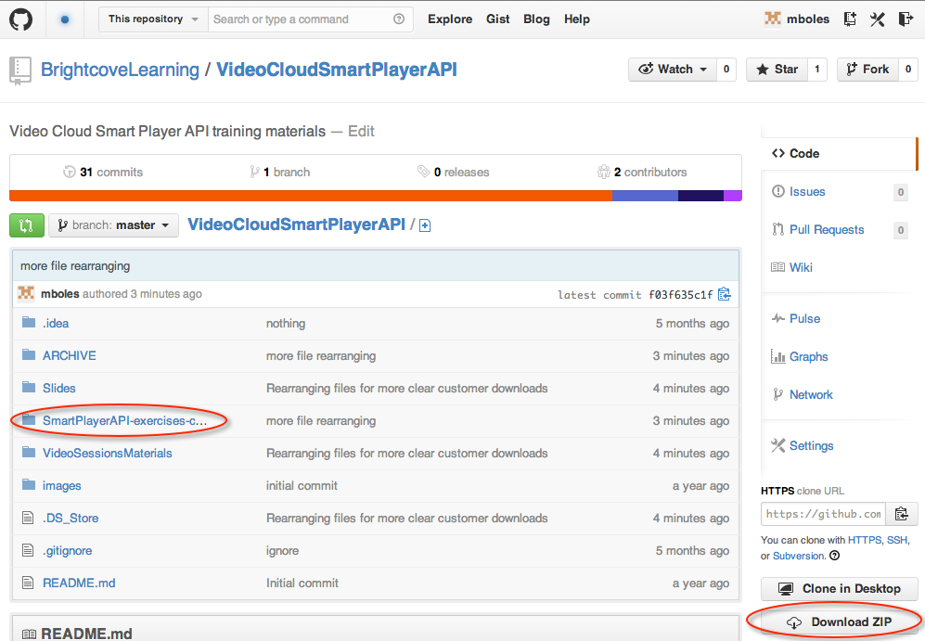
getting the student files
Get the student files and the slides
https://github.com/BrightcoveLearning/VideoCloudSmartPlayerAPI

Slide 5
Thank you
Brightcove Learning

