Slide 1
Accessing Video Data
1
Notes:
1

Slide 2
method to retrieve video data
getCurrentVideo() – Retrieves video information for the currently playing video
Invokes a callback function with the video DTO as a parameter

Slide 3
Calling Methods
onTemplateReady : function (evt) {
videoPlayer = player.getModule(APIModules.VIDEO_PLAYER);
videoPlayer.getCurrentVideo( function(videoDTO) {
videoName.innerHTML = "Currently watching: <strong>" + videoDTO.displayName + "</strong>";
});
}
Remember: calls are asynchronous, so you must provide a callback function to handle returned data
3
Notes:
3

Slide 4
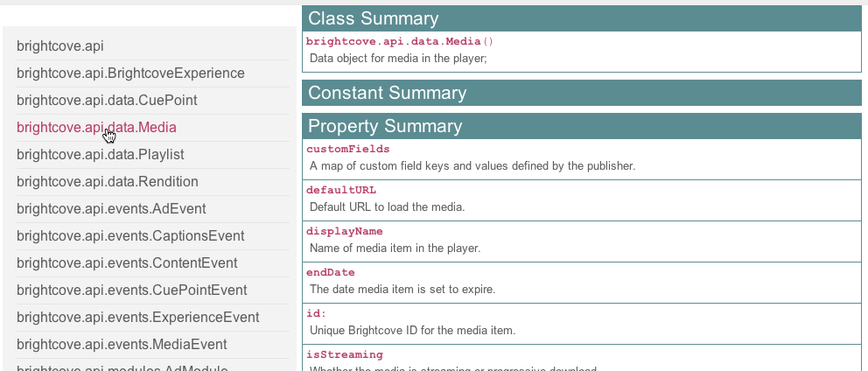
Understanding the video DTO
Use the API documentation

Slide 5
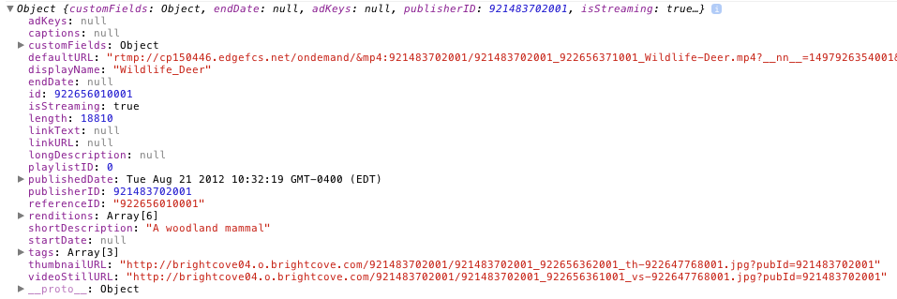
Understanding the video DTO (cont)
Use developer / debugging tools

Slide 6
Demo 2: Displaying Basic Video Information
6
Notes:
6

Slide 7
Thank you
Brightcove Learning

