Slide 1
Developing with the Smart Player API
Brightcove Video Cloud Training
Robert Crooks, Director of Learning Services (rcrooks@brightcove.com)
Matt Boles, Learning Specialist (mboles@brightcove.com)

Slide 2
Agenda
Introduction
Getting Started
Accessing Video Data
Adding and Removing Event Listeners
Checking Renditions
Fetching and Displaying Playlists
Accessing the Video Player Module and Video Data

Slide 3
Smart Player API Training
Provides a overview of interacting with a Brightcove Player programmatically to create a customized online video experience
Designed for developers with JavaScript experience
3
Notes:
3

Slide 4
Set Up
Brightcove Account
All the course samples work off of a Developer Training account, but they should work with your own players as well
Samples
Can be viewed in any web browser (including Safari on iOS devices)
You will also need an editor for HTML/JavaScript
Any plain text editor will work
An editor such as Chocolat, Sublime Text, Dreamweaver, BBEdit, or CoffeeCup, that provides code-hinting and syntax highlighting is recommended
4
Notes:
4
WAMP Package on USB Drive / CD-R
Copy Folder XAMPP to C:\
Run C:\XAMPP\xampp_setup.bat
Run C:\XAMPP\xampp_start.bat
This will be part of the set up ….
WAMP Package on USB Drive / CD-R
Copy Folder XAMPP to C:\
Run C:\XAMPP\xampp_setup.bat
Run C:\XAMPP\xampp_start.bat
What are the instructions to restart the sandbox

Slide 5
Players Used in the Course
The Smart Player API will work with any Brightcove Player
In this course we will be using the standard Chromeless for all examples

Slide 6
Javascript Code Dilemma
Purpose of this session is to teach Smart Player API code
Is it also appropriate to suggest best practices in JavaScript?
What if code is copied directly and not modified thus giving user poorly architected code?
Good pattern to use is a basic version of the Module pattern
Keeps variables out of the global name space to avoid collisions with other scripts used in the page
All variable initialized at the top to make it easier to find them
Allows you to have both public and private data/functions

Slide 7
Introduction

Slide 8
The Smart Player API
Customize, integrate with or add functionality to your players through external scripts. The API:
Exposes objects and events in the player
Offers methods to control or alter functionality
Allows for reporting or acting on player events
Works with all Brightcove Players, both the Flash and HTML5 versions
8
Notes:
8
Need to get code from the publishing module to start.
You’ll be writing lots of code that deals with the different events.
If you need features we don’t provide,

Slide 9
Smart Player API Classes
Brightcove Experience
Modules
Events
Data
High level functional classes
Player / playback events that you can handle
Data objects that can be accessed
API Reference: http://docs.brightcove.com/en/smart-player-api/index.html

Slide 10
The Player API is EVENT-DRIVEN
function foo()
{
player = loadPlayer();
player.loadVideo(123);
player.start();
}
Experience is created
onTemplateLoad ()
Player data is downloaded
onTemplateReady ()
Player is setup and ready to interact with
10
Notes:
10

Slide 11
Methods are asynchronous
Not this:
var video =
videoPlayer.getCurrentVideo();
document.getElementById
("videoTitle").innerHTML=
video.displayName;
Anonymous Function
videoPlayer.getCurrentVideo(function(videoDTO) {
document.getElementById("displayName").
innerHTML = videoDTO.displayName;
});
or
Function Expression / Declaration
videoPlayer.getCurrentVideo(onGetVideo);
var onGetVideo = function(videoDTO) {
document.getElementById("displayName").
innerHTML = videoDTO.displayName;
};
Note that callback functions are not required when the method returns no data

Slide 12
Getting Started
12
Notes:
12

Slide 13

Setup
In Brightcove Studio
Create player instance
Enable the APIs!!!
Get the JavaScript publishing code
In the Publishing Code
Include the API
Specify the template Load and Ready event listeners
In JavaScript
Set up onTemplateLoad() and onTemplateReady() handlers
Get references to API modules
Set up handlers for events
13
Notes:
13

Slide 14
Studio Generated JS Code with added params
<object id="myExperience921449663001" class="BrightcoveExperience">
<param name="bgcolor" value="#FFFFFF" />
<param name="width" value="480" />
<param name="height" value="270" />
<param name="playerID" value="2079935931001" />
<param name="playerKey" value="AQ~~,AAAA1oy1bvE~,ALl2ezBj3WE0z3yX6Xw29sdCvkH5GCJv" />
<param name="isVid" value="true" />
<param name="isUI" value="true" />
<param name="dynamicStreaming" value="true" />
<param name="@videoPlayer" value="921449663001" />
<!-- smart player api params -->
<param name="includeAPI" value="true" />
<param name="templateLoadHandler" value="BCLS.onTemplateLoad" />
<param name="templateReadyHandler" value="BCLS.onTemplateReady" />
</object>
14
Notes:
14

Slide 15
Initial Event Handlers
<script type="text/JavaScript">
var player,
APIModules,
videoPlayer;
var onTemplateLoad = function(experienceID){
player = brightcove.api.getExperience(experienceID);
APIModules = brightcove.api.modules.APIModules;
};
var onTemplateReady = function(evt){
videoPlayer = player.getModule(APIModules.VIDEO_PLAYER);
videoPlayer.play();
};
</script>
15
Notes:
15

Slide 16
Demo 1: The Basics
16
Notes:
16

Slide 17
Accessing Video Data
17
Notes:
17

Slide 18
Calling Methods
onTemplateReady : function (evt) {
videoPlayer = player.getModule(APIModules.VIDEO_PLAYER);
videoPlayer.getCurrentVideo( function(videoDTO) {
videoName.innerHTML = "Currently watching: <strong>" + videoDTO.displayName + "</strong>";
} );
Remember: calls are asynchronous, so you must provide a callback function to handle returned data
18
Notes:
18

Slide 19
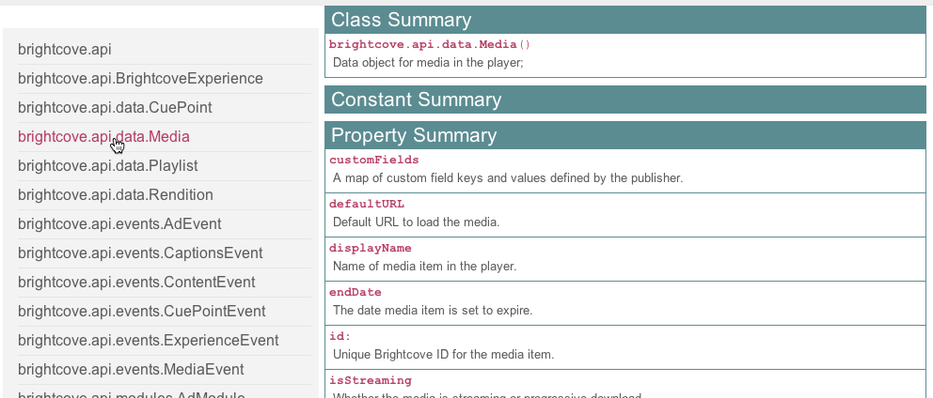
Understanding the video DTO
Use the API documentation

Slide 20
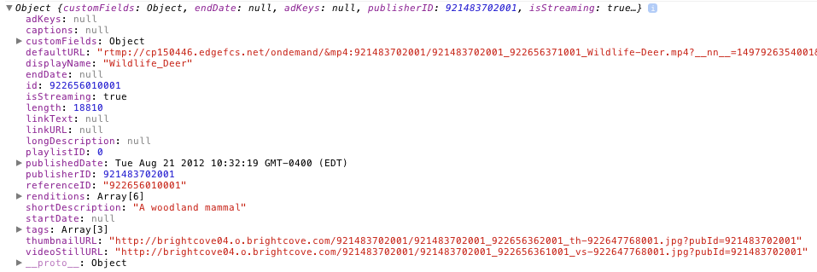
Understanding the video DTO (cont)
developer / debugging tools

Slide 21
Demo 2: Displaying Basic Video Information
21
Notes:
21

Slide 22
Adding and Removing Event Listeners

Slide 23
Event Listeners
var onTemplateReady = function (evt) {
videoPlayer = player.getModule(APIModules.VIDEO_PLAYER);
videoPlayer.getCurrentVideo( function(videoDTO) {
videoName.innerHTML = "Currently watching: " + videoDTO.displayName;
} );
videoPlayer.addEventListener(mediaEvent.PROGRESS, onProgress);
videoPlayer.addEventListener(mediaEvent.COMPLETE, onComplete);
},
var onProgress = function(evt) {
elapsedTime.innerHTML = evt.position;
};
var onComplete = function(evt) {
videoPlayer.removeEventListener(brightcove.api.events.MediaEvent.PROGRESS, onProgress);
};
23
Notes:
23

Slide 24
An alternative to Complete event
var onTemplateReady = function (evt) {
videoPlayer = player.getModule(APIModules.VIDEO_PLAYER);
videoPlayer.getCurrentVideo( function(videoDTO) {
videoName.innerHTML = "Currently watching: " + videoDTO.displayName;
} );
videoPlayer.addEventListener(mediaEvent.PROGRESS, onProgress);
};
var onProgress = function(evt) {
if ((evt.duration - evt.position) > .1) {
//Normal progress actions
} else {
//Video complete actions
}
};
24
Notes:
24

Slide 25
Demo 3: Displaying Video Time Using the PROGESS Event
25
Notes:
25

Slide 26
Accessing the Video Player Module and Video Data

Slide 27
Player Modules
Higher level functional areas
Experience Module: the overall player
Video Player Module: the video player component
Content Module: for retrieving content from the Video Cloud server
Cue Points Module: for setting or handling cue points
Captions Module: for retrieving/displaying captions/subtitles
Ad Module: for managing ad interactions
All modules include:
addEventListener(type, handler);
removeEventListener(type, handler);
Modules are all methods, no properties
27
Notes:
27
Started at 1:43
10 minutes for this exercise
1:50 it started

Slide 28
Accessing Modules
onTemplateLoad : function (experienceID) {
player = brightcove.api.getExperience(experienceID);
APIModules = brightcove.api.modules.APIModules;
},
/**** template ready event handler ****/
onTemplateReady : function (evt) {
// get references to modules
videoPlayer = player.getModule(APIModules.VIDEO_PLAYER);
…
28
Notes:
28

Slide 29
Public Constants for Modules
CAPTIONS : CaptionModule
CONTENT : ContentModule
CUE_POINTS : CuePointsModule
EXPERIENCE : ExperienceModule
VIDEO_PLAYER : VideoPlayerModule
Always use the Public Constant names, as these will not change, even if the real class names do

Slide 30
Data Transfer Objects
Data objects sent from server
Simple collection of properties (no methods)
Represent media managed in Brightcove Studio media module
MediaDTO => VideoDTO
To get the VideoDTO for the video currently in the player, get a reference to the VideoPlayer Module, and then use the getCurrentVideo() method
Full listing of objects and properties in reference documentation
30
Notes:
30
Started at 1:43
10 minutes for this exercise
1:50 it started

Slide 31
Displaying videoDTO information in HTML
The HTML that displays the information from the videoDTO will be built dynamically
Two possible approaches to display the information
Build HTML with JavaScript
displayInfo.innerHTML += "<p>Custom Fields:</p><ul>";
for (var key in videoDTO.customFields) {
displayInfo.innerHTML += "<li>" + key + ": " + videoDTO.customFields[key] + "</li>";
}
displayInfo.innerHTML += "</ul>";
Build HTML with a templating tool (like Handlebars)
var videoInfoTemplate = "<h3>About this video</h3><h4>Title: {{displayName}}</h4><p>Description: {{shortDescription}}</p><p>Tags:</p><ul>{{#tags}}<li>{{.}}</li>{{/tags}}</ul>";
template = Handlebars.compile(videoInfoTemplate);
results = template(videoDTO);
displayInfo.innerHTML = results;

Slide 32
Getting the Video Duration
Another VIDEO_PLAYER module method: getVideoDuration(formatted?, callback)
The video length is in the DTO, but as milliseconds – this method gives you a nicely formatted version
videoPlayer.getVideoDuration( true, function(duration) {
videoInfo.innerHTML += "<p>Duration: " + duration + "</p>";
});

Slide 33
Demo 4: Displaying Metadata, Custom Fields and Duration
33
Notes:
33

Slide 34
Checking Renditions

Slide 35
Checking for Rendition changes
Implementation
Use getCurrentRendition() at initial video play
Display rendition information
Use progress event to periodically check for new rendition, and if new
Display new rendition information
Set new rendition information to current rendition information

Slide 36
Code implementation
var onProgress = function(evt){
if ((evt.duration - evt.position) > .1) {
videoPlayer.getCurrentRendition( function(renditionDTO){
if (currentEncodingRate != renditionDTO.encodingRate){
displayRendition(renditionDTO);
currentEncodingRate = renditionDTO.encodingRate;
currentSize = renditionDTO.size;
}
});
}
};

Slide 37
Demo 5: Displaying Rendition Information
37
Notes:
37

Slide 38
Fetching and Displaying Playlists

Slide 39
Retrieving Content from Video Cloud
In addition to accessing the data for the video already in the player, you can also retrieve data – for videos or playlists – from Video Cloud
Use the CONTENT module
You need to know the IDs (or reference IDs) of the content you want
contentModule.getPlaylistByID(id, function( playlistDTO ) {
/* using the same technique as in the previous example, we
can display the playlist in the page any way we want to –
Handlebars is useful for this */
}

Slide 40
A possible implementation
Get the playlist
Loop over array of videos in the playlist (videos property form playlist DTO)
Display videos per implementation (e.g. HTML <select> tag)
On selection of video use loadVideoByID(id) to play video
40
Notes:
40
Started at 1:43
10 minutes for this exercise
1:50 it started

Slide 41
Demo 6: Play a Video on Selection
41
Notes:
41

Slide 42
What’s Next
42
Notes:
42

Slide 43
Other Resources
http://docs.brightcove.com/en/smart-player-api/index.html
Getting Started Guide
Complete API Reference
More examples
http://forum.brightcove.com
Includes a Developer forum with a section specifically on the Smart Player API

Slide 44
Thank you
Brightcove Learning

