Slide 1
Accessing Video Data
1
Notes:
1

Slide 2
Calling Methods
onTemplateReady : function (evt) {
videoPlayer = player.getModule(APIModules.VIDEO_PLAYER);
videoPlayer.getCurrentVideo( function(videoDTO) {
videoName.innerHTML = "Currently watching: <strong>" + videoDTO.displayName + "</strong>";
});
}
Remember: calls are asynchronous, so you must provide a callback function to handle returned data
2
Notes:
2

Slide 3
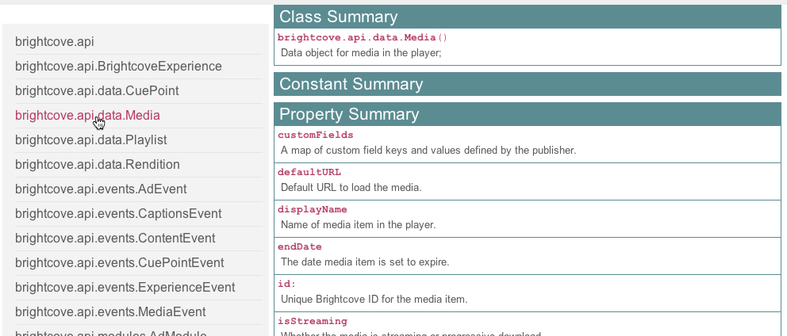
Understanding the video DTO
Use the API documentation

Slide 4
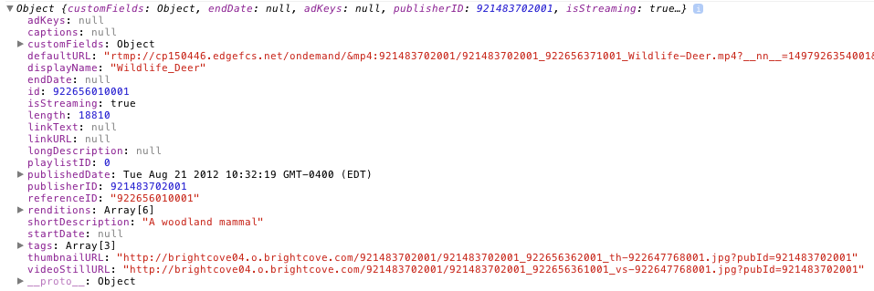
Understanding the video DTO (cont)
developer / debugging tools

Slide 5
Thank you
Brightcove Learning

