Slide 1
Introducing the Course

Slide 2
What: The Smart Player API
Used to customize, integrate with, or add functionality to, your players through external scripts
The API:
Exposes objects and events in the player
Offers methods to control or alter functionality
Allows for reporting or acting on player events
Works with all Brightcove Players, both the Flash and HTML5 versions
2
Notes:
2
Need to get code from the publishing module to start.
You’ll be writing lots of code that deals with the different events.
If you need features we don’t provide,

Slide 3
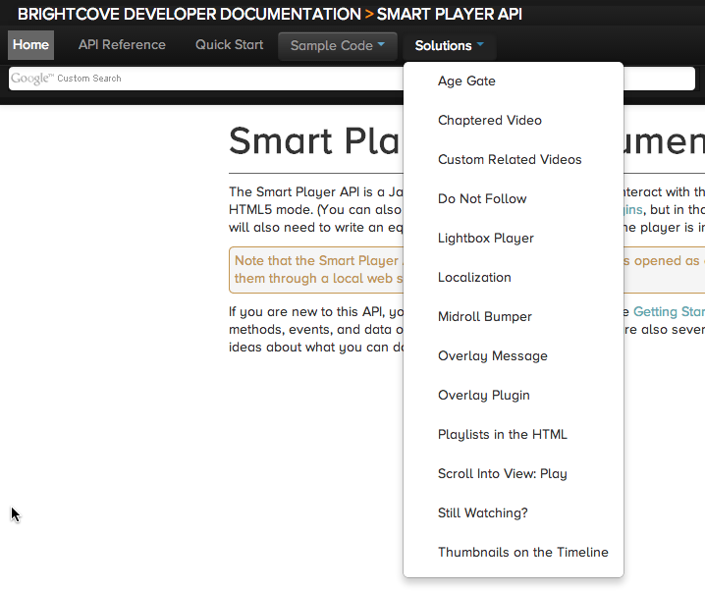
why: Code Samples and solutions
http://docs.brightcove.com/en/video-cloud/smart-player-api/index.html

Slide 4
HOW: Agenda
Introducing the Course
Setting Up
Understanding the Smart Player API
Using JavaScript with the Smart Player API
Getting Started with the Smart Player API & Demo (code exploration)
Access Video Data & Demo
Adding and Removing Event Listeners & Demo
Accessing the Video Player Module and Video Data & Demo
Fetching and Displaying Playlists & Demo

Slide 5
Smart Player API Training & Pre-reqs
This course provides a overview of interacting with a Brightcove Player programmatically to create a customized online video experience
Designed for developers with basic HTML and JavaScript experience
5
Notes:
5

Slide 6
Thank you
Brightcove Learning

