Slide 1
Adding and Removing Event Listeners

Slide 2
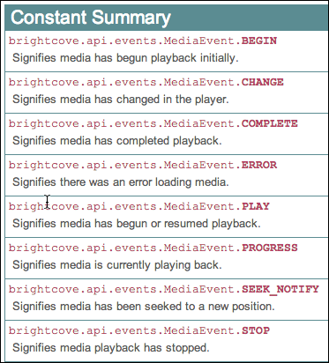
Events
Media events simply indicate the video has done something
Can listen for the following events

Slide 3
event listeners
Setup a function to be called when an event is dispatched
Use the addEventListener(event,eventHandlerFunction) method to assign a function to an event
Can also remove event listeners using the removeEventListener(event,eventHandlerFunction) method
It is a best practice to remove event listeners that are no longer needed

Slide 4
Event Listener Examples
var onTemplateReady = function (evt) {
videoPlayer = player.getModule(APIModules.VIDEO_PLAYER);
videoPlayer.getCurrentVideo( function(videoDTO) {
videoName.innerHTML = "Currently watching: " + videoDTO.displayName;
} );
videoPlayer.addEventListener(mediaEvent.PROGRESS, onProgress);
videoPlayer.addEventListener(mediaEvent.COMPLETE, onComplete);
},
var onProgress = function(evt) {
elapsedTime.innerHTML = evt.position;
};
var onComplete = function(evt) {
videoPlayer.removeEventListener(brightcove.api.events.MediaEvent.PROGRESS, onProgress);
};
4
Notes:
4

Slide 5
An alternative to Complete event
var onTemplateReady = function (evt) {
videoPlayer = player.getModule(APIModules.VIDEO_PLAYER);
videoPlayer.getCurrentVideo( function(videoDTO) {
videoName.innerHTML = "Currently watching: " + videoDTO.displayName;
} );
videoPlayer.addEventListener(mediaEvent.PROGRESS, onProgress);
};
var onProgress = function(evt) {
if ((evt.duration - evt.position) > .25) {
//Normal progress actions
} else {
//Video complete actions
}
};
5
Notes:
5

Slide 6
Demo 3: Displaying Video Time Using the Progress Event
6
Notes:
6

Slide 7
Thank you
Brightcove Learning

