Slide 1
Developing with the Smart Player API
Matt Boles, Brightcove Learning Specialist
mboles@brightcove.com or training@brightcove.com

Slide 2
Introducing the Course

Slide 3
What: The Smart Player API
Used to customize, integrate with, or add functionality to, your players through external scripts
The API:
Exposes objects and events in the player
Offers methods to control or alter functionality
Allows for reporting or acting on player events
Works with all Brightcove Players, both the Flash and HTML5 versions
3
Notes:
3
Need to get code from the publishing module to start.
You’ll be writing lots of code that deals with the different events.
If you need features we don’t provide,

Slide 4
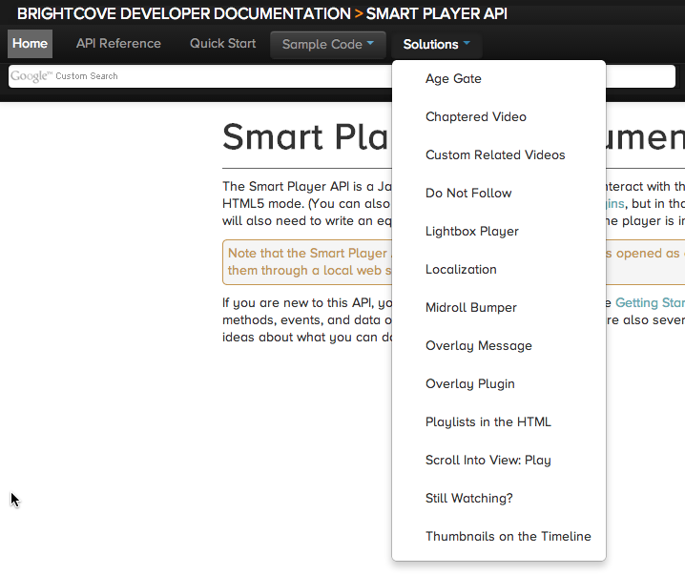
why: Code Samples and solutions
http://docs.brightcove.com/en/video-cloud/smart-player-api/index.html
4

Slide 5
HOW: Agenda
Introducing the Course
Setting Up
Understanding the Smart Player API
Using JavaScript with the Smart Player API
Getting Started with the Smart Player API & Demo (code exploration)
Access Video Data & Demo
Adding and Removing Event Listeners & Demo
Accessing the Video Player Module and Video Data & Demo
Fetching and Displaying Playlists & Demo
5

Slide 6
Smart Player API Training & Pre-reqs
This course provides a overview of interacting with a Brightcove Player programmatically to create a customized online video experience
Designed for developers with basic HTML and JavaScript experience
6
Notes:
6

Slide 7
Setting Up to Use the
Smart Player API

Slide 8
Set Up
Video Cloud Account
All the course samples work off of a Developer Training account, but they will work with your own players as well
You will also need an editor for HTML/JavaScript
Any plain text editor will work
An editor such as Chocolat, Sublime Text, Dreamweaver, BBEdit, or CoffeeCup, that provides code-hinting and syntax highlighting is recommended
8
Notes:
8
WAMP Package on USB Drive / CD-R
Copy Folder XAMPP to C:\
Run C:\XAMPP\xampp_setup.bat
Run C:\XAMPP\xampp_start.bat
This will be part of the set up ….
WAMP Package on USB Drive / CD-R
Copy Folder XAMPP to C:\
Run C:\XAMPP\xampp_setup.bat
Run C:\XAMPP\xampp_start.bat
What are the instructions to restart the sandbox

Slide 9
Players Used in the Course
The Smart Player API will work with any Video Cloud Player
In this course we will be using the standard Chromeless for all examples
9

Slide 10
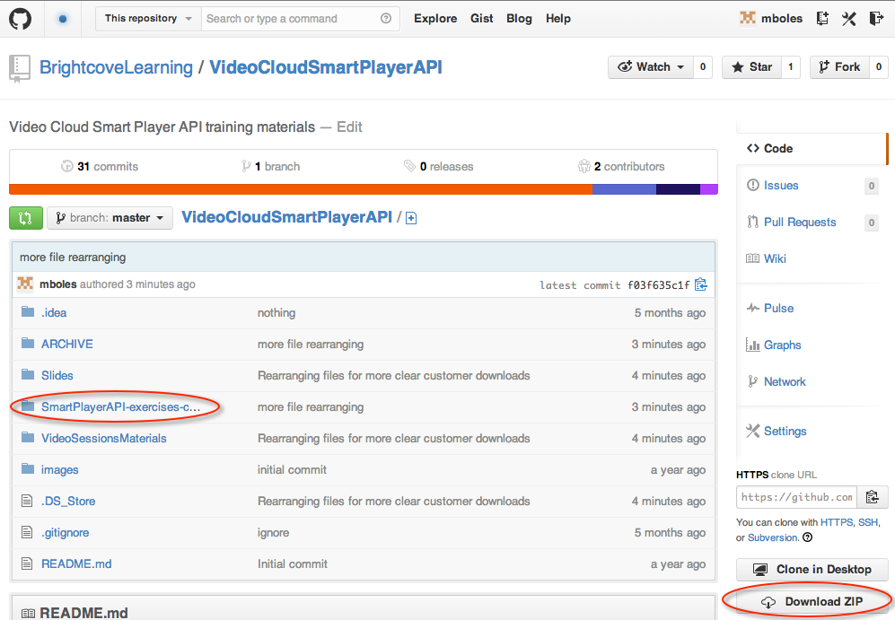
getting the student files
Get the student files and the slides
http://bit.ly/1hipNNZ
10

Slide 11
Understanding the
Smart Player API

Slide 12
The Smart Player API
Used to customize, integrate with, or add functionality to, your players through external scripts
The API:
Exposes objects and events in the player
Offers methods to control or alter functionality
Allows for reporting or acting on player events
Works with all Video Cloud Players, both the Flash and HTML5 versions
12
Notes:
12
Need to get code from the publishing module to start.
You’ll be writing lots of code that deals with the different events.
If you need features we don’t provide,

Slide 13
Smart Player API Classes
Brightcove Experience
Modules
Events
Data
High level functional classes
Player / playback events that you can handle
Data objects that can be accessed
API Reference: http://docs.brightcove.com/en/smart-player-api/index.html
13

Slide 14
Using JavaScript with the Smart Player API

Slide 15
Javascript Code Dilemma
Purpose of this session is to teach Smart Player API code
Is it also appropriate to suggest best practices in JavaScript?
What if code is copied directly and not modified thus giving user poorly architected code?
Good pattern to use is a basic version of the Module pattern
Keeps variables out of the global name space to avoid collisions with other scripts used in the page
All variable initialized at the top to make it easier to find them
Allows you to have both public and private data/functions
15

Slide 16
The Player API is EVENT-DRIVEN
function foo()
{
player = loadPlayer();
player.loadVideo(123);
player.start();
}
Experience is created
onTemplateLoad ()
Player data is downloaded
onTemplateReady ()
Player is setup and ready to interact with
16
Notes:
16

Slide 17
Methods are asynchronous
Not this:
var video =
videoPlayer.getCurrentVideo();
document.getElementById
("videoTitle").innerHTML=
video.displayName;
Anonymous Function
videoPlayer.getCurrentVideo(function(videoDTO) {
document.getElementById("displayName").
innerHTML = videoDTO.displayName;
});
or
Function Expression / Declaration
videoPlayer.getCurrentVideo(onGetVideo);
var onGetVideo = function(videoDTO) {
document.getElementById("displayName").
innerHTML = videoDTO.displayName;
};
Note that callback functions are not required when the method returns no data
17

Slide 18
Getting Started with the
Smart Player API
18
Notes:
18

Slide 19

Setup
In Video Cloud Studio
Create player instance
Enable the APIs!!!
Get the JavaScript publishing code
In the Publishing Code
Include the API
Specify the template load and ready event listeners
In JavaScript
Set up onTemplateLoad() and onTemplateReady() handlers
Get references to API modules
Set up handlers for events
19
Notes:
19

Slide 20
Studio Generated JS Code with added params
<object id="myExperience921449663001" class="BrightcoveExperience">
<param name="bgcolor" value="#FFFFFF" />
<param name="width" value="480" />
<param name="height" value="270" />
<param name="playerID" value="2079935931001" />
<param name="playerKey" value="AQ~~,AAAA1oy1bvE~,ALl2ezBj3WE0z3yX6Xw29sdCvkH5GCJv" />
<param name="isVid" value="true" />
<param name="isUI" value="true" />
<param name="dynamicStreaming" value="true" />
<param name="@videoPlayer" value="921449663001" />
<!-- smart player api params -->
<param name="includeAPI" value="true" />
<param name="templateLoadHandler" value="onTemplateLoad" />
<param name="templateReadyHandler" value="onTemplateReady" />
</object>
20
Notes:
20

Slide 21
Initial Event Handlers
<script type="text/JavaScript">
var player,
APIModules,
videoPlayer;
var onTemplateLoad = function(experienceID){
player = brightcove.api.getExperience(experienceID);
APIModules = brightcove.api.modules.APIModules;
};
var onTemplateReady = function(evt){
videoPlayer = player.getModule(APIModules.VIDEO_PLAYER);
videoPlayer.play();
};
</script>
21
Notes:
21

Slide 22
Demo 1: Getting Started with the Smart Player API
22
Notes:
22

Slide 23
Accessing Video Data
23
Notes:
23

Slide 24
method to retrieve video data
getCurrentVideo() – Retrieves video information for the currently playing video
Invokes a callback function with the video DTO as a parameter
24

Slide 25
Calling Methods
onTemplateReady : function (evt) {
videoPlayer = player.getModule(APIModules.VIDEO_PLAYER);
videoPlayer.getCurrentVideo( function(videoDTO) {
videoName.innerHTML = "Currently watching: <strong>" + videoDTO.displayName + "</strong>";
});
}
Remember: calls are asynchronous, so you must provide a callback function to handle returned data
25
Notes:
25

Slide 26
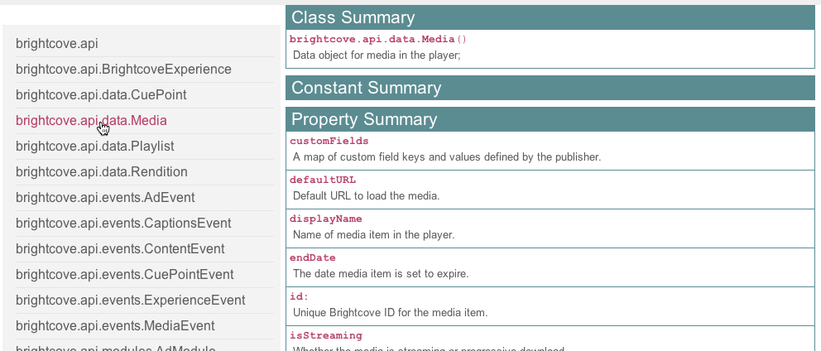
Understanding the video DTO
Use the API documentation
26

Slide 27
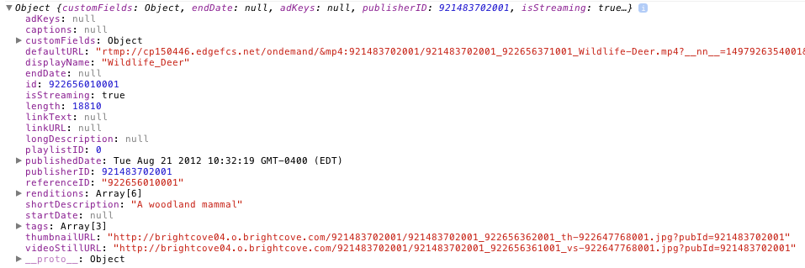
Understanding the video DTO (cont)
Use developer / debugging tools
27

Slide 28
Demo 2: Displaying Basic Video Information
28
Notes:
28

Slide 29
Adding and Removing Event Listeners

Slide 30
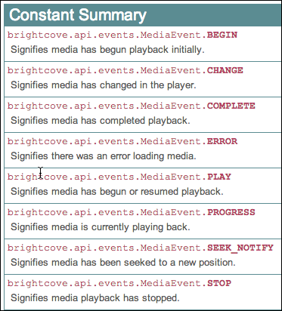
Events
Media events simply indicate the video has done something
Can listen for the following events
30

Slide 31
event listeners
Setup a function to be called when an event is dispatched
Use the addEventListener(event,eventHandlerFunction) method to assign a function to an event
Can also remove event listeners using the removeEventListener(event,eventHandlerFunction) method
It is a best practice to remove event listeners that are no longer needed
31

Slide 32
Event Listener Examples
var onTemplateReady = function (evt) {
videoPlayer = player.getModule(APIModules.VIDEO_PLAYER);
videoPlayer.getCurrentVideo( function(videoDTO) {
videoName.innerHTML = "Currently watching: " + videoDTO.displayName;
} );
videoPlayer.addEventListener(mediaEvent.PROGRESS, onProgress);
videoPlayer.addEventListener(mediaEvent.COMPLETE, onComplete);
},
var onProgress = function(evt) {
elapsedTime.innerHTML = evt.position;
};
var onComplete = function(evt) {
videoPlayer.removeEventListener(brightcove.api.events.MediaEvent.PROGRESS, onProgress);
};
32
Notes:
32

Slide 33
An alternative to Complete event
var onTemplateReady = function (evt) {
videoPlayer = player.getModule(APIModules.VIDEO_PLAYER);
videoPlayer.getCurrentVideo( function(videoDTO) {
videoName.innerHTML = "Currently watching: " + videoDTO.displayName;
} );
videoPlayer.addEventListener(mediaEvent.PROGRESS, onProgress);
};
var onProgress = function(evt) {
if ((evt.duration - evt.position) > .25) {
//Normal progress actions
} else {
//Video complete actions
}
};
33
Notes:
33

Slide 34
Demo 3: Displaying Video Time Using the Progress Event
34
Notes:
34

Slide 35
Accessing the Video Player Module and Video Data

Slide 36
Player Modules
Higher level functional areas
Experience Module: the overall player
Video Player Module: the video player component
Content Module: for retrieving content from the Video Cloud server
Cue Points Module: for setting or handling cue points
Captions Module: for retrieving/displaying captions/subtitles
Ad Module: for managing ad interactions
All modules include:
addEventListener(type, handler);
removeEventListener(type, handler);
Modules are all methods, no properties
36
Notes:
36
Started at 1:43
10 minutes for this exercise
1:50 it started

Slide 37
Accessing Modules
var onTemplateLoad = function (experienceID) {
player = brightcove.api.getExperience(experienceID);
APIModules = brightcove.api.modules.APIModules;
},
/**** template ready event handler ****/
var onTemplateReady = function (evt) {
// get references to modules
videoPlayer = player.getModule(APIModules.VIDEO_PLAYER);
…
37
Notes:
37

Slide 38
Public Constants for Modules
CAPTIONS : CaptionModule
CONTENT : ContentModule
CUE_POINTS : CuePointsModule
EXPERIENCE : ExperienceModule
VIDEO_PLAYER : VideoPlayerModule
Always use the Public Constant names, as these will not change, even if the real class names do
38

Slide 39
Data Transfer Objects
Data objects sent from server
Simple collection of properties (no methods)
Represent media managed in Video Cloud Studio media module
mediaDTO → videoDTO
To get the videoDTO for the video currently in the player, get a reference to the VideoPlayer Module, and then use the getCurrentVideo() method
Full listing of objects and properties in reference documentation
39
Notes:
39
Started at 1:43
10 minutes for this exercise
1:50 it started

Slide 40
Displaying videoDTO information in HTML
The HTML that displays the information from the videoDTO will be built dynamically
Two possible approaches to display the information
Build HTML with JavaScript
Build HTML with a templating engine
40

Slide 41
Build HTML with JavaScript
displayInfo.innerHTML += "<p>Custom Fields:</p><ul>";
for (var key in videoDTO.customFields) {
displayInfo.innerHTML += "<li>" + key + ": " + videoDTO.customFields[key] + "</li>";
}
41

Slide 42
Build HTML with a Javascript Templating tool
Handlebars is an example templating engine
var videoInfoTemplate = "<h3>About this video</h3> <h4>Title: {{displayName}}</h4> <p>Description: {{shortDescription}}</p> <p>Tags:</p><ul>{{#tags}}<li>{{.}}</li>{{/tags}}</ul>";
template = Handlebars.compile(videoInfoTemplate);
results = template(videoDTO);
displayInfo.innerHTML = results;
42

Slide 43
Getting the Video Duration
Another VIDEO_PLAYER module method: getVideoDuration(formatted, callback)
The video length is in the DTO, but as milliseconds – this method gives you a nicely formatted version
videoPlayer.getVideoDuration( true, function(duration) {
videoInfo.innerHTML += "<p>Duration: " + duration + "</p>";
});
43

Slide 44
Demo 4: Displaying Tags, Custom Fields and Duration
44
Notes:
44

Slide 45
Fetching and Displaying Playlists

Slide 46
Retrieving Content from Video Cloud
In addition to accessing the data for the video already in the player, you can also retrieve data – for videos or playlists – from Video Cloud
Use the CONTENT module
You need to know the IDs (or reference IDs) of the content you want
contentModule.getPlaylistByID(id, function( playlistDTO ) {
/* using the same technique as in the previous example, we
can display the playlist in the page any way we want to –
Handlebars is useful for this */
}
46

Slide 47
A possible implementation
Get the playlist
Loop over array of videos in the playlist (videos property form playlist DTO)
Display videos per implementation (e.g. HTML <select> tag)
On selection of video use loadVideoByID(id) to play video
47
Notes:
47
Started at 1:43
10 minutes for this exercise
1:50 it started

Slide 48
code example
contentModule.getPlaylistByID("1323984733001", onGetPlaylist);
…
var onGetPlaylist = function(playlistDTO){
console.log(playlistDTO);
videosAra = playlistDTO.videos;
for (var i = 0; i < playlistDTO.videoCount; i++) {
videoSelect.innerHTML += '<option value="' +
playlistDTO.videos[i].id +'">' +
playlistDTO.videos[i].displayName + '</option>';
}
};
48

Slide 49
Demo 5: Playing a Video on Selection
49
Notes:
49

Slide 50
Thank you
Brightcove Learning

