Slide 1
AUTOMATIC DETECTION OF LICENSE PLATE NUMBER OF MOTORCYCLISTS WITHOUT HELMET
DOMAIN : DEEP LEARNING
BATCH :A17
TEAM MEMBERS:
BANGALORE HARIKA
BRIGHTLIN SELVAMARY.A
MADDINA SREELEKHA
GUIDE :
Mrs. ANITHA MOSES V
DESIGNATION: Associate Professor

Slide 2
INTRODUCTION
The Helmet detection system is recommended for the identification of a particular person with no helmet. The input to the system is captured video which is then converted into images. Then preprocessing functions are applied to the image such as background noise, enhancing contrast and binarization of images. In order to know the characteristics of the image, the Feature descriptor algorithm is used to extract the exact feature and to differentiate one feature from another. CNN classifier is used to split the images into two groups, one for training data and another for test data to use in classification. After extracting the Region of Interest (RoI), the CNN classifier is being trained by a certain number of pictures wearing a helmet is provided. By matching RoI and trained features, it will be determined whether motorcyclists are wearing a helmet or not. Convolutional Neural Network is used to solve theclassification problem efficiently. Then the license plate number is detected.

Slide 3
S.NO | TITLE | AUTHOR NAME | YEAR OF PUBLISH | ALGORITHM USED | DRAWBACKS
1 | Automatic detection of bike-riders without helmet using surveillance videos in real-time | IKunal Dahiya, et al | Institute of Electrical and Electronics Engineers (IEEE),July 2016 Volume 8, Issue 1 . | Histogram of oriented gradients (HOG), scale-invariant feature transform (SIFT), and local binary patterns (LBP) | Video surveillance based methods are passive and require significant human assistance. It is not an efficient solution due to its requirement of dedicated hardware
2 | Visual Big Data Analytics for Traffic Monitoring in Smart City | Dinesh Singh, et al | Institute of Electrical and Electronics Engineers (IEEE), Dec 2016 Volume 7,Issue 2 . | Applying background subtraction and object segmentation methods | Environment conditions like illumination variance over the day, shadows, shaking tree branches, and other sudden changes make it difficult to recover and update background from continuous stream of frames.

Slide 4
S.NO | TITLE | AUTHOR NAME | YEAR OF PUBLISH | ALGORITHM USED | DRAWBACKS
3 | Mission on! Innovations in bike systems to provide a safe ride based on IOT | Aditya Subramanian et al | International Journal of Computer Science and Mobile Applications, April 2018 , Volume: 07 Issue: 03 | Object Detection Method | Cost is one major hindrance to the widespread use of safety systems.
4 | An Improved License Plate Location Method Based On Edge | Rongbao Chen et al | International Conference on Applied Physics and Industrial Engineering, 2012 ,Volume:24 Issue:9 | Edge processing algorithms | More similar database is needed to compare all edge-based methods.
5 | An Improved License Plate Location Method Based On Edge | Rongbao Chen, Yunfei Luo | International Conference on Applied Physics and Industrial Engineering, 2012 ,Volume :8 Issue: 20 | Edge processing algorithms | More similar database is needed to compare all edge-based methods.

Slide 5
S.NO | TITLE | AUTHOR NAME | YEAR OF PUBLISH | ALGORITHM USED | DRAWBACKS
6 | Detection of helmets on motorcyclists | RomuereR.V.eSilva | SIBGRAPI Conference on Graphics, Patterns and Images (SIBGRAPI), Feb 2017 Volume :28 Issue: 9 | Segmentation of moving objects | Low Performance and high complexity .
7 | Automated detection of helmet on motorcyclists from traffic surveillance videos: a comparative analysis using hand-crafted features and CNN | Linu Shine & Jiji C. V. | February 2020,Multimedia tools and applications Volume :79 Issue:9 | A comparative analysis using hand-crafted features and CNN. | Suitable only at particular whether conditions and low performance .
8 | Detection of Non-Helmet Riders and Extraction of License Plate Number using Yolo v2 and OCR Method | Prajwal M. J., Tejas K. B., | International Journal of Innovative Technology and Exploring Engineering (IJITEE), December 2019 Volume :9 Issue:2 | Yolo v2 and OCR Method | More complex

Slide 6
S.NO | TITLE | AUTHOR NAME | YEAR OF PUBLISH | ALGORITHM USED | DRAWBACKS
1 | License Plate Recognition in Urban Road Based on Vehicle Tracking and Result Integration | Chengyang Li and Zhongguo Yang | Journal of Intelligent Systems, September 7, 2019 Volume:29 Issue:1 | Segmentation-Based LPR | Not Accurate .
2 | An Automatic Number Plate Recognition System under Image Processing | Sarbjit Kaur | I.J. Intelligent Systems and Applications, March 2016 Volume:6 Issue:12 | Ant Colony Optimization | In some cases, bad weather and hindrances can make automatic license plate recognition systems not completely effective.
3 | Smart Vehicle Number Plate Detection System | Naveen Balaji Gowthaman | Imperial Journal of interdisciplinary Research(IJIR), June 2017 Volume:3 Issue:6 | Character Segmentation | Time Consuming Process .

Slide 7
S.NO | TITLE | AUTHOR NAME | YEAR OF PUBLISH | ALGORITHM USED | DRAWBACKS
4 | A Review Paper on License Plate Recognition System | Shally Gupta*, Rajesh Singh, H.L. Mandoria | International Journal of Innovative Research in computer and communication Engineering ,2020 Volume :5 Issue:1 | Segmentation and character recognition | Low performance
5 | A Real-Time Automatic Plate Recognition System Based on Optical Character Recognition and Wireless Sensor Networks for ITS | Nicole do Vale,Dalarmelina *, Marcio Andrey Teixeira and Rodolfo I. Meneguette | MDPI Journals, Dec 2019 Volume :22 Issue :10 | Optical Character Rcognition (OCR) | Not Accurate

Slide 8
PROBLEM STATEMENT
Two-wheeler is the most convenient and easy mode of transportation. It is mandatory to wear a helmet in heavy traffic areas to prevent accidents. By considering the use of helmet, Governments have made it a punishable offense to ride a bike without a helmet and have adopted manual strategies to catch the violators. Image processing means processing the images based on the application with the specific parameters. Pre- processing is the first step to improve the quality of the images. The feature descriptor algorithm is used to extract the exact feature and to differentiate one feature from another. CNN classifier is used to split the images into two groups, one for training data and another for test data to use in classification. A Convolutional Neural Network (CNN) is a class of artificial neural networks used in image processing that is specifically designed to process pixel data. Then the license plate is detected.

Slide 9
TECHNOLOGY STACK
HARDWARE ENVIRONMENT
Memory of 4 GB RAM.
64 bit distribution capable of running 32 bit application.
1200*800 minimum screen resolution.
2 GB of available disk space minimum 4 GB recommended.
SOFTWARE ENVIRONMENT
Backend Language: Python
Technology: Deep Learning
Operating System: Windows 10
Platform: IDLE (Python's Integrated Development and Learning Environment)

Slide 10
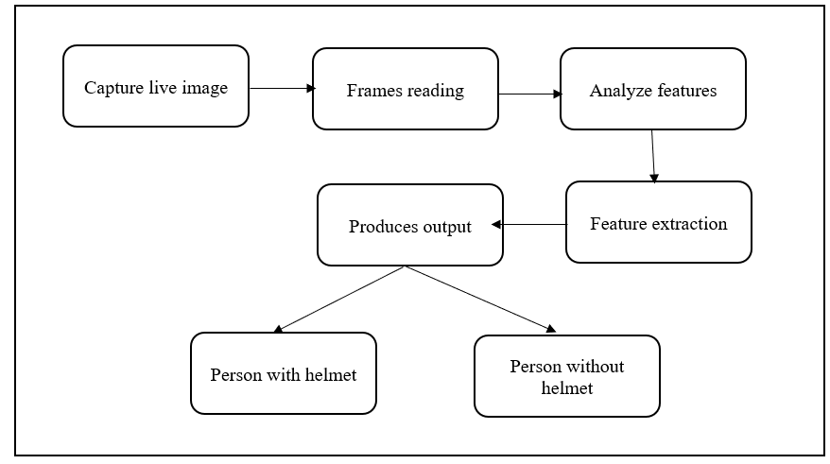
SYSYEM ARCHITECTURE HELMET DETECTION

Slide 11
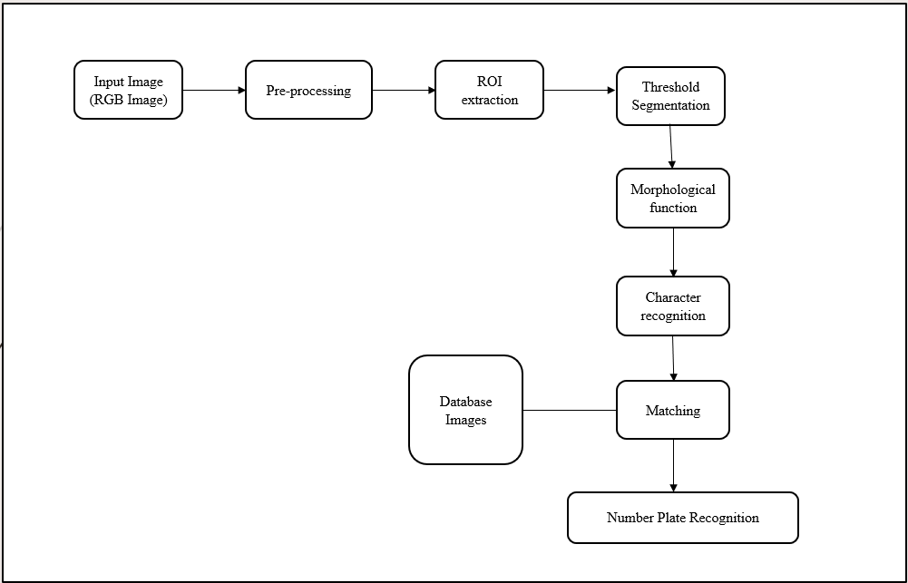
LICENSE PLATE DETETCTION

Slide 12
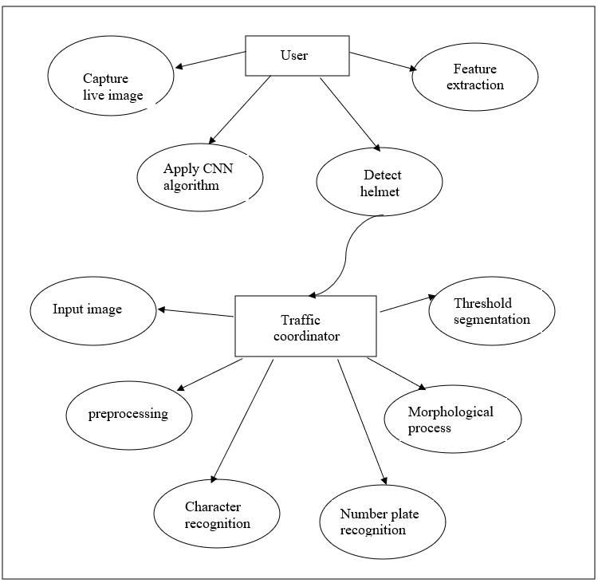
Data flow Diagram

Slide 13
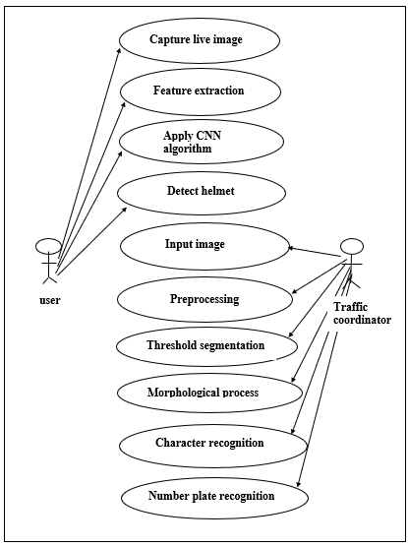
USE CASE Diagram

Slide 14
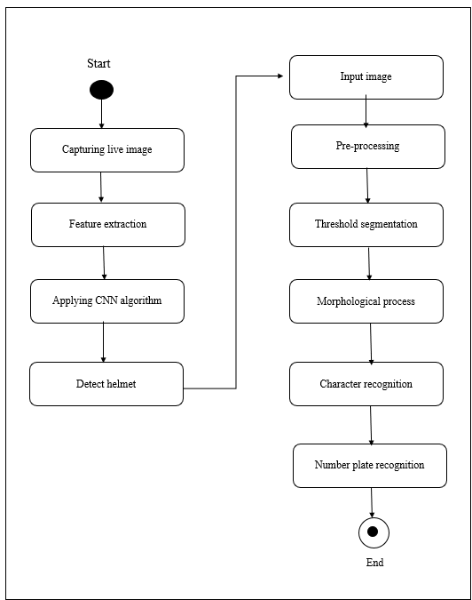
Activity Diagram
Applying CNN algorithm

Slide 15
MODULES
HELMET DETECTION:
1.Input Video
2.Image Classification
3.CNN Classifier
4.Result Interpretation
LICENSE PLATE DETECTION:
1.Segmentation
2.Connected Component Analysis
3.Template Matching
4.Number Plate Recognition

Slide 16
HELMET DETECTION
1.INPUT VIDEO
The input video has been captured by using either ipcam or webcam, From this the bike is detected. This methods to detect the photo of motorcycle and driver from the image and then detect an area of the biker head before classify that this person is wearing a helmet or not.
2. IMAGE CLASSIFICATION
After gathering images for our training dataset, we split our images into two groups, one for training data and another for test data to use in classification experiment. This experiment we test them with CNN models for image classification. All videos will be tested and calculated the accuracy of the biker with helmet and no helmet detection in the video.

Slide 17
3. CNN CLASSIFIER
A CNN is a neural network with some convolutional layers (and some other layers). A convolutional layer has a number of filters that does convolutional operation. CNN can take in an input image, assign importance to various objects in the image and able to differentiate one from the other.
4. RESULT INTERPRETATION
The accuracy of the experiments will show the performance of each technique in terms of image classification and image detection. Deep Learning or CNN techniques are the good algorithms that we can apply on the problem of image detection and classification about bikers wearing a helmet or no helmet problem.

Slide 18
LICENSE PLATE DETECTION
1.SEGMENTATION
The goal of image segmentation is to cluster pixels into salient image regions, i.e., regions corresponding to individual surfaces, objects, or natural parts of objects. In computer vision segmentation refers to the process of partitioning a digital image to multiple segment. The goal of segmentation is to simplify and/or change the representation of an image into something that is more meaningful and easier. The result of image segmentation is a set of segments that collectively cover the entire image, or a set of contours extracted from the image.

Slide 19
2. CONNECTED COMPONENT ANALYSIS
In order to find the objects in an image, we want to employ an operation that is called Connected Component Analysis (CCA). This operation takes a binary image as an input. Usually, the False value in this image is associated with background pixels, and the True value indicates foreground, or object pixels. Such an image can be e.g. produced with thresholding. Given a thresholded image, CCA produces a new labeled image with integer pixel values. Pixels with the same value, belong to the same object.
3.TEMPLATE MATCHING
Template matching refers to the image processing where we find similar templates in a source image by giving a base template to compared on. The process of template matching is done by comparing each of the pixel values of the source image one at a time to the template image. The output would be an array of similarity values when compared to the template image.

Slide 20
4. NUMBER PLATE RECOGNITION
After applying above processes, we will get the foreground and background separated output, From this number plate is extracted.

Slide 21
TESTING
UNIT TESTING
In computer programming, unit testing is a method by which individual units of source code, sets of one or more computer program modules together with associated control data, usage procedures, and operating procedures are tested to determine if they are fit for use. Intuitively, one can view a unit as the smallest testable part of an application. In procedural programming, a unit could be an entire module, but is more commonly an individual function or procedure. In object-oriented programming, a unit is often an entire interface, such as a class, but could be an individual method. Unit tests are created by programmers or occasionally by white box testers during the development process. Unit testing is conducted to verify the functional performance of each modular component of the software. Unit testing focuses on the smallest unit of the software design (i.e.), the module. The white-box testing techniques were heavily employed for unit testing.
In this project
Test Case 1: The input given for the license plate detection should be image file.
Test Case 2: The live image should be detected for helmet detection.
RESULT: All the test cases mentioned above passed successfully.

Slide 22
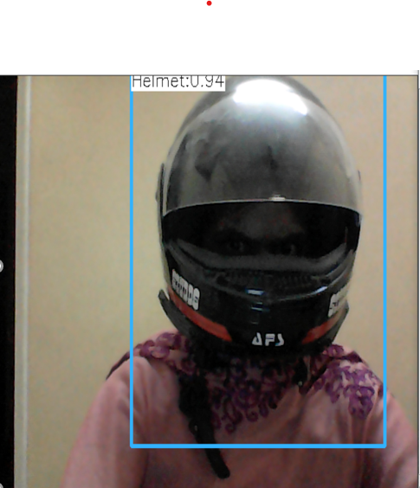
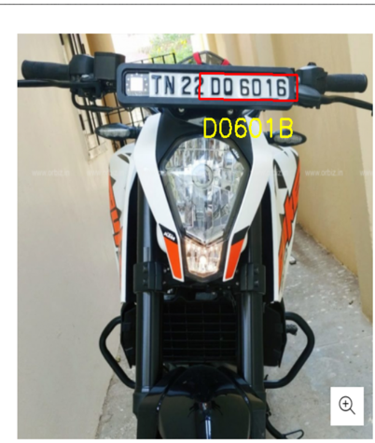
Fig a: Test case 1
Fig b: Test case 2

Slide 23
INTEGRATION TESTING
Integration testing is a systematic technique for construction the program structure while at the same time conducting tests to uncover errors associated with interfacing. i.e., integration testing is the complete testing of the set of modules which makes up the product. The objective is to take untested modules and build a program structure tester should identify critical modules. Critical modules should be tested asearly as possible. One approach is to wait until all the units have passed testing, and then combine them and then tested. This approach is evolved from unstructured testing of small programs. Another strategy is to construct the product in increments of tested units. A small set of modules are integrated together and tested, to which another module is added and tested in combination. And so on. The advantages of this approach are that, interface dispenses can be easily found and corrected.
In this project
Test case 3: If the biker wears helmet the output must be given as helmet detected.
Test case 4: If the biker did not wear helmet the output must be given as no helmet.

Slide 24


Fig c: Test case 3
Fig d:Test case :4

Slide 25
SCREEN SHOTS

Slide 27
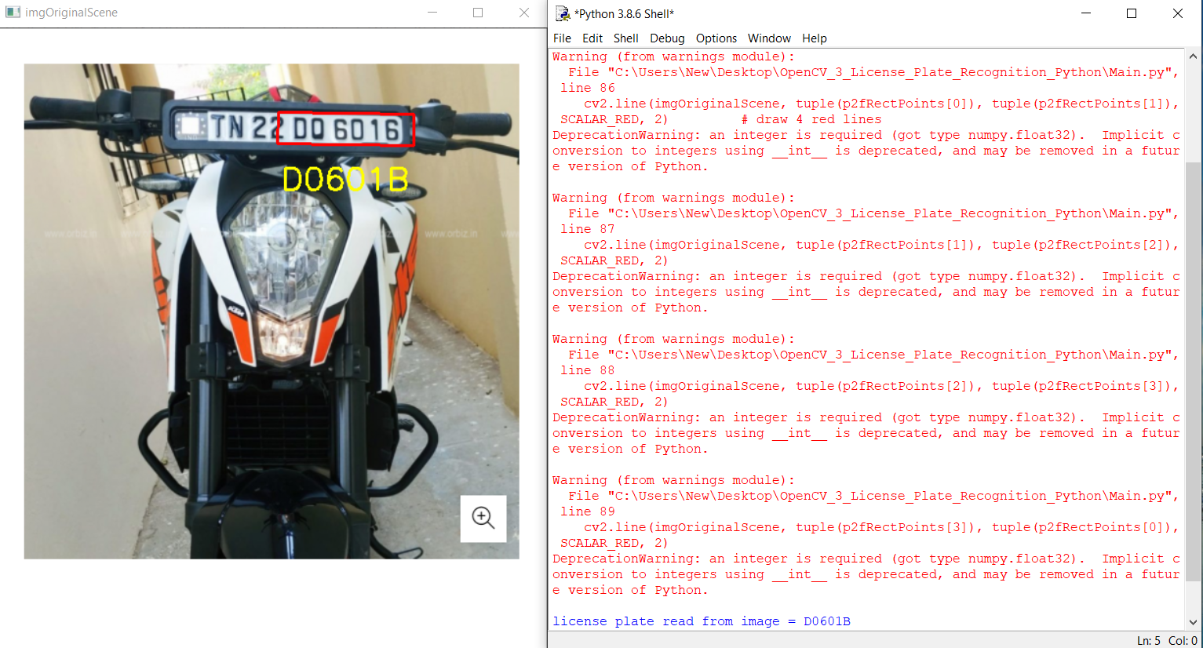

Slide 28
CONCLUSION
This project Produces a Real time Helmet detection method by capturing live images .Four algorithms of image preprocessing, license plate location, license plate segmentation and character recognition are introduced in this paper. License plate location is the basis of image preprocessing. The location of license plate has a direct impact on the accuracy of character segmentation. In our project Helmet id detected and vehicle plate detection is obtained by using character recognization and region of interest

Slide 29
REFERENCES
[1] Aditya Subramanian et al ., International Journal of Computer Science and Mobile Applications,
April 2018,” Mission on! Innovations in bike systems to provide a safe ride based on IOT”
[2] Chengyang Li and Zhongguo Yang ., Journal of Intelligent Systems,September 7, 2019 ,
“License Plate Recognition in Urban Road Based on Vehicle Tracking and Result Integration”
[3] Dinesh Singh, et al ., Institute of Electrical and Electronics Engineers (IEEE), Dec 2016
“Visual Big Data Analytics for Traffic Monitoring in Smart City”
[4] Linu Shine & Jiji C. V. February 2020,Multimedia tools and applications ,
” Automated detection of helmet on motorcyclists from traffic surveillance videos: a comparative
analysis using hand-crafted features and CNN”
[5] Naveen Balaji Gowthaman , Imperial Journal of interdisciplinary Research(IJIR), June 2017
“Smart Vehicle Number Plate Detection System “
[6] Nicole do Vale,Dalarmelina *, Marcio Andrey Teixeira and Rodolfo I. Meneguette , MDPI Journals,
Dec 2019 , “A Real-Time Automatic Plate Recognition System Based on Optical Character
Recognition and Wireless Sensor Networks for ITS”

Slide 30
REFERENCES
[7] Prajwal M. J., Tejas K. B., International Journal of Innovative Technology and Exploring
Engineering (IJITEE), December 2019, “An Improved License Plate Location Method Based On Edge”
[8] Rongbao Chen et al ., International Conference on Applied Physics and Industrial Engineering,
2012 ,” An Improved License Plate Location Method Based On Edge ”
[9] Rongbao Chen, Yunfei Luo ., International Conference on Applied Physics and Industrial
Engineering 2012 ,” An Improved License Plate Location Method Based On Edge “
[10] RomuereR.V.eSilva ., SIBGRAPI Conference on Graphics, Patterns and Images (SIBGRAPI),
Feb 2017,” Detection of helmets on motorcyclists”
[11] Sarbjit Kaur ., I.J. Intelligent Systems and Applications, March 2016,” An Automatic Number Plate
Recognition System under Image Processing”
[12] Shally Gupta*, Rajesh Singh, H.L. Mandoria , International Journal of Innovative Research in
computer and communication Engineering ,2020 ,” A Review Paper on License Plate Recognition
System”

