Slide 1
KEYLOGGER AND SECURITY
CAPSTONE PROJECT
Presented By:
1.A.Brightline Viji-vv college of engineering -computer science and engineering

Slide 2
OUTLINE
Problem Statement (Should not include solution)
Proposed System/Solution
System Development Approach (Technology Used)
Algorithm & Deployment
Result (Output Image)
Conclusion
Future Scope
References

Slide 3
Problem Statement
In today's digital age, where cybersecurity threats loom large, one of the significant concerns is the proliferation of keyloggers, stealthy software tools designed to monitor and record keystrokes on a user's computer without their knowledge. Keyloggers pose a severe threat to individuals and organizations as they can capture sensitive information such as passwords, credit card details, and other personal data, leading to identity theft, financial loss, and privacy breaches.

Slide 4
Proposed Solution
keyloggers are often used by cypercriminals to steal sensitive information such as passwords,credit card numbers ,and personal messages.
Data collection:
This involves gathering data on user interactions.
system activities, and potentially malicious behavior..
Data Preprocessing:
Raw data often needs to be cleaned, normalized, and formatted before it can be effectively analyzed.
This step ensures that the data is suitable for machine learning algorithms.
Machine Learning Algorithm:
Machine learning algorithms, such as anomaly detection or pattern.
recognition models, can be trained on preprocessed data to identify abnormal behavior indicative of keylogging activity.
Deployment:
Once the machine learning model is trained and tested, it needs to be deployed within the system or network infrastructure.
where it can actively monitor and detect potential keylogger threats.
Evaluation:
Continuous evaluation is essential to assess the effectiveness of the deployed solution.
This may involve monitoring detection rates, false positives, and other metrics to ensure that the system remains robust against evolving threats.
Result:

Slide 5
System Approach
The "System Approach" section outlines the overall strategy and methodology for developing and implementing keylogger and security. Here's a suggested structure for this section:
System requirements
Python IDLE
Library required to build the model
pynput
json

Slide 6
Algorithm & Deployment
In the Algorithm section, describe the machine learning algorithm chosen for predicting bike counts. Here's an example structure for this section:
Algorithm Selection:
Choose appropriate machine learning algorithms based on the nature of the data and the problem at hand.
For keylogger detection, anomaly detection algorithms such as Isolation Forest, One-Class SVM, or deep learning models like recurrent neural networks (RNNs) may be suitable.
Data Input:
Collect data from various sources such as user inputs, system logs, network traffic, etc.
Ensure the data is representative of both normal and potentially malicious activities.
Training Process:
Split the collected data into training and validation sets.
Prediction Process:
In the prediction process, input new data streams in real-time or periodically.

Slide 7
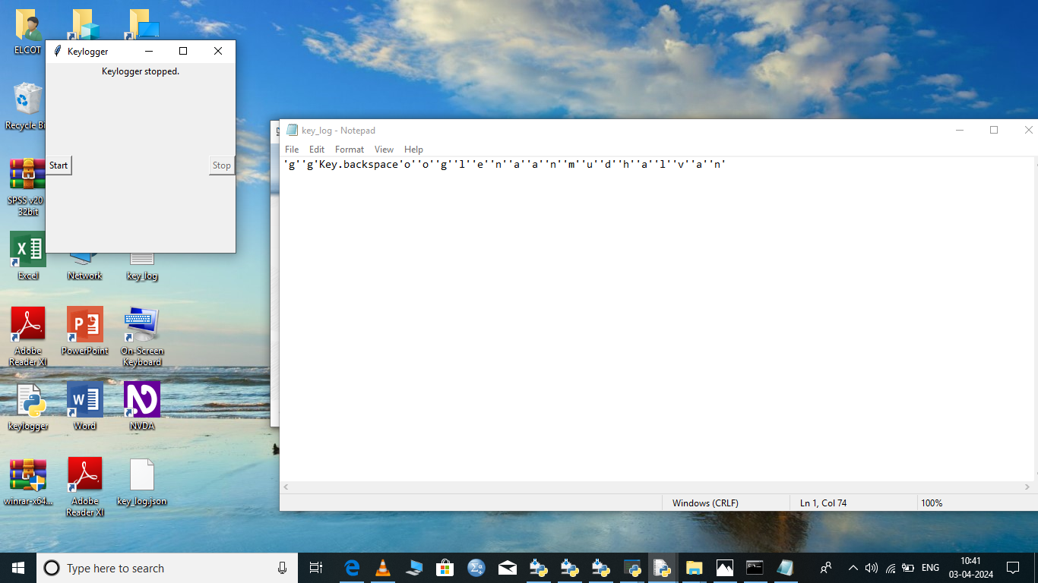
Result

Slide 8
Conclusion
Keyloggers are a potent threat to both individuals and enterprises, with the potential to cause significant harm if left undetected. Understanding the nature of keyloggers, their methods of infiltration, and the dangers they pose is crucial for maintaining a secure digital environment.

Slide 9
Future scope
A keylogger or keystroke logger/keyboard capturing is a form of malware or hardware that keeps track of and records your keystrokes as you type. It takes the information and sends it to a hacker using a command-and-control (C&C) server.

Slide 10
References
1."Keylogger Detection and Prevention Techniques: A Survey" by Mohammad Rashed Iqbal Faruqui and Md. Liakat Ali
2."A Study of Keyloggers and Detection Techniques" by Richa Singh and Mayank Dave
3."Keylogger Detection Using Machine Learning Techniques" by Yuming Zhang, Jianwei Niu, and Shuai Li
4."Enhancing Computer Security against Keyloggers" by Quynh Nguyen and Madhusudan Singh
5."Machine Learning-Based Keylogger Detection System" by Ashraf El-Sisi and Eslam Gamal
6."A Survey of Keylogger Detection and Prevention Techniques" by T. Kavitha and N. Balakumar
7."Seurity Issues and Solutions in Computer Systems: A Review" by Samer Samarah and Muneer Bani Yassein.

Slide 11
THANK YOU

