Slide 1
BrightnessMonitor von Steffen Exler s0556166 & Samuel Erb s0556350
Verteielte Sonnenzeit messen

Slide 2
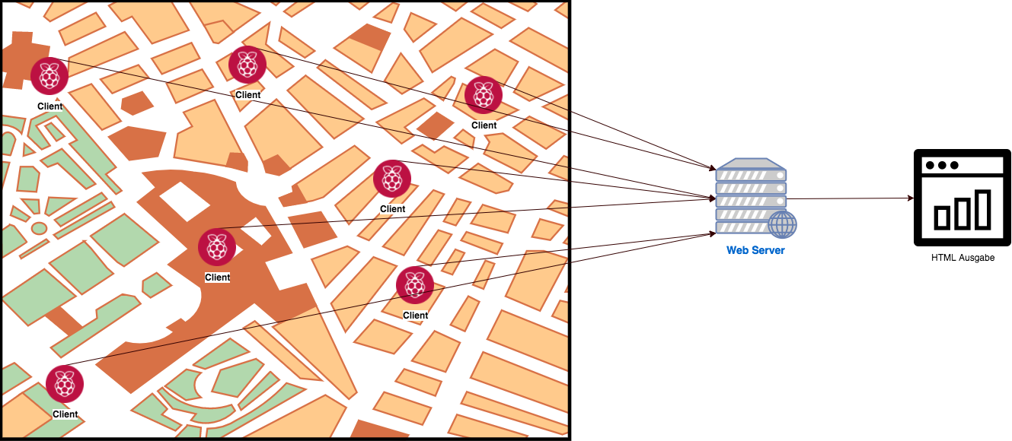
Idee & Umsetzung

Slide 3
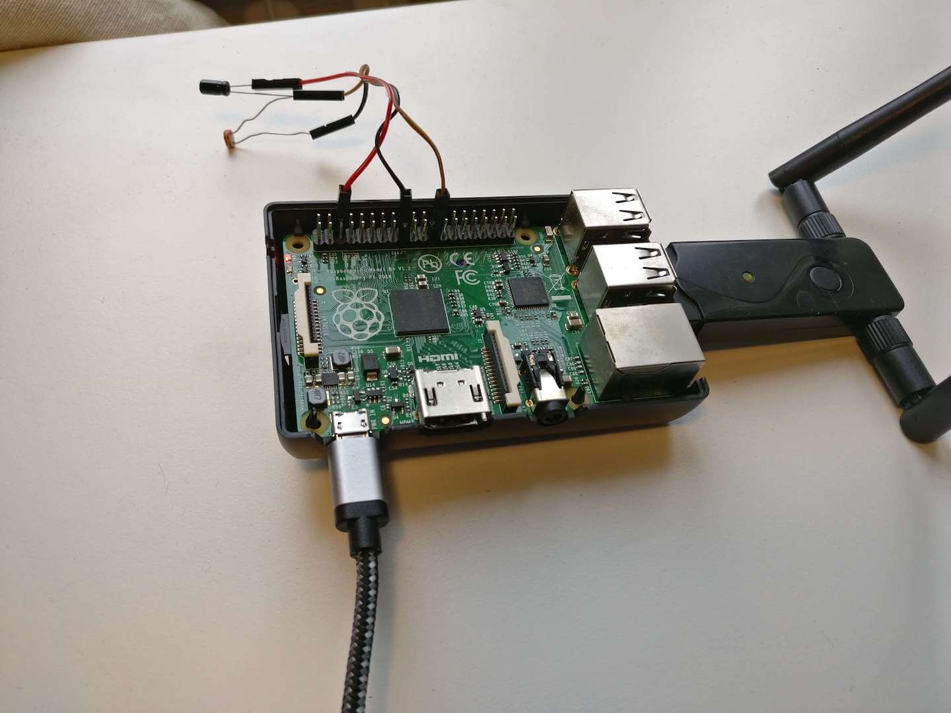
Client – Raspberry Pi mit LDR Sensor

Slide 4
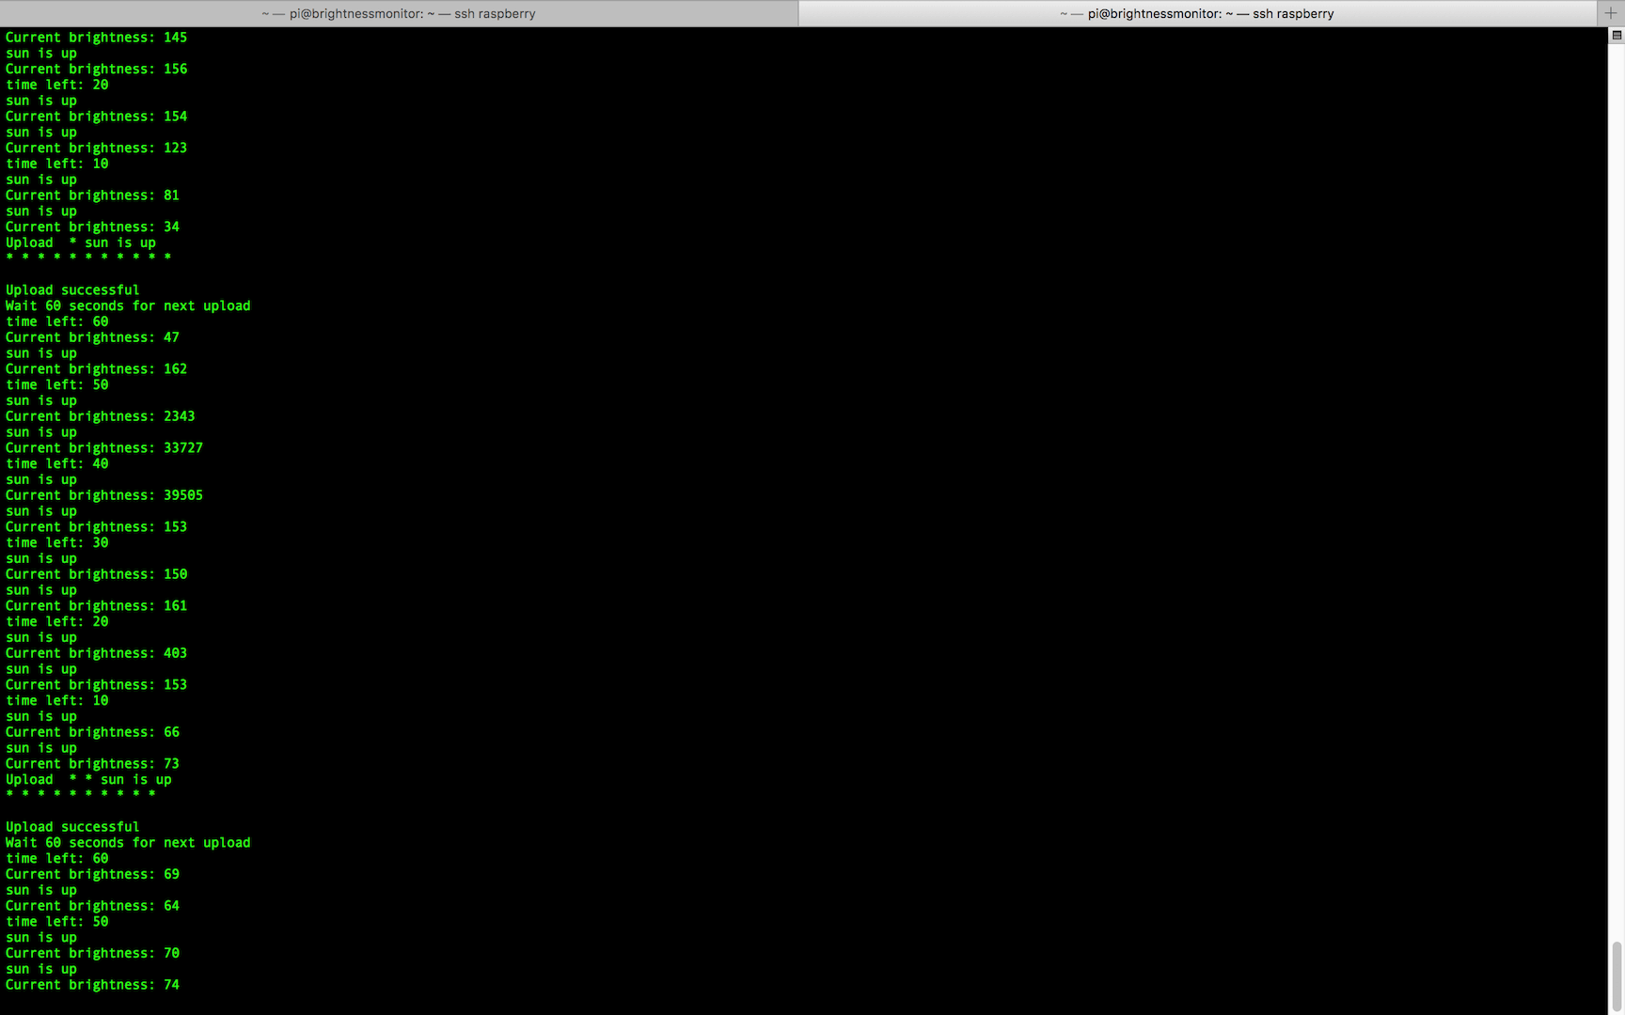
Client – Terminal Ausgabe

Slide 5
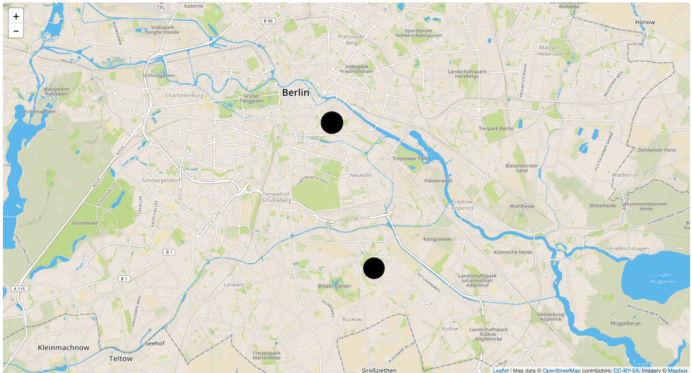
Website – Ausgabe https://infinite-crag-79176.herokuapp.com/

Slide 6
Links
Website: https://infinite-crag-79176.herokuapp.com/
Online Dokumentation: http://brightness-monitor-docs.readthedocs.io/de/latest/
Online Dokumentation: https://brightnessmonitor.github.io/
Quellcode:
Client: https://github.com/BrightnessMonitor/BrightnessMonitorClient
Server: https://github.com/BrightnessMonitor/BrightnessMonitorWeb
Dokumentation: https://github.com/BrightnessMonitor/BrightnessMonitor.github.io

