Slide 1
Happiness and corruption
Group 2 Katri Järvinen, Milla Vuojolahti and Salla Kivistö

Slide 2
AGENDA
Scrum process
Topic introduction
Data Warehouse
Demonstrations
Summary
Q&A

Slide 3
Scrum process

Slide 4
Our scrum process
Planning
We worked in 1 sprint, lasting 1 week
Key design decisions:
Scope: Comparing corruption against happiness and wealth
Tools: PostgeSQL / PgAdmin 4, DBeaver, Power BI, GitHub
Outcome: user-friendly &, easy to understand
Sprint
Data exploration
Data cleaning
Building data warehouse
Creating Power BI visuals
Main focuses:
Salla: Scrum master
Katri: Data warehouse
Milla: Data exploration, visuals
UPS:
Successfully accomplished all the tasks in time.
DOWNS:
Faced challenges merging datasets
Notes:
Planning (how many sprints? Design decisions, things you chose to do or not to do)
Sprints (Describe the sprint(s) and the ups and downs)
Who worked with what during the process?

Slide 5
Data warehouse

Slide 6
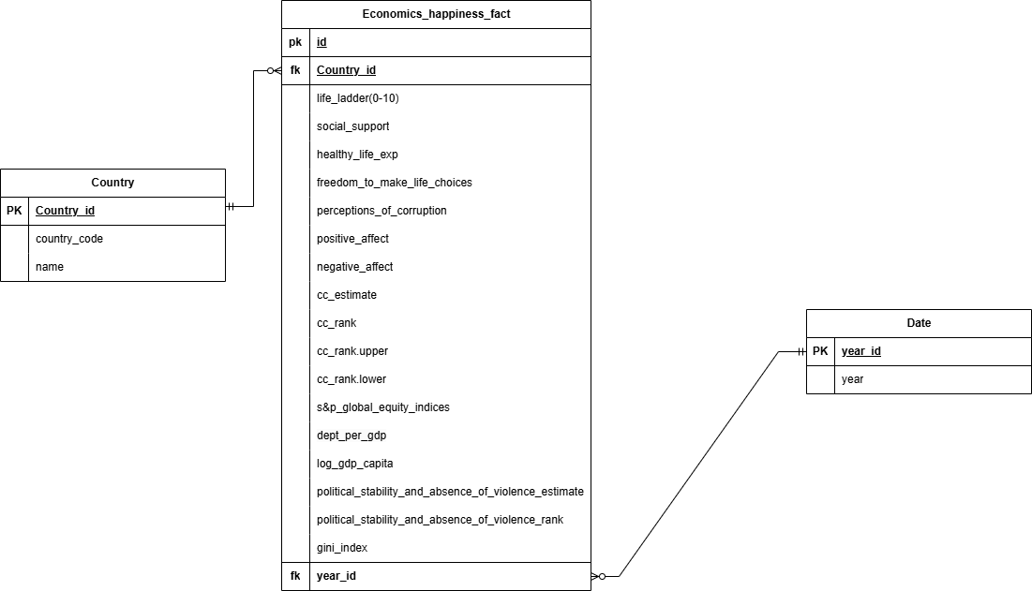
Star schema
Two dimensions as context
Most of the data was identified as key measures for our process
Natural keys used to make surrogate keys
Cleaned data using DBeaver and PowerBI
Constructed the data warehouse with a script in pgAdmin
Notes:
We used a star schema to model our data warehouse:
Fact Table: Contains key measures like Happiness scores, Corruption metrics and GDP (Government debt)
Dimensions: Country, Date, and other attributes to provide context for each fact.
This structure is clear and supports efficient querying and analysis of data.
Cleaned data using DBeaver and PowerBI

Slide 7
Country corruption and happiness measures

Slide 8
Our metrics and what we wanted to inspect
Our metrics
Our perspective: Exploring the relationships between life satisfaction, corruption and economic wealth.
Life happiness (life ladder)
Social support
Positive affect
Negative affect
Freedom to make life choices
Perception of corruption
Corruption estimate and ranking
S&P Equity Index
GDP
Gini Index
Political Stability and absence of violence
Our initial assumption was that lower perceived corruption, and higher wealth would correlate with higher happiness.
We examined the link between corruption and happiness to see how transparency and wealth affect life satisfaction and well-being across countries.
Focus on Finland, Switzerland, Brazil
Notes:
We looked into the connection between corruption and happiness to understand how factors like government transparency (meaning how clear and honest government is about its actions, decisions and processes. ) and wealth impact life satisfaction and well-being in different countries.
We wanted to compare Finland, Switzerland and Brazil to explore how corruption and happiness relate to economic conditions. Why Brazil? Brazil, in particular, because it provides a contrasting view to Finland and Switzerland, offering interesting insights into how different governmental systems and wealth distribution affect citizens' well-being. We did research and looked through countries different to Finland and Switzerland, and we also wanted to pick one with data available. And Brazil ended up being a good country to include in our analysis.
Our metrics:
Life Happiness (Life Ladder): Life Happiness (Life Ladder): Measures overall life satisfaction on scale 1-10
Social Support: Reflects how supported people feel by society, based on responses to whether they have someone to rely on in times of trouble. (0 or 1)
Positive and Negative Affect: Assesses positive and negative feelings of people
Freedom to Make Life Choices: Measures satisfaction with personal freedom to choose life decisions.
Perception of corruption: most widely used global corruption ranking. The average is based on survey responses on a 0 or 1 scale, where 0 means corruption is not widespread and 1 means it is.
Corruption estimate: used to assess the extent of corruption in a country. Specifically, it looks at how public power is used for private gain. This includes both small-scale (petty) and large-scale (grand) corruption. Estimate gives the country's score in units of a standard normal distribution, ranging from approximately -2.5 to 2.5.
S&P Equity Index: Tracks stock market performance, indicating economic strength and market sentiment.
GDP (Central Government Debt): Measures a country’s financial position, showing government debt accumulated over time.
Gini Index: Measures income inequality, with 0 for perfect equality and 100 for perfect inequality.
Political stability and absence of violence: Evaluates the likelihood of government instability or overthrow through violent means.

Slide 9
Visualization of our data

Slide 10
Summary
Findings of the data
- Brazil: big dip in governmental debt in 2011
- Financial crisis in 2008
- Political stability in Finland: 2010-2015 it was 1,32 vs. 2015-2020 it was 0,98
Any correlations?
- What was expected turned out to be mostly true.
Any surprises
- Considering the high corruption in Brazil, it was surprisingly little of an impact on happiness.
What troubles we had during this week
- We didn’t define all the data we needed, which led to extra work later to gather and merge additional data.
- Perceived daily scrums unnecessary as we collaborated closely throughout the sprint
What did we learn
- The importance of thorough data cleaning before analysis.
- Gained important skills in using PostgreSQL, Power BI, and scrum techniques
- Importance to name files and data measures consistently
Notes:
Findings → We noticed surprising changes in certain years – we investigated what happened during those years:
- Brazil: Gross domestic product (GDP) in 2011 grew by just 2.7 percent — the second-slowest pace since 2003 — and Brazil skidded dangerously close to a recession. Also, Brazilian government invested a lot of money for FIFA Cup 2014, but the impact of the event was very low. The economy shrank more in 2015, partly due to low commodity prices and slow global growth.
- Financial crisis in 2008: The 2008 financial crisis is clearly reflected in the data, showing a significant dip in government debt in all countries that year. (was a major worldwide economic crisis, centered in the United States, which triggered the Great Recession of late 2007 to mid-2009)
- Political stability in Finland: The immigration crisis and the annexation of Crimea have impacted Finland's political stability.

Slide 11
THANK YOU!
Do you have any questions?

