Slide 1


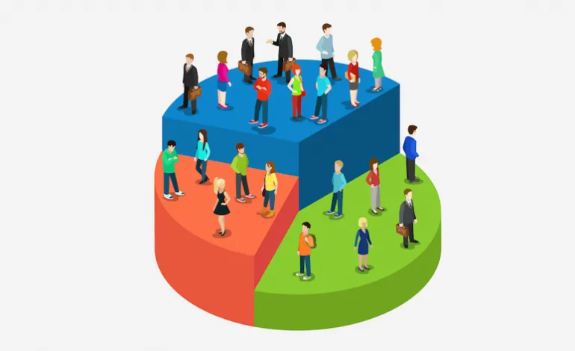
Customer Segmentation
K.BRIGHTY JOEL
22R21A6728
CSD-A

Slide 2
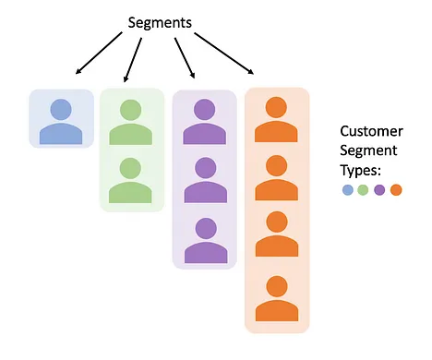
Introduction
Customer segmentation is the process of division of customer base into several groups of individuals that share a similarity in different ways that are relevant to marketing such as Age, Gender, Interests etc.
Data collection is the primary thing in order to perform segmentation.
Through the data collected from the customers about their interests, companies can gain a deeper understandings of customer preferences and can discover maximum profits.
k-map clustering helps to group the customers with similar interests.

Slide 3


The Importance of Customer Segmentation
Personalized Marketing
Enhanced Customer Experience
Increased Profitability
Competitive Advantage

Slide 4
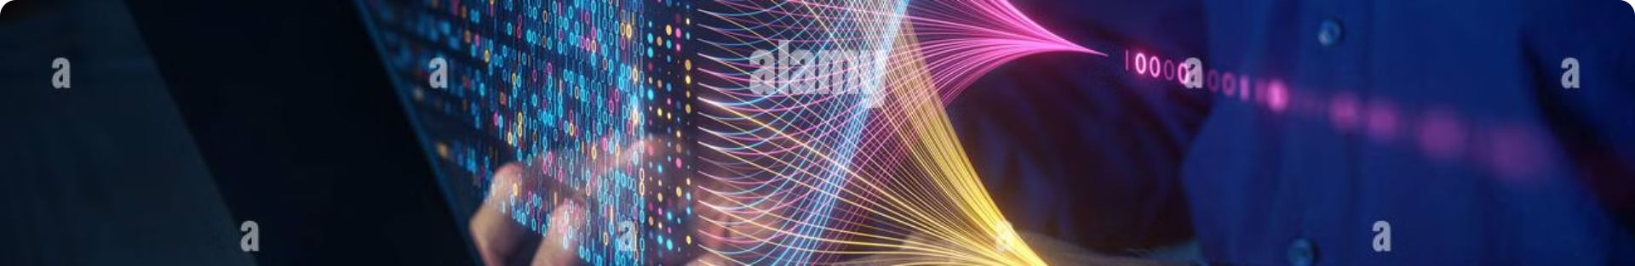
Data Preparation and Cleaning
Data Collection
1
Gather relevant customer data from various sources,. for this project we’ve taken a formatted Data set from Kaggle.com
2
Data Cleaning
Identify and remove errors, inconsistencies, and missing values in the collected data to ensure accuracy and reliability.
Data Transformation
3
Convert data into a suitable format for analysis, such as tabular format for proper visualization, creating variables, and scaling variables.

Slide 5

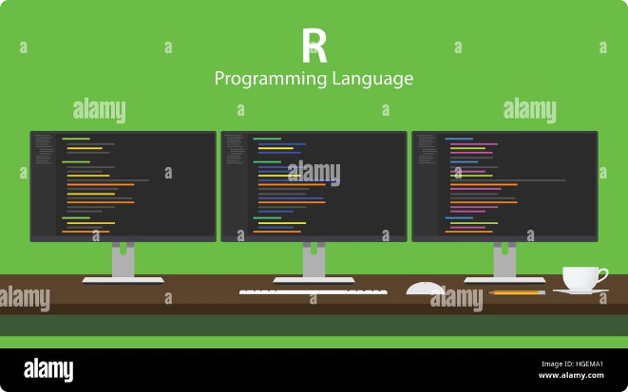
Clustering Techniques in R
1
K-Means Clustering
An iterative algorithm that partitions data points into k clusters based on their distance from cluster centroids.
2
Hierarchical Clustering
A method that creates a hierarchical tree of clusters by successively merging or splitting clusters based on their similarity.
3
DBSCAN
A density-based algorithm that identifies clusters as areas of high density separated by areas of low density.
4
Model Selection
Evaluate different clustering algorithms and parameters to choose the best model based on the specific data and business objectives.

Slide 6
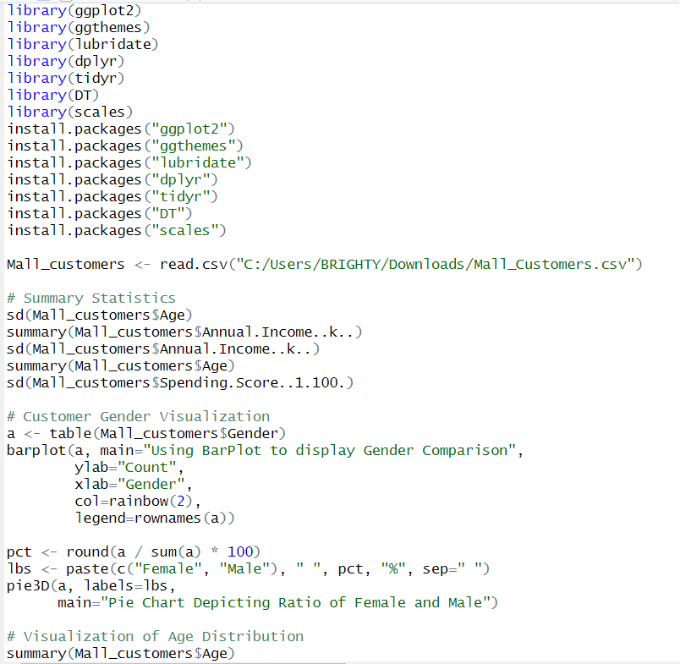
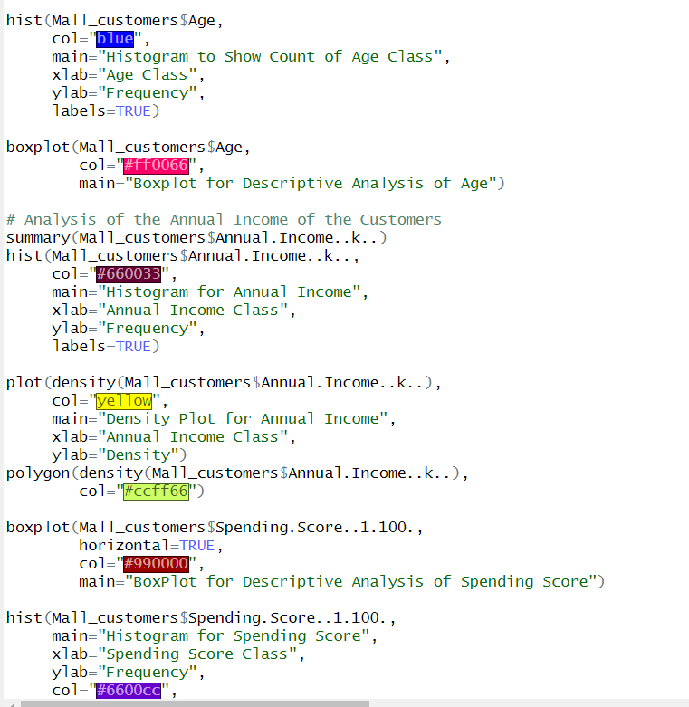
R Code

Slide 7
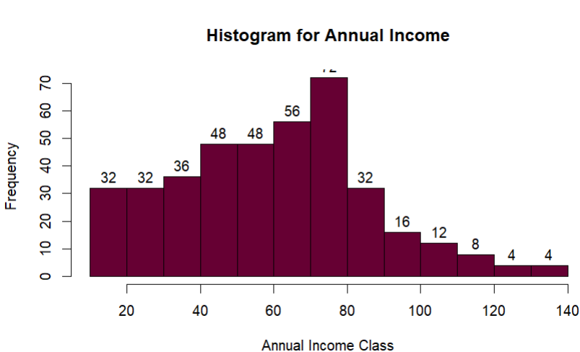
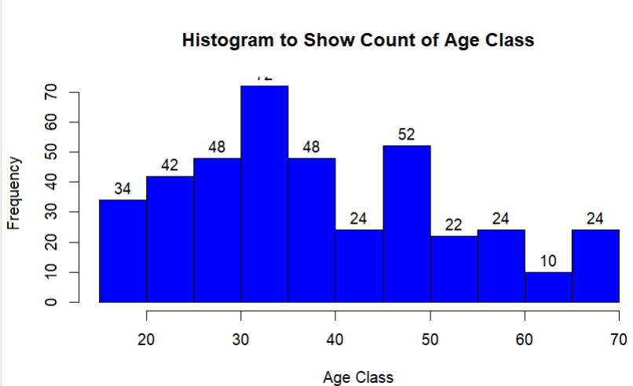
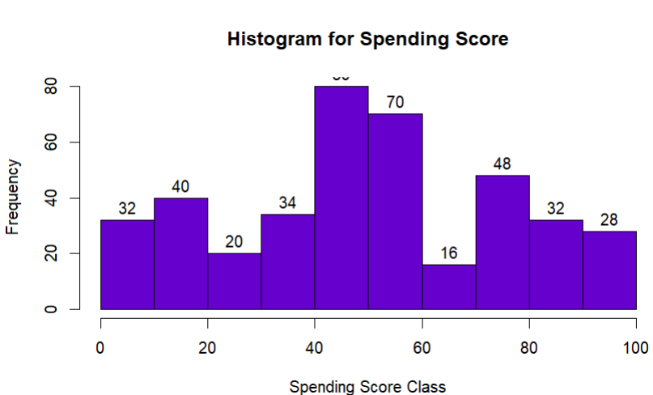
Outputs

Slide 8






Applying Segmentation Insights
Targeted Marketing
Develop tailored marketing campaigns that resonate with the specific needs and preferences of each customer segment.
Personalized Customer Service
Offer customized service experiences that address the unique needs of different customer segments.
Product Development
Develop new products or features that cater to the specific needs and preferences of identified customer segments.
Pricing Strategies
Implement pricing strategies that are tailored to the value perception and willingness to pay of different customer segments.

Slide 9


Conclusion
Customer segmentation is a powerful tool that allows businesses to gain a deeper understanding of their customers and tailor their marketing efforts for greater success. By leveraging data and applying appropriate clustering techniques, businesses can effectively identify and target customer segments, ultimately driving profitability and achieving their business objectives.

