Slide 1


Project Sahay
An Intelligent Conversational AI for Automated Appointment Scheduling
TEAM - 12
SDG GOAL NUMBER-3
Under the Guidance of
Presented By -
Guide Name:Mrs. Navyatha Ravi Assistant Professor
Name
G.SAMPATH YADAV K.BRIGHTY JOEL
G. SRUJAN KUMAR
Roll no 23R25A6702
22R21a6728
22R21A6717
Department of Data Science.

Slide 2

Abstract
Project Sahay is a conversational AI assistant designed for Prudence Hospitals to automate patient interactions such as booking, rescheduling, and canceling appointments via web and phone. Built on a serverless architecture using Netlify Functions, Supabase, and Google Gemini, it integrates natural language understanding with secure transactions to ensure reliable healthcare scheduling. Featuring voice and text communication powered by speech recognition and synthesis, Sahay’s modular design enables scalability and independent development. Through Exotel integration, it supports telephonic access for non-digital users, while PostgreSQL ensures data consistency and prevents booking conflicts. Overall, Sahay enhances hospital administration by reducing manual workload, improving accessibility, and delivering a faster, more efficient patient experience, with planned advancements in real-time communication and analytics.

Slide 3
Objectives
The main objective of this project is to create an AI assistant that helps patients easily book, reschedule, and cancel appointments through natural and user-friendly conversations. It aims to support both text-based web chat and voice-based telephony so that people of all ages can use the system comfortably. Another objective is to automate backend operations using a serverless microservice design to ensure fast responses and high reliability. The system also focuses on accurate intent recognition using a Large Language Model to understand user requests correctly. A further goal is to maintain secure and consistent data storage through an ACID-compliant database. The project aims to provide an administrative dashboard for healthcare staff to monitor appointments and system activity in real time. It also seeks to reduce manual workload and errors by automating repetitive appointment tasks. Overall, the objective is to improve efficiency, accessibility, and user satisfaction in healthcare appointment management.

Slide 4
Introduction
Project Sahay is an AI-powered assistant developed to simplify hospital operations and make healthcare services more accessible. It allows patients to easily book, reschedule, or cancel appointments through voice or text, either on a website or via phone calls. The system uses advanced technologies like Google Gemini for natural language understanding, Supabase for secure data storage, and Netlify Functions for efficient backend processing. Integrated with Exotel for telephony support, Sahay ensures that even non-digital users can interact with the hospital seamlessly. By automating routine tasks, it reduces staff workload, improves service speed, and helps patients receive timely medical care, ultimately creating a more efficient and patient-friendly healthcare experience.

Slide 5
Literature Survey
1. Generative AI for Transformative Healthcare (IEEE, 2024)
Reference: https://ieeexplore.ieee.org/iel7/6287639/10380310/10440330.pdf
This paper explains how generative AI and conversational agents are being adopted in healthcare for appointment automation, telemedicine, and administrative workflows. It highlights multi-layered system design including voice/text interfaces, serverless middleware, telephony integration, and secure databases with transactional integrity.
2. Leveraging Large Language Models to Power Chatbots for Healthcare (ACM, 2025)
Reference: https://dl.acm.org/doi/10.1145/3637364
The study explores the use of LLMs like Google Gemini to build healthcare chatbots for tasks such as appointment booking, triage, and information retrieval. It presents an architecture with a decoupled frontend (web/voice), serverless backend functions, and secure database handling with medical-grade data integrity.

Slide 6
Literature Survey
3. AI Health Assistant Project (2025)
Reference: https://www.scribd.com/document/828419263/AI-HEALTH-ASSISTANT-PROJECT-BY-TUSHAR-BISANE-2025
An AI assistant supporting voice and text interactions through NLP chatbots and modular backend APIs. Includes encrypted data handling and a real-time hospital dashboard for appointment monitoring.
4. Conversational Medical AI: Ready for Practice (arXiv, 2024)
Reference: https://arxiv.org/abs/2411.12808
Describes real-world deployment of clinician-supervised LLM agents integrated with chat interfaces and microservices. Focuses on multi-turn dialogue, appointment execution, and monitoring dashboards.
5. AI-Based Conversational Agents for Chronic Diseases (JMIR, 2020)
Reference: https://www.jmir.org/2020/9/e20701/
A systematic review highlighting NLP-based conversational systems with multimodal interfaces. Emphasizes secure backends, interoperability, and real-time communication for chronic disease support.

Slide 7
Literature Survey Summary Table
S.no. | TITLE | METHODOLOGY | ADVANTAGES | DISADVANTAGES
1. | LLM Chatbots for Healthcare ​ | AI chatbot, serverless backend, web/phone | Scalable, multi-channel, efficient | Needs secure setup, evolving AI
2. | Generative AI in Healthcare | Voice/text AI, serverless, telephony, dashboard | Real-time, efficient | Setup, monitoring, privacy
3. | AI Health Assistant Project | Modular NLP backend, telephony, dashboard | Secure, expandable, practical | Maintenance, regulatory needs
4. | Conversational Medical AI in Practice | LLM agent, microservices, live dashboard | Safe, patient-focused, automated | Needs supervision, complex system
5. | AI Agents for Chronic Diseases ​ | Multi-modal agents, secure backend, dashboard | Evidence-based, reliable | Limited scope, privacy compliance

Slide 8
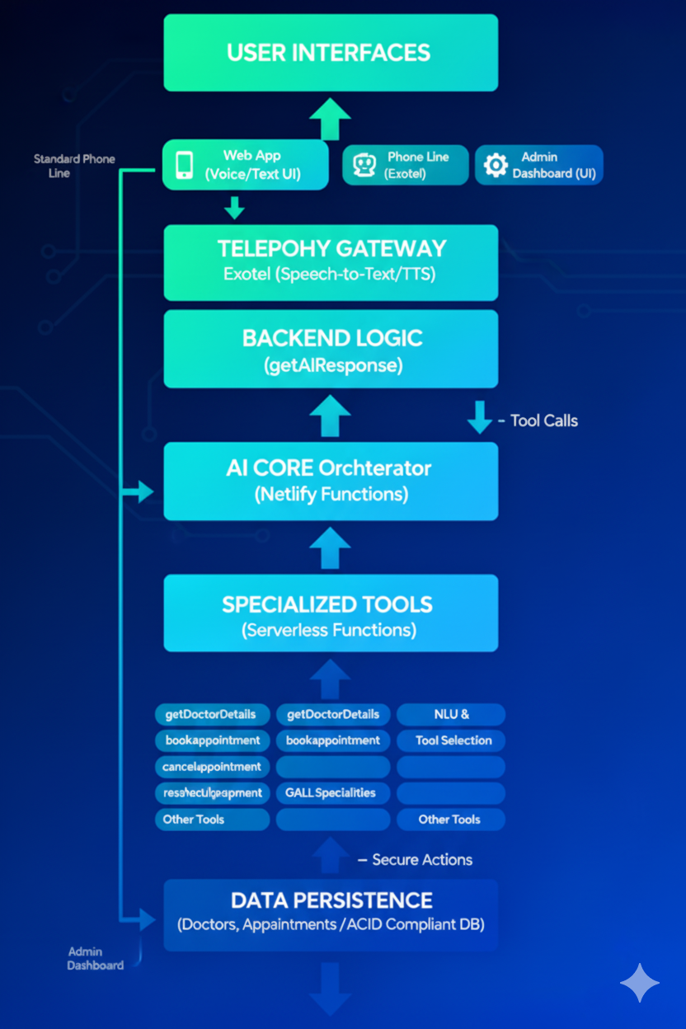
Proposed System Architecture

Slide 9
Sahay System Architecture
1 User Interfaces (The Front-Door)
Web App: For voice and text chat.
Phone Line (Exotel): For regular phone calls.
Admin Dashboard: For hospital staff to see bookings.
2 Backend Logic (The "Brain")
The main getAIResponse function understands the user's request.
It acts as an orchestrator that decides which "tool" to use.
3 Specialized Tools (The "Hands")
Secure, single-job serverless functions (e.g., bookAppointment, getDoctorDetails).
The "brain" tells these "hands" what to do (like save a booking).
4 Data Persistence (The "Memory")
An ACID-compliant Supabase (PostgreSQL) database.
Reliably stores all doctors and appointments data, preventing errors like double-bookings.

Slide 10
SAHAY – Module Division
1. Conversational User Interface (UI)
Handles patient interaction through text (web chat), voice (browser speech API).
Captures user queries and displays AI responses in real time.
2. Telephony Integration Module
Connects phone calls to the system using Exotel webhooks.
Converts speech input into text and relays responses via automated voice.
3. AI Orchestrator / LLM Gateway
Sends user queries and conversation history to the Large Language Model.
Interprets model responses and triggers the correct backend microservice.
4. Tool-Based Serverless Microservices
Independent functions for booking, rescheduling, cancelling & retrieving doctor details.
Ensures modularity, scalability, and secure backend execution.
5. Database & Transaction Manager (PostgreSQL – Supabase)
Stores doctors, appointments, patient data, and logs with ACID consistency.
Prevents double-booking using constraints and transactional workflows.

Slide 11
SAHAY – Module Division
6. Admin Dashboard Module
Allows hospital staff to monitor appointments, check availability & filter data
Provides real-time management and complete operational visibility.
7. Security & Access Control Module
Manages admin login, role-based access encrypted data handling.
Protects sensitive patient and appointment records.
8. Logging, Monitoring & Analytics Module
Tracks system performance, errors, function calls, and telephony logs.
Supports debugging and generates insights for performance improvement.
9. Notification & Reminder Module
Sends confirmation messages and appointment reminders via SMS/voice.
Improves patient engagement and reduces missed appointments.

Slide 12
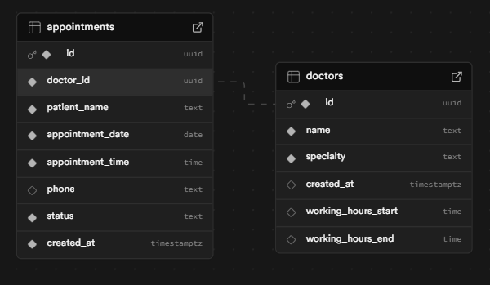
Dataset Details
Doctor Table:
What it is: A directory of all doctors.
Contains: Doctor's Name and Speciality.
Appointment Table:
What it is: A log of all bookings.
Contains: Patient's Name, Patient's Phone, Appointment Time, and Status ('confirmed' or 'cancelled').

Slide 13
Conclusion
Project Sahay is a comprehensive AI-powered health assistant designed to streamline hospital operations and improve patient experience. It automates the full appointment lifecycle—booking, rescheduling, and cancellation—through both web and telephone interfaces, making healthcare services more accessible and convenient. Its architecture, based on serverless microservices, ensures scalability, security, and resilience, while the tool-augmented AI intelligently interacts with backend systems without compromising safety. Real-time voice interaction, multi-channel access, and a user-friendly administrative dashboard enable seamless communication between patients and hospital staff. Overall, Project Sahay is a future-ready solution that combines cutting-edge AI, reliable transactional databases, and robust system design to deliver efficiency, accuracy, and a superior healthcare experience.

Slide 14
Thankyou

Slide 15


Objectives
Develop a highly accurate NLP engine for symptom analysis.
Build a secure and scalable microservices platform.
Ensure the data architecture is fully HIPAA-compliant.
Create an intelligent algorithm for doctor-patient matching.
Automate over 80% of routine scheduling tasks for staff.
Provide a seamless and simple booking experience for patients.

Slide 16
Purpose of the project
The purpose of Project Sahay is to make hospital appointment management easier, faster, and more efficient for both patients and staff. It aims to reduce the time and effort needed for booking, rescheduling, and canceling appointments by using AI-powered voice and text communication. By automating these routine tasks, the project helps hospitals provide better service, avoid scheduling errors, and ensure that patients get quick access to the right doctors. Overall, Sahay’s purpose is to improve the healthcare experience through smart technology and simple, accessible communication.

Slide 17
Motivation
Project Sahay was inspired by the need to simplify and improve the patient experience in hospitals. Managing appointments manually or over the phone is time-consuming, prone to errors, and inconvenient for both patients and staff. By creating an AI-powered assistant that can handle booking, rescheduling, and canceling appointments through both web and phone, the project aims to save time, reduce errors, and make healthcare services more accessible, efficient, and patient-friendly.

Slide 18
Literature Survey
IEEE PAPER-1
-Title: Generative AI for Transformative Healthcare
-Reference: https://ieeexplore.ieee.org/iel7/6287639/10380310/10440330.pdf
-Authors: Vishal Jain, Pooja Sharma, Krishna Narra, Renuka G
-Published on: 2024
-Methodology:
This paper details how generative AI, particularly conversational agents, are being incorporated into healthcare for tasks like appointment management, telemedicine, and administrative automation. It discusses a multi-layered architecture comprising voice and text interfaces, serverless middleware, and cloud databases that support transactional integrity. Key techniques include natural language understanding, secure API-driven integration with telephony gateways, and deployment of real-time voice assistants using cloud speech services. Observability features such as admin dashboards for operational KPI tracking are implemented, along with recommendations for future scalability and security, including WebSocket real-time communication and role-based access control for sensitive functions.

Slide 19
Literature Survey
IEEE PAPER-2
-Title: Leveraging Large Language Models to Power Chatbots for Healthcare: Opportunities and Challenges
-Reference: https://dl.acm.org/doi/10.1145/3637364
-Authors: Yunxiang Li, Zhaodong Ding, Peiyuan Sun, Xin Xie, Dongdong Li
-Published on: 2025
-Methodology:
The paper explores how Large Language Models (LLMs), such as Google Gemini, can be used for building chatbots capable of automating healthcare workflows like appointment booking, patient triage, and information retrieval. These chatbots integrate with existing hospital databases and telephony systems via APIs. The research highlights system architecture involving a decoupled frontend (web and voice interface), serverless backend functions for business logic, and secure database management to ensure medical-grade data integrity. Automatic scaling, cost efficiency through serverless deployment, and multi-modal interaction (web/text and voice/phone) are emphasized. The methodology focuses on improving accessibility, reliability, and operational management for hospitals, demonstrated through the implementation and real-world evaluation of automated appointment lifecycle management and admin dashboard features.

Slide 20
Literature Survey
IEEE PAPER-3
-Title: Ai Health Assistant Project - by Tushar Bisane 2025
-Reference: https://www.scribd.com/document/828419263/AI-HEALTH-ASSISTANT-PROJECT-BY- TUSHAR-BISANE-2025
-Authors: Tushar Bisane
-Published on: July 16, 2025
-Methodology:
The project presents an AI health assistant capable of handling both web-based and voice-based patient interactions. The methodology involves deploying NLP-driven chatbots with a modular backend that manages doctor and appointment data. Appointment booking, rescheduling, and cancellation workflows are facilitated through independent serverless tools communicating via APIs. Data security is maintained using encrypted storage and compliance with medical standards, and an administrative dashboard enables hospital staff to track and manage appointments with real-time KPIs and filters. The system architecture supports multi-channel accessibility, production-grade transactional integrity, and future extensibility towards scalable, enterprise healthcare solutions.

Slide 21
Literature Survey
IEEE PAPER-4
-Title: Conversational Medical AI: Ready for Practice
-Reference: https://arxiv.org/abs/2411.12808
-Authors: Antoine Lizée, Pierre-Auguste Beaucoté, James Whitbeck, Marion Doumeingts, Anaël Beaugnon, Isabelle Feldhaus
-Published on: November 18, 2024
-Methodology:
This paper describes the deployment and physician-supervised evaluation of a large language model (LLM)-based conversational agent in a real medical setting. The agent was integrated into a chat service for patient support, automating the entire patient interaction lifecycle—answering queries, providing medical information, and managing consultations. The methodology relied on seamless integration between a multimodal web chat interface and a secure backend, leveraging microservices to execute real actions such as booking appointments. Safety was maintained through physician oversight, and features like multi-turn dialogue management, automatic conversation history, and real-time monitoring dashboards were highlighted as essential architectural components for successful healthcare AI.

Slide 22
Literature Survey
IEEE PAPER-5
-Title: Artificial Intelligence-Based Conversational Agents for Chronic Diseases: Systematic Literature Review
-Reference: https://www.jmir.org/2020/9/e20701/
-Authors: Sanne C van Velthoven, David Coyle, John Powell
-Published on: September 13, 2020
-Methodology:
This systematic review examines multiple AI-based conversational agents used in healthcare, especially for the management of chronic diseases. Methodologies explored include natural language processing and the use of multimodal interfaces (such as web chat and telephony) to increase patient engagement. Systems described in the review typically follow a layered architecture: frontend patient interfaces, middleware logic, and secure backend data stores. Methodological emphasis is placed on data privacy, reliability, interoperability, and operational efficiency, with dashboards for monitoring and real-time communication (voice/text) central to many reviewed solutions. The review highlights the importance of transaction safety and robust integration to support appointment management, patient education, and support functions.

Slide 23
Requirements
Software Requirements
Frontend: HTML, Tailwind CSS, JS
Backend: Netlify Functions (Node.js)
Database: Supabase (PostgreSQL)
AI: Google Gemini API
Telephony: Exotel
Dev & Deploy: GitHub + Netlify
Voice: Web Speech API
Hardware Requirements
Client: PC, laptop, or smartphone with mic & internet
Server/Cloud: Netlify + Supabase + internet for telephony
Optional: Headset for better voice quality

Slide 24
Real Time Applications
Instant Appointment Booking: Patients can book, reschedule, or cancel appointments immediately.
Voice-Based Interaction: Real-time conversation via web or phone with AI assistant.
Live Doctor Availability: Immediate updates on doctor schedules and time slots.
Administrative Dashboard: Hospital staff can monitor appointments and KPIs in real-time.
Multi-Channel Access: Web and telephony integration ensures services are available instantly across platforms.

