Slide 1
Classification by Backpropagation
Brihat Ratna Bajracharya
19/075
CDCSIT

Slide 2
Introduction
The Backpropagation neural network is a multilayered, feedforward neural network
It is also one of the simplest and most general methods used for supervised training of multilayered neural networks
It works by approximating the non-linear relationship between the input and the output by adjusting the weight values internally

Slide 3
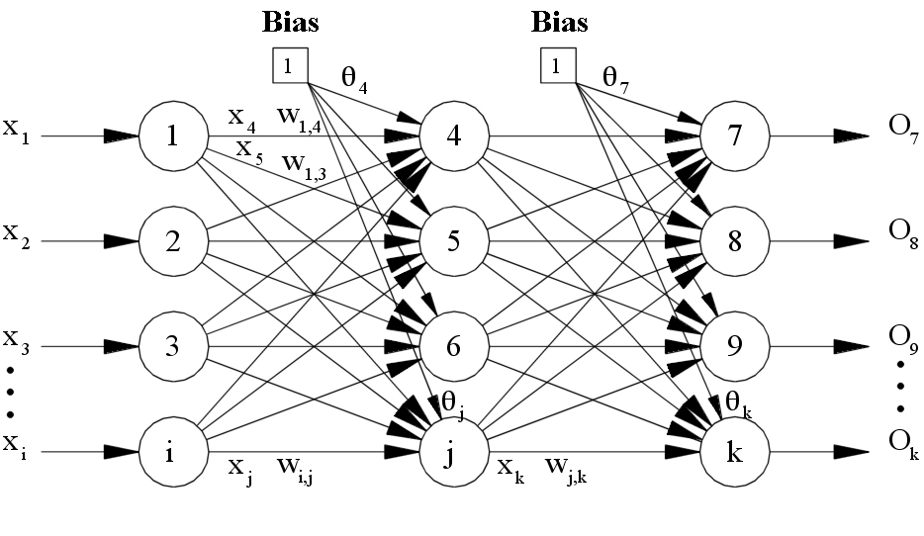
Topology
Backpropagation topology includes an input layer, one or more hidden layer and an output layer

Slide 4
Operation I
The operations of Backpropagation neural networks can be divided into two steps: feedforward and Backpropagation
In the feedforward step, an input pattern is applied to the input layer and its effect propagates, layer by layer, through the network until an output is produced
The network's actual output value is then compared to the expected output, and an error signal is computed for each of the output nodes

Slide 5
Operation II
The output error signals are transmitted backwards from the output layer to each node in the hidden layer that immediately contributed to the output layer
This process is then repeated, layer by layer, until each node in the network has received an error signal
The Backpropagation algorithm looks for the minimum value of the error function in weight space using the delta rule or gradient descent
The weights that minimize the error function is considered to be a solution to the learning problem

Slide 6
Pseudo Code I
Assign all network inputs and output
Initialize all weights with small random numbers, typically between -1 and 1
repeat
for every pattern in the training set
Present the pattern to the network
// Propagated the input forward through the network (Feed Forward)
// Propagate the errors backward through the network (Back propagation)
// Calculate Global Error
Calculate the Error Function
end
while ((maximum number of iterations < than specified) AND (Error Function is > than specified))

Slide 7
Pseudo Code II
Feed Forward Step
for each layer in the network
for every node in the layer
Calculate the weight sum of the inputs to the node
Add the threshold to the sum
Calculate the activation for the node
end
end

Slide 8
Pseudo Code III
Backpropagation of Error Step
for every node in the output layer
calculate the error signal
end
for all hidden layers
for every node in the layer
Calculate the node's signal error
Update each node's weight in the network
end
end

Slide 9
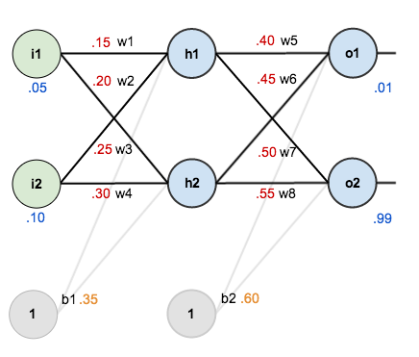
Example

Slide 10
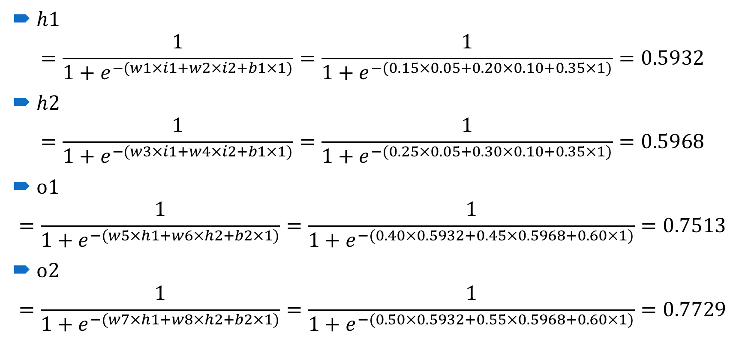
Example (Forward Pass)
$h1$
$$=\frac{1}{1+e^{−(w1×i1+w2×i2+b1×1)}}=\frac{1}{1+e^{−(0.15×0.05+0.20×0.10+0.35×1)}}=0.5932$$
$h2$
$$=\frac{1}{1+e^{−(w3×i1+w4×i2+b1×1)}}=\frac{1}{1+e^{−(0.25×0.05+0.30×0.10+0.35×1)}}=0.5968$$
$o1$
$$=\frac{1}{1+e^{−(w5×h1+w6×h2+b2×1)}}=\frac{1}{1+e^{−(0.40×0.5932+0.45×0.5968+0.60×1)}}=0.7513$$
$o2$
$$=\frac{1}{1+e^{−(w7×h1+w8×h2+b2×1)}}=\frac{1}{1+e^{−(0.50×0.5932+0.55×0.5968+0.60×1)}}=0.7729$$

Slide 11
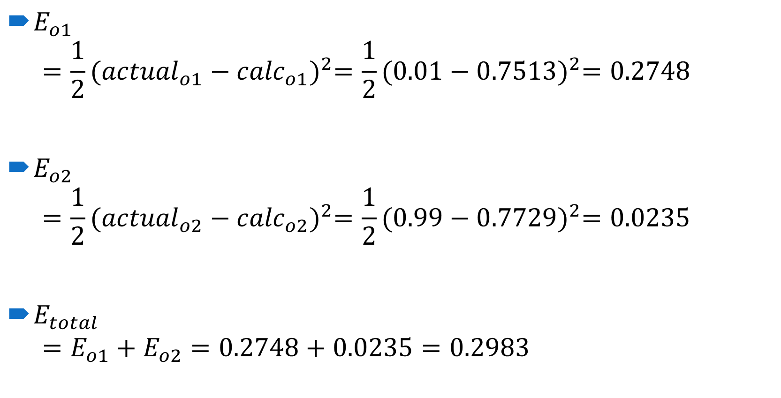
Example (Error Calculation)
$E_{o1}$
$$=\frac{1}{2}{({actual}_{o1}−{calc}_{o1})}^{2}=\frac{1}{2}{(0.01−0.7513)}^{2}=0.2748$$
$E_{o2}$
$$=\frac{1}{2}{({actual}_{o2}−{calc}_{o2})}^{2}=\frac{1}{2}{(0.99−0.7729)}^{2}=0.0235$$
$E_{total}$
$$=E_{o1}+E_{o2}=0.2748+0.0235=0.2983$$

Slide 12
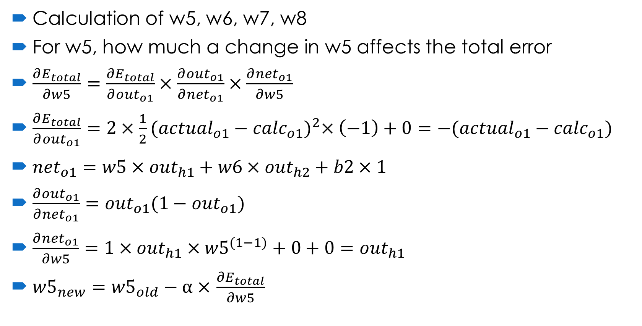
Example (Backpropagation of Error)
Calculation of w5, w6, w7, w8
For w5, how much a change in w5 affects the total error
$\frac{∂E_{total}}{∂w5}=\frac{∂E_{total}}{∂{out}_{o1}}×\frac{∂{out}_{o1}}{∂{net}_{o1}}×\frac{∂{net}_{o1}}{∂w5}$
$\frac{∂E_{total}}{∂{out}_{o1}}=2×\frac{1}{2}{({actual}_{o1}−{calc}_{o1})}^{2}×\left(−1\right)+0={−(actual}_{o1}−{calc}_{o1})$
${net}_{o1}=w5×{out}_{h1}+w6×{out}_{h2}+b2×1$
$\frac{∂{out}_{o1}}{∂{net}_{o1}}={out}_{o1}(1−{out}_{o1})$
$\frac{∂{net}_{o1}}{∂w5}=1×{out}_{h1}×{w5}^{(1−1)}+0+0={out}_{h1}$
${w5}_{new}={w5}_{old}−α×$ $\frac{∂E_{total}}{∂w5}$

Slide 13
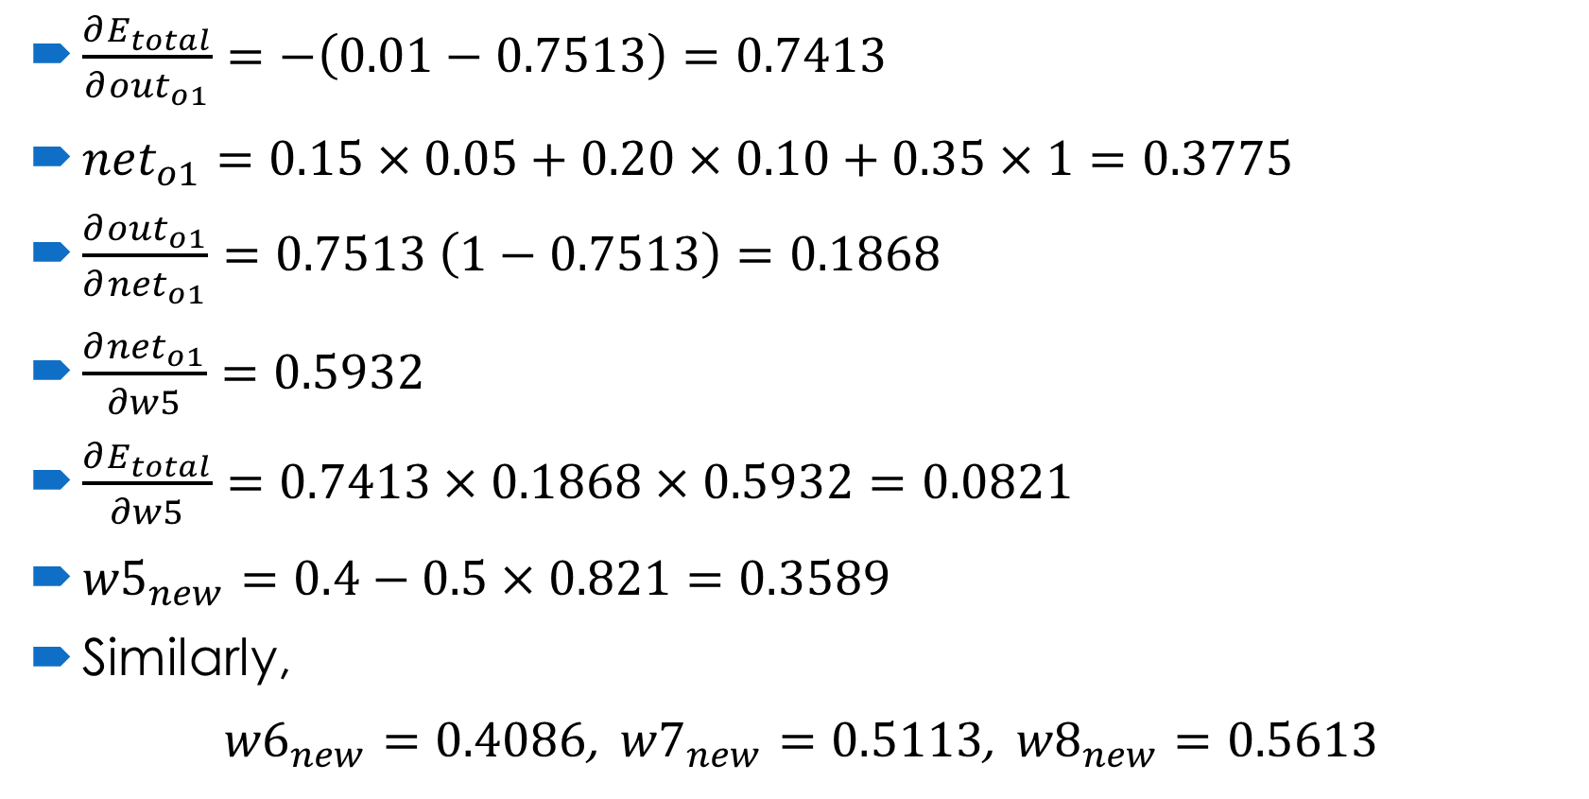
Example (Backpropagation of Error)
$\frac{∂E_{total}}{∂{out}_{o1}}=−\left(0.01−0.7513\right)=0.7413$
${net}_{o1}=0.15×0.05+0.20×0.10+0.35×1=0.3775$
$\frac{∂{out}_{o1}}{∂{net}_{o1}}=0.7513 \left(1−0.7513\right)=0.1868$
$\frac{∂{net}_{o1}}{∂w5}=0.5932$
$\frac{∂E_{total}}{∂w5}=0.7413×0.1868×0.5932=0.0821$
${w5}_{new}=0.4−0.5×0.821=0.3589$
Similarly,
${w6}_{new}=0.4086$, ${w7}_{new}=0.5113$, ${w8}_{new}=0.5613$

Slide 14

Example (Backpropagation of Error)
Calculation of w1, w2, w3, w4
For w1,
$\frac{∂E_{total}}{∂w1}=\frac{∂E_{total}}{∂{out}_{h1}}×\frac{∂{out}_{h1}}{∂{net}_{h1}}×\frac{∂{net}_{h1}}{∂w1}$
$\frac{∂E_{total}}{∂{out}_{h1}}=\frac{∂E_{o1}}{∂{out}_{h1}}+\frac{∂E_{02}}{∂{out}_{h1}}$
$\frac{∂E_{o1}}{∂{out}_{h1}}=\frac{∂E_{o1}}{∂{net}_{o1}}×\frac{∂{net}_{01}}{∂{out}_{h1}}$
$\frac{∂E_{o1}}{∂{net}_{h1}}=\frac{∂E_{o1}}{∂{out}_{o1}}×\frac{∂{out}_{01}}{∂{net}_{01}}$
$\frac{∂{out}_{h1}}{∂{net}_{h1}}={out}_{h1}(1−{out}_{h1})$
${net}_{h1}=w1×i1+w3×i2+b1×1$
$\frac{∂{net}_{h1}}{∂w1}=i1+0+0=i1$
${w1}_{new}={w1}_{old}−α×$ $\frac{∂E_{total}}{∂w1}$

Slide 15
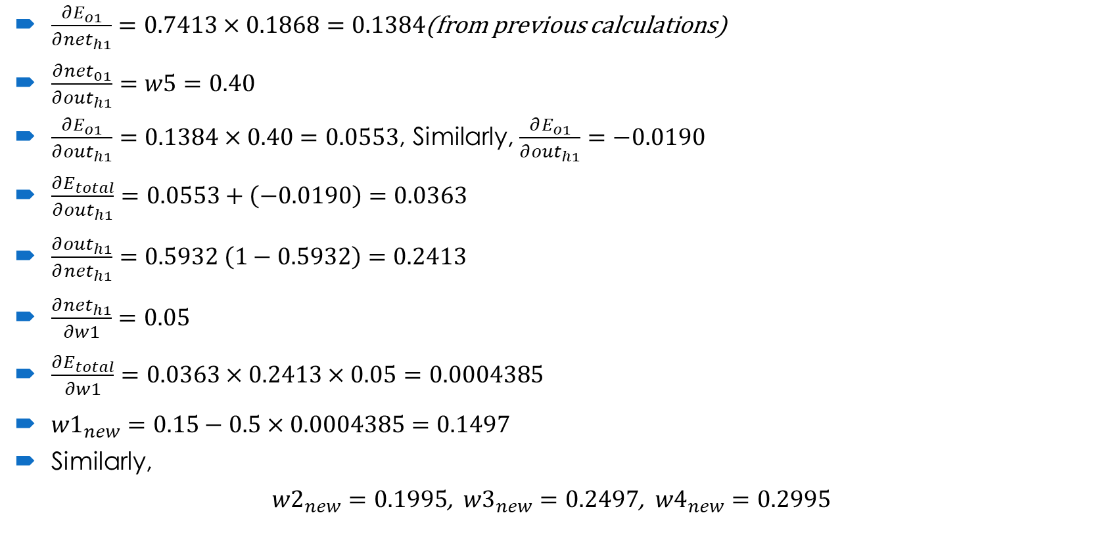
Example (Backpropagation of Error)
$\frac{∂E_{o1}}{∂{net}_{h1}}=0.7413×0.1868=0.1384$(from previous calculations)
$\frac{∂{net}_{01}}{∂{out}_{h1}}=w5=0.40$
$\frac{∂E_{o1}}{∂{out}_{h1}}=0.1384×0.40=0.0553$, Similarly, $\frac{∂E_{o1}}{∂{out}_{h1}}=−0.0190$
$\frac{∂E_{total}}{∂{out}_{h1}}=0.0553+\left(−0.0190\right)=0.0363$
$\frac{∂{out}_{h1}}{∂{net}_{h1}}=0.5932 \left(1−0.5932\right)=0.2413$
$\frac{∂{net}_{h1}}{∂w1}=0.05$
$\frac{∂E_{total}}{∂w1}=0.0363×0.2413×0.05=0.0004385$
${w1}_{new}=0.15−0.5×0.0004385=0.1497$
Similarly,
${w2}_{new}=0.1995$, ${w3}_{new}=0.2497$, ${w4}_{new}=0.2995$

Slide 16
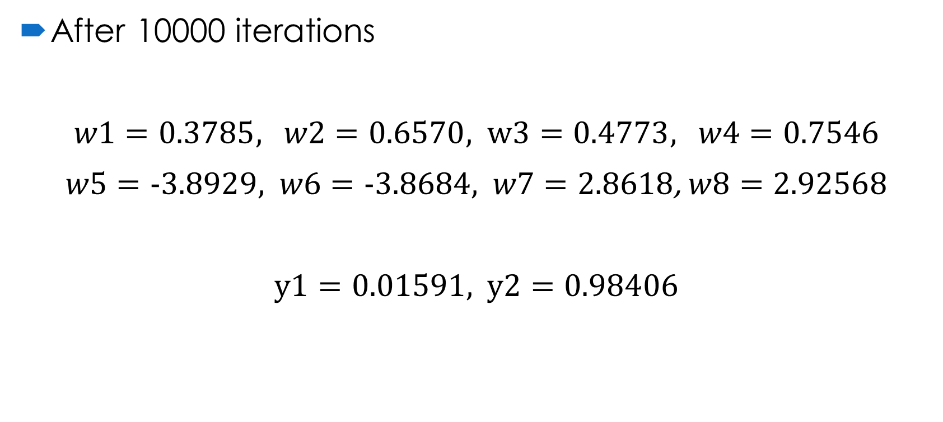
Example (Final)
After 10000 iterations
$w1=0.3785$, $w2=\text{0.6570}$, $w3=\text{0.4773}$, $w4=\text{0.7546}$
$w5=\text{−3.8929}$,$w6=\text{−3.8684}$,$w7=\text{2.8618}$, $w8=\text{2.92568}$
$y1=\text{0.01591}$, $y2=\text{0.98406}$

Slide 17
Advantages
Backpropagation is fast, simple and easy to program
It has no parameters to tune apart from the numbers of input
It is a flexible method as it does not require prior knowledge about the network
It is a standard method that generally works well
It does not need any special mention of the features of the function to be learned.

Slide 18
Disadvantages
The actual performance of backpropagation on a specific problem is dependent on the input data.
Backpropagation can be quite sensitive to noisy data
You need to use the matrix-based approach for backpropagation instead of mini-batch.

Slide 19
References
https://www.cse.unsw.edu.au/~cs9417ml/MLP2/
https://www.guru99.com/backpropogation-neural-network.html
https://mattmazur.com/2015/03/17/a-step-by-step-backpropagation-example/

